Slide 1
Arrays

Slide 2
Arrays
Array is a collection of similar data types in which each element is unique and located in contiguous (continuous/sequential) memory locations.

Slide 3
Arrays
The values held in an array are called array elements
An array stores multiple values of the same type – the element type
we can create an array of integers, an array of characters, an array of String objects, etc.

Slide 4
Arrays
An array is an ordered list of values
The entire array
has a single name
Each value has a numeric index
0 1 2 3 4 5 6 7 8 9
scores
79 87 94 82 67 98 87 81 74 91
An array of size N is indexed from zero to N-1
This array holds 10 values that are indexed from 0 to 9

Slide 5
Arrays
A particular value in an array is referenced using the array name followed by the index in brackets
For example, the expression
scores[2]
refers to the value 94 (the 3rd value in the array)
That expression represents a place to store a single integer and can be used wherever an integer variable can be used

Slide 6
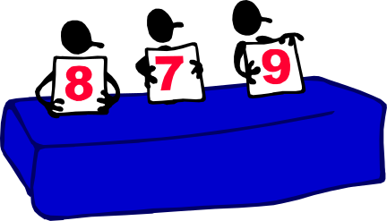

Array Applications
Given a list of test scores, determine the maximum and minimum scores.
Read in a list of student names and rearrange them in alphabetical order (sorting).
Given the height measurements of students in a class, output the names of those students who are taller than average.

Slide 7

1-dimensional array
A one dimensional array is a list of data values, with all values having the same data type(the base type), such as:
integer
float
double
char
Technically, an array is a uniform data structure. Individual array elements are referenced using the array name and a subscript that identifies the element position in the array.
15-<number>

Slide 8
Declaring Arrays
To declare an array in C, a programmer s specifies the type of the elements and the number of elements required by an array as follows −
type arrayName [ arraySize ];
This is called a single-dimensional array. The arraySize must be an integer constant greater than zero and type can be any valid C data type.
Here are a few examples :
int marks[4]={ 67, 87, 56, 77 }; // integer array initialization
float area[5]={ 23.4, 6.8, 5.5 }; // float array initialization
int marks[4]={ 67, 87, 56, 77, 59 }; // Compile time error

Slide 9

Arrays can be initialized at declaration time:
int age[5]={22,25,30,32,35};
A Pictorial Representation of the Array:

Slide 10
How to insert and print array elements? int mark[5] = {19, 10, 8, 17, 9}
// insert different value to third element mark[3] = 9;
// take input from the user and insert in third element scanf("%d", &mark[2]);
// take input from the user and insert in (i+1)th element scanf("%d", &mark[i]);
// print first element of an array printf("%d", mark[0]);
// print first element of an array printf("%d", mark[0]);
// print ith element of an array printf("%d", mark[i-1]);

Slide 11
Example 1:
#include <stdio.h>
void main()
{
int scores[10];
scores[0]=79;
scores[1]=87;
scores[2]=94;
scores[3]=82;
scores[4]=67
scores[5]=98;
scores[6]=87;
printf(“%d”,scores[0]);
return ;
}

Slide 12
Example 2:
#include<stdio.h>
void main()
{
int arr[4];
int i, j;
printf("Enter array element");
for(i = 0; i < 4; i++)
{
scanf("%d", &arr[i]); //Run time array initialization
}
for(j = 0; j < 4; j++)
{
printf("%d\n", arr[j]);
}
getch();
}

Slide 13
Searching in 1-D array
#include <stdio.h>
void main()
{
int array[100], search, c, n;
printf("Enter the number of elements in array\n");
scanf("%d", &n);
printf("Enter %d integer(s)\n", n);
for (c = 0; c < n; c++)
scanf("%d", &array[c]);
printf("Enter a number to search\n");
scanf("%d", &search);
for (c = 0; c < n; c++)
{
if (array[c] == search) /* If required element is found */
{
printf("%d is present at location %d.\n", search, c+1);
break;
} }
if (c == n)
printf("%d isn't present in the array.\n", search);
getch();
}

Slide 14
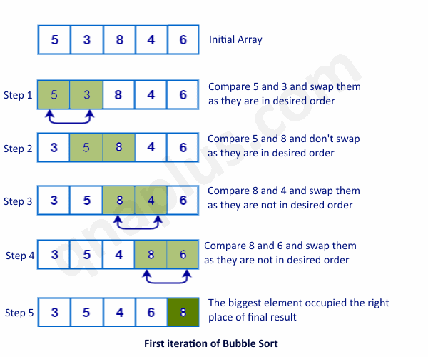
Sorting in 1-D array

Slide 15
Sorting in array
#include <stdio.h>
#define MAX 100
void main()
{
int arr[MAX],n,i,j;
int temp;
printf("Enter total number of elements: ");
scanf("%d",&n); //read array elements
printf("Enter array elements:\n");
for(i=0;i< n;i++)
{
printf("Enter element %d: ",i+1);
scanf("%d",&arr[i]);
} //sort array
for(i=0;i< n;i++)
{
for(j=i+1;j< n;j++)
{
if(arr[i]>arr[j])
{
temp =arr[i];
arr[i] =arr[j];
arr[j] =temp; } }}
printf("\nArray elements after sorting:\n");
for(i=0;i< n;i++)
{
printf("%d\n",arr[i]);
}
getch();
}

Slide 16
Two-dimensional array
The two dimensional (2D) array in C programming is also known as matrix. A matrix can be represented as a table of rows and columns.
For eg.
a[3][4]// array a is having 3 rows and 4 columns.
a[0][0]
a[0][1]
a[0][2]
a[0][3]
a[1][0]
a[1][1]
a[1][2]
a[1][3]
a[2][0]
a[2][1]
a[2][2]
a[2][3]

Slide 17
Declaration of two dimensional Array in C
data_type array_name[size1][size2];
Initialization of 2D Array in C
int arr[4][3]={{1,2,3},{2,3,4},{3,4,5},{4,5,6}};

Slide 18
Initializing Two-dimensional array
There are two ways to initialize a two Dimensional arrays during declaration.
int disp[2][4] = { {10, 11, 12, 13}, {14, 15, 16, 17} };
OR
int disp[2][4] = { 10, 11, 12, 13, 14, 15, 16, 17};

Slide 19
Example: 1
#include<stdio.h>
int main(){
int i=0,j=0;
int arr[4][3]={{1,2,3},{2,3,4},{3,4,5},{4,5,6}};
//traversing 2D array
for(i=0;i<4;i++){
for(j=0;j<3;j++){
printf("arr[%d] [%d] = %d \n",i,j,arr[i][j]);
}//end of j
}//end of i
return 0;
}

Slide 20
Example: 2
#include<stdio.h>
int main(){ /* 2D array declaration*/
int abc[5][4]; /*Counter variables for the loop*/
int i, j;
for(i=0; i<5; i++)
{
for(j=0;j<4;j++)
{
printf("Enter value for abc[%d][%d]:",i,j);
scanf("%d", &abc[i][j]);
}
}
return 0;
}

Slide 21
Passing Arrays as Function Arguments in C:
Passing array to function using call by value method: In this type of function call, the actual parameter is copied to the formal parameters.
Passing array to function using call by reference
When we pass the address of an array while calling a function then this is called function call by reference. When we pass an address as an argument, the function declaration should have a pointer as a parameter to receive the passed address.

Slide 22
In C, the name of the array represents the address of its first element.
Passing the array name, passing the address of the array to the called function. The array in the called function refers to the same array stored in the memory.
Any changes in the array in the called function will be reflected in the original array

Slide 23
Rules to pass array to function
Function must be called by passing only the name of the array
In function definition, the formal parameter must be an array type, the array size must not be specified.
Function prototype must show the argument is an array.

Slide 24
#include<stdio.h>
int sum(int a[]); //declaration
int main()
{
int a[] = {1,2,3,4,5};
int s;
s = sum(a); //sum function returns an integer value and it is stored in int variable s
printf("Sum of the array elements is %d ",s);
return(0);
}
int sum(int a[])//receiving array as a formal argument
{
int i,total=0;
for(i=0;i<5;i++)
{
total += a[i];
}
return total; //returning an integer variable total
}

Slide 25
Passing by value
#include<stdio.h>
int funct(int arr1[]);
void main()
{
int arr[5]={1,2,3,4,5};
funct(arr);
getch();
}
int funct(int arr1[])
{
int i;
clrscr();
for(i=0;i<5;i++)
{
printf("\n%d",arr1[i]);
}
}
Passing by reference
#include<stdio.h>
int funct(int *arr1);
void main()
{
int arr[5]={1,2,3,4,5};
funct(&arr);
getch();
}
int funct(int *arr1)
{
int i;
clrscr();
for(i=0;i<5;i++)
{
printf("\n%d",*arr1);
*arr1++;
}
}

Slide 26
Passing arrays to functions
To pass a 1-dimensional array to a called function
The name of the array without any subscript and the size of the array is passed as an argument to the function.
Syntax:
function-name(array-name , size);
Example:
largest(value,4);

Slide 27
float largest(float a[], int n);
void main()
{
float value[4]={2.5,6.5,66.8,98.2};
printf(“%f \n”, largest(value,4));
}
float largest(float a[], int n)
{
int i;
float max;
max=a[0];
for(i=1;i<n ; i++)
{
if(max<a[i])
max=a[i];
}
return(max);
}

Slide 28

Character Arrays
We will implement strings in C by using a one dimensional array of characters
the last character is the “NULL” character ‘\0’.
In C, you must always terminate a character array with the NULL character, ‘\0’ . Therefore, the array size of your character array should be one plus the maximum length of the string you want to store.
Example: In the declaration
char atomic[ ] = "hydrogen";
“atomic” is an array of nine elements, the last being ‘\0’
15-<number>

Slide 29
Declaring a Character Array
Declaring a string array with character constants
char aString[ ] = {'Z', 'i', 'p', '!‘, '\0'};
Declaring character arrays with a string constant
char aString[5] = "Zip!";
char atomic[ ] = "hydrogen";
15-<number>

Slide 30
Declaring a Character Array
You may declare and initialize a character arrays with a string constant as in,
char atomic[ ] = "hydrogen";
but you cannot assign an array in the same manner, e.g. ,
atomic = "carbon";
not legal in C!
however you may use the strcpy function (found in the string.h library).
strcpy(atomic, "carbon");
15-<number>

Slide 31
Input and Ouput of Strings
Use the %s conversion specifier to read in a string of characters. Blanks in the input are considered delimiters.
That is, any blank character input such as in the string
“Hello World”, would indicate two strings “Hello” and “World”.
For security reasons it’s good to use %9s rather than %s in the following example for scanf.
char strArray [10];
printf("Input a string with at most nine characters ”);
printf("with no blanks in the string: \n");
scanf("%9s", strArray);
/* Notice: No & is used for an array argument! */
printf("\n%s", strArray);
15-<number>

Slide 32
Outputing a String
You can use the %c conversion specifier to output the string character by character.
k = 0;
while (strArray[k] != ‘\0’)
printf("%c", strArray[k++]);
15-<number>

