Slide 1
Functions in C

Slide 2
WHAT IS C FUNCTION?
A large C program is divided into basic building blocks called C function.
C function contains set of instructions enclosed by “{ }” which performs specific operation in a C program.
Every C program has at least one function, which is main().

Slide 3
WHAT IS C FUNCTION?
A function declaration tells the compiler about a function's name, return type, and parameters. A function definition provides the actual body of the function.
The C standard library provides numerous built-in functions that your program can call. For example, strcat() to concatenate two strings,
A function can also be referred as a method or a sub-routine or a procedure, etc.

Slide 4
USES OF C FUNCTIONS
C functions are used to avoid rewriting same logic/code again and again in a program.
There is no limit in calling C functions to make use of same functionality wherever required.
A large C program can easily be tracked when it is divided into functions.
The core concept of C functions are, re-usability, dividing a big task into small pieces to achieve the functionality and to improve understandability of very large C programs.

Slide 5
Function definition:
return_type function_name (arguments list)
{
Body of function;
}
Function call: function_name (arguments list);
Function declaration:
return_type function_name (argument list);

Slide 6
FUNCTION DECLARATION, FUNCTION CALL AND FUNCTION DEFINITION
There are 3 aspects in each C function. They are:
  Function declaration or prototype – This informs compiler about the function name, function parameters and return value’s data type.
  Function call – This calls the actual function
  Function definition – This contains all the statements to be executed.

Slide 7
EXAMPLE
void main()
{
int a,b,c;
scanf(“%d%d”, &a,&b);
c=pqr(a , b);
printf(“%d”, c);
}
X=5
y=6
a
b
int pqr(int x, int y)
{
int p;
p=x+y;
return p;
}
5
6
c=11
p=11
11

Slide 8
#include<stdio.h>
int square ( int ); // function prototype, also called function declaration
int main( )
{
int m, n ;
printf ( "\nEnter some number for finding square \n");
scanf ( "%d", &m ) ;
n = square (m) ; // function call
printf ( "\nSquare of the given number %d is %d",m,n );
}
int square ( int x ) // function definition
{
int p ;
p = x * x ;
return p;
}

Slide 9
HOW TO CALL C FUNCTIONS IN A PROGRAM?
There are two ways that a C function can be called from a program. They are:
  Call by value
  Call by reference
  Types of function parameters:
Actual parameter – This is the argument which is used in function call.
Formal parameter – This is the argument which is used in function definition

Slide 10
CALL BY VALUE
In call by value method, the copy of the variable is passed to the function as parameter.
The value of the actual parameter can not be modified by formal parameter.
Different Memory is allocated for both actual and formal parameters. Because, value of actual parameter is copied to formal parameter.
Note:

Slide 11
#include<stdio.h>
void swap(int a, int b); // function prototype, also called function declaration
void main()
{
int m = 22, n = 44;
printf(" values before swap m = %d \n and n = %d", m, n);
swap(m, n); //call by value
printf(" \nvalues after swap m = %d\n and n = %d", m, n);
getch();
}
void swap(int m, int n)
{
int tmp;
tmp = m;
m = n;
n = tmp;
printf(" \nvalues after swap m = %d\n and n = %d", m, n);
}

Slide 12
CALL BY REFERENCE
In call by reference method, the address of the variable is passed to the function as parameter.
The value of the actual parameter can be modified by formal parameter.
Same memory is used for both actual and formal parameters since only address is used by both parameters.

Slide 13
#include<stdio.h>
void swap(int *, int *); // function prototype, also called function declaration
void main()
{
int m = 22, n = 44;
printf("values before swap m = %d \n and n = %d",m,n);
swap(&m, &n); // calling swap function by reference
printf("\n values after swap m = %d \n and n = %d", m, n);
getch();
}
void swap(int *a, int *b)
{
int tmp;
tmp = *a;
*a = *b;
*b = tmp;
printf("\n Swap function values after swap a = %d \nand b = %d", *a, *b);
}

Slide 14
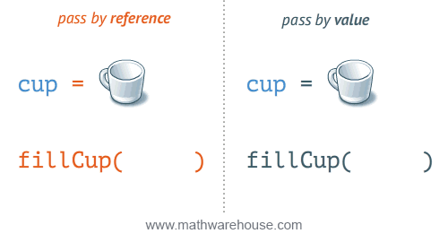

Slide 15
C - SCOPE RULES
A scope in any programming is a region of the program where a defined variable can have its existence and beyond that variable it cannot be accessed.
There are three places where variables can be declared in C programming language −
  Inside a function or a block which is called local variables.
  Outside of all functions which is called global variables.
  In the definition of function parameters which are called formal parameters.

Slide 16
LOCAL VARIABLES
Variables that are declared inside a function or block are called local variables.
They can be used only by statements that are inside that function or block of code.
Local variables are not known to functions outside their own.

Slide 17
We can define the User defined functions in multiple ways
Function with no argument and no Return value
Function with no argument and with Return value
Function with argument and No Return value
Function with argument and Return value

Slide 18
Function with No argument and No Return value
In this method, We won’t pass any arguments to the function while defining, declaring or calling the function. This type of functions will not return any value when we call the function from main() or any sub function. When we are not expecting any return value but, we need some statements to be printed as output then, this type of functions are very useful.
#include<stdio.h>
void Addition(); // Function Declaration
int main()
{
printf("\n ............. \n");
Addition(); // Function call
}
void Addition()
{
int Sum, a = 10, b = 20;
Sum = a + b;
printf("\n Sum of a = %d and b = %d is = %d", a, b, Sum);
}

Slide 19
Function with no argument and with Return value
In this method, We won’t pass any arguments to the function while defining, declaring or calling the function.
This type of functions will return some value when we call the function from main() or any sub function.
Data Type of the return value will depend upon the return type of function declaration.
For instance, if the return type is int then return value will be int.
#include<stdio.h>
int Multiplication();
int main()
{
int Multi;
Multi = Multiplication();
printf("\n Multiplication of a and b is = %d \n", Multi );
return 0;
}
int Multiplication()
{
int Multi, a = 20, b = 40;
Multi = a * b;
return Multi;
}

Slide 20
Function with argument and No Return value
This method allows us to pass the arguments to the function while calling the function. But, This type of functions will not return any value when we call the function from main () or any sub function.
#include<stdio.h>
int Addition(int, int);
Int main()
{
int a, b;
printf("\n Please Enter two integer values \n");
scanf("%d %d",&a, &b);
Addition(a, b);
}
int Addition(int a, int b)
{
int Sum;
Sum = a + b;
printf("\n Additiontion of %d and %d is = %d \n", a, b, Sum);
}

Slide 21
Function with argument and Return value
This method allows us to pass the arguments to the function while calling the function. This type of functions will return some value when we call the function from main () or any sub function. Data Type of the return value will depend upon the return type of function declaration. For instance, if the return type is int then return value will be int.
#include<stdio.h>
int Multiplication(int, int);
int main()
{
int a, b, Multi;
printf("\n Please Enter two integer values \n");
scanf("%d %d",&a, &b);
Multi = Multiplication(a, b);
printf("\n Multiplication of %d and %d is = %d \n", a, b, Multi);
return 0;
}
int Multiplication(int a, int b)
{
int Multi;
Multi = a * b;
return Multi;
}

Slide 22
Recursion
A function that calls itself is known as a recursive function. And, this technique is known as recursion.
In programming languages, if a program allows you to call a function inside the same function, then it is called a recursive call of the function.
Syntax:
void recursion()
{
recursion(); /* function calls itself */
}
int main()
{
recursion();
}

Slide 23
Example: Sum of n natural numbers using recursion
#include <stdio.h>
int sum(int n);
void main()
{
int number, result;
printf("Enter a positive integer: ");
scanf("%d", &number);
result = sum(number);
printf("sum=%d", result);
getch();
} int sum(int n)
{
if (n!=0)
return n + sum(n-1); // sum() function calls itself
else return n;
}

Slide 24
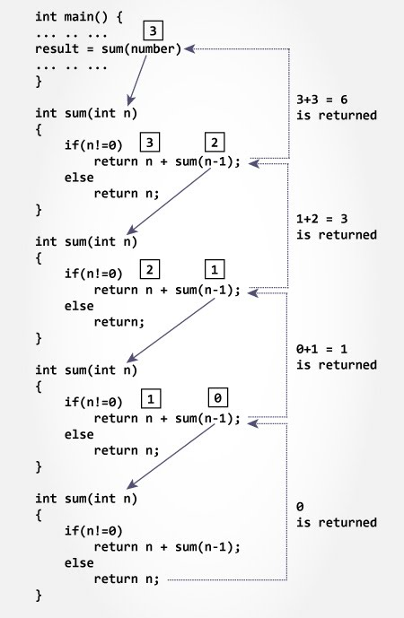

Slide 25
Advantages & Disadvantages of Recursion
Advantage
Recursion makes program elegant and cleaner. All algorithms can be defined recursively which makes it easier to visualize and prove.
Reduce unnecessary calling of function.
Disadvantage
If the speed of the program is vital then, you should avoid using recursion. Recursions use more memory and are generally slow. Instead, you can use loop.
programmers need to be careful to define an exit condition from the function, otherwise it will go into an infinite loop.
Recursive solution is always logical and it is very difficult to trace.(debug and understand).
In recursive we must have an if statement somewhere to force the function to return without the recursive call being executed, otherwise the function will never return.
Recursion takes a lot of stack space, usually not considerable when the program is small and running on a PC.
Recursion uses more processor time

Slide 26

C Standard library functions or simply C Library functions are inbuilt functions in C programming.
The prototype and data definitions of the functions are present in their respective header files, and must be included in your program to access them.
Advantages of using standard library functions:
1. They work
These functions have gone through multiple rigorous testing and are easy to use.
2. The functions are optimized for performance
In the process, they are able to create the most efficient code optimized for maximum performance.
3. It saves considerable development time
Since the general functions like printing to a screen, calculating the square root, and many more are already written. You shouldn't worry about creating them once again.
It saves valuable time and your code may not always be the most efficient.
3. The functions are portable
With ever changing real world needs, your application is expected to work every time, everywhere.
And, these library functions help you in that they do the same thing on every computer.
This saves time, effort and makes your program portable.

Slide 27
#include <stdio.h>
#include <math.h>
int main()
{
float num, root;
printf("Enter a number: ");
scanf("%f", &num); // Computes the square root of num and stores in root.
root = sqrt(num);
printf("Square root of %.2f = %.2f", num, root);
return 0;
}

Slide 28
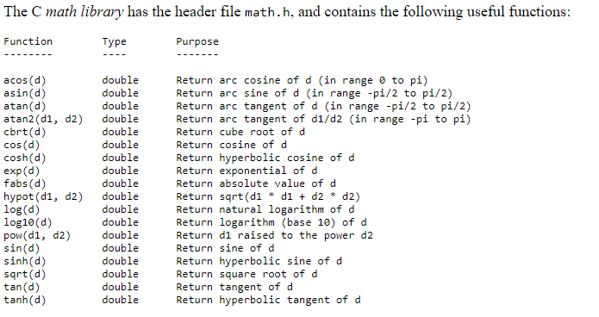
Some more examples of Library functions:

