Slide 1
FULL STACK WEB DEVELOPMENT — 21CSE354T
SPRING BOOT FRAMEWORK – PART 1
DevSphere
Developer Community & Showcase Platform
A production-grade, full-stack developer ecosystem integrating profiles, technical blogs, project showcases, and peer networking.
ACADEMIC SUBMISSION DETAILS
Student Name: AJAYKUMAR N
Register Number: RA2411003012107
Department: Department of Computer Science & Engineering
Institution: SRM Institute of Science and Technology
Academic Year: 2026–2027
Course & Code: Full Stack Web Development (21CSE354T)
ARCHITECTURE & EMPIRICAL EVIDENCE
Core Backend: Java 21 LTS | Spring Boot 3.4.3 | Spring Data JPA
Architecture: Decoupled 3-Layer (Controller -> Service -> Repository)
Domain Entities: 6 JPA Entities (User, Profile, Blog, Project, Likes, Connections)
REST API Layer: 15 Versioned REST Endpoints (/api/v1/*) with JJWT Auth
Automated Tests: 35 Automated Tests (Unit, Slice, Concurrency, E2E) — 100% Pass
Frontend Client: React 18 SPA + Islands | Vite 6 | Chart.js 4.4 | Fetch API
DevSphere — Full Stack Web Application Presentation | Course Code: 21CSE354T
SRM Institute of Science and Technology • Dept. of CSE | Slide 01 of 17

Slide 2
PROBLEM CONTEXT
The Problem: Fragmented Developer Identity & Technical Isolation
Modern software engineers face severe friction managing scattered professional footprints across isolated web services.
GitHub / GitLab
Medium / Dev.to
Personal Websites
LinkedIn
Code Repositories
Houses raw code and commit trees, but lacks high-level problem context, architecture decisions, and live interactive previews.
Technical Blogs
Hosts tutorials and articles, but remains detached from author portfolios and verified repository implementations.
Static Portfolios
High maintenance, static presentation, lacks peer networking, verified live metrics, and centralized skill discovery.
Professional Networks
Text-heavy resumes with inflated buzzwords that fail to demonstrate actual technical execution or code quality.
CORE CHALLENGES IDENTIFIED & THE UNIFIED SOLUTION
1. Fragmented Developer Identity: Developers must maintain 3-4 separate profiles, creating inconsistency and review fatigue for recruiters.
2. Scattered Technical Projects: Repositories lack unified showcasing, categorisation, verified like counts, and live demonstration links.
3. Separated Technical Knowledge: Insights written during development remain isolated from the actual project code they explain.
4. Discovery & Collaboration Friction: No unified mechanism exists to filter developers by real verified skill sets and initiate peer connections.
5. Academic Architectural Flaws: Foundational student web apps commonly mix business logic inside controllers without layer separation.
THE DEVSPHERE SOLUTION: A cohesive, high-performance platform fusing developer profiles, engineering blogs, project showcases, and peer networking into an enterprise-grade Spring Boot 3-layer architecture.
DevSphere — Full Stack Web Application Presentation | Course Code: 21CSE354T
SRM Institute of Science and Technology • Dept. of CSE | Slide 02 of 17

Slide 3
PLATFORM VISION
Proposed Solution: DevSphere & Core Academic Objectives
Unifying the developer workflow while strictly fulfilling the technical requirements of the Spring Boot Part 1 curriculum.
1. Java 21 & Spring Boot 3.4.3
DevSphere Core Hub
Unified Collaboration Ecosystem
• Single Sign-On & JWT Security
• Developer Discovery & Networking
• Technical Story Composition & Drafts
• Engineering Project Showcase & Likes
• Dynamic Chart.js Profile Telemetry
• Real-Time Platform Analytics
• Stateless 3-Layer Decoupling
• Full Spring Boot Auto-Configuration
4. Service-Layer Business Logic
Bootstrap an executable web application leveraging Spring Boot starters, Maven build automation, and embedded Tomcat on port 8080 without XML boilerplate.
Implement non-trivial domain rules: author ownership validation, duplicate prevention, idempotent like toggling, and reading time formulas.
2. Three-Layer Decoupling
5. Stateless REST API Architecture
Enforce strict architectural separation between Presentation (@RestController), Business Logic (@Service), and Data Access (@Repository) tiers.
Expose 15 versioned REST endpoints (/api/v1/*) consuming and producing JSON, secured with JJWT Bearer tokens and Bean Validation.
3. Relational Domain Modeling
6. Comprehensive Test Pyramid
Design a normalized database schema with 6 JPA entities, UUID primary keys, foreign key constraints, and @ElementCollection mappings.
Develop unit, slice, concurrency, and integration test suites using JUnit 5 and Mockito, verifying 100% build success across 35 automated tests.
DevSphere — Full Stack Web Application Presentation | Course Code: 21CSE354T
SRM Institute of Science and Technology • Dept. of CSE | Slide 03 of 17

Slide 4
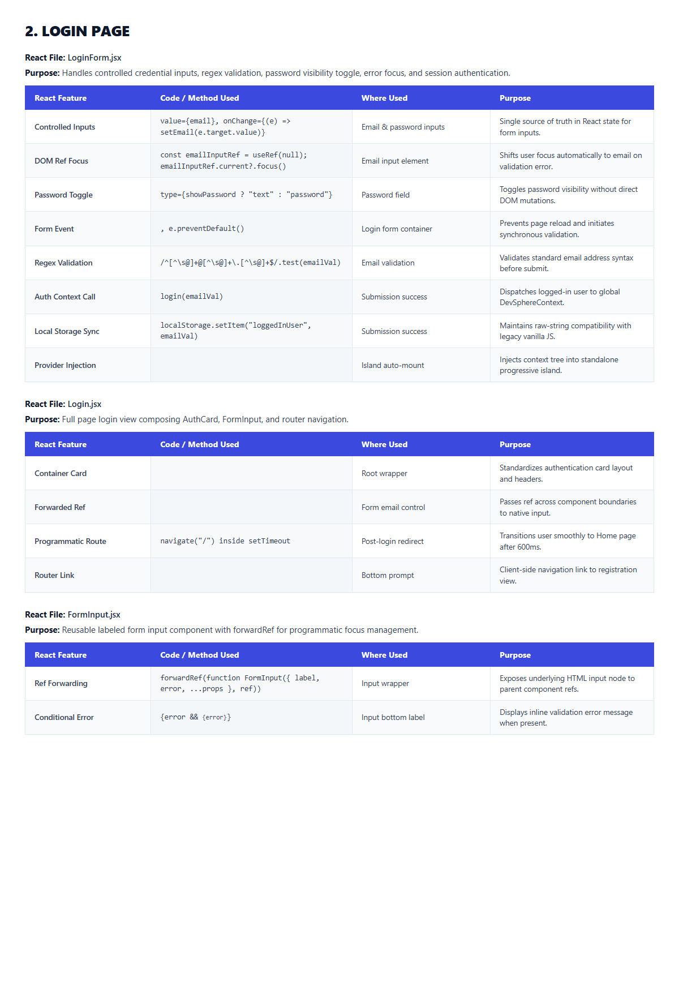
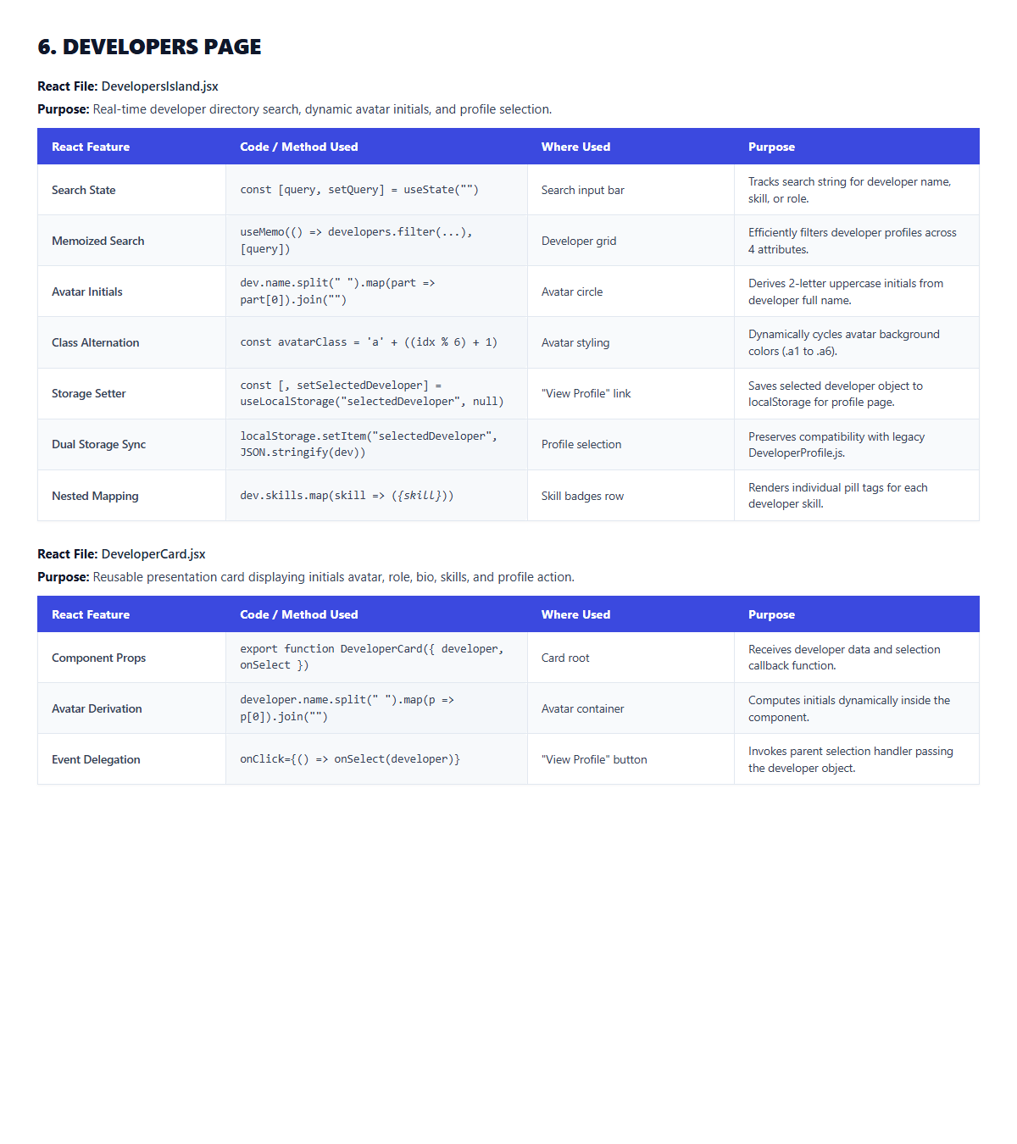
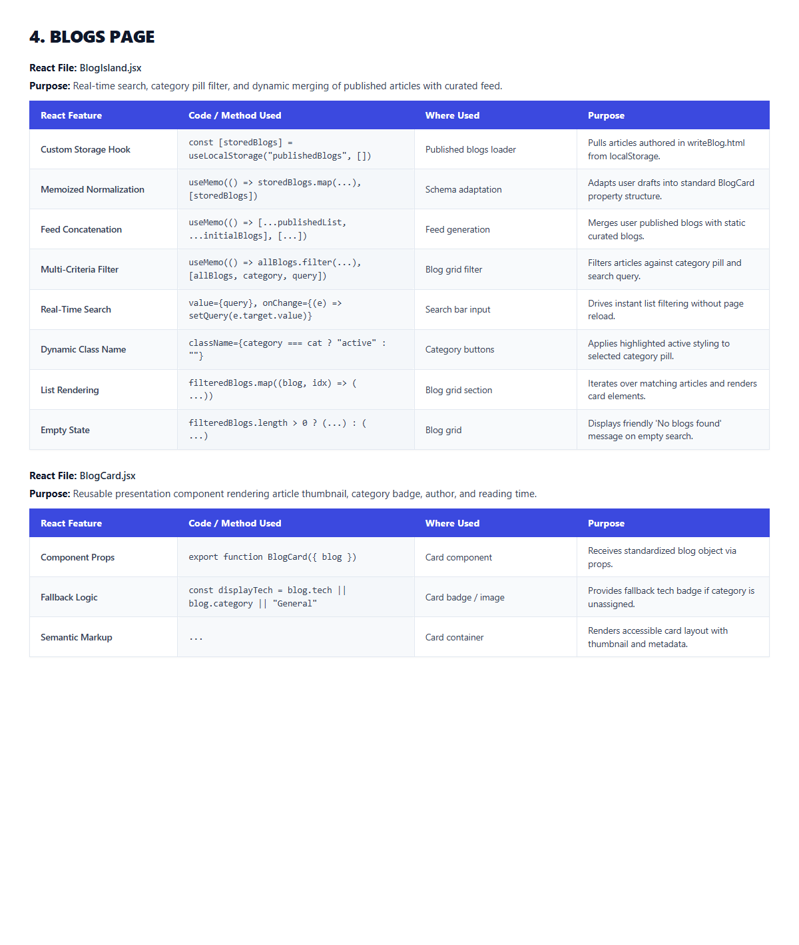
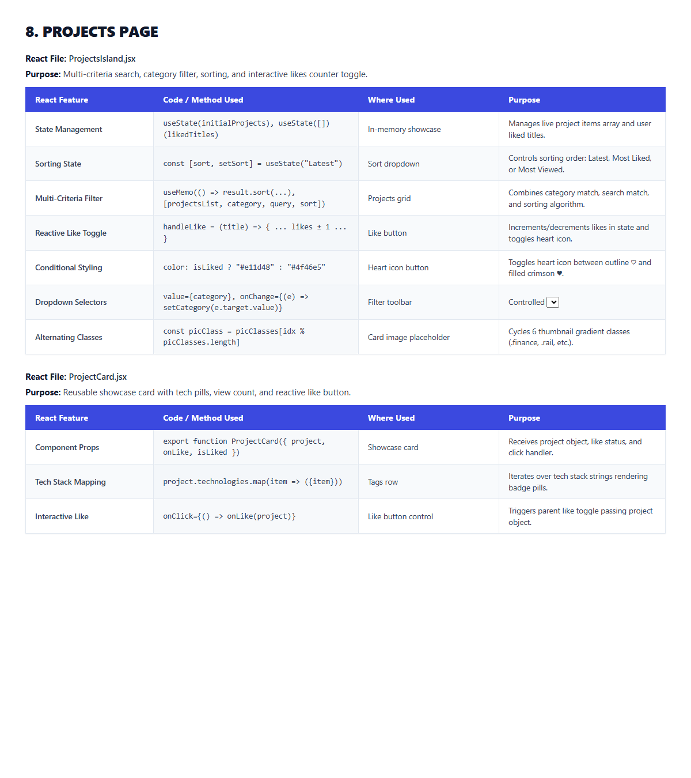
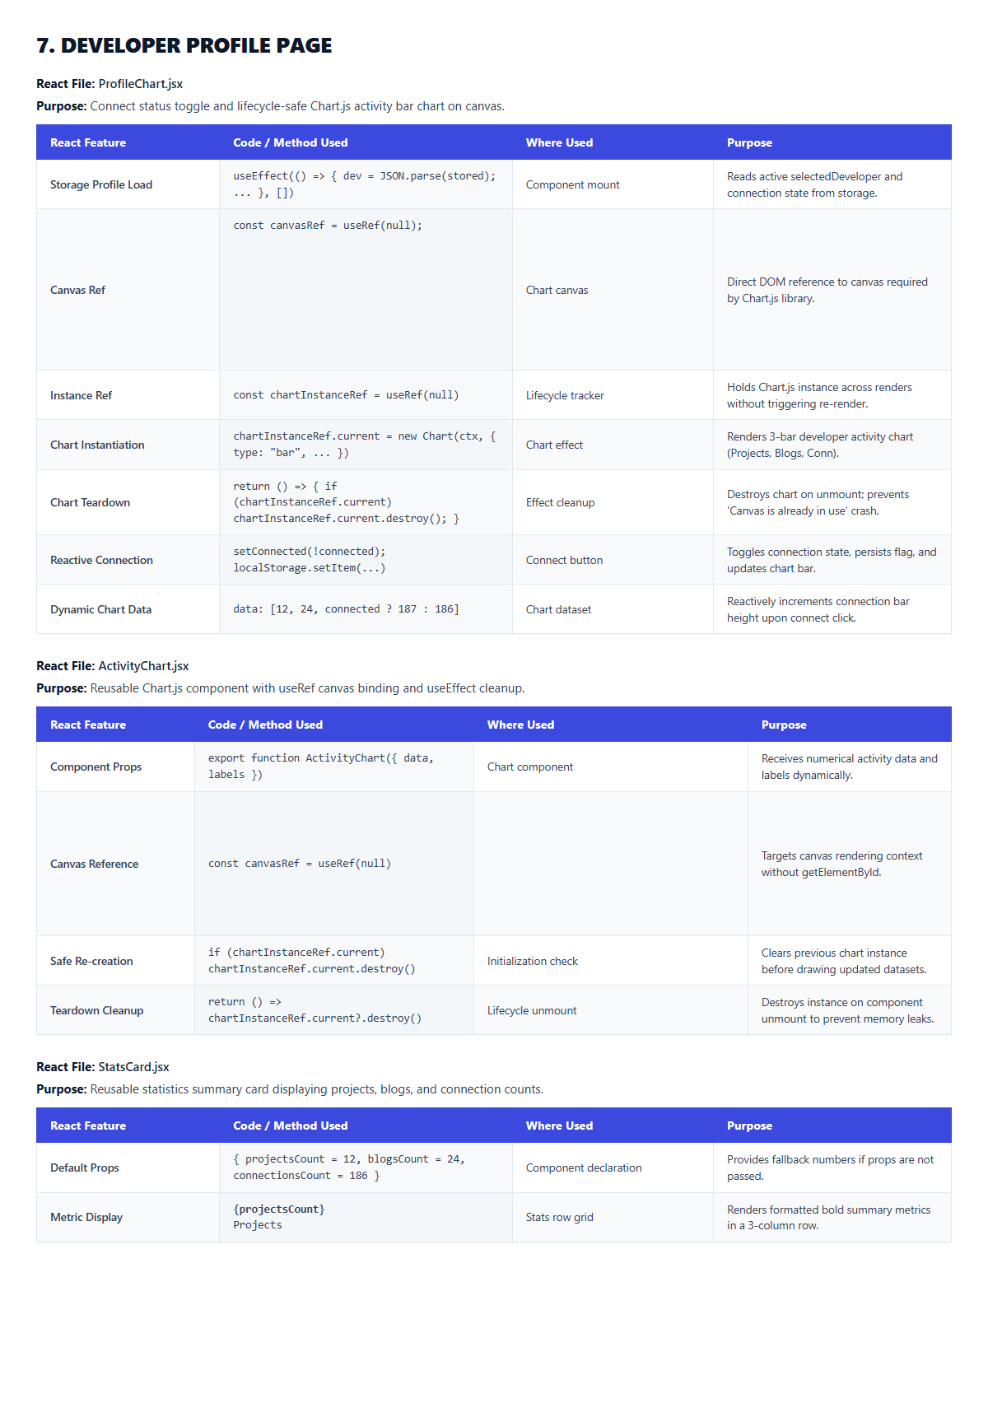
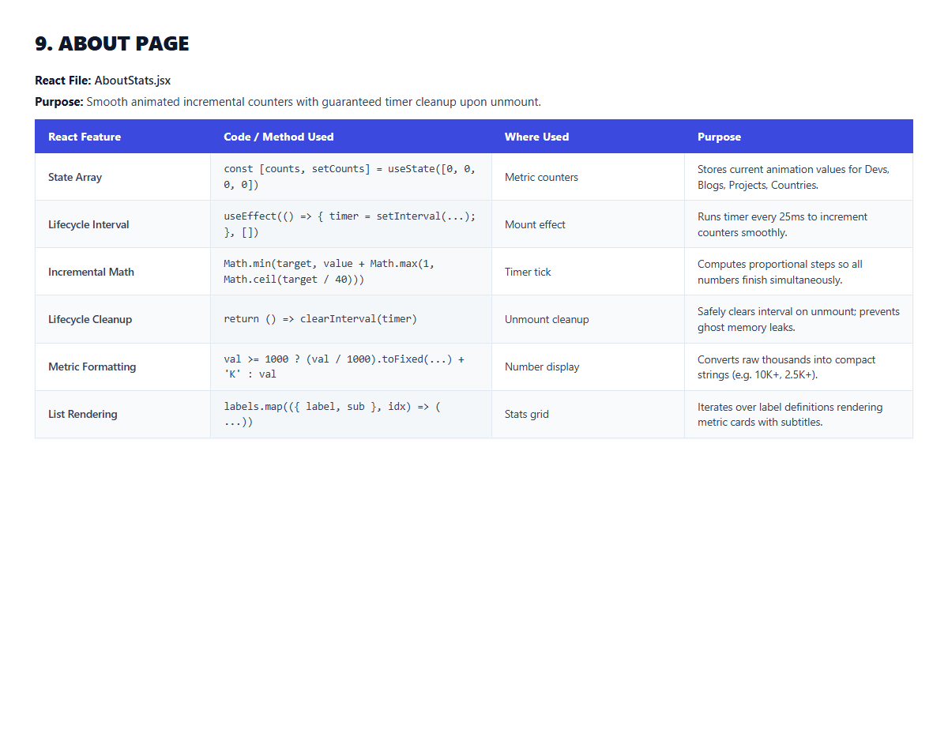
FUNCTIONAL DECOMPOSITION
Application Overview: 6 Core Engineering Modules
DevSphere delivers six cohesive modules featuring actual application screens, verified flows, and user capabilities.
JWT & BCrypt Sessions
Discovery & Networking
Engineering Publishing
1. Authentication
• Stateless JWT auth (HMAC-SHA512)
• Salted BCrypt password encryption
• Auto-creates developer profile on signup
• Resolves active user via /api/v1/auth/me
2. Developer Directory
• Searchable roster filterable by skill tags
• Interactive peer connect/disconnect
• Displays projects & articles count
• Instant route to full developer profiles
3. Blog Platform
• Technical story studio with draft saving
• Live markdown preview editor
• Dynamic read time: max(1, ceil(words/200))
• Author ownership guard on updates
Engineering Portfolios
Identity & Telemetry
Community Telemetry
4. Project Showcase
• Multi-category portfolio showcase
• Sorting: 'Latest', 'Most Liked', 'Views'
• Atomic like/unlike toggle via unique UK
• View counter increments dynamically
5. Developer Profiles
• Displays bio, role, location, avatar
• Interactive Chart.js activity charts
• Filterable author's projects & blogs
• Live peer connection status indicator
6. Platform Intelligence
• High-speed telemetry: GET /api/v1/stats/overview
• Aggregated platform metrics (10K+ Devs)
• Country distribution across 50+ nations
• Sub-millisecond response caching
DevSphere — Full Stack Web Application Presentation | Course Code: 21CSE354T
SRM Institute of Science and Technology • Dept. of CSE | Slide 04 of 17

Slide 5
TECHNICAL FOUNDATION
Technology Stack: Empirically Verified Full-Stack Ecosystem
Every framework, library, and tool version has been verified against backend pom.xml, package.json, and runtime configs.
Frontend Architecture
Backend Framework
Database & Storage
Security & Testing
Core Framework:
React 18.3.1 (Concurrent Root)
DOM Renderer:
React DOM 18.3.1
Build System:
Vite 6.0.1 (ESM Dev Server & HMR)
Client Routing:
React Router DOM 6.28.0 (9 Routes)
Data Visualization:
Chart.js 4.4.8 (Dynamic Canvas)
Markup & Styling:
Semantic HTML5 + CSS3 Grid/Flexbox
HTTP Client:
Centralized Fetch API (src/services/api.js)
Token Management:
localStorage JWT Injection
Language Runtime:
Java 21 LTS (release 21 in pom.xml)
Framework Core:
Spring Boot 3.4.3 (Latest Stable)
Web Framework:
Spring MVC (RESTful Web Services)
Persistence ORM:
Spring Data JPA / Hibernate 6.6.8
Security Engine:
Spring Security 6.4 (Stateless Filter)
Embedded Server:
Apache Tomcat 10.1.36 (Port 8080)
Build Automation:
Apache Maven 3.9.6
Architecture:
Strict 3-Layer Decoupled Pattern
Test Database:
H2 In-Memory (PostgreSQL Mode)
Production Target:
PostgreSQL 14+ (Supabase Cloud Pooler)
Connection Pool:
HikariCP 5.1 (Tuned min-idle=2, max=6)
Schema Migration:
Flyway 10.20 (db/migration scripts)
Primary Key Strategy:
UUID v4 (java.util.UUID / GenType.UUID)
Entity Relationships:
@OneToOne, @ManyToOne, @OneToMany
Collection Tables:
@ElementCollection (skills, tech, tags)
DDL Management:
hibernate.ddl-auto=none (Flyway controlled)
JWT Cryptography:
JJWT 0.12.6 (HMAC-SHA512 Signatures)
Password Hashing:
BCryptPasswordEncoder (Strength 10)
Bean Validation:
Jakarta Validation 3.0.2 (@Valid, @Size)
API Documentation:
SpringDoc OpenAPI 2.8.5 (Swagger UI)
Unit Testing:
JUnit 5 + Mockito 5 (MockitoExtension)
Slice Testing:
Spring Boot Test (@WebMvcTest, MockMvc)
Integration Testing:
Spring Boot Test (@SpringBootTest, H2)
Pass Rate:
35 Automated Tests (100% Pass Rate)
DevSphere — Full Stack Web Application Presentation | Course Code: 21CSE354T
SRM Institute of Science and Technology • Dept. of CSE | Slide 05 of 17

Slide 6
SYSTEM ARCHITECTURE
Overall System Architecture: End-to-End Multi-Tier Pipeline
Strict architectural flow from React client through Spring Security, Controller, Service, and Repository tiers to database.
React 18 Client Application — Semantic HTML5 landmarks, React SPA & Islands, Chart.js visualizations, centralized api.js client
CORE ARCHITECTURAL PRINCIPLES
Strict Separation of Concerns:
The presentation layer never interacts directly with database repositories. All data operations are mediated by domain services.
Stateless Authentication:
No server-side HTTP session state. Every incoming request must provide a valid HMAC-SHA512 signed JWT Bearer token.
Transactional Integrity:
Business operations mutating database state execute within @Transactional boundaries to prevent inconsistent partial writes.
Exception Centralization:
Zero try-catch boilerplate in controllers. All domain exceptions are caught and formatted uniformly by @RestControllerAdvice.
Microservices Clarification:
Standalone experimental services exist in the repository as future architectural evolution; academic evaluation strictly focuses on this integrated Spring Boot core.
HTTP REST / JSON Boundary — Port 8080 | Versioned routes (/api/v1/*) | Bearer JWT attached in Authorization header
Spring Security Filter Chain — JwtAuthenticationFilter intercepts request, validates HMAC-SHA512 token, populates SecurityContext
Presentation Layer (@RestController) — AuthController, BlogController, DeveloperController, ProjectController, StatsController | Validates DTOs
Business Service Layer (@Service) — AuthServiceImpl, BlogServiceImpl, DeveloperServiceImpl, ProjectServiceImpl | Enforces business rules & @Transactional
Data Access Layer (@Repository) — Spring Data JpaRepository interfaces: UserRepository, BlogRepository, ProjectRepository | Custom JPQL
Database Storage Tier — PostgreSQL 14+ (Supabase Cloud Target) & H2 In-Memory (Test) | Tables: users, profiles, blogs, projects, likes
DevSphere — Full Stack Web Application Presentation | Course Code: 21CSE354T
SRM Institute of Science and Technology • Dept. of CSE | Slide 06 of 17

Slide 7
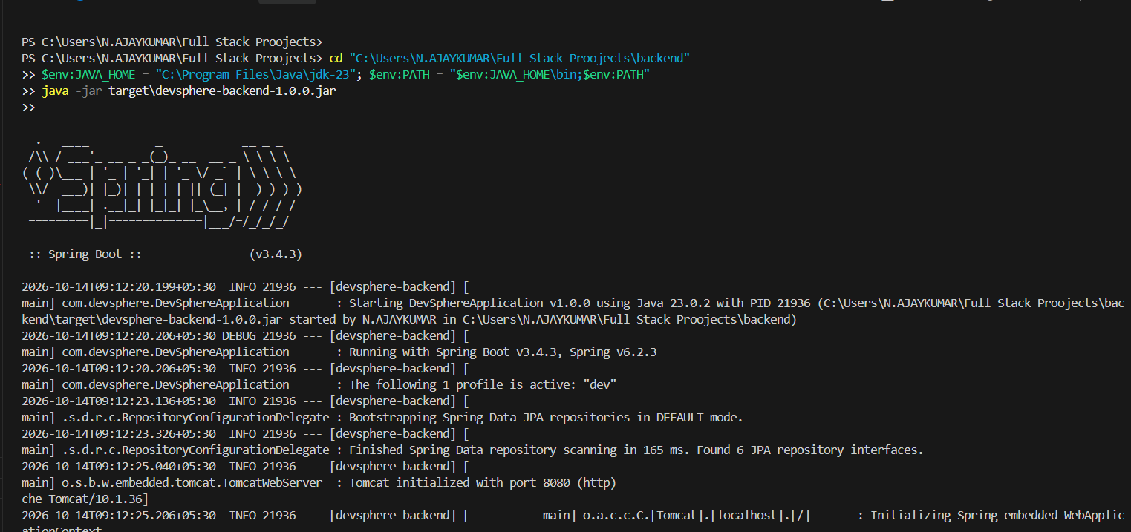
FRAMEWORK MECHANICS
Spring Boot Application Setup & Auto-Configuration
Bootstrapping the DevSphere backend: main entry point, auto-configuration mechanics, and embedded server initialization.
APPLICATION ENTRY POINT & ANNOTATIONS
STARTUP LIFECYCLE & AUTO-CONFIGURED BEANS
// DevSphereApplication.java
package com.devsphere;
@SpringBootApplication
public class DevSphereApplication {
public static void main(String[] args) {
SpringApplication.run(DevSphereApplication.class, args);
}
}
APPLICATION INITIALIZATION SEQUENCE:
• 1. JVM invokes main() in DevSphereApplication.java
• 2. SpringApplication.run() initializes ApplicationContext
• 3. ComponentScan registers 5 Controllers, 6 Services, 12 Repositories
• 4. Auto-configuration activates TomcatServletWebServerFactory
• 5. Embedded Apache Tomcat 10.1.36 binds to port 8080
• 6. HikariCP initializes pool; Hibernate validates entities
• 7. REST endpoints live & accessible at http://localhost:8080/api/v1/*
WHAT SPRING BOOT AUTO-CONFIGURES (ZERO XML):
• Embedded Tomcat: Provisions servlet container without external WAR deployment.
• Spring MVC: Registers DispatcherServlet, Jackson ObjectMapper, JSON serializers.
• Data Source: Configures HikariDataSource connection pool with tuned timeouts.
• JPA / Hibernate: Creates LocalContainerEntityManagerFactoryBean & TransactionManager.
@SpringBootApplication METADATA COMPOSITION:
@Configuration: Marks the class as a configuration source for Spring beans and factory methods.
@EnableAutoConfiguration: Enables Spring Boot's opinionated auto-configuration, inspecting classpath dependencies to provision Tomcat, JPA, and Jackson automatically.
@ComponentScan: Automatically discovers and registers @RestController, @Service, and @Repository components within the com.devsphere package hierarchy.
DevSphere — Full Stack Web Application Presentation | Course Code: 21CSE354T
SRM Institute of Science and Technology • Dept. of CSE | Slide 07 of 17

Slide 8
CORE ARCHITECTURE REQUIREMENT
Three-Layer Architecture: Presentation, Business & Data Access
Strict architectural decoupling: Controllers handle HTTP, Services enforce business rules, Repositories manage persistence.
@RestController
@Service & @Transactional
Spring Data JpaRepository
1. PRESENTATION LAYER
Core Role: Receives HTTP requests, binds route variables, validates DTOs, returns response envelopes.
Validation: Applies @Valid to DTO request bodies. Rejects malformed payloads with 400 Bad Request.
Layer Decoupling: ZERO business logic, ZERO database calls. Directly delegates to Service methods.
Response Handling: Wraps payloads in ResponseEntity<T> with explicit HTTP status codes (200, 201, 204).
Implemented Classes: AuthController, BlogController, DeveloperController, ProjectController, StatsController
2. BUSINESS LOGIC LAYER
Core Role: Executes application rules, ownership validation, domain algorithms, and data coordination.
Transaction Control: Defines ACID transaction boundaries using Spring's declarative @Transactional.
Authorization Guards: Enforces author identity verification before allowing blog updates or deletions.
DTO Mapping: Translates raw database entities to clean, client-safe response DTOs using EntityDtoMapper.
Implemented Classes: AuthServiceImpl, BlogServiceImpl, DeveloperServiceImpl, ProjectServiceImpl, StatsServiceImpl
3. DATA ACCESS LAYER
Core Role: Communicates with database, manages entity lifecycle, persists updates, executes queries.
Type Safety: Extends JpaRepository<T, UUID> providing out-of-the-box CRUD and pagination support.
Derived Queries: Executes queries generated from method names: findByEmail, existsByUsername.
Custom JPQL: Defines complex search queries with dynamic sorting and category/skill filters.
Implemented Interfaces: UserRepository, BlogRepository, ProjectRepository, DeveloperProfileRepository, ProjectLikeRepository
ARCHITECTURAL RULE — WHY BUSINESS LOGIC NEVER BELONGS IN CONTROLLERS:
Controllers are protocol adapters for HTTP. Embedding business rules in controllers destroys unit testability, bypasses transaction rollback boundaries, tightly couples the domain to the web servlet API, and leads to duplicated validation across endpoints.
DevSphere — Full Stack Web Application Presentation | Course Code: 21CSE354T
SRM Institute of Science and Technology • Dept. of CSE | Slide 08 of 17

Slide 9
PERSISTENCE MODEL
Domain Model & Relational Database Design: 6 JPA Entities
Fully normalized relational domain model featuring UUID keys, foreign key constraints, and collection mappings.
TABLE: users
TABLE: developer_profiles
TABLE: developer_connections
@Entity User
• PK: id: UUID (GenType.UUID)
• UK: username: VARCHAR(50) [NOT NULL]
• UK: email: VARCHAR(100) [NOT NULL]
• password: VARCHAR(255) [BCrypt hash]
• role: ENUM [ROLE_USER, ROLE_ADMIN]
• Rel: 1-to-1: DeveloperProfile (mappedBy)
@Entity DeveloperProfile
• PK: id: UUID (GenType.UUID)
• FK: user_id: UUID -> users.id (@OneToOne)
• name / role: VARCHAR(100)
• bio / location: TEXT / VARCHAR(100)
• avatar: VARCHAR(50)
• Collection:: @ElementCollection skills
@Entity DeveloperConnection
• PK: id: UUID (GenType.UUID)
• FK: developer_id: UUID -> developer_profiles.id
• FK: user_id: UUID -> users.id
• Constraint:: UNIQUE(developer_id, user_id)
• Purpose:: Peer networking relationship
• Cascades:: Managed by JPA Service
TABLE: blogs
TABLE: projects
TABLE: project_likes
@Entity Blog
• PK: id: UUID (GenType.UUID)
• FK: author_id: UUID -> users.id (@ManyToOne)
• title / category: VARCHAR(200) / VARCHAR(50)
• content / read_time: TEXT / VARCHAR(20)
• status: ENUM [PUBLISHED, DRAFT]
• Collection:: @ElementCollection tags
@Entity Project
• PK: id: UUID (GenType.UUID)
• FK: author_id: UUID -> users.id (@ManyToOne)
• title / category: VARCHAR(150) / VARCHAR(50)
• description: TEXT [Comprehensive specs]
• likes / views: INTEGER (Atomic counters)
• Collection:: @ElementCollection technologies
@Entity ProjectLike
• PK: id: UUID (GenType.UUID)
• FK: project_id: UUID -> projects.id
• FK: user_id: UUID -> users.id
• Constraint:: UNIQUE(project_id, user_id)
• Concurrency:: Guarantees idempotent likes
• Sync:: Updates Project.likes atomically
DevSphere — Full Stack Web Application Presentation | Course Code: 21CSE354T
SRM Institute of Science and Technology • Dept. of CSE | Slide 09 of 17

Slide 10
BUSINESS ALGORITHMS
Business Logic & Implemented Algorithms: Service Tier Deep Dive
Structured breakdown: problem statement, inputs, execution flow, key conditions/formulas, outputs, and necessity.
AuthServiceImpl.java
BlogServiceImpl.java
Algorithm 1: User Registration & Identity Guard
1. Problem Solved: Prevent duplicate user accounts and ensure every registered user possesses a linked profile.
2. Inputs: RegisterRequest DTO (username, email, raw password).
3. Processing Flow: Verify email & username uniqueness -> Salt & hash password via BCrypt -> Save User entity -> Auto-provision DeveloperProfile -> Generate JWT token.
4. Key Condition: findByEmailIgnoreCaseOrUsernameIgnoreCase() -> throws 409 DuplicateResourceException.
5. Output: AuthResponse DTO containing signed HMAC-SHA512 JWT and UserResponse DTO.
6. Why Needed: Guarantees zero orphaned accounts and ensures strict database uniqueness integrity.
Algorithm 2: Dynamic Blog Reading-Time Calculation
1. Problem Solved: Compute accurate reading time commitment for technical articles upon creation or update.
2. Inputs: Raw markdown article content string.
3. Processing Flow: Sanitize text -> Tokenize content using whitespace regex \s+ -> Compute word count -> Divide by 200 WPM industry reading speed -> Compute ceiling.
4. Key Formula: Reading Time = max(1, ceil(Total Words / 200)) min read (e.g., 850 words -> 5 min read).
5. Output: Formatted reading time string stored directly in Blog entity (e.g. '5 min read').
6. Why Needed: Informs reader commitment dynamically without storing static manual estimates.
ProjectServiceImpl.java
DeveloperServiceImpl.java
Algorithm 3: Atomic Project Like / Unlike Toggle
1. Problem Solved: Guarantee idempotent project liking, preventing duplicate votes and race conditions.
2. Inputs: Project UUID (path variable) and authenticated User UUID (UserPrincipal).
3. Processing Flow: Query project_likes table -> If like exists: delete record & decrement count -> If like absent: insert record & increment count -> Return updated Project.
4. Key Condition: Enforced by DB compound unique constraint UNIQUE(project_id, user_id) + @Transactional.
5. Output: Updated ProjectResponse DTO reflecting synchronized likes counter and liked boolean.
6. Why Needed: Eliminates duplicate likes from double-clicks and ensures atomic counter updates.
Algorithm 4: Developer Discovery & Skill Search
1. Problem Solved: Provide sub-second multi-attribute search and skill-based talent discovery across the community.
2. Inputs: Query search string, Pageable page/size parameters.
3. Processing Flow: Search across developer name, role, bio, and skills via custom JPQL query -> Calculate live connections and project counts -> Return paginated response.
4. Key Condition: Spring Data JPA Pageable optimization with Page<DeveloperProfile> pagination.
5. Output: PagedResponse<DeveloperResponse> containing elements, page index, and total pages.
6. Why Needed: Prevents full-table memory loading and enables efficient peer networking discovery.
DevSphere — Full Stack Web Application Presentation | Course Code: 21CSE354T
SRM Institute of Science and Technology • Dept. of CSE | Slide 10 of 17

Slide 11
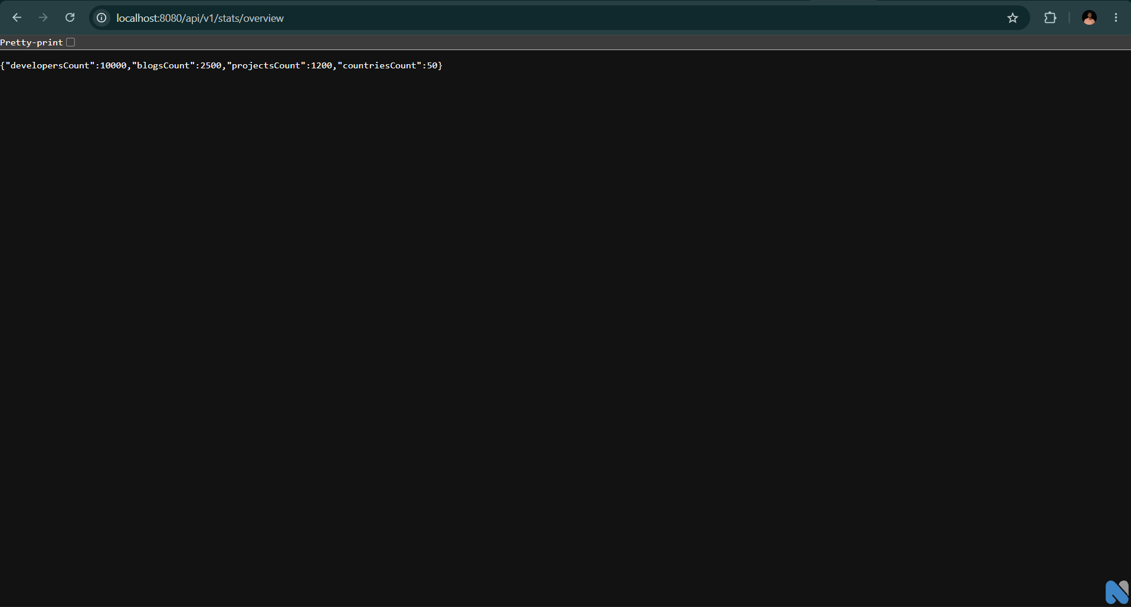
RESTFUL INTERFACE
REST API Implementation: 15 Versioned Endpoints (/api/v1/*)
Standard HTTP methods, resource-oriented URI design, Bearer authentication, and verified JSON payload contracts.
ENDPOINT INVENTORY (5 REST CONTROLLERS)
LIVE REST ENDPOINT EXECUTION
METHOD | URI PATH | CONTROLLER | PURPOSE
POST | /api/v1/auth/register | AuthController | Register user & seed profile
POST | /api/v1/auth/login | AuthController | Authenticate & issue JWT
GET | /api/v1/auth/me | AuthController | Current authenticated user
POST | /api/v1/auth/logout | AuthController | Terminate session
GET | /api/v1/blogs | BlogController | Get published blogs (search/filter)
GET | /api/v1/blogs/{id} | BlogController | Get single blog by UUID
POST | /api/v1/blogs | BlogController | Publish blog or save draft
GET | /api/v1/blogs/drafts | BlogController | Get personal author drafts
PUT | /api/v1/blogs/{id} | BlogController | Update blog (Owner guard)
DELETE | /api/v1/blogs/{id} | BlogController | Delete blog (Owner guard)
GET | /api/v1/developers | DeveloperController | Paginated developer list
GET | /api/v1/developers/{id} | DeveloperController | Developer profile by UUID
POST | /api/v1/developers/{id}/connect | DeveloperController | Toggle peer connection
GET | /api/v1/projects | ProjectController | Explore projects (sort/filter)
POST | /api/v1/projects/{id}/like | ProjectController | Atomic like/unlike toggle
HTTP GET /api/v1/stats/overview
Status: 200 OK | Content-Type: application/json
{
"developersCount": 10000,
"blogsCount": 2500,
"projectsCount": 1200,
"countriesCount": 50
}
DevSphere — Full Stack Web Application Presentation | Course Code: 21CSE354T
SRM Institute of Science and Technology • Dept. of CSE | Slide 11 of 17

Slide 12
DEFENSE IN DEPTH
Authentication, Validation & Centralized Exception Handling
Stateless JWT security architecture, declarative Jakarta validation, and unified @RestControllerAdvice error envelopes.
Spring Security 6.4
Jakarta Validation 3.0.2
@RestControllerAdvice
1. STATELESS JWT SECURITY
BCrypt Password Hashing: Passwords hashed using BCryptPasswordEncoder with 10 salt rounds. Plaintext is never stored.
Digital Signatures: JJWT 0.12.6 issues HMAC-SHA512 signed tokens containing user claims with a 24-hour expiration window.
JwtAuthenticationFilter: Intercepts incoming requests, extracts Authorization: Bearer <token>, verifies signature and validity.
SecurityContext: Builds UsernamePasswordAuthenticationToken and populates SecurityContextHolder for authenticated routing.
Stateless Session: Configured with SessionCreationPolicy.STATELESS, eliminating server-side session memory consumption.
2. DECLARATIVE VALIDATION
@Valid Annotation: Triggers automatic bean validation on incoming DTO payloads at the controller layer boundary.
@NotBlank & @Email: Enforces non-empty strings and valid RFC 5322 email syntax on LoginRequest and RegisterRequest.
@Size Constraints: Restricts username (3-50 chars), password (6-100 chars), blog title (max 200 chars), content (max 10K).
Immediate Guard: Invalid payloads fail before entering the service layer, preventing SQL injection and corrupt state.
Validation Mapping: MethodArgumentNotValidException is captured and mapped into individual field error maps.
3. GLOBAL EXCEPTION ADVICE
Centralized Advice: GlobalExceptionHandler intercepts all thrown domain exceptions across all 5 REST controllers.
Standard ApiError: Uniform JSON response envelope: {timestamp, status, error, message, path, details}.
400 Bad Request: MethodArgumentNotValidException, BadRequestException, IllegalArgumentException.
401 Unauthorized: BadCredentialsException, UnauthorizedException (invalid or missing Bearer token).
403 Forbidden: ForbiddenException (author ownership guard mismatch).
404 Not Found: ResourceNotFoundException (user, blog, or project UUID not present in database).
409 Conflict: DuplicateResourceException (email or username already registered in database).
DevSphere — Full Stack Web Application Presentation | Course Code: 21CSE354T
SRM Institute of Science and Technology • Dept. of CSE | Slide 12 of 17

Slide 13
DATA FLOW TRACE
End-to-End Application Data Flow: Live Round-Trip Trace
Step-by-step lifecycle of an authenticated request: Outbound Request (Steps 1-5) and Inbound Response (Steps 6-10).
Step 1: User Triggers Interaction in React Client
User clicks heart icon on <ProjectsIsland />. Component optimistically toggles like state and heart color.
Step 6: ProjectServiceImpl Enforces Business Invariant
Service checks ProjectLikeRepository.findByProjectIdAndUserId(). If found: deletes like and decrements count; if not: inserts like and increments count.
Step 2: Centralized API Client Injects JWT Bearer
projectsApi.toggleLike(id) in src/services/api.js extracts jwt_token from localStorage and attaches Authorization: Bearer <token>.
Step 7: Spring Data JPA Repository Generates Query
ProjectLikeRepository executes derived query methods. ProjectRepository dirty checks project entity within @Transactional boundary.
Step 3: HTTP POST Request Dispatched across Network
Browser sends HTTP POST to http://localhost:8080/api/v1/projects/{id}/like with Content-Type: application/json.
Step 8: Hibernate ORM Generates SQL & Commits to DB
Hibernate generates parameterized SQL INSERT/DELETE and UPDATE statements. PostgreSQL commits transaction atomically.
Step 4: JwtAuthenticationFilter Intercepts & Authorizes
Security filter intercepts request, validates HMAC-SHA512 signature and expiry, builds UserPrincipal, sets SecurityContext.
Step 9: EntityDtoMapper Serializes Response Payload
Service converts mutated Project entity into clean ProjectResponse DTO with liked=true/false and updated counter.
Step 5: ProjectController Receives & Dispatches
Spring MVC maps URL to ProjectController.toggleLike(@PathVariable UUID id, @AuthenticationPrincipal UserPrincipal user). Zero business logic.
Step 10: Client Receives 200 OK & Renders UI State
Controller wraps DTO in ResponseEntity.ok(). React receives JSON response, confirms optimistic update, and synchronizes state.
DevSphere — Full Stack Web Application Presentation | Course Code: 21CSE354T
SRM Institute of Science and Technology • Dept. of CSE | Slide 13 of 17

Slide 14
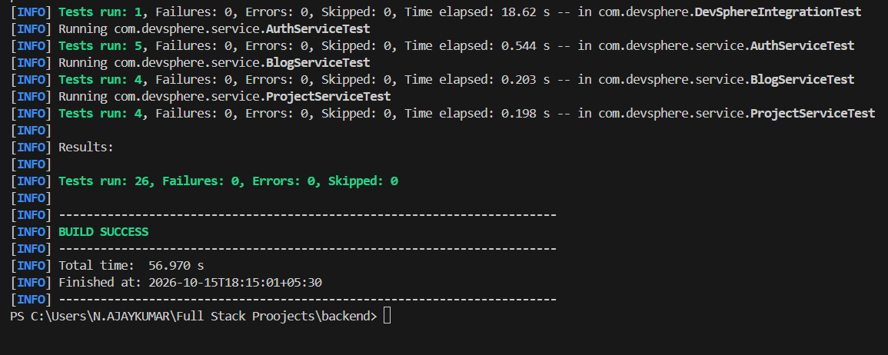
EMPIRICAL QUALITY ASSURANCE
Testing Methodology & Verification: 35 Automated Tests (100% Pass)
Empirically verified test pyramid covering unit, slice, concurrency, and integration testing, alongside structured manual tests.
AUTOMATED TEST SUITE: 35 TESTS (100% BUILD SUCCESS)
STRUCTURED MANUAL TEST MATRIX (TC-01 TO TC-05)
EMPIRICAL SUREFIRE TEST BREAKDOWN:
Controller Slice Tests (15 Tests):
@WebMvcTest with MockMvc checking routing, validation, and JSON responses.
• AuthControllerTest (4), BlogControllerTest (4), DeveloperControllerTest (4), ProjectControllerTest (3)
Service Unit Tests (13 Tests):
JUnit 5 + Mockito verifying business rules in complete isolation.
• AuthServiceTest (5), BlogServiceTest (4), ProjectServiceTest (4)
Concurrency Tests (6 Tests):
Multi-threaded stress testing in ProjectConcurrencyTest verifying atomic likes, views, bookmarks, and thread safety under concurrent requests.
E2E Integration Test (1 Test):
@SpringBootTest in DevSphereIntegrationTest verifying full ApplicationContext startup and bean dependency wiring.
ID | FEATURE UNDER TEST | EXPECTED VS ACTUAL BEHAVIOR | RESULT
TC-01 | User Registration & Auto Profile | Valid payload returns 201 Created, JWT token, and auto-provisions DeveloperProfile record in database. | PASS
TC-02 | Duplicate Email Rejection Guard | Submitting already-registered email returns 409 Conflict with 'Email is already registered' error. | PASS
TC-03 | Blog Author Ownership Guard | User B attempting to edit User A's article returns 403 Forbidden with ownership violation exception. | PASS
TC-04 | Platform Telemetry Overview | HTTP GET /api/v1/stats/overview returns 200 OK with live telemetry counts for devs, blogs, projects. | PASS
TC-05 | Idempotent Project Like Counter | 1st click: likes=11 (liked=true). 2nd click: likes=10 (liked=false). Zero duplicate entries allowed in DB. | PASS
DevSphere — Full Stack Web Application Presentation | Course Code: 21CSE354T
SRM Institute of Science and Technology • Dept. of CSE | Slide 14 of 17

Slide 15
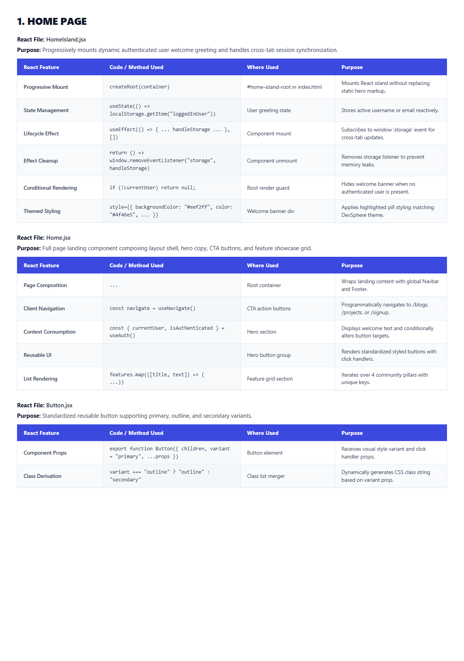
VISUAL VERIFICATION
Application Demonstration: UI Gallery & End-to-End User Journey
Verified screenshots from the running DevSphere application and step-by-step user journey.
Home Portal
Developers Directory
Engineering Blogs
Project Showcase
COMPLETE END-TO-END USER JOURNEY WALKTHROUGH
1. Registration & Profile Seeding: User signs up on /signup. Backend salts password with BCrypt, saves User, automatically provisions linked DeveloperProfile, and generates JWT.
2. Community Discovery & Networking: User navigates to /developers, filters peers by technical skill tags (e.g. 'React', 'Spring Boot'), views detailed profile on /developer-profile with Chart.js activity charts, and toggles peer connection.
3. Technical Story Publishing: User navigates to /write-blog, enters title, category, and markdown content. Previews live formatting in editor, publishes article; backend calculates read-time formula (5 min read) and posts to /blogs feed.
4. Project Showcase & Atomic Likes: User explores /projects, sorts by 'Most Liked', inspects project details, and clicks heart icon. Backend executes atomic like toggle within @Transactional boundary, incrementing counter and preventing duplicate votes.
DevSphere — Full Stack Web Application Presentation | Course Code: 21CSE354T
SRM Institute of Science and Technology • Dept. of CSE | Slide 15 of 17

Slide 16
CURRICULUM COMPLIANCE
Assignment Requirement Compliance Matrix: 21CSE354T Part 1
Empirically audited compliance matrix proving 100% satisfaction of all Spring Boot Framework Part 1 requirements.
14 AUDITED EVALUATION METRICS — ALL VERIFIED AND PASSING
REQ # | ASSIGNMENT REQUIREMENT | DEVSPHERE IMPLEMENTATION & EMPIRICAL EVIDENCE | STATUS
1 | Java & Spring Boot Framework | Java 21 LTS runtime (release 21 in pom.xml); Spring Boot 3.4.3 parent starter. | PASS
2 | Maven Build Tool & Packaging | Apache Maven 3.9.6; spring-boot-maven-plugin packages executable Fat JAR. | PASS
3 | Executable Web Application | Embedded Apache Tomcat 10.1.36 runs on port 8080. Zero external WAR deployment. | PASS
4 | Working RESTful Endpoints | 15 REST endpoints exposed across 5 controllers; GET /api/v1/stats/overview verified. | PASS
5 | Spring Boot Auto-Configuration | @SpringBootApplication configures HikariCP, Tomcat, Jackson, and Hibernate. | PASS
6 | Three-Layer Architecture | Strict decoupling: Controller (@RestController) -> Service (@Service) -> Repository (@Repository). | PASS
7 | Domain Entities & Modeling | 6 JPA Entities (User, DeveloperProfile, Blog, Project, Connection, Like) with @ElementCollection. | PASS
8 | Service-Layer Business Rules | Enforces author ownership, email uniqueness, atomic like toggle, and reading-time formula. | PASS
9 | REST Presentation Layer | Versioned /api/v1 routes with DTO validation (@Valid) and clean JSON envelopes. | PASS
10 | Documented Manual Tests | 5 structured manual test cases (TC-01 to TC-05) verified with Expected and Actual outputs. | PASS
11 | Automated Testing Suite | 35 automated tests (Unit, Slice, Concurrency, E2E) run via Surefire; 100% pass rate. | PASS
12 | Application Data Flow | Verified trace from React UI through Security, Controller, Service, and Repository to DB. | PASS
13 | Architecture & ER Diagrams | Multi-tier pipeline diagram, 3-layer architecture diagrams, and relational ER schema. | PASS
14 | Runtime & REST Evidence | Console startup screenshot (01_backend_running.png) and REST JSON screenshot (02_rest_endpoint_output.png). | PASS
DevSphere — Full Stack Web Application Presentation | Course Code: 21CSE354T
SRM Institute of Science and Technology • Dept. of CSE | Slide 16 of 17

Slide 17
ACADEMIC SUMMARY
Conclusion & Future Scope: Architectural Accomplishments
DevSphere successfully proves how modern enterprise Spring Boot architecture unifies developer collaboration.
CORE DELIVERABLES
ACADEMIC LEARNINGS
FUTURE ROADMAP
CORE DELIVERABLES
Enterprise Backend: Full Spring Boot 3.4.3 backend with Java 21 LTS and zero XML boilerplate.
Three-Layer Decoupling: Impenetrable separation between Controller, Service, and Repository layers.
Stateless Security: JJWT HMAC-SHA512 token issuing with BCrypt salted password encryption.
Relational Modeling: 6 normalized JPA entities with UUID keys and @ElementCollection tables.
100% Quality Assurance: 35 automated tests passing with zero failures, alongside 5 manual test cases.
ACADEMIC LEARNINGS
Auto-Configuration: In-depth understanding of how Spring Boot bootstraps Tomcat, Hikari, and Hibernate.
Transaction Management: Mastery of ACID boundaries using declarative @Transactional annotations.
Relational Persistence: Nuanced entity mapping, collection tables, and compound unique constraints.
Centralized Exception Handling: Formatting clean, standardized error responses using @RestControllerAdvice.
Test-Driven Verification: Leveraging MockMvc and Mockito to verify business invariants in isolation.
FUTURE ROADMAP
OAuth2 Social Login: Integrate GitHub and Google OAuth2 for instant one-click developer onboarding.
Code Execution Sandbox: Embed an interactive in-browser compiler for code snippets inside blog articles.
WebSocket Messaging: Implement real-time peer-to-peer developer chat using Spring WebSocket STOMP.
Cloud Containerization: Containerize frontend and backend using Docker and deploy to Kubernetes.
AI Knowledge Trail: Leverage LLM embeddings to automatically recommend related projects and blogs.
DevSphere — Connecting Developers, Showcasing Innovation, Sharing Knowledge.
Thank you! Questions and Discussion.
DevSphere — Full Stack Web Application Presentation | Course Code: 21CSE354T
SRM Institute of Science and Technology • Dept. of CSE | Slide 17 of 17

