Slide 1
YĀTRĀ AI (यात्रा AI)
A Personalized Multi-Modal Travel Recommendation Engine for India
Discrete Choice Recovery using Grounded Public Infrastructure & Calibrated Synthetic Behaviour
RESEARCH & TECHNICAL SPECIFICATIONS
• Core Dataset: 5,000 Synthetic Travellers | 40,000 Search Sessions | 138,603 Itinerary Candidate Rows
• Grounded Data: 8,400+ Railway Stations | 11,100+ Scheduled Trains | 300,000+ Flight Records | IMD Rainfall
• Evaluation: Strict 70/15/15 Traveller-Level Split | Pre-Training Leakage Audit | Deterministic Seed 42
• Final Champion Model: Gradient Boosting Core (GB_core) @ Decision Threshold τ* = 0.30
Notes:
Welcome committee members. Today I am presenting Yātrā AI, an intelligent multi-modal travel recommendation framework specifically engineered for the Indian transit ecosystem. This project addresses the lack of personalized multi-modal trip planning in India by coupling grounded public transport infrastructure with an axiomatic Multinomial Logit discrete choice simulation across 5,000 travellers and 138,603 candidate alternatives.

Slide 2
YĀTRĀ AI — ACADEMIC RESEARCH TRACK
The Problem: Fragmented Transit & Multi-Attribute Trade-offs
The Indian Transit Dilemma
Contrasting Traveller Trade-offs
1. Siloed Digital Platforms:
Indian Railways (IRCTC) and domestic commercial airlines operate on disconnected booking portals. Travellers must cross-reference schedules manually across browser tabs.
2. Hidden Door-to-Door Friction:
Commercial OTAs sort by flight airtime or train schedule, ignoring check-in buffers, terminal airport transfers, and intermediate railway layovers.
3. Zero Personalization:
Existing engines cannot evaluate multidimensional trade-offs across cost, transit speed, operational delay risk, cabin comfort, and carbon emissions.
Scenario: Delhi to Bengaluru Corridor (1,740 km)
• Executive Business Traveller:
- Values: High punctuality, minimal door-to-door transit time.
- Choice: Non-stop 2.8h flight (₹5,500). Price inelastic.
- Priority: Time & Reliability > Cost.
• Budget-Conscious Student / Family:
- Values: Ticket affordability, sleeping berths, zero transfer penalty.
- Choice: Rajdhani Express or Sleeper Rail (₹850–₹2,200, 32h).
- Priority: Cost & Comfort > Duration.
Core Challenge: How can an ML recommendation system automatically infer and satisfy these divergent trade-offs?
Notes:
Here we articulate the core real-world motivation. India has immense transit supply, but consumers face a high cognitive burden. A 1,740 km trip between Delhi and Bengaluru presents wildly divergent options: a 3-hour flight for 5,500 rupees versus a 32-hour train for 850 rupees. Existing travel websites treat all users identically. Yātrā AI is built to automate multi-attribute trade-offs tailored to each traveller's latent preferences.

Slide 3
YĀTRĀ AI — ACADEMIC RESEARCH TRACK
The Yātrā AI Solution & Architectural Concept
1. Transit Knowledge Graph
2. Travel DNA Layer
3. ML Recommendation Filter
Multi-Modal Graph Engine
• Ingests 8,400+ rail stations and major metro airports.
• Resolves stations into unified Metropolitan Transit Zones (e.g. NDLS/NZM/DEL -> Delhi NCR).
• Computes realistic door-to-door duration including check-in, ground transfer, and buffer times.
• Integrates historical rail punctuality and IMD climate rainfall.
Psychometric Modeling
• 7-Dimensional continuous preference representation:
1. Cost Sensitivity
2. Time Sensitivity
3. Reliability Sensitivity
4. Comfort Preference
5. Transfer Tolerance
6. Departure Time Flexibility
7. Sustainability Preference
• Continuous coordinate space replaces rigid demographic buckets.
Pointwise Scoring & Filter
• Evaluates candidate itineraries generated by routing graph.
• Derives relative choice-set quality scores normalized per session.
• Predicts alternative selection probability: P(chosen = 1 | X).
• Calibrated decision threshold (τ* = 0.30) balances precision and recall.
• Surfaces curated 'Recommended For You' carousel to user.
Notes:
Yātrā AI operates in three interconnected tiers: first, a multimodal knowledge graph that bridges rail and flight schedules into unified metro corridors; second, a 7-dimensional continuous psychometric vector called Travel DNA that models user sensitivity; and third, a machine learning recommendation filter that scores candidates and surfaces the best itineraries.

Slide 4
YĀTRĀ AI — ACADEMIC RESEARCH TRACK
Data Architecture: The Hybrid Data Strategy
Grounded Public Transit Data (100% Real)
Canonical Join & Provenance Classification
Authentic Supply Infrastructure:
• 8,400+ Railway Stations (Ministry of Railways / OGD India):
Latitude, longitude, state, zone, station codes.
• 11,100+ Train Timetables (IRCTC / CRIS):
Schedules, intermediate halts, train types (Rajdhani, Shatabdi, Mail).
• 300,000+ Domestic Flight Itineraries (Kaggle / OTA records):
Air carriers (IndiGo, Air India, etc.), departure windows, fare classes.
• Historical Railway Delay Statistics:
Punctuality baselines aggregated by service class.
• IMD High-Resolution Climate Rainfall:
Gridded monthly precipitation archives for weather disruption risk.
Strict Join Strategy (Zero Fabricated Links):
• Station-to-Metro Aggregation: Haversine distance clustering (threshold <= 45 km) links individual stations (NDLS, NZM) and airport (DEL) to unified metro hubs.
• Regional Climate Linking: Rainfall joined strictly at state/meteorological sub-division level, avoiding invalid station-level micro-joins.
Explicit Feature Provenance Tiers:
• OBSERVED: Station GPS, flight fares, train timetables.
• DERIVED: Door-to-door transit duration, IRCA distance-based rail tariffs, carbon emission estimates (DGCA/CEA factors).
• SIMULATION PROXIES: Punctuality baselines, cabin comfort scores.
• SYNTHETIC: Traveller profiles, search sessions, choice labels.
Notes:
It is vital to emphasize our Hybrid Data Strategy. Because commercial booking logs across Indian Railways and airlines are private, we ground all physical supply—stations, trains, flights, delay distributions, and rainfall—in real public data. We also explicitly audit feature provenance: observed, derived tariffs, simulation proxies, and synthetic demand. We never invent joins merely to force datasets together.

Slide 5
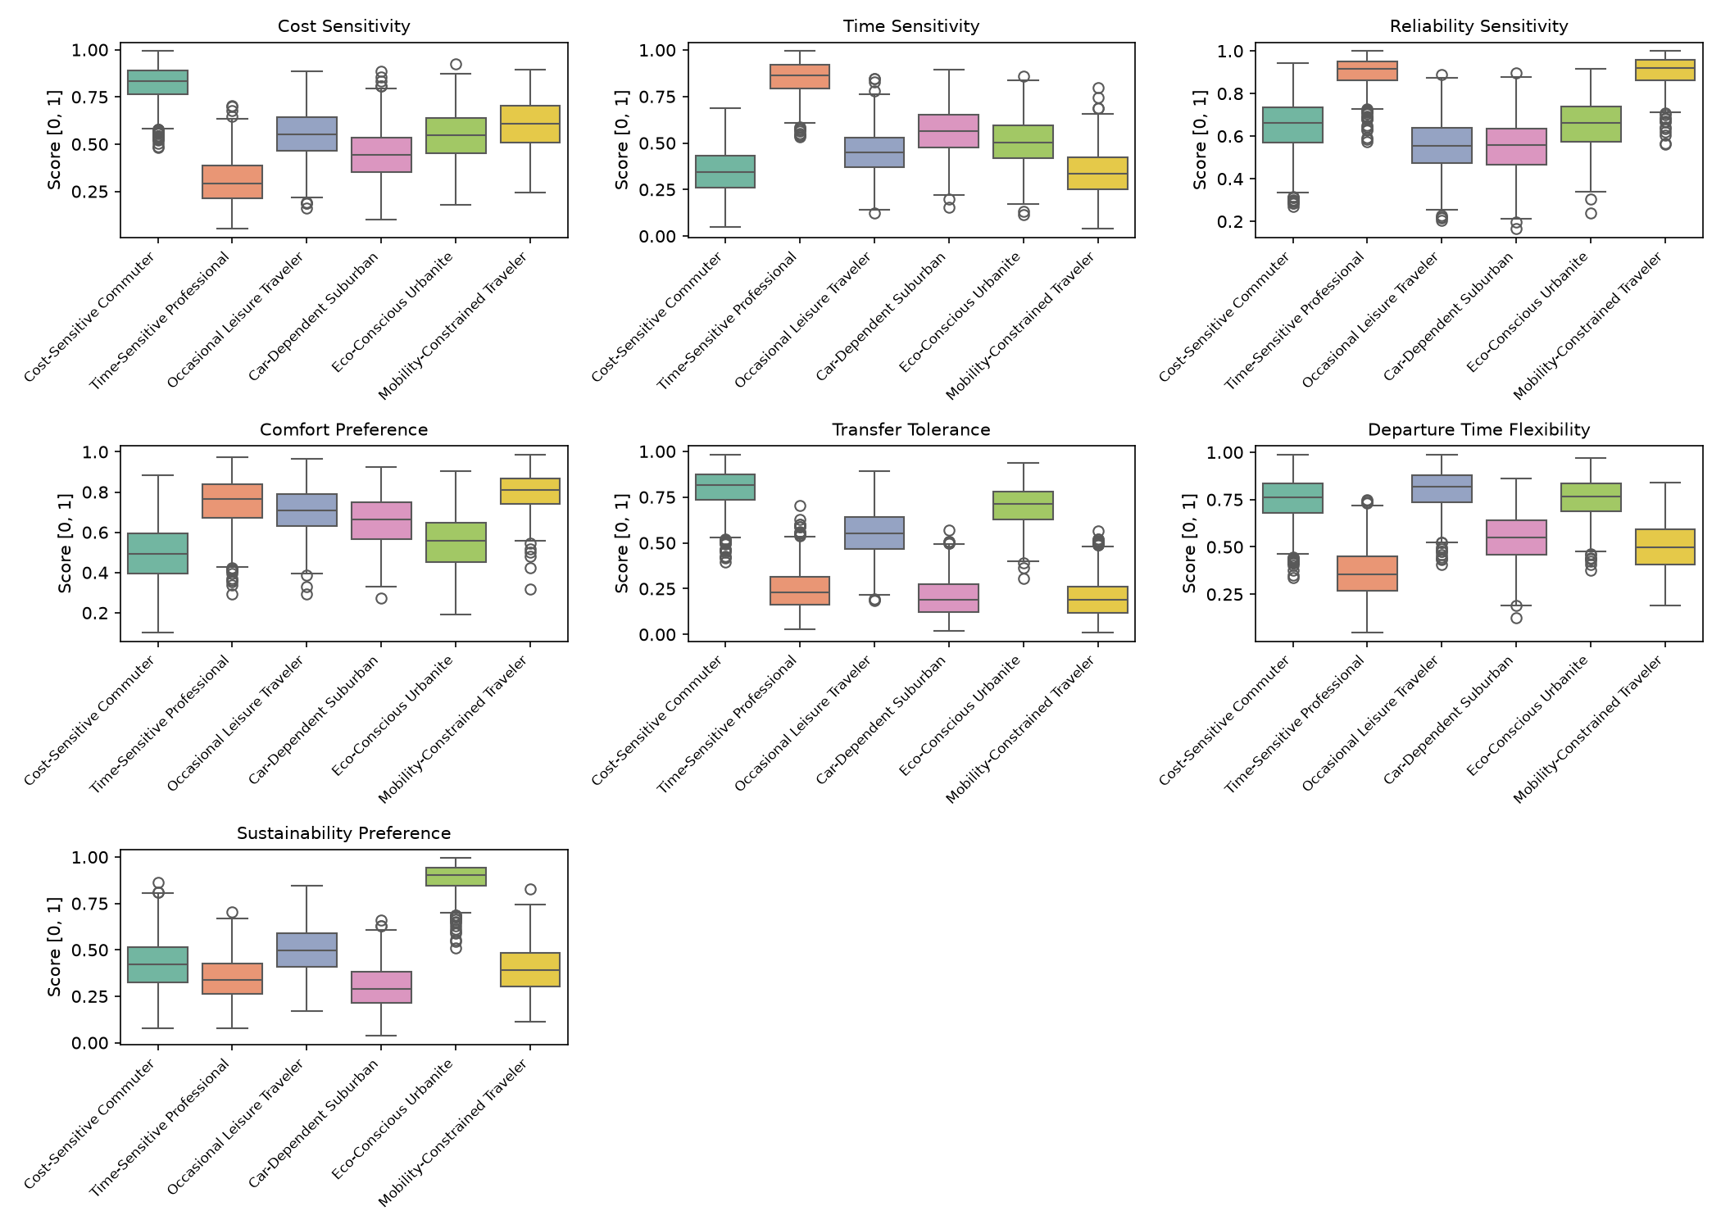
YĀTRĀ AI — ACADEMIC RESEARCH TRACK
Synthetic Methodology: Axiomatic Multinomial Logit
Random Utility Maximization (RUM)
Travel DNA Distributions by Persona Archetype
1. Systematic Bilinear Utility:
V_ni = Σ β_k · DNA_nk · Score_nik
Captures interactive valuation (e.g. cost sensitivity × relative fare score).
2. Gumbel Error Disturbance:
U_ni = V_ni + ε_ni, where ε_ni ~ Gumbel(0, 1)
3. Multinomial Logit Closed-Form Choice:
P_ni = exp(V_ni) / Σ_j exp(V_nj)
4. Discrete Choice Sampling:
chosen_ni = 1 if alternative i maximizes U_ni within session.
Automated Validation Suite (5/5 Passed):
• Structural: 0 nulls, exact 138,603 rows.
• Statistical: Empirical vs theoretical mean delta <= 0.0102.
• Axiomatic: Choice sum = 1.0 to machine epsilon (3.33e-16).
• Behavioral: 6/6 sensitivity interventions passed.
• Reproducibility: Seed 42 bitwise identical.
Notes:
To model demand choices, we utilize the Nobel Prize-winning Multinomial Logit formulation from econometric choice theory. Systematic utility is a bilinear product of continuous Travel DNA sensitivities and normalized candidate quality scores. Crucially, our synthetic population passed 5 rigorous validation suites, verifying structural integrity, mathematical axioms to double machine epsilon, and behavioral sensitivity.

Slide 6
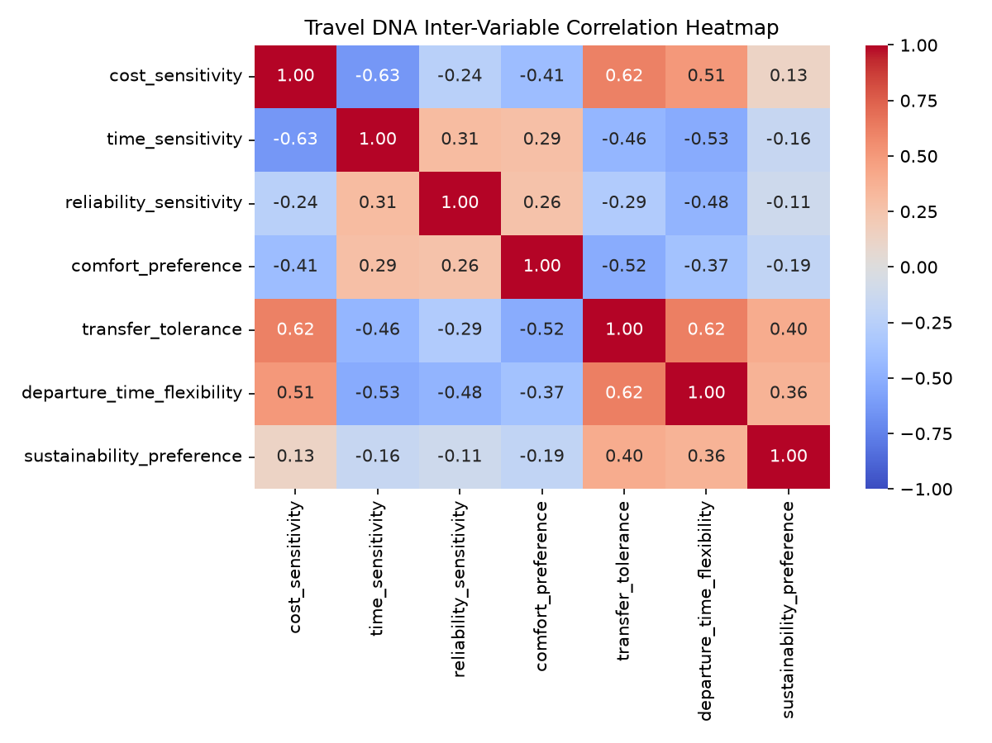
YĀTRĀ AI — ACADEMIC RESEARCH TRACK
Exploratory Data Analysis & Behavioural Patterns
Key Dataset Distributions
Travel DNA Correlation Matrix (Population Mixture)
A. Class Distribution (Natural Imbalance):
• Class 0 (Not Chosen): 98,603 (71.14%)
• Class 1 (Chosen): 40,000 (28.86%)
• Natural Imbalance Ratio: 2.465 : 1
• Structural origin: Exactly 1 chosen among 2 to 5 candidate alternatives per session (mean = 3.465).
B. Modal Choice Share:
• Heavy Rail Choices: 20,884 (52.21%)
• Domestic Aviation: 19,116 (47.79%)
C. Correlation Structure Clarification:
• Intra-persona dimensions were sampled independently (|r| <= 0.089).
• Moderate aggregate correlation (Cost vs Time = -0.63) arises naturally from the mixture of persona-conditioned priors.
Notes:
Here we observe the exploratory data analysis. The target variable exhibits a natural 2.465 to 1 class imbalance because exactly one option is chosen among 2 to 5 candidates per session. Notice also that modal share is well-balanced: 52% rail and 48% flight. Furthermore, we clarify that while individual persona dimensions are sampled independently, aggregate correlations like negative cost-time sensitivity reflect the mixture of diverse traveller archetypes.

Slide 7
YĀTRĀ AI — ACADEMIC RESEARCH TRACK
ML Problem Formulation & Leakage Prevention
Supervised Binary Classification
Pre-Training Leakage Audit Matrix
• Formulation: Predict whether an alternative is selected:
y_ni = chosen_ni ∈ {0, 1}
• Grouped Partitioning (Traveller-Level Split):
- TRAIN (70%): 3,500 Travellers (97,163 rows)
- VALIDATION (15%): 750 Travellers (20,715 rows)
- TEST (15%): 750 Travellers (20,725 rows)
- Invariant: Zero traveller overlap across splits (Seed 42).
• Two Feature Configurations:
- Core (Model A — 28 features): 8 Travel DNA, 7 Candidate Scores, 8 Raw Attributes, 5 Context/Climate.
- Extended (Model B — 29 features): Core + persona_type.
• Dual Preprocessing Pipelines:
- Linear: StandardScaler + OneHotEncoder (fitted strictly on train).
- Tree: Native numericals + OrdinalEncoder.
Strict Exclusion of Post-Choice Derivatives:
• utility (latent driver) -> EXCLUDED (Critical Leakage)
• choice_probability (posterior) -> EXCLUDED (Critical Leakage)
• rank (post-utility order) -> EXCLUDED (Critical Leakage)
• session_id, traveller_id -> EXCLUDED (Identifier Leakage)
Verification of Candidate Quality Scores:
• cost_score, time_score, reliability_score, comfort_score, transfer_score, carbon_score, departure_fit
AUDIT CONFIRMATION:
All candidate scores are pre-choice attributes computed from raw itinerary attributes relative to session bounds prior to utility calculation and choice simulation. They carry zero information about whether the alternative was chosen.
Notes:
Before training, we conducted a rigorous leakage audit. We strictly excluded all post-choice simulation outputs like utility, rank, and choice probability. Furthermore, we verified that normalized candidate scores are strictly pre-choice attributes computed before any choice occurs. We also enforced a strict traveller-level split to prevent identity leakage.

Slide 8
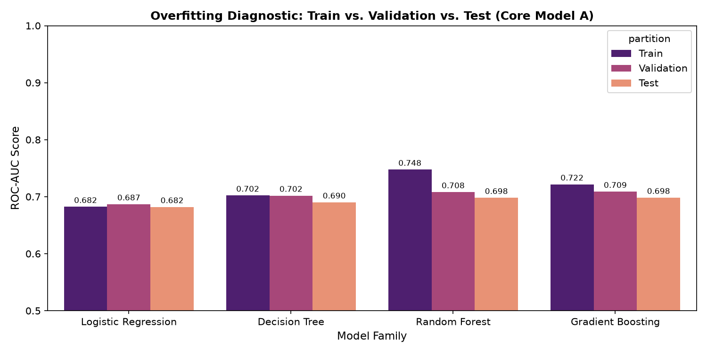
YĀTRĀ AI — ACADEMIC RESEARCH TRACK
Algorithmic Benchmarking: Four Model Families
Model Architectures & Inductive Biases
Train vs. Val vs. Test Metric Comparison
1. Logistic Regression (L2 Regularized):
- Benchmark for linear separability.
- Standard scaled continuous features + One-Hot Encoding.
2. Single Decision Tree (max_depth=10, min_leaf=20):
- Non-linear orthogonal splitting.
- Evaluates baseline tree partitioning capacity.
3. Random Forest (100 trees, max_depth=12, min_leaf=15):
- Bagging ensemble to reduce tree variance.
- Evaluates random subspace feature selection.
4. Histogram Gradient Boosting (max_iter=100, lr=0.1):
- Gradient boosted decision trees with regularized shrinkage.
- Native support for categorical splits and missing values.
Notes:
We evaluated four distinct model families representing linear, single-tree, bagging, and boosting paradigms. This provided a rigorous benchmark across inductive biases, allowing us to evaluate whether non-linear interactions are necessary and how regularized boosting compares to bagging in controlling overfitting.

Slide 9
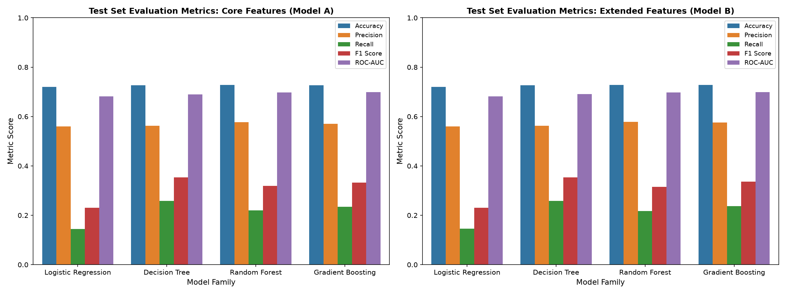
YĀTRĀ AI — ACADEMIC RESEARCH TRACK
Phase 4 Step 1: Baseline Findings & Insights
Three Major Empirical Findings
Baseline Model Performance Comparison
1. Tree Ensembles Decisively Outperform Linear Models:
• Gradient Boosting achieved Test F1 = 0.3386 vs. 0.2300 for Logistic Regression (+47.2% relative gain).
• Random Forest achieved highest baseline ROC-AUC = 0.6979.
• Rationale: Discrete choice utility is bilinear (Sensitivity × Score); tree partitions naturally capture this interaction.
2. persona_type Adds Negligible Incremental Value:
• Extended Model B showed ΔROC-AUC <= 0.0005 across all algorithms.
• Feature importance of persona_type was only 0.81%.
• Rationale: Continuous Travel DNA already provides complete psychometric coordinates; persona is redundant.
3. Candidate Scores Out-Predict Raw Attributes by 2.3x:
• cost_score (15.4%) vs. raw_cost (7.9%).
• Choice depends on relative superiority within session.
Notes:
Step 1 yielded three critical scientific insights: First, tree models substantially outperformed logistic regression because choice utility is inherently interactive. Second, adding categorical persona type provided zero incremental value, proving that continuous Travel DNA is the superior representation. Third, candidate quality scores out-predicted raw attributes by 2.3 times, proving that choice depends on relative within-session comparisons.

Slide 10
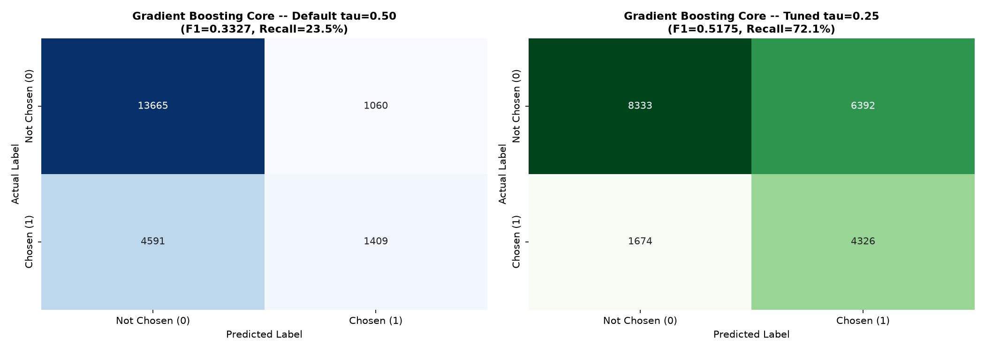
YĀTRĀ AI — ACADEMIC RESEARCH TRACK
Threshold Optimization & Final Champion Selection
Champion: Gradient Boosting Core @ τ* = 0.30
Confusion Matrix Shift: Default (0.50) vs. Tuned (0.30)
Validation-Only Threshold Selection:
• Evaluated τ ∈ [0.20, 0.60] strictly on validation data.
• Peak Validation F1 = 0.5283 @ τ* = 0.30 (tie-breaker saved 1,578 FP over 0.25).
Final Test Performance (Applied Once to Test Set):
• Test F1 Score: 0.5116 (Surged from 0.3366, +52.0%)
• Test Recall: 62.65% (Surged from 23.82%, +38.8% pts)
• Test Precision: 43.23% (Shift from 57.37%)
• Test ROC-AUC: 0.6976 (Invariant)
• Test Accuracy: 65.37% (Shift from 72.82%)
Confusion Matrix Shift (Test Set N = 20,725):
• True Positives: 1,429 -> 3,759 (+2,330 / +163.0% gain)
• False Negatives: 4,571 -> 2,241 (-2,330 / -50.97% drop)
• False Positives: 1,062 -> 4,936
• True Negatives: 13,663 -> 9,789
Notes:
In Step 2, we addressed the positive recall deficit. At default 0.50 threshold, models missed 76% of chosen journeys. By optimizing the threshold strictly on validation data to 0.30, Test Recall surged from 23.8% to 62.7%, and F1 jumped from 0.3366 to 0.5116. We slashed false negatives by more than half, capturing 2,330 additional preferred journeys.

Slide 11
YĀTRĀ AI — ACADEMIC RESEARCH TRACK
Academic Boundaries, Limitations & Future Roadmap
Explicit Research Limitations
Engineering & Research Roadmap
1. Synthetic Behavioral Ground Truth:
Labels (chosen) reflect simulated Multinomial Logit choices, NOT real-world booking conversions.
2. Simulation Proxies:
Flight punctuality and cabin comfort are calibrated proxy baselines rather than live airline operations feeds.
3. Derived Tariff Schedules:
Rail fares are derived from IRCA distance formulas rather than observed transaction receipts.
4. Pointwise Independence Assumption:
The binary classifier predicts alternatives independently as Bernoulli trials; it does not enforce the constraint that exactly one option is chosen per session (Σ Y_nj = 1).
5. Geographic Coverage:
Focuses on 6 major Indian metropolitan corridors.
Phase 6 Production Extensions:
• Session-Aware Learning-to-Rank (LTR):
Transition to LightGBM Ranker / LambdaMART optimizing listwise NDCG@1 and MRR conditioned on session_id.
• Econometric Mixed Logit Modeling:
Estimate unobserved preference heterogeneity and cross-elasticities between rail and air modes.
• Live Transit API Integrations:
Ingest live airline GDS fares and IRCTC dynamic pricing / waitlist confirmation probability feeds.
• Online Preference Learning:
Update Travel DNA sliders dynamically via contextual multi-armed bandits (LinUCB) from user clickstream telemetry.
Notes:
We maintain full transparency regarding limitations. The choice labels are synthetic, flight delay values are proxies, and our binary model evaluates alternatives independently rather than enforcing the one-choice-per-session constraint. This lays out an exciting roadmap: transitioning to Learning-to-Rank with LambdaMART and connecting live IRCTC and airline APIs.

Slide 12
Conclusions & Project Sign-Off
1. Feasibility Demonstrated:
Yātrā AI successfully proved the feasibility of recovering multi-attribute traveller discrete choice preferences across Indian multi-modal transit networks using grounded public data and calibrated simulation.
2. Superiority of Gradient Boosting & Relative Scoring:
Tree-based gradient boosting decisively outperforms linear classification by capturing bilinear utility interactions. Candidate scores relative to session bounds represent 52% of predictive importance, dominating raw attributes.
3. Optimal Operational Champion:
Gradient Boosting Core (GB_core) at τ* = 0.30 achieves 0.6976 ROC-AUC and 0.5116 F1, capturing 62.65% of preferred journeys while preserving parsimony and zero persona-coupling.
Closing Scientific Boundary:
"The results demonstrate the feasibility of recovering simulated traveller preference patterns from grounded itinerary and Travel DNA features; they should not be interpreted as empirical estimates of real-world traveller conversion behaviour."
Notes:
In conclusion, Yātrā AI establishes a principled, reproducible benchmark for multi-modal travel recommendation in India. We demonstrated that relative candidate scoring and continuous Travel DNA combined with gradient boosting provide the strongest architecture for discrete choice recovery. Thank you, and I now welcome your questions.

