Slide 1

UTTARANCHAL UNIVERSITY, DEHRADUN
BACHELOR OF TECHNOLOGY(CSE)
2022-23
VOICE BASED EMAIL SYSTEM FOR VISUALLY IMPAIRED
SUBMITTED BY:-
AJAY MRIDHA, NIDHI DHIMAN, KAVITA GAIRA, AMAN KUMAR

Slide 2
OUTLINES
Introduction
Objectives
Existing system
Proposed system
Process flow
Implementation
Future scope
Conclusion

Slide 3
INTRODUCTION
The navigation system uses TTS(Text-to-speech), STT(Speech-to-text) for blindness in order to provide a navigation service through voice. This system, as an independent program, is fairly cheap and it is possible to install onto smartphone held by visually impaired people.
Here we have described the voice mail architecture used by visually challenged people to access E-mail and multimedia functions of the operating system very effeciently.

Slide 4
OBJECTIVES
The system will not let the user make use of the keyboard instead will work on the speech recognition. In today’s world, much of the communication takes place through internet.
The proposed work aims to develop a mechanism which converts Speech-to-Text for email composing and also converts Text to speech for the reading emails.
This application recognizes user voice and performs comparisons with pre-sample voice stored in the database and thus it will execute the voice command.

Slide 5
EXISTING SYSTEM
There are many screen readers available but still the visually challanged people face minor difficulties.
The screen reader read whatever content on the screen but to perform any action that person has to use keyboard and mouse click, which can not be traced by the blinds.
There are various existing search engine which take request in the form of text from user and retrieve the relevent documents from the user and responds by displaying it in the form of text which is not possible for visually impaired people.

Slide 6
PROPOSED SYSTEM
The proposed system will make the user email system very easily accessible to visually challenged people and also help other categories.
Email composer : The email composer comprises of five modules. They are processing user voice input, text writing, verifiyng the output text and send email, compare the pre-recored samples. The input is given by the user in her/his voice.
Voice processing : This application will use installed libraries for voice recognition and processing.
Comparing voice with pre-recored sample : The speech synthesis interface properties like pending, speaking, resume, cancel,etc.

Slide 7
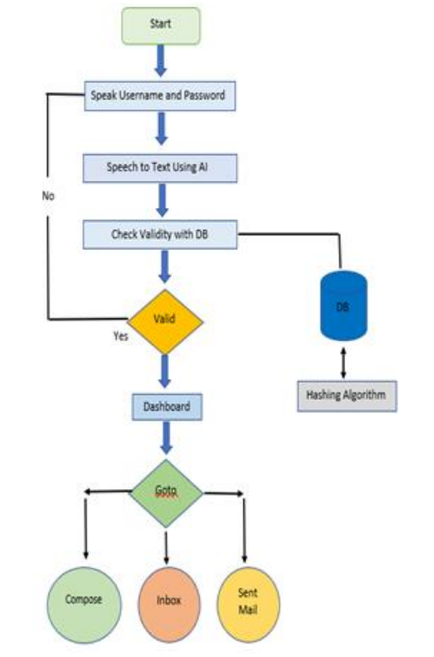
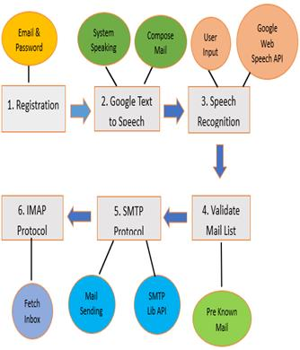
PROCESS FLOW
Fig., Dataflow system design of the source

Slide 8
IMPLEMENTATION
This system is developed by us on the already developed modules and the working is as follows:
Registration
Login
Home Page :
The avilable options are given below:-
1. Inbox
2. Compose
3. Sent mail
4. Trash

Slide 9
FUTURE SCOPE
There is wide scope of this system many enchancements can be done in the system such as including native langugaes as well as the functionality of accessing the delted malis and spam mails.
We can implement this system on andriod applications.
We can also integrate the sign languagge with this sytem to make it more scalable.

Slide 10
CONCLUSION
This e-mail system will help the visually challanged people as well as it can be used by any user of any age group with ease of access.
This system overcomes many drawbacks that were faced by visually challanged people in accessing the mails.
There is elimination of use of keyboard shortcuts along with the screen reader.

Slide 11
THANK YOU

