Slide 1

Capstone Power bi project
Coffee Quality

Slide 2

Project Overview
This project leverages a comprehensive dataset from the Coffee Quality Institute (CQI) to analyze the key factors influencing coffee quality, including sensory attributes, processing methods, and defect occurrences.
The aim is to uncover insights, identify trends, and build predictive models to support data-driven decision-making in the specialty coffee industry.

Slide 3

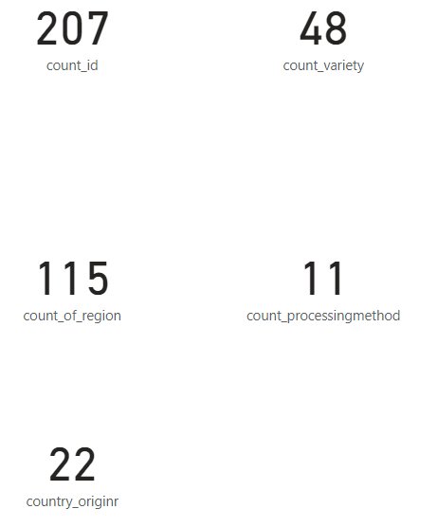
Overview:
The dataset includes 206 unique IDs, 115 regions, 11 processing methods, 48 coffee varieties, and 22 origins, providing a diverse range of data for analysis.

Slide 4
Dataset Overview:
The dataset includes rich information across multiple dimensions.
Sensory Attributes: Aroma, flavour , aftertaste, acidity, body, balance, uniformity, clean cup, sweetness, and Total Cup Points.
The dataset consist of CQI 31 Columns and 206 rows.
Defects:
Category One Defects
Category Two Defects
The dataset includes 206 unique IDs, 115 regions, 11 processing methods, 48 coffee varieties, and 22 origins
Approach:
Data cleaning and analysis preprocessing
Exploratory data analysis (EDA)
Visualization

Slide 5
Objective:
This project utilizes a comprehensive dataset provided by CQI to explore and analyze the factors contributing to coffee quality. The primary goals are:
Identifying the key determinants of coffee quality as evaluated through sensory attributes.
Analyzing correlations between coffee origin, processing methods, and quality scores.
Examining defect occurrences and their impact on overall coffee quality.
Investigating interactions between various variables that influence Total Cup Points, a holistic measure of coffee quality.
.

Slide 6

Thank you
AJAY KUMAR
S-9693

