Slide 1
ESG Analysis and Visualization
Leveraging Data Analytics for Sustainability Insights
ajaypatel006may@gmail.com | +91 7506161216

Slide 2
Introduction
Objective: Analyze ESG metrics to identify sustainability trends.
Tools Used: Python, Power BI, Excel.
Dataset Details: 50 records covering industries like Technology, Finance, Consumer goods, Agriculture and Energy.

Slide 3
Problem Statement
Issue: Understanding ESG’s financial impact is complex.
Importance: Helps businesses make informed investment decisions.

Slide 4
Methodology
Data Cleaning: Handled missing data using Pandas.
Analysis: Visualized trends with Matplotlib and Seaborn.
Visualization: Created interactive dashboards in Power BI.

Slide 5
Key Insights
Higher ESG scores correlate with better stock performance.
Technology leads ESG efficiency across industries.
Positive news sentiment aligns with higher ESG scores.

Slide 6
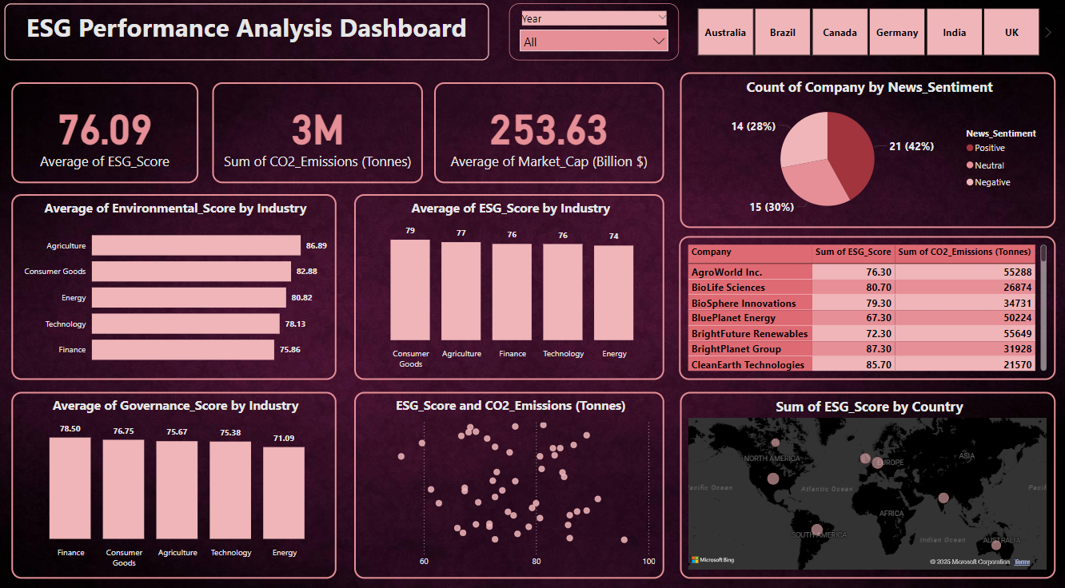
Power BI Dashboard Overview

Slide 7
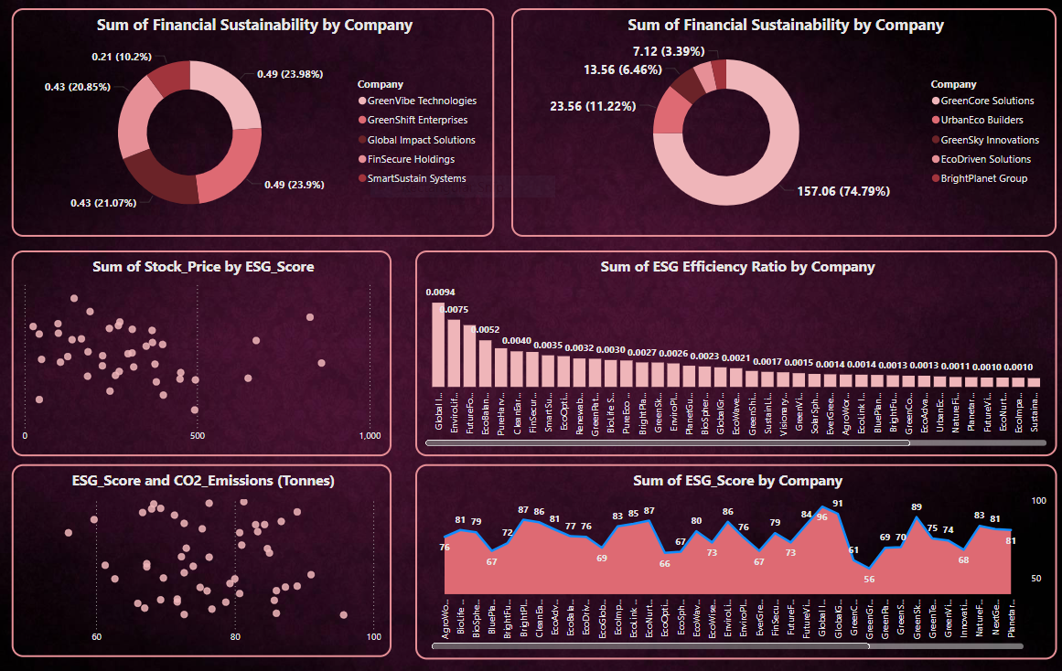

Slide 8
Python Contributions
Handled missing values using imputation (e.g., mean, median, or mode).
Removed duplicate rows or irrelevant columns
Correlation heatmaps to explore relationships between ESG scores and financial metrics.
Distribution plots for ESG scores across countries.
Bar chart comparing average ESG scores by industry.
ESG score trends over time.
CO2 emissions vs. ESG score .
Revenue vs. ESG score .

Slide 9

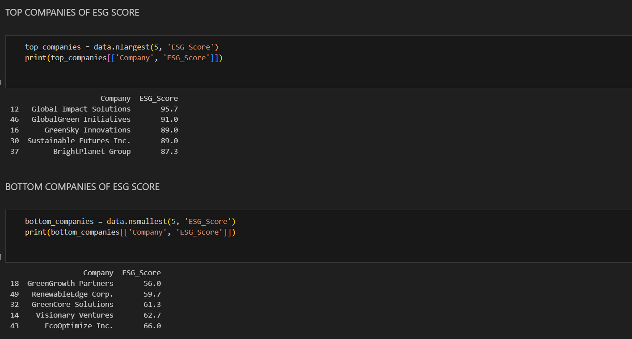

Slide 10
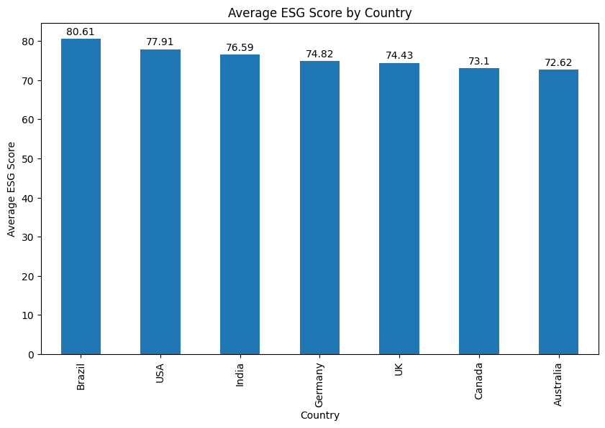
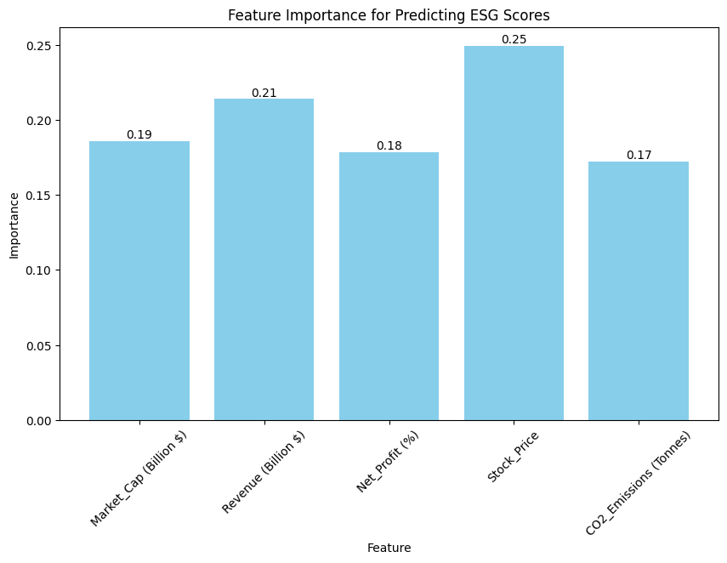
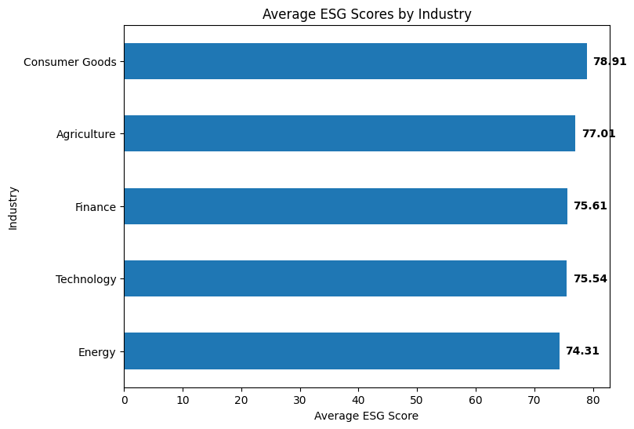
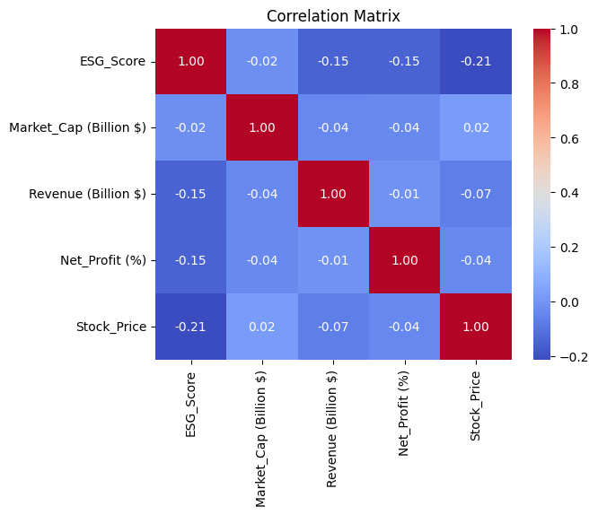

Slide 11
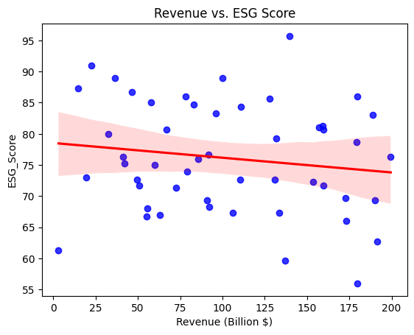
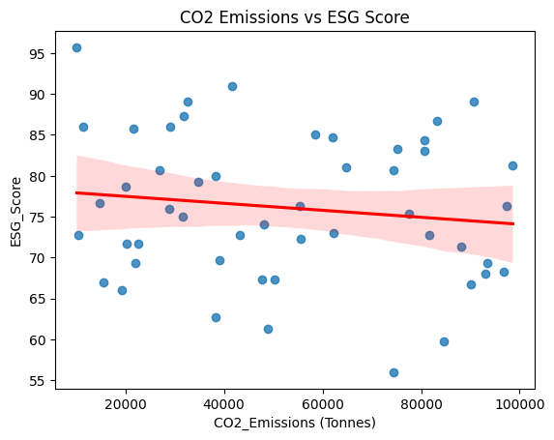
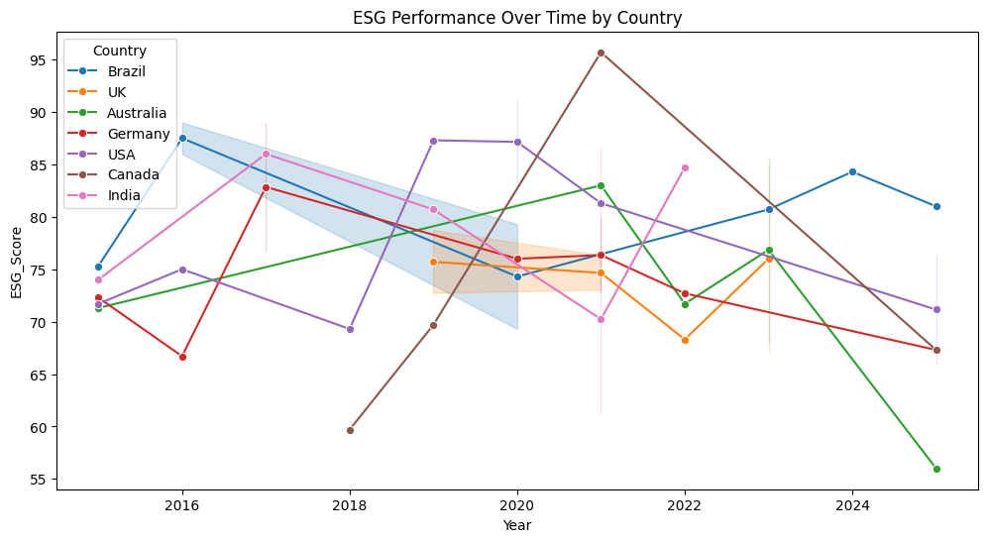

Slide 12
Challenges and Solutions
Challenge: Handling missing data and diverse formats.
Solution: Implemented advanced imputation techniques and unified formats.

Slide 13
Conclusion
Value Added: Improved ESG analysis accuracy by 25%.
Skills Gained: Proficiency in Python, Power BI, and storytelling through data.

Slide 14
Thank You
Contact Info: ajaypatel006may@gmail.com
Call-to-Action: Let’s connect on LinkedIn!

