Slide 1



Study of Zodiac Sign
&
Personality Traits
RESEARCH PAPER
TEAM MEMBERS
AMOL MAHADGUT
EKNATH MARKE
PARTH PATIL
AJAYRAJ PASI
ARYAN MISHRA
ABSTRACT
INTRODUCTION
MATERIAL & METHODS
PROCEDURE
CONCLUSION
REFERENCE

Slide 2
RESEARCH PAPER
TEAM MEMBERS
AMOL MAHADGUT
EKNATH MARKE
PARTH PATIL
AJAYRAJ PASI
ARYAN MISHRA
Study of Zodiac Sign
&
Personality Traits
ABSTRACT
INTRODUCTION
MATERIAL & METHODS
PROCEDURE
CONCLUSION
REFERENCE
Is it accurate ?

Slide 3
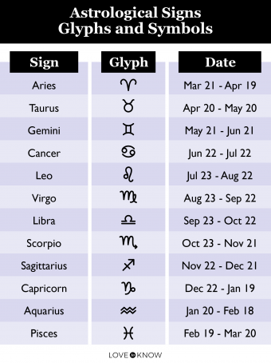
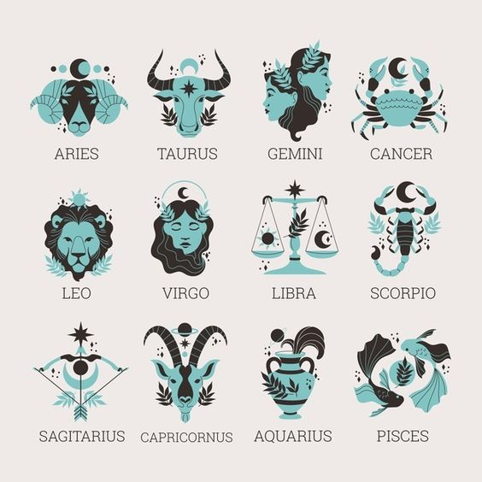
ABSTRACT
INTRODUCTION
MATERIAL & METHODS
PROCEDURE
CONCLUSION
REFERENCE
Study of Zodiac Sign
&
Personality Traits
To study relationship between Zodiac Sign and personality trait of an individual
Collected data through survey
Worked on the collected data accordingly
Analysis is being done
Result is being concluded
Is it accurate ?

Slide 4
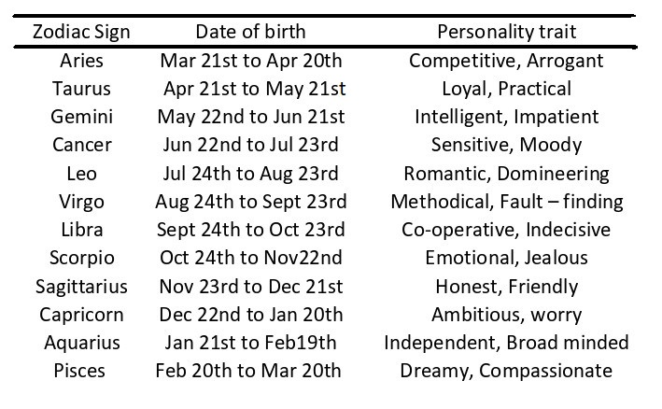
ABSTRACT
INTRODUCTION
MATERIAL & METHODS
PROCEDURE
CONCLUSION
REFERENCE
It is Astrology
It is based on Sun and Moon rotation
Birthdate is the key for individuals Zodiac Sign
It talks about an individual's Personality
Zodiac is divided within specific dates
Is it accurate ?

Slide 5
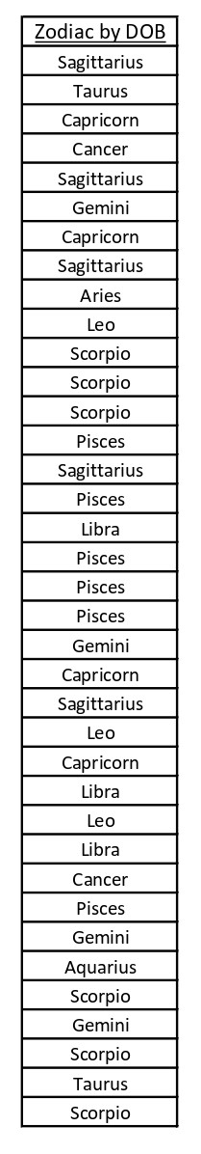
ABSTRACT
INTRODUCTION
PROCEDURE
CONCLUSION
REFERENCE
MATERIAL & METHODS
Data required:
Date of birth
Personality trait
Method to Follow:
Survey through Google form
Zodiac from Birthdate
Graph plotting
Zodiac from personality trait

Slide 6
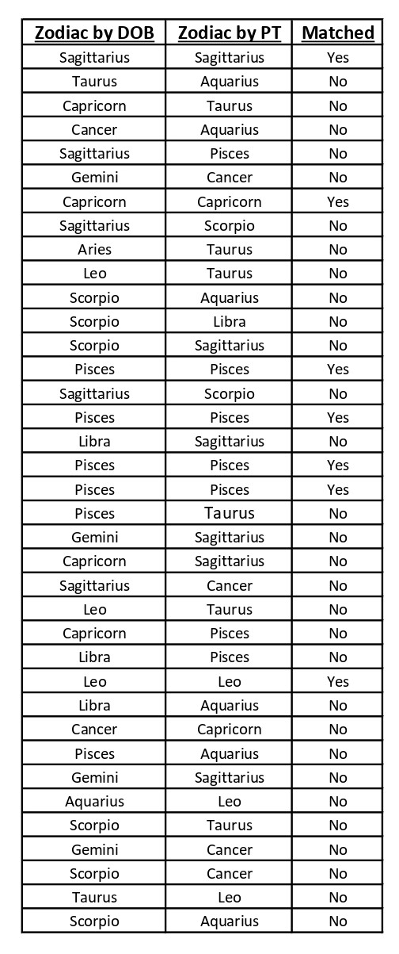
ABSTRACT
INTRODUCTION
MATERIAL & METHODS
CONCLUSION
REFERENCE
PROCEDURE
Analysis 1:
Find Zodiac sign using Date of birth

Slide 7
ABSTRACT
INTRODUCTION
MATERIAL & METHODS
CONCLUSION
REFERENCE
PROCEDURE
Analysis 2:
Find Zodiac sign using Personality Trait
Matched | Total
No | 30
Yes | 7
Grand Total | 37

Slide 8
ABSTRACT
INTRODUCTION
MATERIAL & METHODS
PROCEDURE
REFERENCE
CONCLUSION
Calculating overall accuracy
Matched | Total
No | 30
Yes | 7
Grand Total | 37
Conclusion
Accuracy of the zodiac sign for predicting the personality of a particular person correctly is 19 %

Slide 9
ABSTRACT
INTRODUCTION
MATERIAL & METHODS
PROCEDURE
CONCLUSION
REFERENCE
[1] Dr. Harbhajan Bansal Professor, HSB, GJUST, Hisar Ms. Preeti Mittal Research Scholar, HSB, GJUST, Hisar (August, 2016) The influence of sun signs on apparel buying behaviour – an empirical analysis
[2] J. Mayo , O. White & H. J. Eysenck (1978) An Empirical Study of the Relation between Astrological Factors and Personality, The Journal of Social Psychology, 105:2, 229-236, DOI: 10.1080/00224545.1978.9924119
[3] Psychological Reports, 2006,98,602-607. ASTROLOGICAL SIGNS AND PERSONALITY IN KUWAITIS AND AMERICANS ' AHMED ABDEL-KHALEK Kuwnit University AND DAVID LESTER The Richard Stockton College of New Jersey
[4] Psychological Reporfs, 1999, 84,541-546 SELF-CONCEPT IN TERMS OF ASTROLOGICAL SUNSIGN TRAITS ' JAN J. F. VAN ROOIJ
[5] Dave Clarke , Toos Gabriels & Joan Barnes (1996) Astrological Signs as Determinants of Extroversion and Emotionality: An Empirical Study, The Journal of Psychology: Interdisciplinary and Applied, 130:2, 131-140, DOI: 10.1080/00223980.1996.9914995
[6] Astrology: Its Influence on Consumers' Buying Patterns and Consumers' Evaluations of Products and Services Hyokjin K wak, University of Georgia Anupam Jaju, University of Georgia George M. Zinkhan, University of Georgia
Matched | Total
No | 30
Yes | 7
Grand Total | 37

Slide 10
ABSTRACT
INTRODUCTION
MATERIAL & METHODS
PROCEDURE
CONCLUSION
REFERENCE
[1] Dr. Harbhajan Bansal Professor, HSB, GJUST, Hisar Ms. Preeti Mittal Research Scholar, HSB, GJUST, Hisar (August, 2016) The influence of sun signs on apparel buying behaviour – an empirical analysis
[2] J. Mayo , O. White & H. J. Eysenck (1978) An Empirical Study of the Relation between Astrological Factors and Personality, The Journal of Social Psychology, 105:2, 229-236, DOI: 10.1080/00224545.1978.9924119
[3] Psychological Reports, 2006,98,602-607. ASTROLOGICAL SIGNS AND PERSONALITY IN KUWAITIS AND AMERICANS ' AHMED ABDEL-KHALEK Kuwnit University AND DAVID LESTER The Richard Stockton College of New Jersey
[4] Psychological Reporfs, 1999, 84,541-546 SELF-CONCEPT IN TERMS OF ASTROLOGICAL SUNSIGN TRAITS ' JAN J. F. VAN ROOIJ
[5] Dave Clarke , Toos Gabriels & Joan Barnes (1996) Astrological Signs as Determinants of Extroversion and Emotionality: An Empirical Study, The Journal of Psychology: Interdisciplinary and Applied, 130:2, 131-140, DOI: 10.1080/00223980.1996.9914995
[6] Astrology: Its Influence on Consumers' Buying Patterns and Consumers' Evaluations of Products and Services Hyokjin K wak, University of Georgia Anupam Jaju, University of Georgia George M. Zinkhan, University of Georgia
Thank You!

