Slide 1
AJAY RAJU KALIDINDI
-Final Project
3/21/2024 Annual Review

Slide 2
PROJECT TILE :
KEY-LOGGER SECURITY
- A keylogger is a form of malware or hardware that keeps track of and records your keystrokes as you type. It takes the information and sends it to a hacker using a command-and-control (C&C) server.

Slide 3

Key-logger & security :
- Keylogger: A keylogger is a type of software or hardware that records every keystroke made on a computer or device, often without the user's knowledge or consent. Also known as keyboard capturing or keystroke logging.
- Security: Security refers to the measures
taken to protecta computer system, network, or
sensitive information from unauthorized
access, use, disclosure, disruption, modificat
-ion, or destruction. This includes protection
against malware, viruses, hacking, phishing, and other types of cyber
threats.

Slide 4


AGENDA
PROBLEM STATEMENT
PROJECT OVERVIEW
WHO ARE THE END USER
SOLUTION & ITS VALUE
MODELLING
RESULST
PROJECT LINK
3/21/2024 Annual Review

Slide 5

PROBLEM STATEMENT
- The increasing prevalente of keyloggers poses a significant threat to digital security, compromising the confidentiality and integrity of sensitive information. Despite advancements in cybersecurity, many individuals and organizations remain vulnerable to these covert tools, which can capture keystrokes to steal passwords, financial information, and confidential data.
- This project aims to address the critical need for effective detection and prevention methods against keyloggers. It will explore the current landscape of keylogger technology, evaluate existing security measures, and develop innovative solutions to enhance protection against these threats. By doing so, the project seeks to mitigate the risks associated with keyloggers, safeguard personal and organizational data, and promote a secure digital environment.

Slide 6

PROJECT OVERVIEW
- Imagine delving into the realm of cybersecurity by crafting a cutting-edge Python keylogger enriched with a sleek graphical interface using tkinter. This project embarks on a journey to blend the art of key press monitoring with the science of user-friendly design, culminating in a dynamic tool that captures keystrokes with precision and presents them in a visually engaging format
- By harmonizing technical prowess with aesthetic appeal, this endeavor not only enhances data logging efficiency but also elevates the user experience, offering a novel perspective on the intersection of functionality and style in software development

Slide 7
BENEFITS OF KEY-LOGGER
Intrusion Detection: Keyloggers can be used as a part of intrusion detection systems to monitor user activity and detect suspicious behavior
Forensic Analysis: Keyloggers can be valuable tools for digital forensic investigators when analyzing security incidents or investigating cybercrimes
Security Research and Testing: Ethical hackers and security researchers may use keyloggers as part of penetration testing and vulnerability assessments to evaluate the security of systems and applications. By simulating real-world attack scenarios, they can identify weaknesses and recommend mitigations

Slide 8
BENEFITS OF KEY-LOGGER
4. Password Strength Testing: Keyloggers can be used to test the effectiveness of password policies by capturing and analyzing user passwords
5. Insider Threat Detection: Keyloggers can assist in detecting insider threats by monitoring employee activity and identifying suspicious behavior, such as unauthorized access to sensitive information or attempts to exfiltrate data

Slide 9

WHO ARE THE END USERS?
- The end users of this project could include cybersecurity professionals, software developers, ethical hackers, and individuals seeking to monitor and log keystrokes for security or productivity purposes.
- Additionally, students or researchers interested in cybersecurity concepts and Python programming may also find this project beneficial for learning and experimentation. The user-friendly GUI aspect could attract individuals who prefer a visually appealing and intuitive interface for interacting with the keylogging tool.

Slide 10
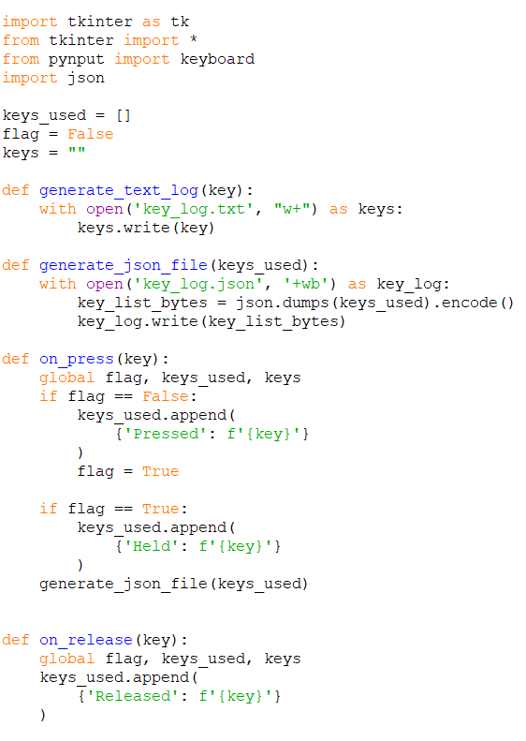
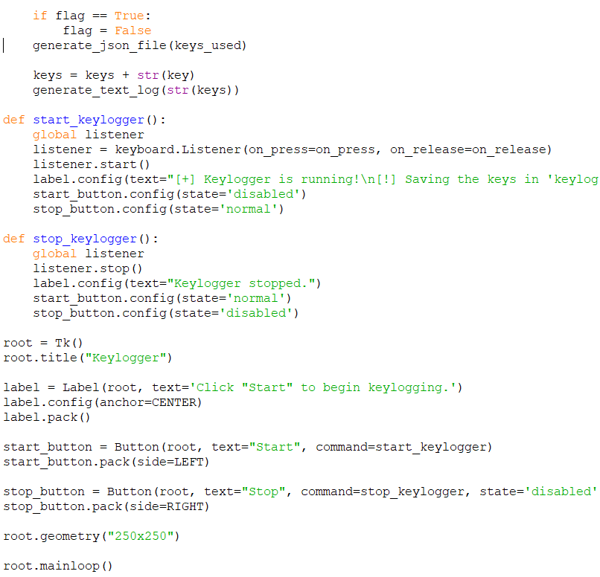
YOUR SOLUTION AND ITS VALUE PROPOSITION
Developing the solution for key-logger using pyinput and isonlib

Slide 11
THE WOW IN YOUR SOLUTION
- The wow factor in Python keylogger project solution lies in the seamless integration of advanced keylogging functionality with a visually appealing GUI interface. By combining the technical sophistication of key press monitoring with the user-friendly design of `tkinter', not only excels in data capture accuracy but also enhances the overall user experience.
- This harmonious blend of powerful functionality and elegant presentation sets your keylogger solution apart, offering a compelling and innovative approach to keystroke logging in the realm of cybersecurity and software development.
3/21/2024 Annual Review
11

Slide 12
MODELLING :
Threat modelling : Threat modeling involves identifying and communicating information about the threats that may impact a particular system or network. Security threat modeling enables an IT team to understand the nature of threats, as well as how they may impact the network
Attack chain analysis : The cyber-attack chain (also referred to as the cyber kill chain) is a way to understand the sequence of events involved in an external attack on an organization's IT environment.
Behavioral modelling : Behavioral Model is specially designed to make us understand behavior and factors that influence behavior of a System. Behavior of a system is explained and represented with the help of a diagram. This diagram is known as State Transition Diagram. It is a collection of states and events. It usually describes overall states that a system can have and events which are responsible for a change in state of a system.
Risk assessment : A risk assessment is a systematic process that helps identify, analyze, and control hazards and risks in a situation or place. The goal is to determine what measures should be implemented to mitigate those risks, and to prioritize them based on their likelihood and impact.
12

Slide 13
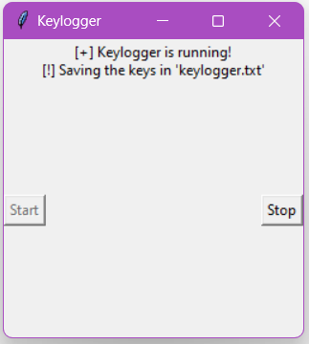
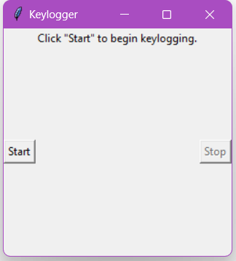
RESULTS :
- The result of a keylogger program typically involves capturing and logging keystrokes entered by a user on a keyboard. These logged keystrokes can then be used for various purposes, depending on the intent of the keylogger user. The covert nature of keyloggers allows them to capture sensitive information, including passwords, personal messages, and financial details, without the user's knowledge or consent. This poses serious risks to individuals, organizations, and society at large. including identity theft, financial fraud, and unauthorized access to confidential data.
13

Slide 14
PROJECT LINK :
https://github.com/Ajayraju7/keylogger_project.git

