Slide 1
RaastaSense
Transforming Road Safety Through Intelligence
Team: NXT-waVE (IIT Madras Road Safety Hackathon)
AJAY RATHOD | ANIMESH BHANARKAR

Slide 2
THE NATIONAL ROAD SAFETY CRISIS
🚨 Critical National Statistics
• 1.5 Lakhs+ Annual Fatalities Indian corridors average over 400 deaths per day. • ₹5.8 Lakh Crores Economic Loss Accidents deplete ~3% of India's annual GDP. • 50%+ Preventable Deaths Delayed Golden Hour response & static navigation.
⚠️ Core Infrastructure Gaps
• Responders blind to real-time satellite coordinates & golden hour locks. • Civic reports lacking public audit trails or visual pothole classification. • Driving violations static across municipal jurisdictions with no localized counselor.

Slide 3
THE RAASTASENSE SOLUTION
🗺️ GIS Live Map HUD
Cyberslate interactive mapping featuring active incident reporting overlays, speedometers, and live coordinate locks.
🛡️ AI Guardian & Legal Localizer
Custom 10-language localizer with state-specific fine surcharges, legal codes, and interactive driver voice/text counseling console.
🆘 SOS Rescue Hub
Decentralized emergency countdown beacon, golden-hour responder coordination, and pre-routed medical pathways.

Slide 4
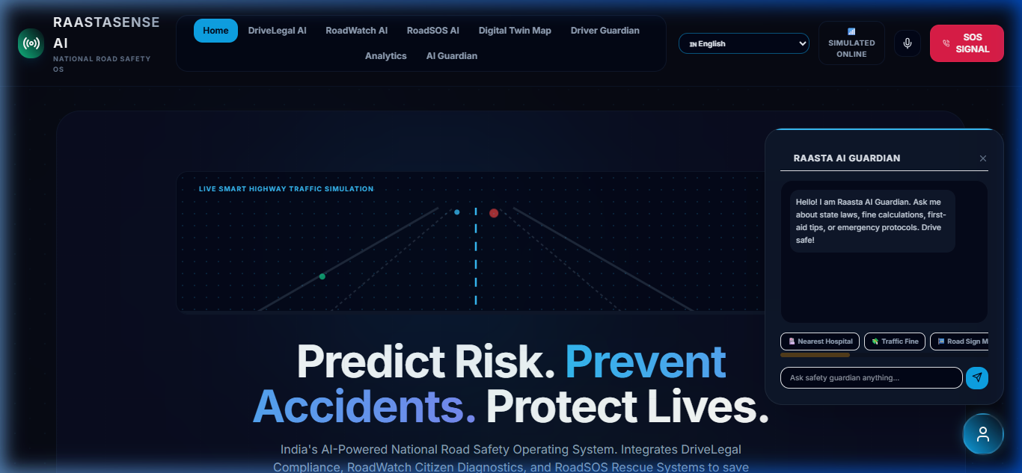
VISUAL HUD: AI SAFETY COCKPIT & LIVE GUARDIAN
Real-time driver cockpit containing telemetry simulators, speedometer, and the pulsing AI Guardian mascot console with integrated 10-language localizer speech options.

Slide 5
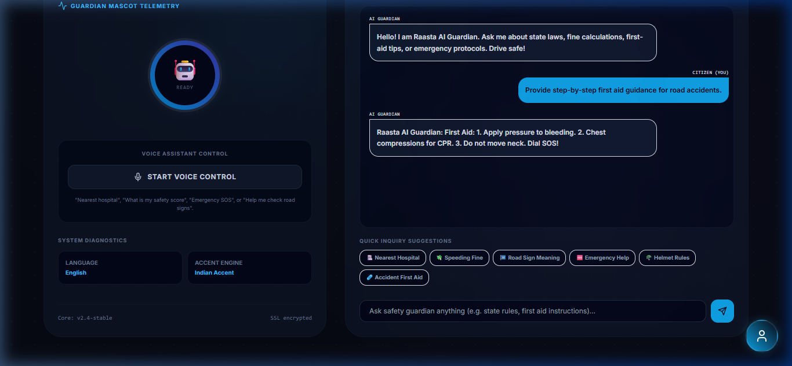
VISUAL HUD: AI GUARDIAN DIALOGUE SYSTEM
Conversational co-pilot interface showing simulated safety counselor recommendations, legal penalty index search, and speech synthesis feedback stream.

Slide 6
VISUAL HUD: AI SAFETY COCKPIT & LIVE GUARDIAN
Real-time driver cockpit containing telemetry simulators, speedometer, and the pulsing AI Guardian mascot console with integrated 10-language localizer speech options.

Slide 7
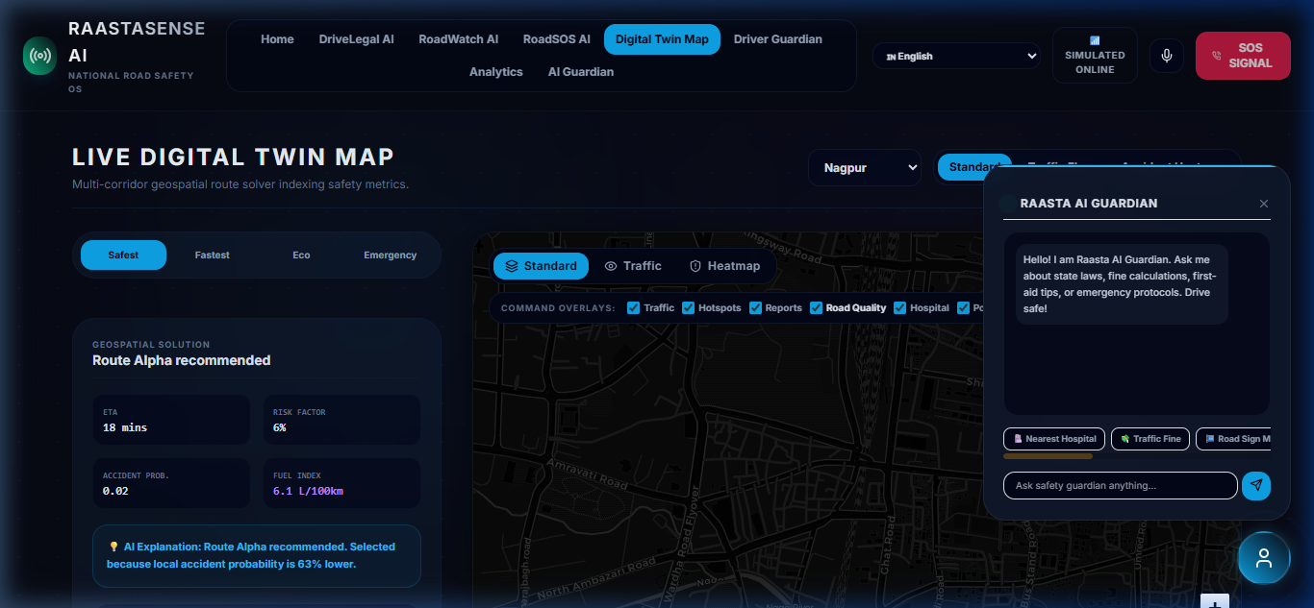
VISUAL HUD: DIGITAL TWIN MAPPING ENGINE
Cyberslate GIS Interface demonstrating safest, fastest, eco-friendly, and emergency vehicle routing paths, dynamic coordinates telemetry, and active incident report layers.

Slide 8
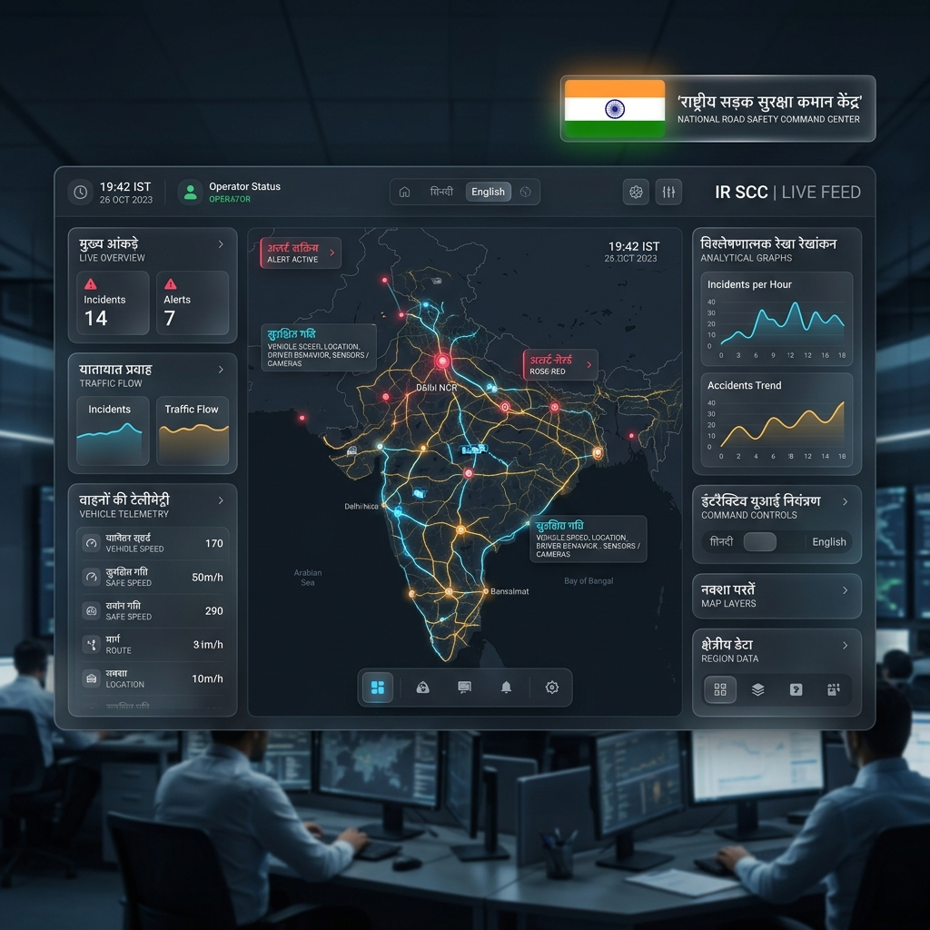
VISUAL HUD: AI SAFETY COCKPIT & LIVE GUARDIAN
Real-time driver cockpit containing telemetry simulators, speedometer, and the pulsing AI Guardian mascot console with integrated 10-language localizer speech options.

Slide 9
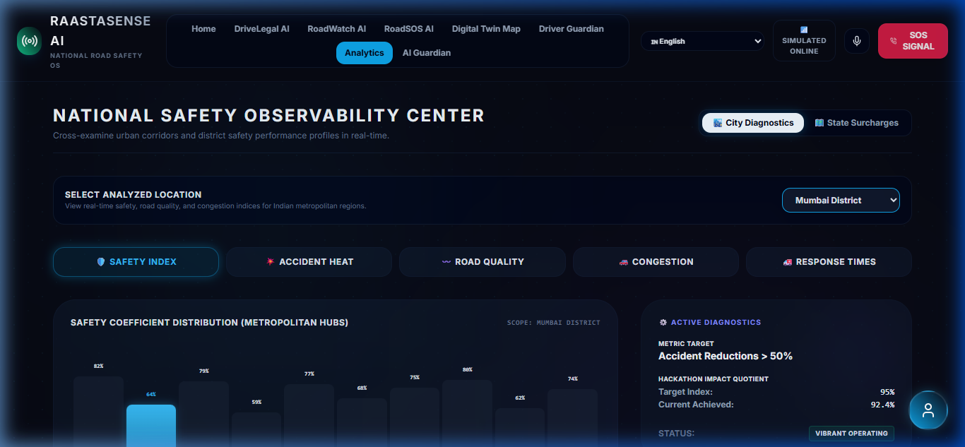
VISUAL HUD: OBSERVABILITY & 10-CITY ANALYTICS
Advanced telemetry dashboard with chronological NoSQL live stream, and dynamic comparative metrics for Nagpur, Mumbai, Pune, Delhi, Hyderabad, Bangalore, Chennai, Ahmedabad, Kolkata, and Jaipur.

Slide 10
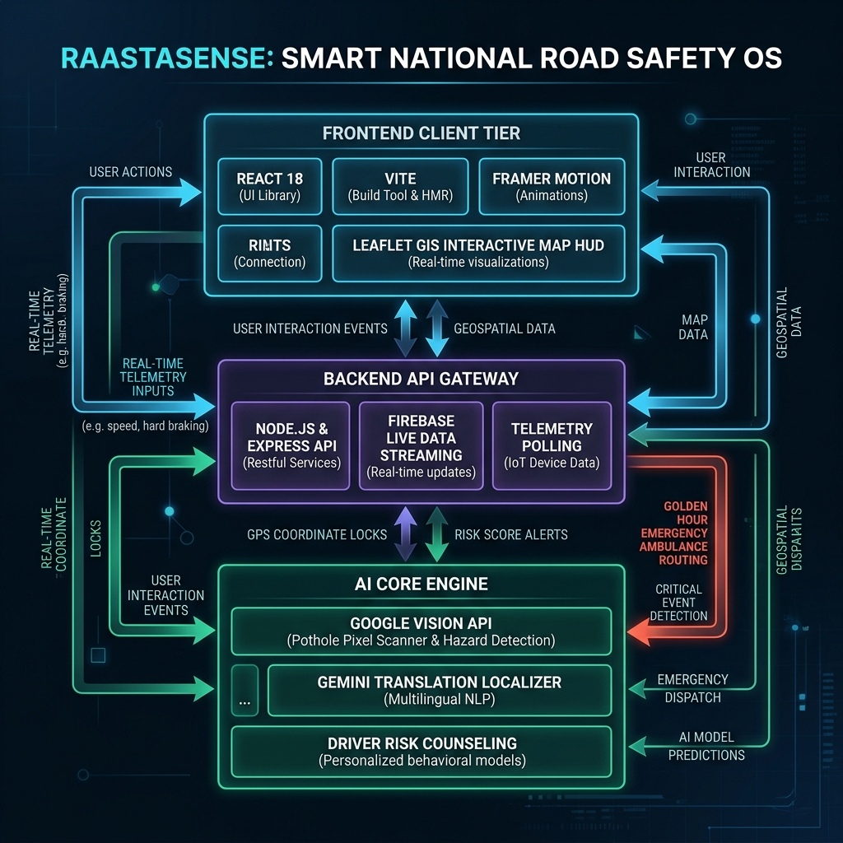
TECHNICAL FLOW & PIPELINE ARCHITECTURE
High-fidelity technology stack showing full-stack Node.js Express connectivity, Leaflet GIS client telemetry interfaces, Google Vision classification, and Firebase sync streams.

Slide 11
VISUAL HUD: DIGITAL TWIN MAPPING ENGINE
Cyberslate GIS Interface demonstrating safest, fastest, eco-friendly, and emergency vehicle routing paths, dynamic coordinates telemetry, and active incident report layers.

Slide 12
INTELLIGENT CORE ENGINE MODULES
🚦 Safe Route Engine (Phase 8 Highlight)
Calculates Fastest, Safest, and Least Incident corridors. Displays Safety Indexes, weather/traffic conditions, and dynamic recommended overlays.
⚖️ AI Guardian Safety Counseling
Monitors driver parameters (fatigue, speed, seatbelt) in real-time. Delivers multilingual voice and text alerts to enforce legal compliance and safe transit.
📸 RoadWatch AI Incident Diagnostics
Citizen hazard submission portals. Features automatic AI-powered image diagnosis with calculated confidence matrices, severity metrics, and direct action protocols.
🆘 RoadSOS Emergency Controller
GPS telemetry tracker locks precise coordinates. Displays immediate emergency dials, trauma center proximities, and custom full-screen alarm dispatch overlay panels.

Slide 13
VISUAL HUD: OBSERVABILITY & 10-CITY ANALYTICS
Advanced telemetry dashboard with chronological NoSQL live stream, and dynamic comparative metrics for Nagpur, Mumbai, Pune, Delhi, Hyderabad, Bangalore, Chennai, Ahmedabad, Kolkata, and Jaipur.

Slide 14
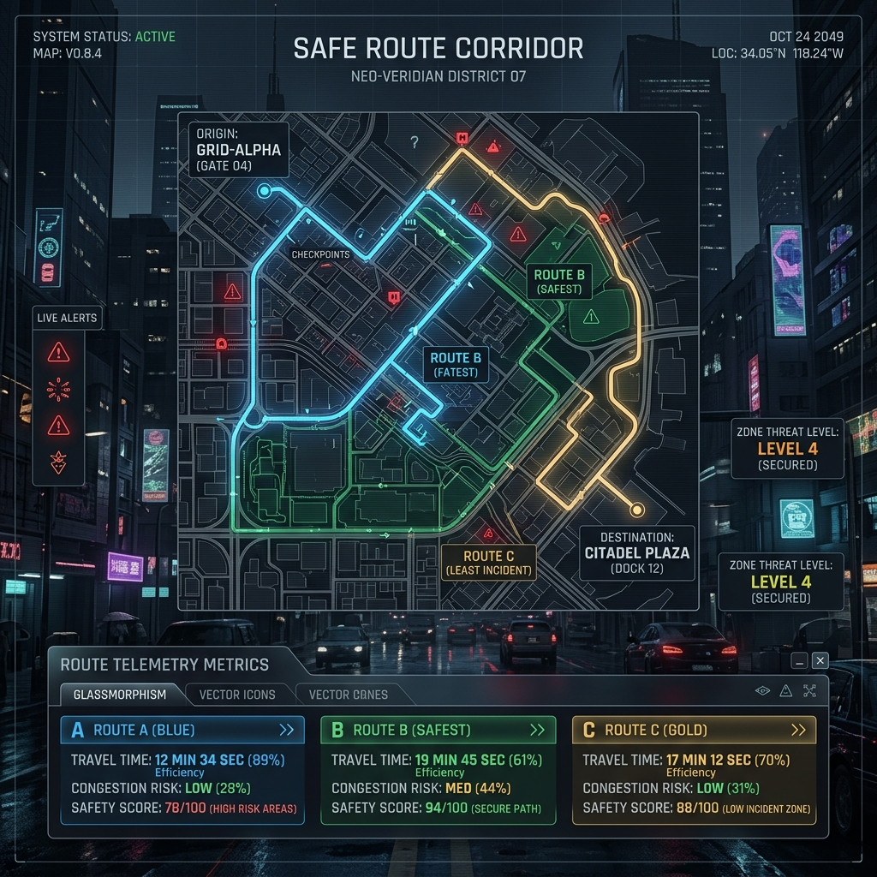
VISUAL HUD: DIGITAL TWIN MAPPING ENGINE
Cyberslate GIS Interface demonstrating safest, fastest, eco-friendly, and emergency vehicle routing paths, dynamic coordinates telemetry, and active incident report layers.

Slide 15
SYSTEM ARCHITECTURE & OBSERVABILITY HUD
⚙️ Full-Stack Pipeline Architecture
• Client Tier: React 18, Vite, Tailwind CSS, Framer Motion, and custom vector SVGs. • Map/GIS Layer: OpenStreetMap integrations, polyline vector algorithms, dynamic marker overlays. • Backend & Database: Node.js, Express, mock-telemetry sensor algorithms. • AI Core: Google Vision API pothole pixel scanner & safety chatbot fallbacks.
📊 10-City Analytics & Observability HUD
Dynamic comparison console tracking safety scores, accident rates, road quality, and response times for 10 major metropolitan districts.

Slide 16
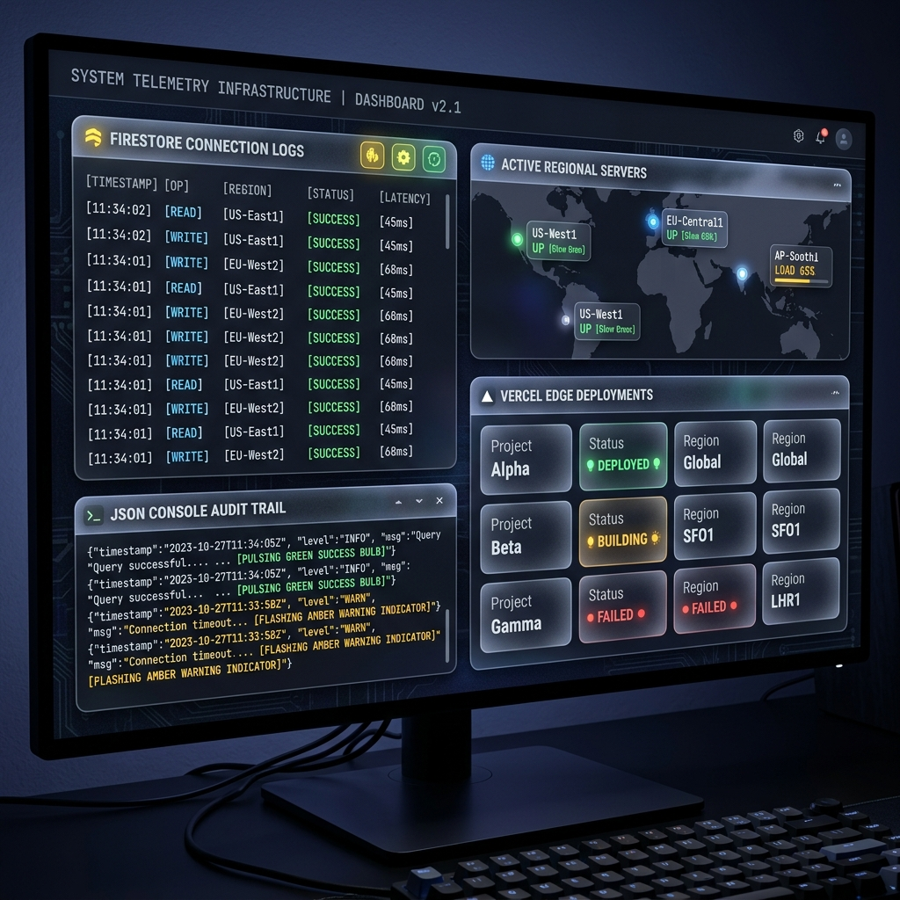
VISUAL HUD: OBSERVABILITY & 10-CITY ANALYTICS
Advanced telemetry dashboard with chronological NoSQL live stream, and dynamic comparative metrics for Nagpur, Mumbai, Pune, Delhi, Hyderabad, Bangalore, Chennai, Ahmedabad, Kolkata, and Jaipur.

Slide 17
MEASURED SOCIETAL & CIVIC IMPACT
🚲 Citizens
Safe routing guidelines keep travelers out of congestion/danger zones. Regional DriveLegal counselor builds critical legal self-awareness.
👮 Municipalities
RoadWatch community dashboards create transparency in public infrastructure spending, pothole repair trails, and automated violation reporting.
🚑 Responders
RoadSOS beacon coordinates lock directly on responder navigation units, slicing dispatch delays and securing the critical Golden Hour rescue frame.

Slide 18
THANK YOU!
Join us in transforming Indian transit corridors, one life at a time.
🌐 Interactive Live Demo: https://raastasense.vercel.app 💻 Open-Source Codebase: https://github.com/Ajayrathod04/RaastaSense

