Slide 1
Yeshwantrao Chavan College of Engineering
Department of Electronics Engineering (VLSI Design & Technology)
PixelFlow: A Low-Latency Feed-Forward Architecture for Image Processing
Final Year Major Project Presentation
Project Group Members:
1. Ajay Rathod
2. Harshita Uikey
3. Varad Vyawhare
4. Sujal Chinche

Slide 2
How Latency Reduction is Achieved (Beginner Explanation)
Traditional Pixel-by-Pixel Architecture:
• Reads 1 pixel per clock cycle.
• Must store (K-1)*N pixels in lumped line buffers before producing 1st output pixel.
• For N=512, initial latency is 1,024 clock cycles!
Proposed Row-by-Row Systolic Architecture:
• Reads 1 ENTIRE ROW of N pixels per clock cycle.
• Direct-Form RConv computes row convolution in 1 cycle.
• Transpose-Form CConv cascades inter-stage line delays.
• First complete output row appears at Cycle 5 regardless of N (up to 509x speedup!).

Slide 3
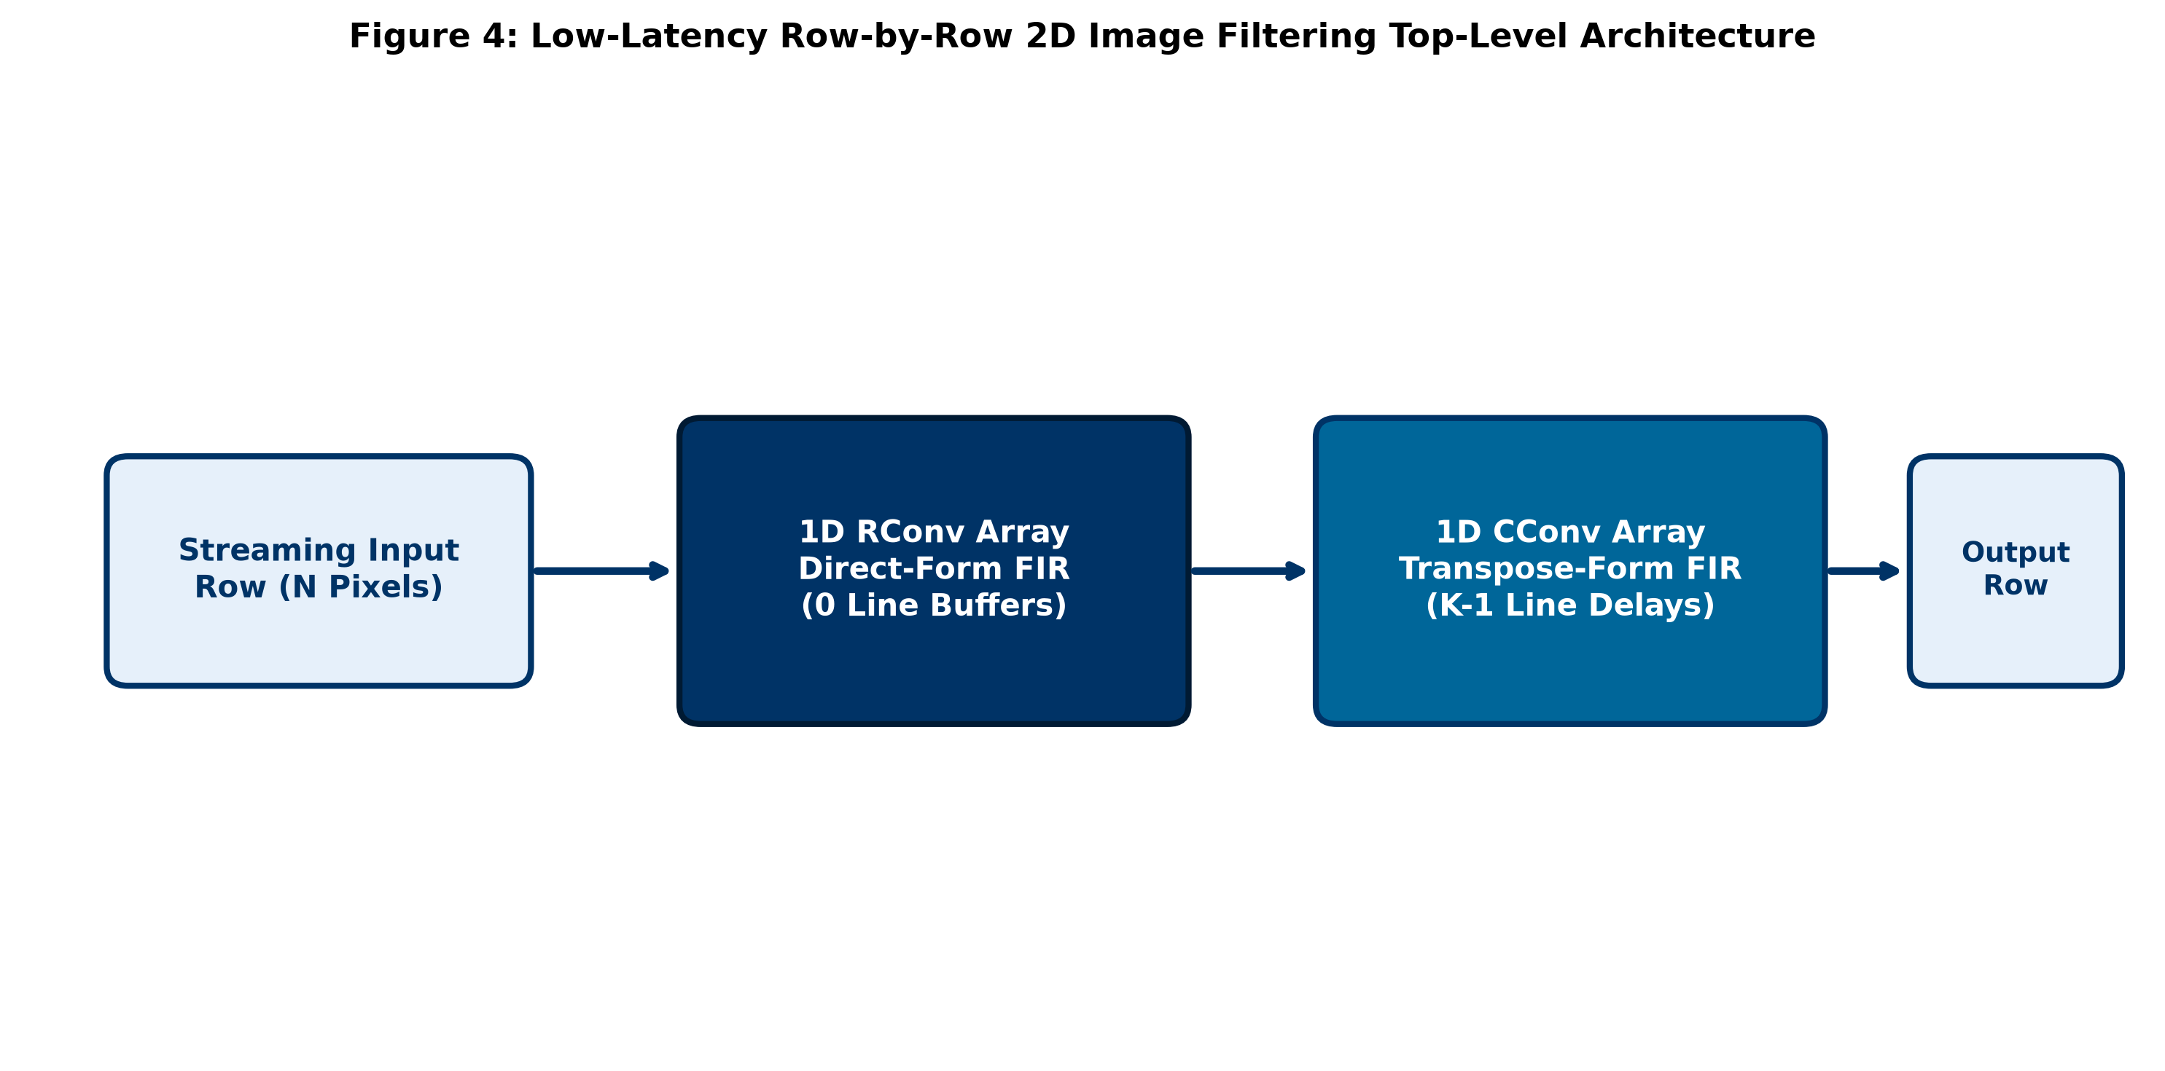
Micro-Architecture (RConv + CConv Systolic Arrays)

Slide 4
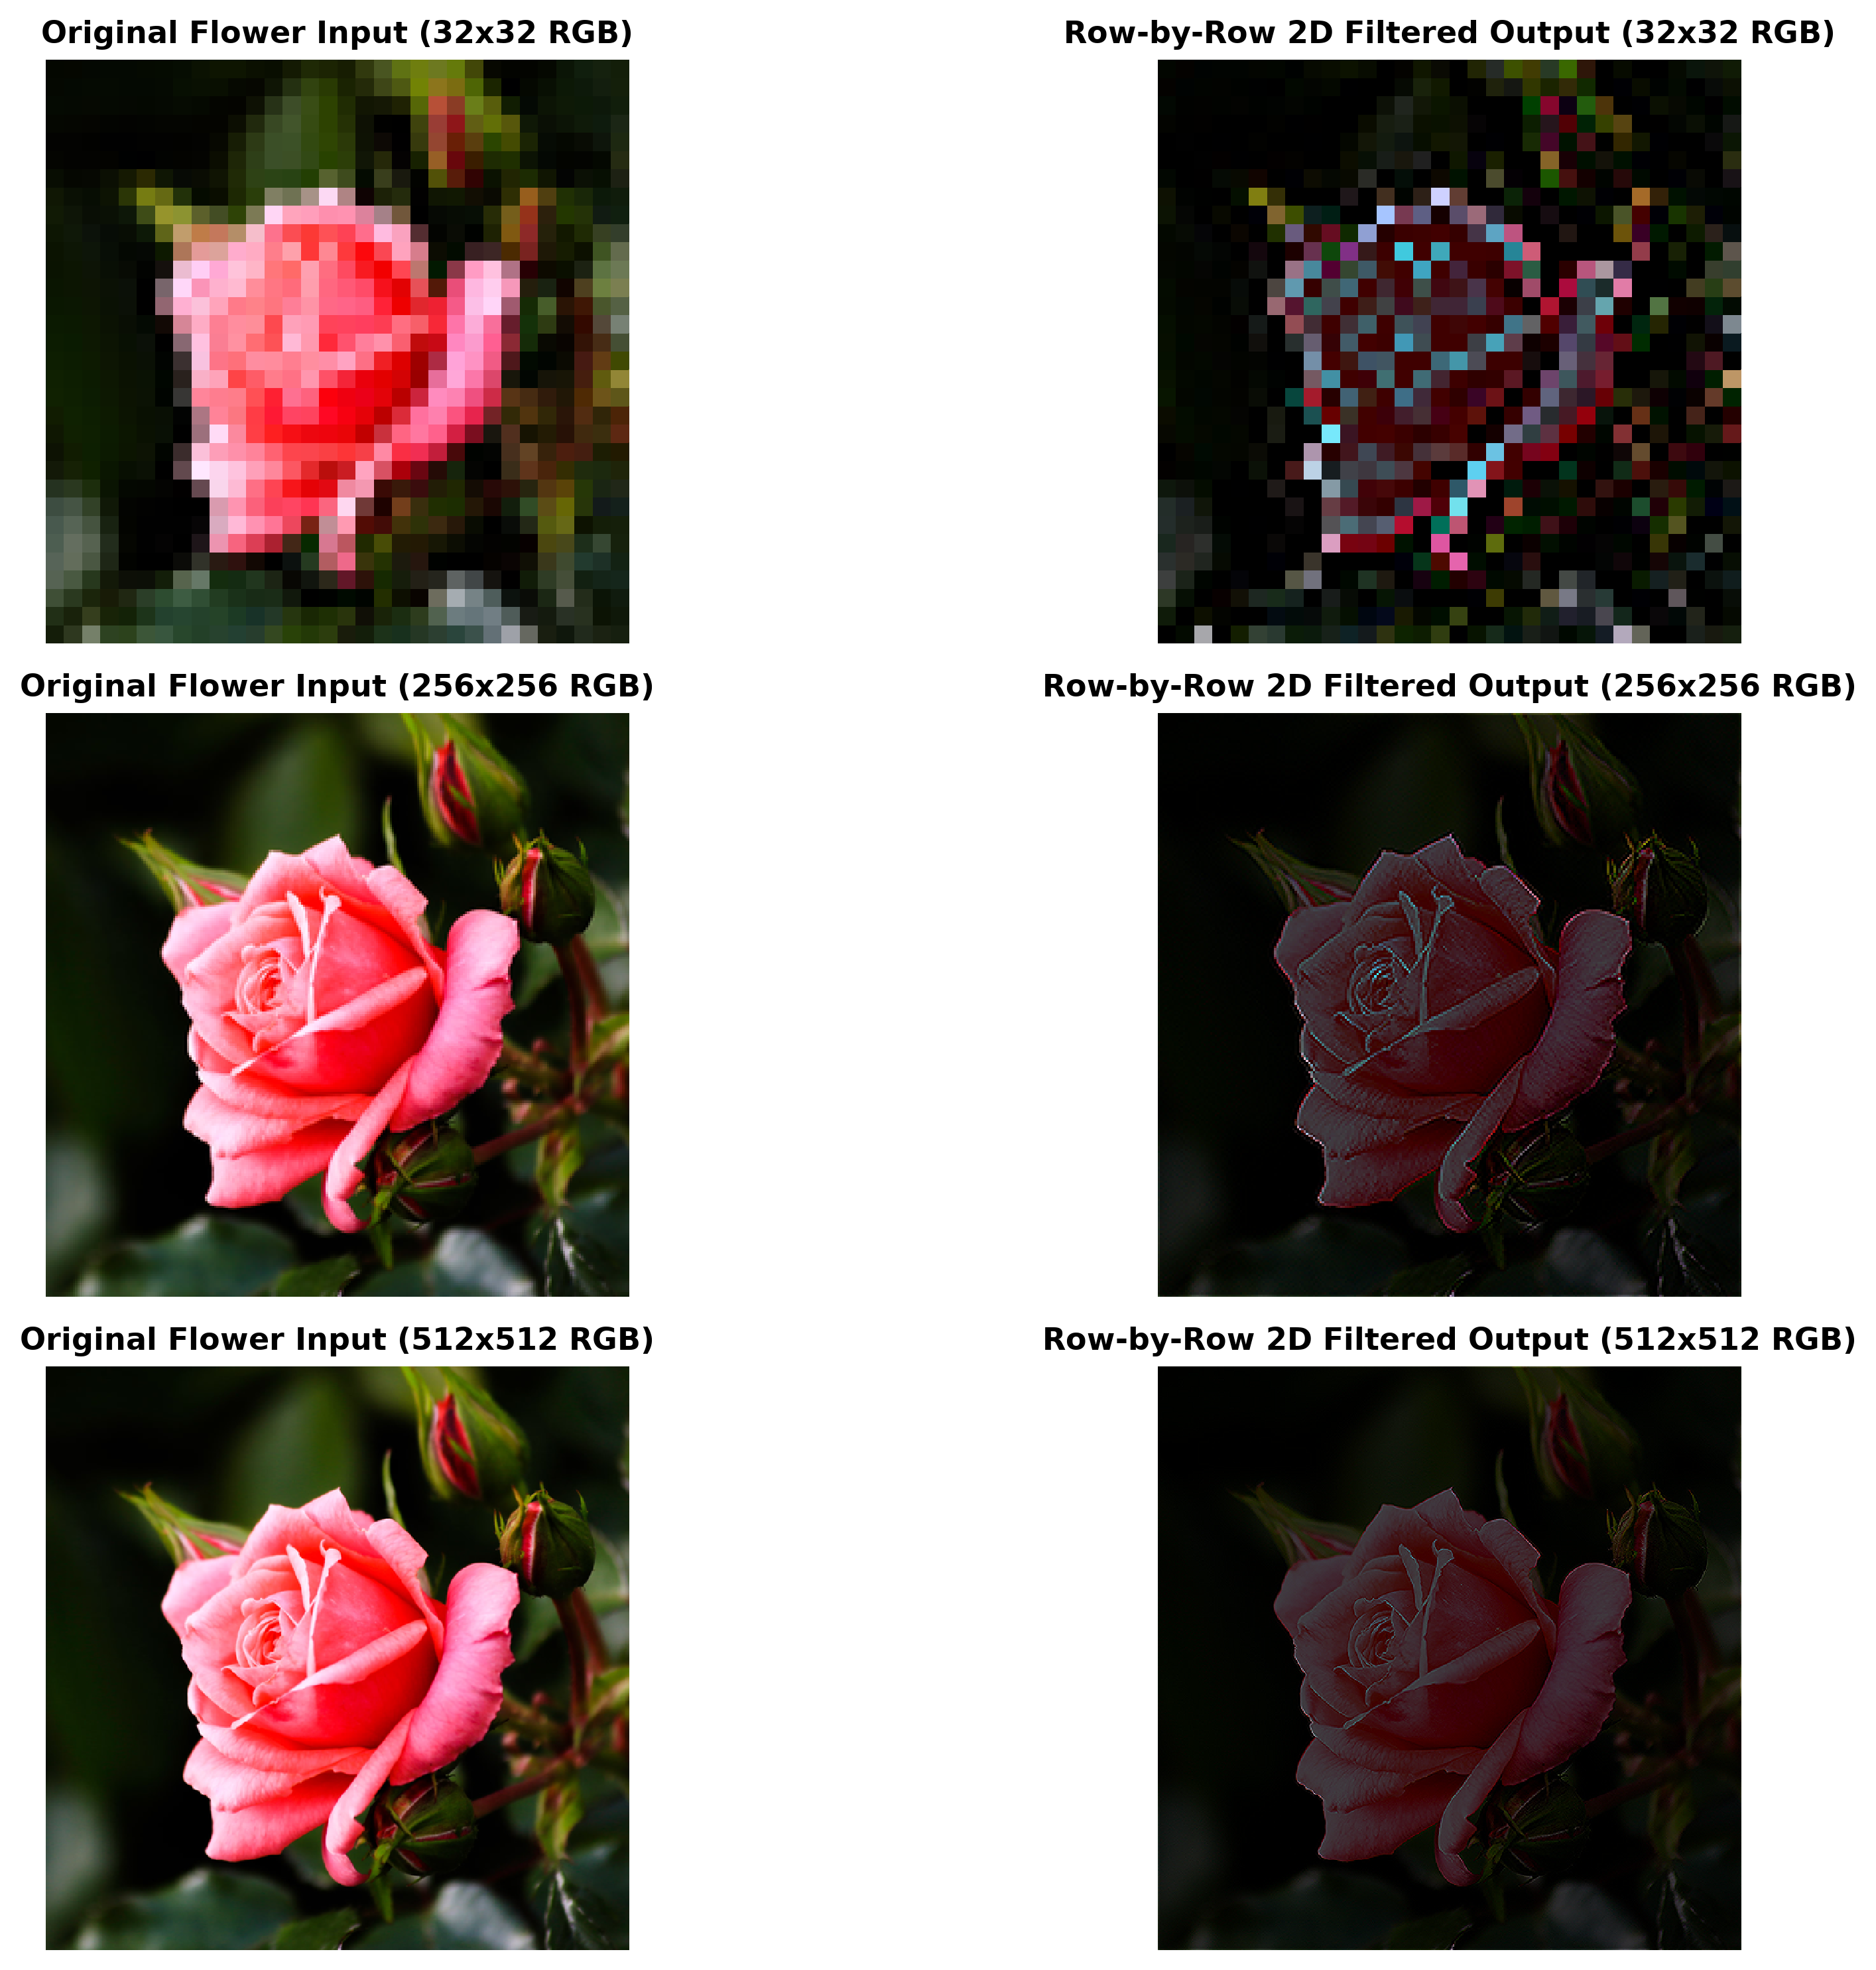
Image 1 Evaluation: Flower ('flower.png')

Slide 5
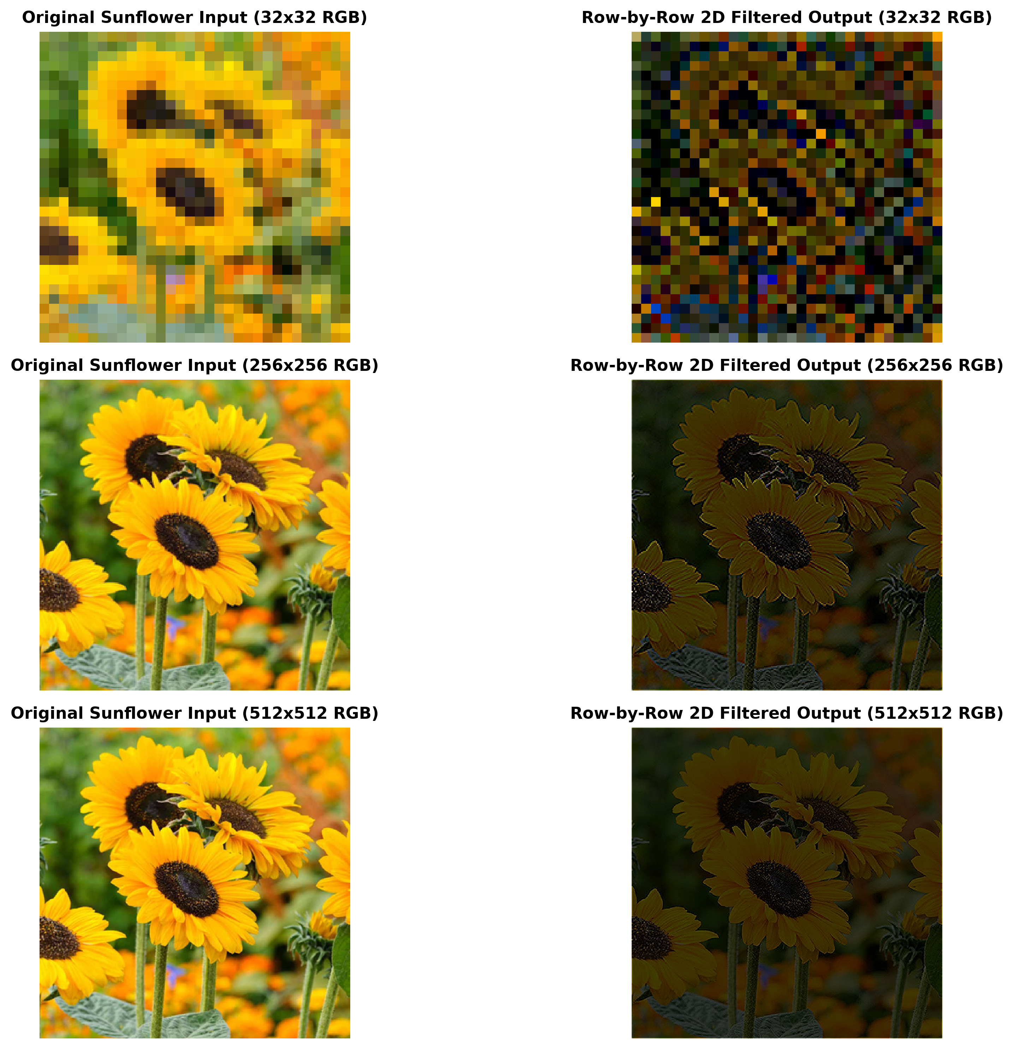
Image 2 Evaluation: Sunflower ('sunflower.png')

Slide 6
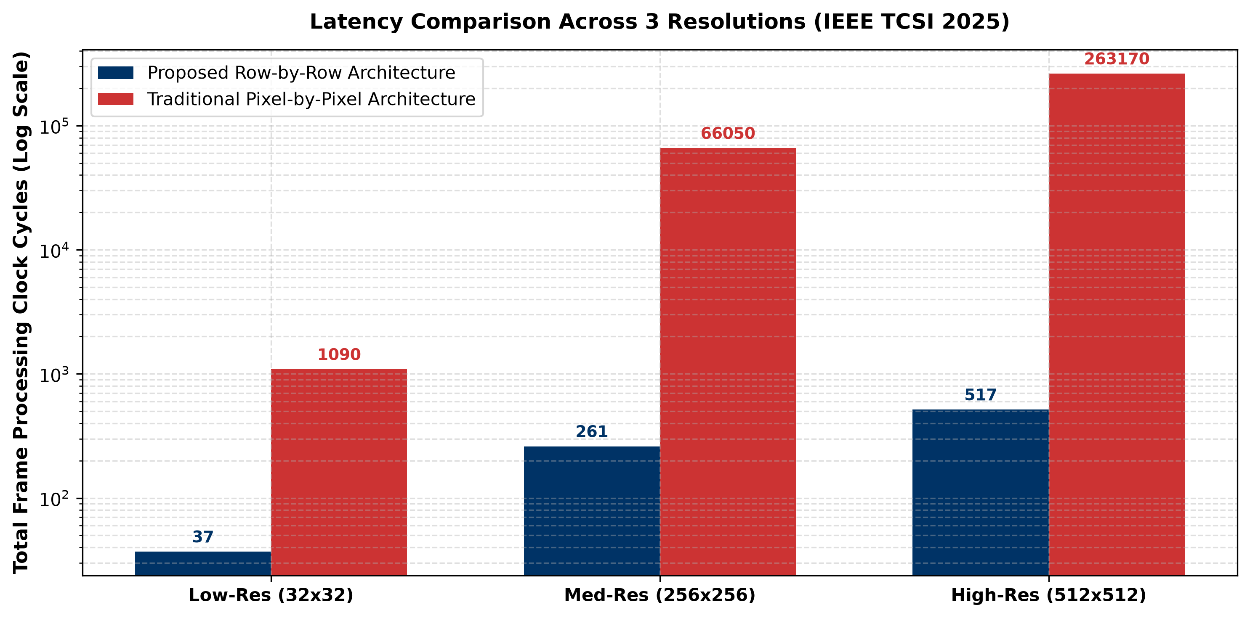
Multi-Resolution Latency Scaling (32x32, 256x256, 512x512)

Slide 7
ModelSim Scripts & Waveform Commands
Dedicated Compilation & Simulation DO Scripts:
• compile.do: Runs vlib, vmap, vlog -sv hdl/*.v (0 Errors check)
• run_sim.do: Executes compile.do -> vsim -onfinish stop -> wave.do -> wave zoomfull
• Combined Command: cd {D:/program files/pixelflow}; do run_sim.do
Key Waveform Commands:
add wave -divider {SECTION}: Adds section divider text
add wave -color {COLOR}: Custom signal colors (Yellow, Red, Green, Lime)
add wave -radix hexadecimal / bus: Displays buses in Hex format
wave zoomfull: Fits simulation timeline from 0 ns to 200 ns

Slide 8
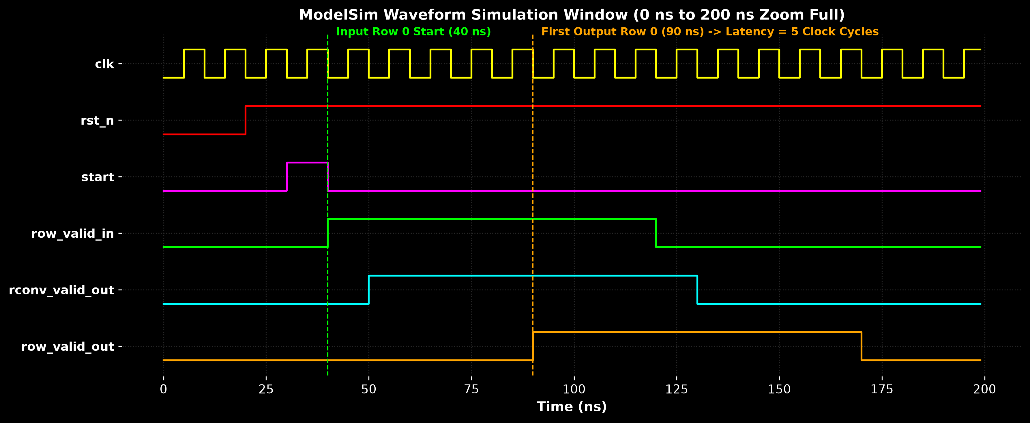
ModelSim Simulation Waveform (0 ns to 200 ns Zoom Full)

Slide 9
Thank You!
Questions & Discussion
Department of Electronics Engineering (VLSI Design & Technology) Yeshwantrao Chavan College of Engineering

