Slide 1
Oolala Cabs: Case Study
Trips to Airport!!

Slide 2
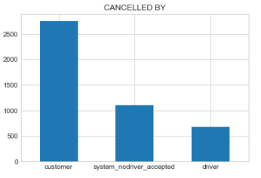
Data Summary/Universe
TYPE | DETAILS
Shape | (20205,11)
Range | 2 Weeks of data available (1st – 14 Jan 2019)
Demographics | 73 Locations (Pickup/Drop)
Total Rides
20205
Successful
77%
Cancelled
23%
Customer
61%
Driver
24%
System
15%

Slide 3
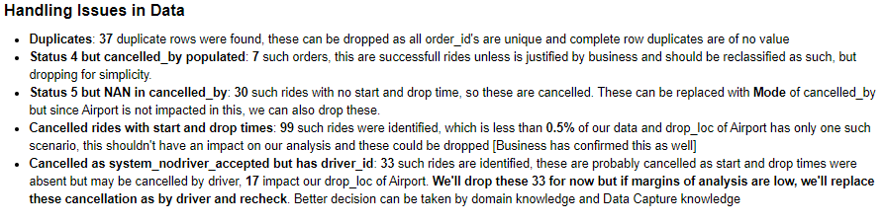
Data Issues
Duplicate Rows Identified
Successful trip, but cancelled_by column populated
Cancelled trip, but cancelled_by has NAN
Cancelled Rides with start or Drop times
Cancelled as system_nodriver_accepted but has driver_id
37
7
30
99
33

Slide 4
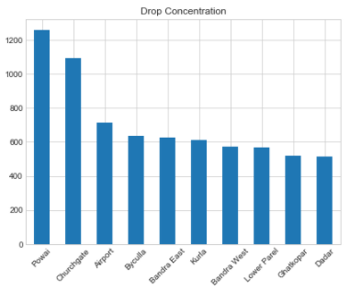
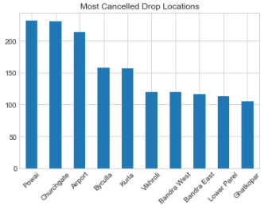
Mystery of Trips to Airport!
Airport is 3rd most in demand in terms of drop locations with more than 35% of requests. It is an important spot for business.
This goes along the lines of demand, more demand projects more cancellations and doesn’t tell us anything.

Slide 5
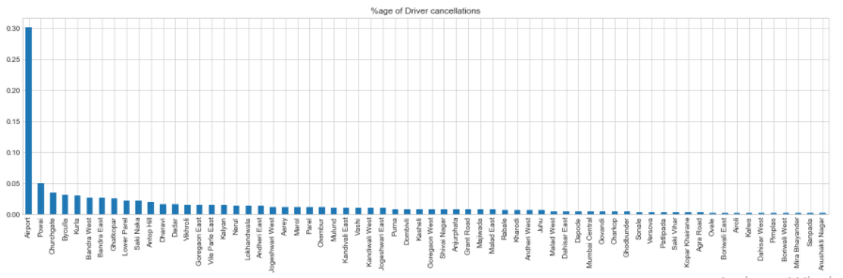
Mystery of Trips to Airport!
We know that of all cancellations, 60% are done by customer. Let’s check which drop locations our Drivers hate
30% of Driver Cancellation happens when drop_loc is Airport and is significantly above than any other location
But it doesn’t conclude if only drivers are cancelling Airport rides!!

Slide 6
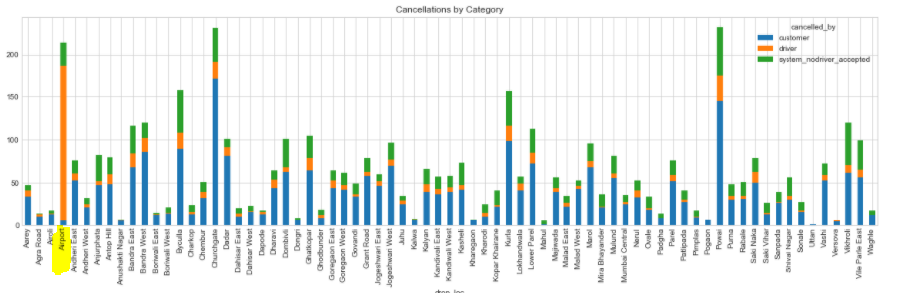
Mystery of Trips to Airport!
We can conclude that Drivers are cancelling trips to Airport and also that this specific location is most disliked by our drivers.

Slide 7
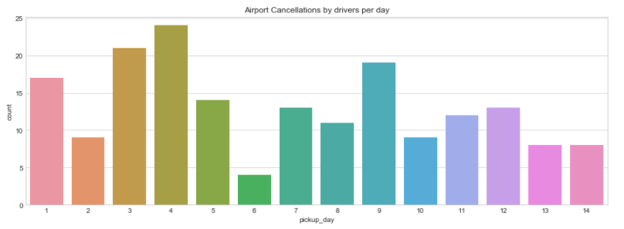
But Why ?
This could have happened due to some unusual (natural) event within 2 weeks of data that we have on route to Airport. (Let’s validate with below graph)
Above hypothesis looks unlikely since cancellations are spread out and isn’t concentrated on any period

Slide 8
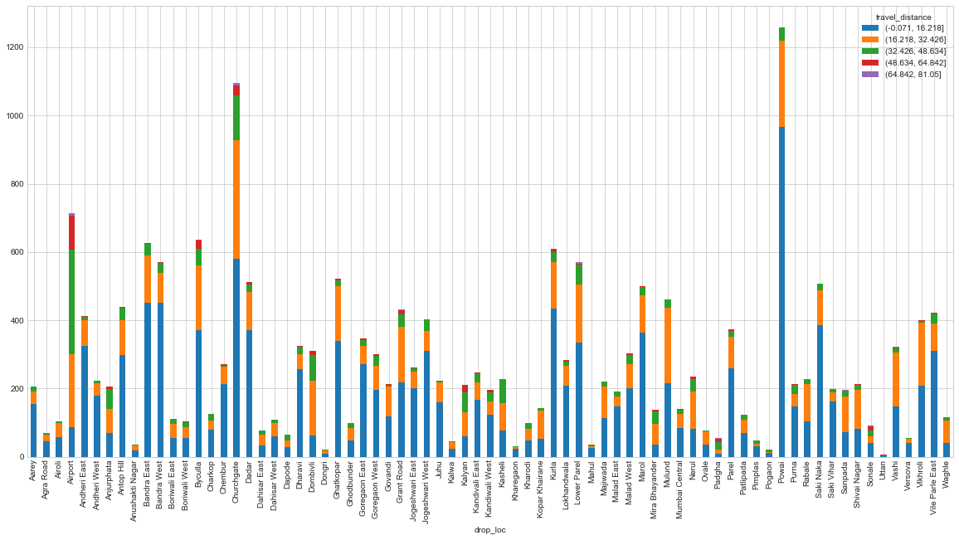
But Why ?
Travel Distance of Trips per Drop_Loc
Above tells us, that for Airport
>85% of trips are of > 16KM
>55% of trips are of > 32KM
Which is way more than for any other drop location
This suggests that drivers are not willing to go for so long trips

Slide 9
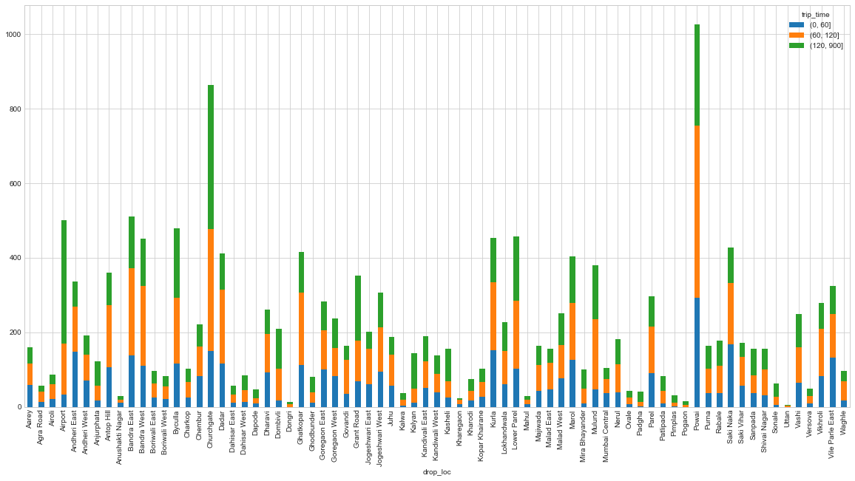
Lets look at past trip time
Journey Time of Trips per Drop_Loc
More than 60% of trips to Airport have taken >2 hr for drivers

Slide 10
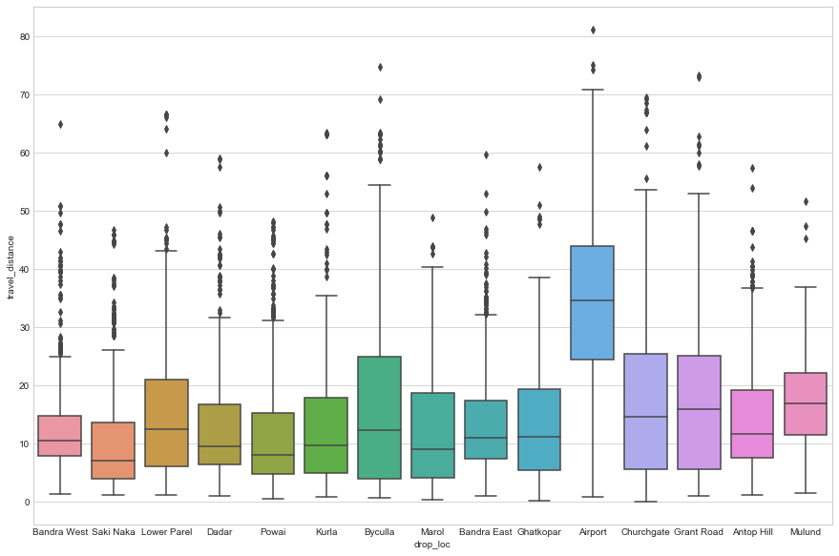
More evidence!
This clearly suggests how different trips to Airport are in terms of Travel Distance as compared to other drop locations
Conclusion:
Trips to Airport are getting cancelled by our Drivers significantly and the reason for their dislike to Airport trips is way more travel distance and journey time experienced in past as compared to other locations

Slide 11
THANK YOU!!!

