Slide 1
Hostel Accommodation Facilitator(HAF)
Group Members-
Abhishek Mishra (41)
Ajaysingh Thakur (43)
Rohit Rathi (65)
Vaibhav Singhania (78)
Yash Mehta (80)
Guided By
Ms. Rina Damdoo

Slide 2
Overview
Introduction
Application
Gap Analysis
Technology
Proposed Implementation
Logic of Implementation
Design
References

Slide 3
Introduction
Problem Definition:
Student after getting admission to his/her preferred college, will be busy in finding best hostel either by visiting the college or through relative but they don’t get adequate information.
Thus our project aims at reducing the tiresome task through an user friendly android app.

Slide 4
Applications of Project
One tap access for students to find Hostel.
Comparison/contrast of facilities
New Students
Existing Hostilities
Provide an alternative to students
Ratings and reviews
Facilitates Hostel Management
To get new admission.
Promote new/existing hostels.

Slide 5
GAP ANAYLYSIS
Why this project ???
Students from different cities
Not familiar with location
Nearest distance from college
People knows about hostel but they don’t facilities provided
Saves Parents and students time

Slide 6
Gap Analysis (Cont.)
Current System:
Just Dial, Google maps only provide contact information and driving information for well known hostel.
Website like trivago, expedia focus on hotel

Slide 7
Gap Analysis (Cont.)
Proposed System:
HAF not only give driving direction but also provides -
Contact information
Security deposit and rent
Fire and security measures
Mess Facilities
Hostel Norms

Slide 8
Gap Analysis (Cont.)
Proposed System:
First Aid
Guest rooms
Sports and Entertainment Facilities

Slide 9
Technology
XML
Java
SQL Lite
TOOLS USED
Eclipse IDE
Android SDK
Eclipse ADT
Google maps API

Slide 10

Proposed Implementation
User Interface for searching hostel and Hostel login for hostel Staff
College hostel Information and list of other hostels available if college hostel is not available
Detailed information of particular hostel on tap
Getting driving direction

Slide 11
Logic of Implementation
Yes
No
Student Registration
Is
College hostel’s room
available
College Hostel Information
Get selected hostel contact details
Other hostel list
Or view on map
Get driving direction
Exit

Slide 12
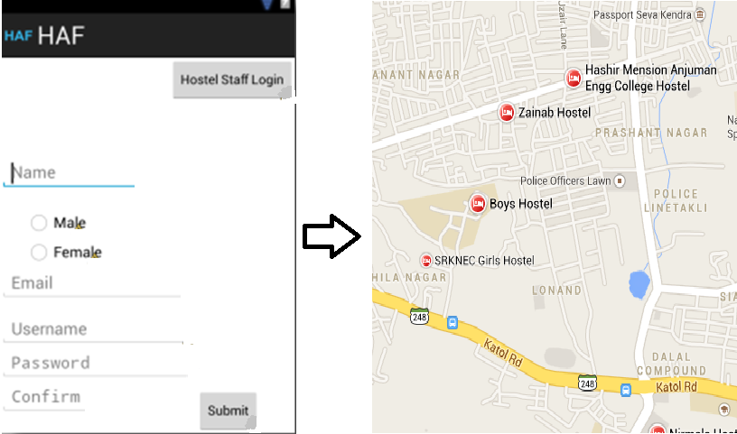
Design

Slide 13
References
Roger Pressman, SOFTWARE ENGINEERING A Practitioner's Approach, New York: McGraw Hill, 2005.
Reto Meier, PROFESSIONAL ANDROID 2 APPLICATION DEVELOPMENT, Indianapolis: Wiley Publishing, 2013.
Jay A. Kreibicb, USING SQLITE, Sebastopol: O'Reilly Media, 2010.

Slide 14

THANK YOU
Hostel Accommodation Facilitator

