Slide 1
California State University, East Bay College of Business and Economics
BAN 620 Data Mining
Introduction to Data Mining
Lecture Materials
Dr. Z. Radovilsky
Notes:
1
1

Slide 2
Learning Objectives
Define data mining in the context of business analytics
Distinguish data mining from other similar terms and methods like statistics and machine learning
Describe core ideas of data mining including classification, prediction, association rules, supervised and unsupervised learning
Explain the steps of data mining process
Apply Python in data mining
Notes:
2
2

Slide 3
What is Data Mining?
Data Mining (DM) refers to advanced business analytics methods of predictive analytics that go beyond counts, descriptive techniques, reporting, and methods based on business rules
Includes statistical and machine learning methods that inform decision making, often in automated fashion
Prediction is typically an important component, specifically at the individual level
Rather than “what is the relationship between advertising and sales” we might be interested in “what specific advertisement, or recommended product, should be shown to a given online shopper at this moment”
May be interested in clustering customers into different “personas” that receive different marketing treatment, then assigning each new prospect to one of these personas
The era of big data accelerated the use of data mining
DM methods, with their power and automaticity, have the ability to cope with huge amounts of data

Slide 4
Data Mining and Statistics
DM stands at the convergence of the fields of statistics and machine learning (also known as artificial intelligence)
Statistics includes a variety of techniques for exploring and building models like linear and logistic regressions, principal component analysis, and discriminant analysis
Main difference between statistics and DM
Statistics focuses on inference from a sample to the population regarding the population mean or population standard deviation, e.g., “a $1 price increase will reduce average demand by 2 boxes.”
The main idea of DM is on predicting individual records, e.g., “the predicted demand for person i given a $1 price increase is 1 box, while for person j it is 3 boxes”
The core tenet of classical statistics, i.e., computing is difficult, and data are scarce, DO NOT apply in DM applications where both data and computing power are available
DM deals with large data sets
Data mining is “statistics at scale and speed”

Slide 5
Data Mining and Machine Learning
DM utilizes machine learning (ML) that applies various algorithms that learn directly from data, especially local data (like clusters), often in layered and iterative fashion
Examples of machine learning methods: classification trees, neural network, and cluster analysis
In contrast, statistical models refer to methods that apply global structure to the data
A simple example is a linear regression, where a record would be treated by linear regression in accord with an overall linear equation that applies to all the historical records
Contrary to that, in the classification tree method, that record will be classified in accord with the values of a small number of nearby records
Many practitioners, particularly those from the IT and computer science communities, use machine learning to refer to all methods used in DM

Slide 6
Core Ideas in Data Mining
Classification
Most basic form of data analysis
Goal is to predict categorical target (outcome) variable
Example: purchase/no purchase; fraud/no fraud, available/not available for service
Prediction
Goal is to predict the value of a numeric variable
Example: amount of purchase (rather than purchaser or no purchaser in classification)
Association rules and collaborative filtering
Association rules (also called affinity rules) identify connections among groups of items in an independent event or transaction
The primary purpose is to determine which of the items are commonly sold together, “Customers who bought X also bought Y”
Used in recommender systems – “Our records show you bought X, you may also like Y”
Collaborative filtering is popular in online recommendation systems like Amazon and Netflix, to generate, based on individual users’ preferences, rules general to an entire population, “what goes with what”
Based on the notions of identifying relevant items for a specific user from a very large set of items (“filtering”) by considering preferences of many users (“collaboration”)

Slide 7
Core Ideas in Data Mining (continued)
Predictive analytics
Combination of classification, prediction, and, to some extent, association rules and collaborative filtering constitutes predictive analytics
According to some sources, can also include clustering
Data reduction and dimension reduction
Distillation of complex/large data into simpler/smaller data, e.g., sampling
Reducing the number of variables/columns, e.g., principal components
Reducing the number of records/rows (e.g., clustering)
Data exploration and visualization
Data sets are typically large, complex & messy
Need to review the data to help refine the task
Data exploration uses techniques of reduction and visualization
Visualization includes graphs and plots of data, e.g., histograms, boxplots, bar charts, scatterplots
Visualization is especially useful to examine relationships between pairs of variables

Slide 8
Core Ideas in Data Mining (continued)
Supervised learning (algorithm)
Goal: predict a single “target” or “outcome” variable
Methods/algorithms: classifications and predictions
Examples: linear regression and classification trees
Unsupervised learning (algorithm)
Goal: segment data into meaningful segments; detect patterns
There is no target (outcome) variable to predict or classify
Examples: association rules, clustering, text mining, data reduction, exploration and visualization
Unsupervised and supervised learning methods are sometime used in conjunction
Example: separate loan applicants into several risk-level groups (unsupervised learning), and then for each group identify loan default propensity (supervised learning)

Slide 9
Examples of Data Mining Methods/Techniques
Supervised
Learning
Unsupervised Learning
Regression
k-NN and Decision Trees
Neural Networks
Bayesian
Classifier
Support Vector Machines (SVM)
Cluster Analysis
Association Rules and Filtering
Text Mining
Topic Analysis – VARIMAX Rotation
Latent Semantic Analysis – SVD
Association Analysis/Association Rules
Collaborative Filtering/Recommender System
Nonhierarchical Clustering – k-Means
Cluster Analysis
k-Nearest Neighbors – Prediction/Classification
Full(Exact) Bayesian Classifier – Classification
Hierarchical Clustering – Agglomerative
Classification Trees -- Classification
Prediction/Classification
Regression Trees – Prediction
Logistic Regression – Classification
Linear/Nonlinear Regression – Prediction
Prediction/Classification

Slide 10
Steps in Data Mining
Develop understanding of purpose of DM project
Obtain data for analysis (if necessary, may involve random sampling)
Explore, clean, and preprocess data
Reduce the data dimension, if necessary
Determine DM task(s) (prediction, classification, clustering, etc.)
Partition data (for supervised task)
Choose the DM technique(s)/model(s), e.g., regression, decision trees, neural networks, etc.
Use selected technique(s) and associated algorithm(s) to perform the task(s) (iterative process using multiple variants, e.g., different variables, settings, and validation performance)
Interpret the results of technique(s)/(models) and assess the technique(s) – compare them and select the best one
Deploy the best technique (model) into operational system

Slide 11
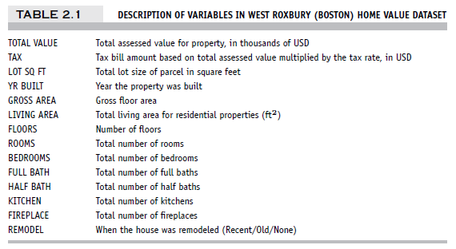
Step 1: Develop Understanding of Purpose of DM Project
Typical questions for a DM project
What is the problem?
How will the stakeholders use the results?
Who will be affected by the results?
Will the analysis be a one-shot effort or an ongoing procedure?

Slide 12
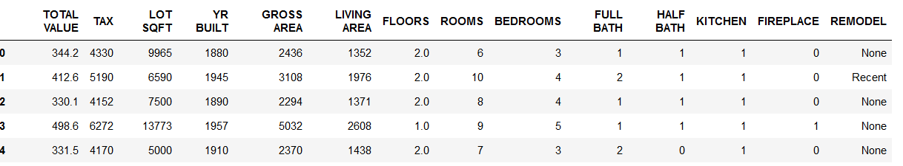
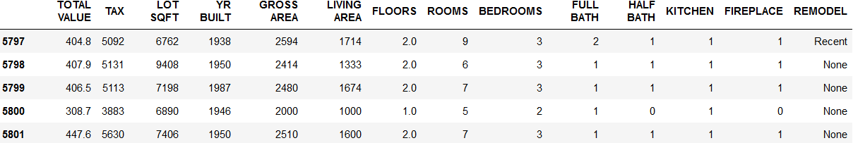
Step 2: Obtain Data for Analysis
Preliminary exploration in Python
Open Anaconda-Navigator and launch a Jupyter notebook. It opens a new browser window
Navigate to the directory where your .csv file is saved and open Python notebook, .ipynb file
Import required packages
Using pd.read.csv() function, Load data set from WestRoxbury.csv file

Slide 13
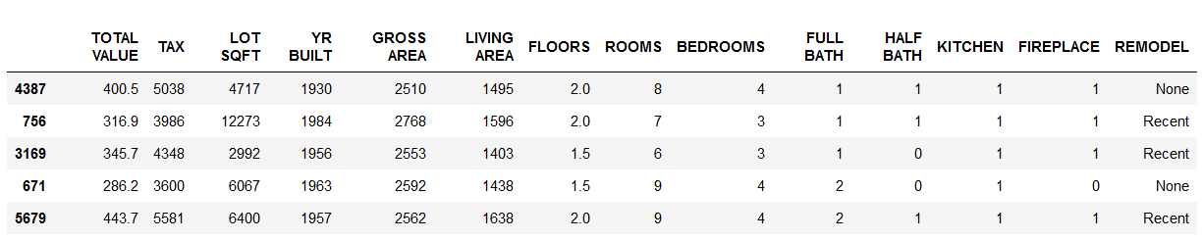
Step 2: Obtain Data for Analysis
DM typically deals with huge data sets
DM algorithms and models are often applied to a sample from a data set
Many algorithms will execute faster with smaller samples
Accurate models can often be built with as few as several hundred or thousand records
Analyst may want to sample a subset of records for DM modeling
Use sample() function to select random sample (observations) from the data set (see 5 random observations from WestRoxbury data set below
Once you develop and select a final model, you use it to “score” the observations in the larger data set

Slide 14
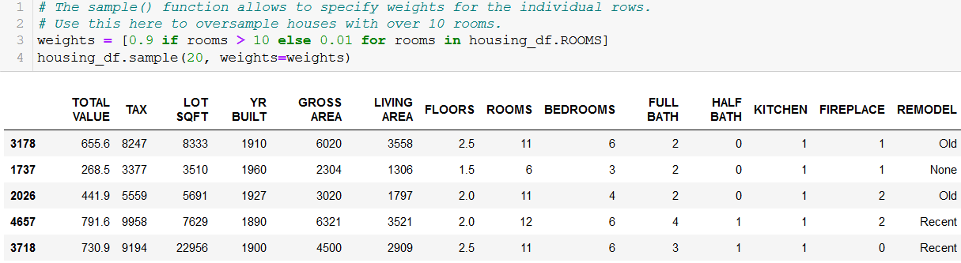
Step 2: Obtain Data for Rare Event – Oversampling
An event of DM interest may be rare
Examples: response to mailing, fraud in taxes, fraudulent credit card transactions
Sampling may yield too few “interesting” cases to effectively train a model
Oversampling a popular approach to oversample the rare cases, to obtain a more balanced training set

Slide 15
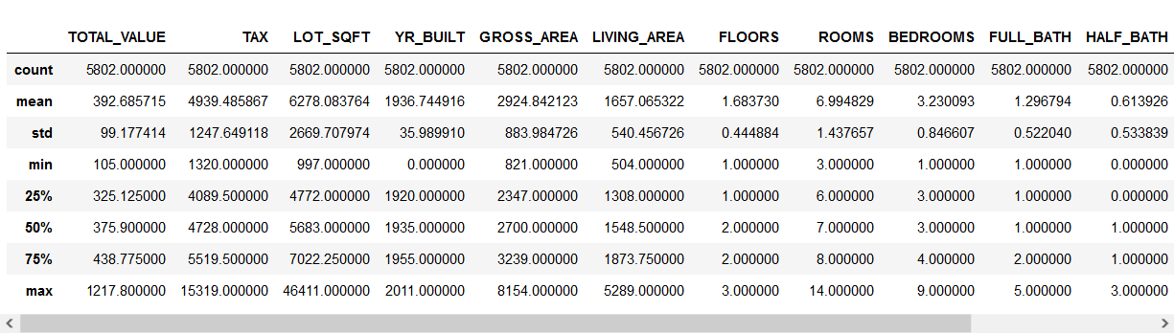
Step 3: Explore, Clean and Preprocess Data
Data Exploration
Review column names
If several words, change to one word with ‘_’ or give a different name
Access and review subsets of data
Data set and column statistics (with describe() function)

Slide 16
Step 3: Explore, Clean and Preprocess Data
Preprocessing and cleaning data
Type of variables used
Detecting outliers
Handling missing data
Overfitting problem

Slide 17
Step 3: Types of Data Variables
Types of variables determine the types of pre-processing needed, and algorithms used
Main distinction: numeric vs. categorical variables
Numeric Variables
Continuous
Integer
Categorical Variables
Ordered or ordinal variables (low, medium, high)
Unordered or nominal variables (male, female)
In Python, categorical variable(s) can be converted into dummy (0,1) variables

Slide 18
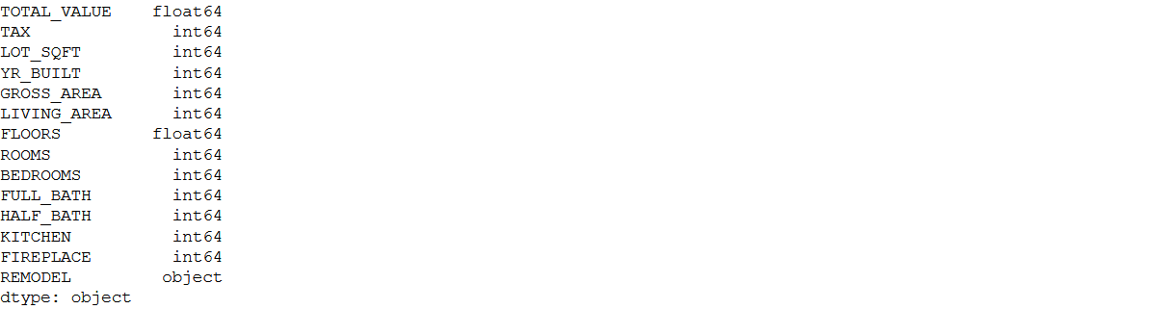
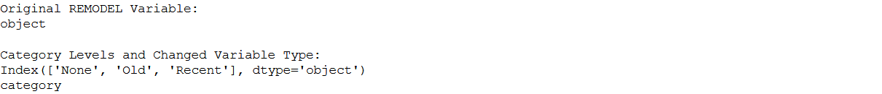
Step 3: Types of Variables and Change to ‘Category’ Variable
Variable types
Modified REMODEL variable type to ‘category’

Slide 19
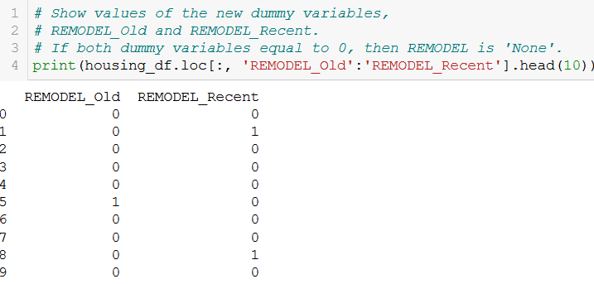
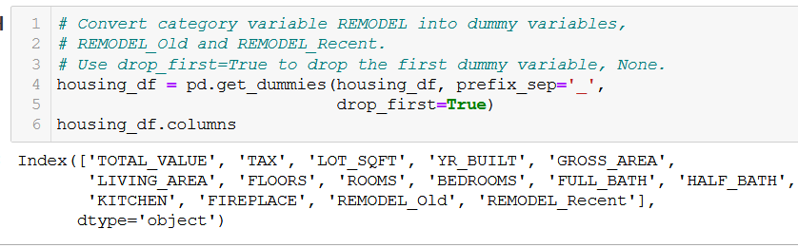
Step 3: Convert to Dummy Variables
Convert REMODEL into two dummy variables, REMODEL_Old and REMODEL_Recent
Drop the first dummy variable for None
Show values of dummy variables for 10 records

Slide 20
Step 3: Detecting Outliers
An outlier is an observation that is “extreme”, being distant from the rest of the data (definition of “distant” is deliberately vague)
Outliers can have disproportionate influence on models, and thus detection is an important step in data pre-processing
Domain knowledge is required to determine if it is an error or truly extreme
In some contexts, finding outliers is the purpose of the DM exercise (airport security screening, suspicious credit card purchases, etc.)
This is called anomaly detection
How to detect outliers
Option 1
Sort records by the first column col1 using the pandas function sort_values(), e.g., df.sort_values(by=[‘col1’])
Review the data for very large or very small values in the column
Repeat for each successive columns
Option 2
Utilize min() and max() functions for each column

Slide 21
Step 3: Handling Missing Data
Most algorithms will not process records with missing values
Default is to drop those records
Solution 1: Omission (Removal)
If a small number of records have missing values, can omit them
If many records are missing values on a small set of variables, can drop those variables
If many records have missing values, omission is not practical
Solution 2: Imputation
Replace missing values with reasonable substitutes, e.g., mean or median of all other non-missing values
Let you keep the record and use the rest of its (non-missing) information

Slide 22
Step 4: Reduce Data Dimension
This step of the DM process is done if necessary
Dimension reduction means
Eliminate unneeded variables (columns), which are not essential to the DM analysis
Transform variable(s), e.g., for the variable ‘demand’, use only those rows that are ≥ 10,000 units, instead of any demand value
Create new variables as some combination of two or more variables, and remove the involved variables (columns)
Principle Component Analysis (PCA) can be used to consolidate multiple similar numerical variables into a small number of variables
In case of West Roxbury data set, the number of variables is not significant (15 variables including 2 dummy variables for REMODEL)

Slide 23
Step 5: Determine Data Mining Task
Translating the general question or problem of Step 1 into more specific DM question
Prediction
Classification
Clustering
Etc.
For West Roxbury, the specific task will be to predict the value of TOTAL VALUE using predictor variables
TOTAL VALUE is outcome or response variable
All other variables, except for TAX (which is a percentage of TOTAL VALUE) are predictors or independent variables

Slide 24
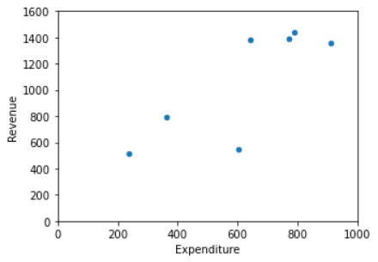
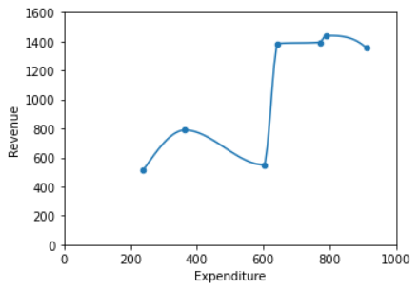
Step 6: Partition Data
Main reason for data partitioning is to prevent overfitting
Statistical models can produce highly complex explanations of relationships between variables
The “fit” may be excellent, but
100% fit may not be useful for new data
Result
Deployed model will not work as well as expected with completely new data
Notes:
24

Slide 25
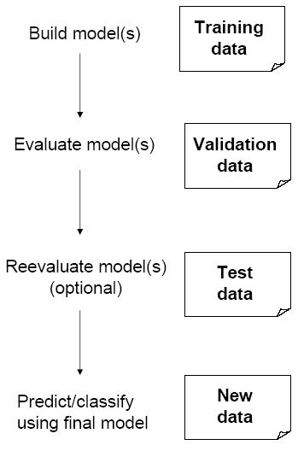
Step 6: Partition Data
Problem: How well will our model perform with new data?
Solution: Separate data into two parts
Training partition to develop the model
Validation partition to implement the model and evaluate its performance on “new” data
Addresses the issue of overfitting
Training data is the data from which the classification or prediction algorithm “learns” or is “trained”
Validation data is a sample of data separate from training data, where outcome is known and is used to validate the learning algorithm (classification or prediction)

Slide 26
Step 6: Test Partition
When a model is developed on training data, it can overfit the training data (hence need to assess on validation)
Assessing multiple models on same validation data can overfit validation data
Some methods use the validation data to choose a model. This too can lead to overfitting the validation data
Solution: final selected model is applied to a test partition to give unbiased estimate of its performance on new data

Slide 27
Step 7: Choose DM Technique(s)
Could be a variety of techniques (methods, models) for prediction, classification, clustering, etc.
For West Roxbury, utilize multiple linear regression for predicting total assessed value for property
TOTAL VALUE is outcome or response variable
All other variables, except for TAX (which is a percentage of TOTAL VALUE) are predictors or independent variables

Slide 28
Step 8: Use Technique(s) and Associated Algorithm
For West Roxbury, use multiple linear regression technique (method) to fit training data
Use Python’s scikit-learn package and, specifically, LinearRegression algorithm (function) to predict house values for training data
Then, apply the same model to predict values for validation data

Slide 29
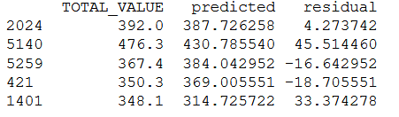
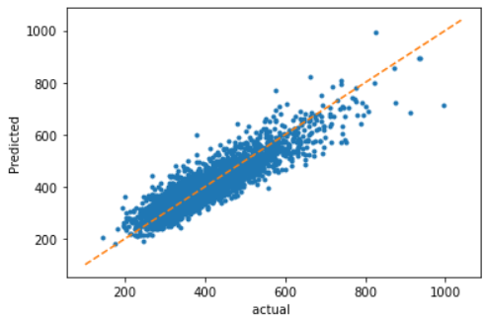
Step 8: Training Predictions – First 5 Records and Actual/Predicted Graph for Training Data

Slide 30
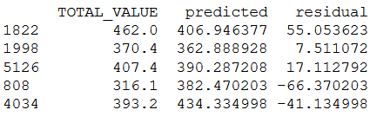
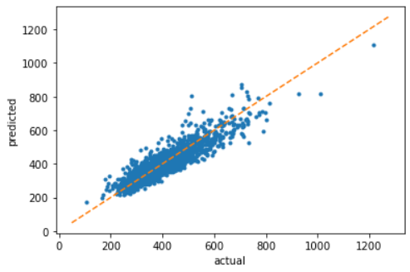
Step 8: Scoring Validation Data – First 5 Records and Actual/Predicted Graph for Validation Data

Slide 31




Step 8: Common Accuracy Performance Measures
Error (e_{i}) = actual - predicted
Consider a validation period with n records, i = 1, 2, …, n, and error e_{i} in each record
Mean/average error (ME or AE) – provides an indication of whether the predictions are over- or under-predicting
Root mean squared error (RMSE) has the same units as the actual values and sensitive to large prediction errors
Mean absolute error/deviation (MAE or MAD) give the magnitude of the average absolute error
Mean absolute percentage error (MAPE) gives an absolute percentage score of how prediction deviates (on the average) from actual values; useful for comparing performance across predictions that have different scales
Mean percentage error (MPE) is similar to MAPE but without absolute value of the ratio; indicates the percentage of over- or under-predicting
$$\text{ME} = \frac{1}{n}\sum_{i=1}^{n}{e_{i}}$$
$$\text{R}\text{MSE}= \sqrt{\frac{1}{n}\sum_{i=1}^{n}{{e_{i}}^{2}}}$$
$$\text{M}\text{A}\text{E}= \frac{1}{n}\sum_{i=1}^{n}{\left|e_{i}\right|}$$
$$\text{M}\text{AP}\text{E}= \frac{100}{n}\sum_{i=1}^{n}{\left|\frac{e_{i}}{\text{y}\text{i}}\right|}$$

Slide 32
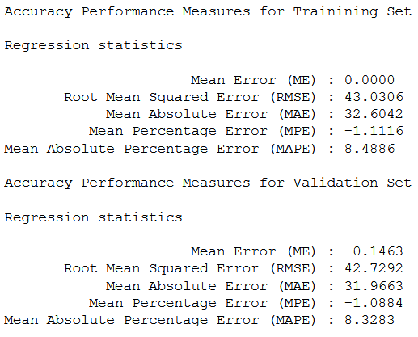
Step 8: Accuracy Performance Measures for Training and Validation Sets

Slide 33
Step 9: Interpret the Results Step 10: Deploy the Best Technique/Model
Step 9: Interpret results
Use other prediction techniques/models and associated algorithms, e.g., regression trees, neural networks, etc.
Compare accuracy performance measures of these techniques/models
Based on the measures, identify the best model to apply for predictions
Step 10: Deploy the best technique/model
Apply the best model to new data records
Scoring – predicting output value for new record
For predictive tasks, scoring produces predicted numerical values, e.g., predict TOTAL VALUE for homes where the value is unknown
For classification tasks, scoring produces classes and/or propensities

