Slide 1

TITLE PAGE
Paytm Build for India AI Hackathon 2026, Mumbai
MUNIM
मुनीम
Paytm fixes its own settlement mistakes before the merchant knows they happened.
TRACK
3, Autonomous AI Teammates
PROBLEM
Settlement errors merchants never report
TEAM NAME
Dracarys
GitHub Our Repo of Munim
Click here for Demo Video Showing Working of Munim

Slide 2

Munim मुनीम
₹270 was deducted from a ₹12,000 day. Nobody asked why.
The problem: A merchant receives one net amount after MDR, GST, device rental and fees are taken out, under rules that change with the payment type, the amount and the date. When one deduction is wrong, nothing on the statement shows it. The loss is small, it repeats every day, and because nobody complains, nobody fixes it.
“₹12,000 ka maal becha, ₹11,730 aaya. Baaki Paytm ka charge hoga.”
— a kirana owner, asked where ₹270 went
Why nobody complains
Every fix today waits
Too complex to check
UPI above/below ₹2,000, RuPay debit, card bands, GST base, rental dates
Chatbots ✗ reactive
answer only when the merchant asks
1
One day’s settlement
Too small to chase
₹30 a day never feels worth a ticket or a phone call
Support desk ✗ reactive
acts only after a ticket is raised
UPI ₹6,000, RuPay debit ₹1,500, credit cards ₹4,500
2
Sold
12,000.00
− MDR on credit cards @ 1.8%
81.00
− GST 18% on that MDR
14.58
So nobody complains
the merchant shrugs: “Paytm ka charge hoga”
Dispute forms ✗ reactive
need the merchant to prove the error
− MDR on RuPay debit
27.00
3
− GST on that MDR
4.86
− Device rental & platform fee
142.56
Silence is read as ‘no problem’
zero tickets → dashboards say merchants are happy
Munim ✓ proactive
checks every settlement before anyone notices
Received in bank
₹11,730.00
4
₹31.86 was never owed: RuPay debit carries no MDR by law. It is only 0.27% of sales, but about ₹9,500 a year.
…and the loop repeats, every day, for every merchant.
02 Munim Paytm Build for India, Track 3

Slide 3
Munim मुनीम
Munim keeps the hisaab. The merchant doesn’t lift a finger.
Solution overview: We built Munim to work on Paytm’s side of the ledger. It re-checks every settlement against the published rules and the merchant’s own agreement. When a charge is wrong, it proves it, files the correction with settlement ops, follows it up, and closes the case only once the money is back in the merchant’s bank. Anything it cannot prove goes to a person.
What the merchant has to do
0
tickets
0
calls
0
spreadsheets
MUNIM
On Paytm’s side, every day, on its own
1
Audits
2
Proves
3
Files
4
Chases
5
Confirms
Every settlement line against 12 months of history. Nobody asks it to start.
Recomputes each charge from the dated rule and the signed agreement, to the paise.
Raises the correction with Paytm settlement ops, proof attached.
Follows up on silence, answers rejections with evidence and escalates what it can’t win.
Closes only when the credit lands in the bank (UTR), then fixes the cause.
MERCHANT
In the Paytm Business app
Nothing to do
no ticket, no call, no spreadsheet, no proof to collect
…but can, in chat:
ask anything, any language, by voice, see the proof, find a payment, decide review cases, appeal, talk to a person
✓ Gets one message
“₹ wapas aa gaya, aapko kuch nahi karna.”
03 Munim Paytm Build for India, Track 3

Slide 4
OUR USP
Everyone else waits for a complaint. Munim fixes the mistake before there is one.
What makes Munim different isn’t that it uses AI. It’s who moves first: Paytm, not the merchant.
OUR USP IN ONE LINE
Paytm catches its own settlement mistake, proves it to the paise and puts the money back, before the merchant even knows something went wrong.
01
02
03
04
It speaks first
Proof, not guesses
Done means money in the bank
Fixes the cause, too
Chatbots, support desks and dispute forms all wait for the merchant to complain. Munim doesn’t wait. It checks every settlement, every day, on its own.
The AI only explains what went wrong. Plain code recomputes the charge, with the rule and its source on every rupee. No proof, no claim.
A case isn’t closed when ops says yes. It closes only when the credit lands in the merchant’s account, matched by UTR.
Every error it wins becomes a config fix, so the same mistake doesn’t hit the next settlement or the next merchant.
0
0 / 389
₹1,26,618
₹1.22 L
tickets the merchant has to raise
false corrections filed
actually returned to banks
of future leakage stopped
WHY IT’S HARD TO COPY
It runs on Paytm’s side of the ledger. It reads the merchant’s signed rate, the dated rule book and the settlement UTRs. An outside app never sees any of that, so it can only guess. And it talks to the merchant in 12 Indian languages, by voice.
04 Munim Paytm Build for India, Track 3

Slide 5
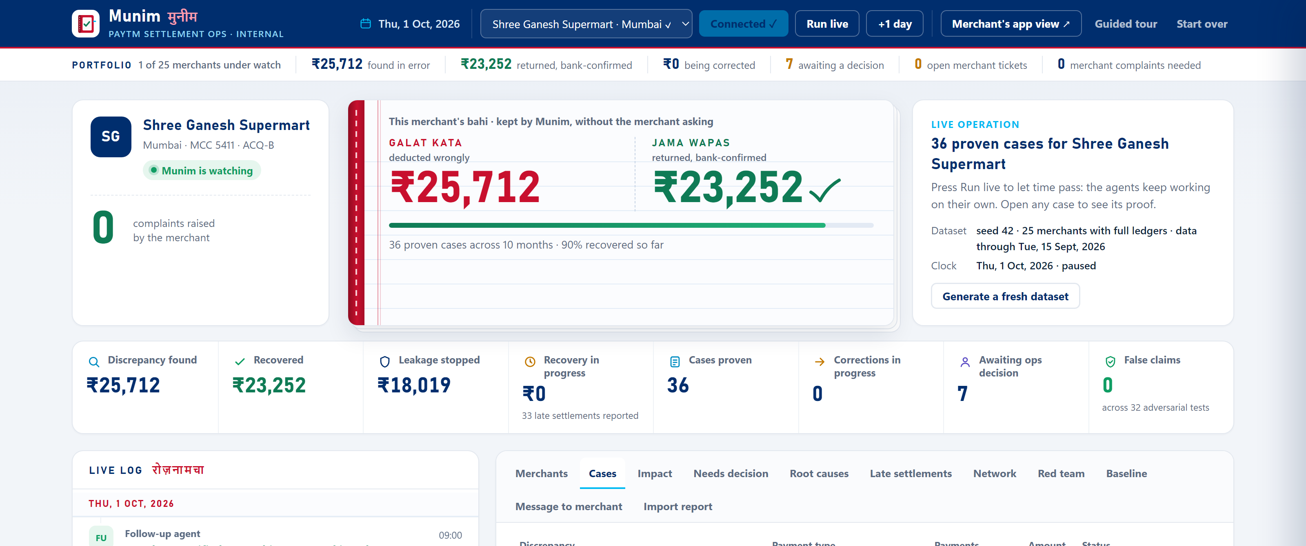
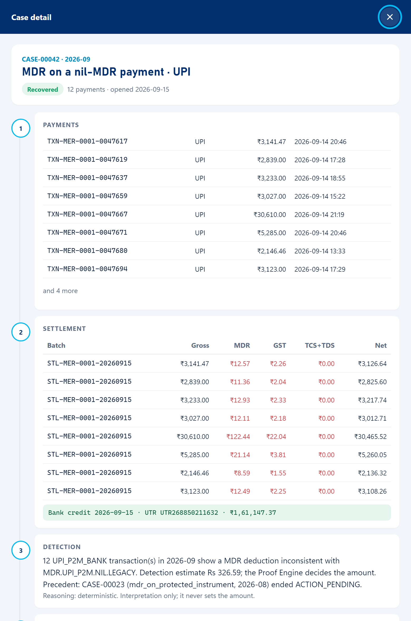
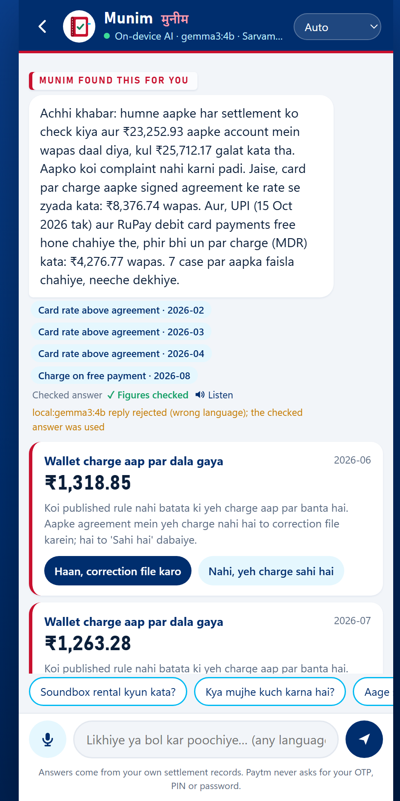
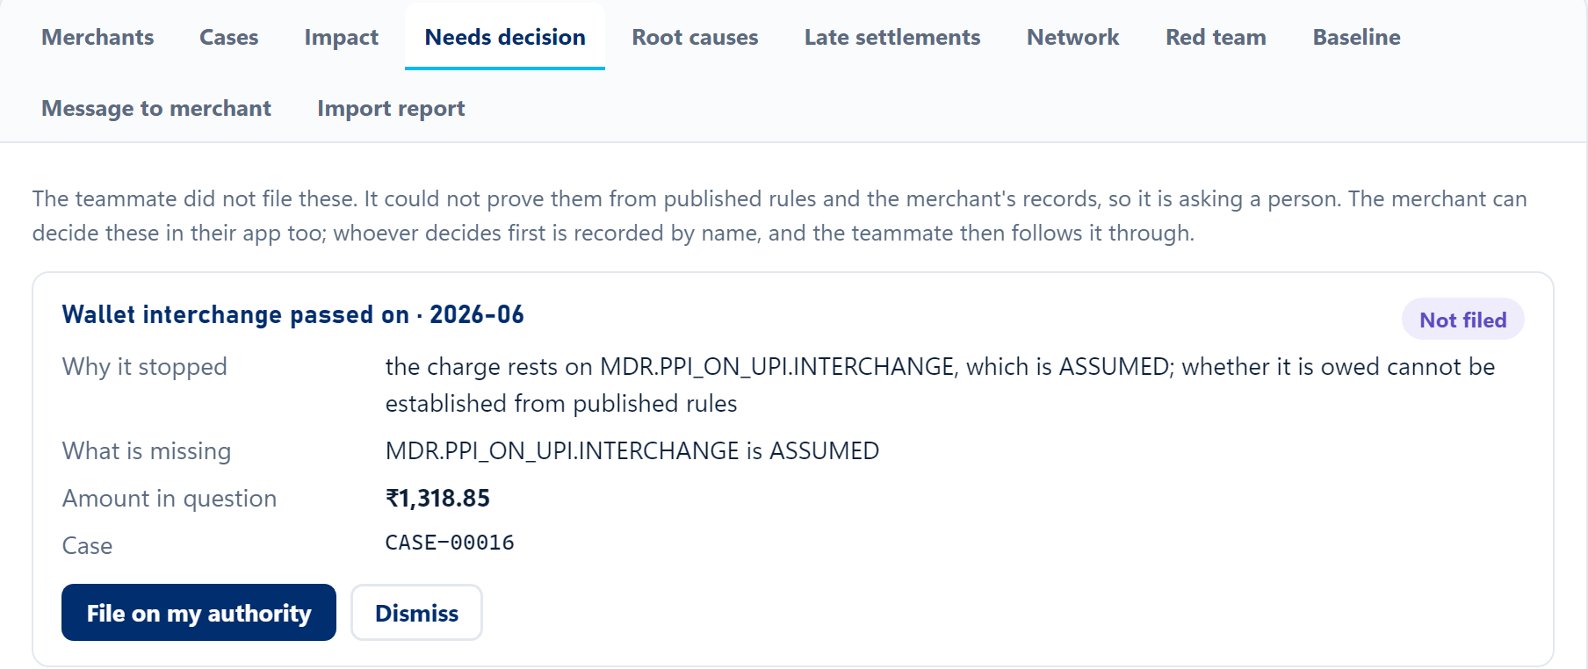
GitHub github.com/Ajbit07/munim
PROTOTYPE
Paytm’s team works in the console; the merchant only ever sees the chat
Screenshots from the working build: three views of the ops console for Paytm’s settlement team, and the chat in the merchant’s Paytm Business app.
1 Live overview: every merchant, money found and returned, agents at work
2 Human review: what Munim could not prove waits for a person
3 Case proof: payments, rule, bank credit
4 Merchant chat: Paytm speaks first
05 Munim Paytm Build for India, Track 3
Click here for Demo Video Showing Working of Munim

Slide 6
TECHNICAL APPROACH
Seven steps, three agents, and one gate nothing can skip
The agents choose what to look at and what to do next, but plain code decides whether money is owed, and every step goes into a log we can replay.
Monitor Agent
What needs attention?
Investigation Agent
What happened, and can we prove it?
Follow-up Agent
What’s next, and can I finish it alone?
Discover
Investigate
Prove
Act
Follow up
Recover
Prevent
Opens a 12-month audit the moment a merchant connects, then opens a case for every new gap.
Pulls the records, dated rules, rate-card history and precedents. The LLM explains what the gap most likely is.
The proof gate
Files a claim only through the gate. Pilots one claim per new pattern before filing the rest.
Chases unanswered claims and re-presents rejections with evidence that worked before, using n8n.
Counts money only when the credit lands in the merchant’s bank, matched by UTR.
Finds the root cause, projects 26 weeks of future leakage, and asks for the config fix so it stops.
Recomputes the charge in plain code. Verdict: PROVEN, UNPROVEN or NOT A DISCREPANCY.
IN settlement file, transactions, merchant master (agreement, devices), rule book with sources
OUT correction claim, bank-confirmed refund, config fix, one message to the merchant
06 Munim Paytm Build for India, Track 3

Slide 7
TECHNICAL APPROACH
Seven ways a settlement goes wrong, each tied to a written rule
Each class maps to a published rule or to the merchant’s own agreement. If no rule settles a case, a person decides instead.
L1
Card rate above agreement
L2
Charge on a free payment
L3
GST on the wrong base
L4
Tax that doesn’t apply
MDR above the merchant’s signed rate, or above RBI’s debit-card ceiling (0.40% for turnover up to ₹20 lakh).
MDR on UPI payments up to ₹2,000, or on RuPay debit cards at any amount. Both are nil-charge by law.
GST is 18% of the MDR only. Charging it on the sale amount, or on a waived fee, is an error.
TCS (CGST s.52) or TDS (s.194-O) deducted from a merchant who does not sell through an e-commerce operator.
RULE Agreement, RBI/2017-18/105
RULE PSS Act s.10A, MoF, 14 Sep 2026
RULE CGST Act, CBIC circulars
RULE CBIC 194/06/2023-GST, CBDT
L5
Refund taken twice
L6
Payment never settled
L7
Rental after return
We tried to fool it
32 / 32
handled correctly, with 0 false claims
The same refund debited from settlement twice, or a refund with no original payment behind it.
A successful payment missing from every settlement after the merchant’s agreed settlement window.
Soundbox or EDC rental charged after the device came back, or inside the free period.
25 legitimate lookalikes built to trick it, plus 7 real errors as controls
UPI of exactly ₹2,000
GST at ₹2,000.01
signed rate rise
chargeback
RULE RBI TAT circular, 20 Sep 2019
RULE Merchant agreement (settlement SLA)
RULE Device records, rental plan
two partial refunds
rental in return month
The hardest trap: A UPI payment of exactly ₹2,000 carries no MDR, but from 15 October one of ₹2,000.01 legitimately can.
07 Munim Paytm Build for India, Track 3

Slide 8
TECHNICAL FLOW
Data enters once, code checks it, agents act on it, and two audiences see it: Paytm’s ops team and the merchant.
From the settlement file to the merchant’s phone
1
INGEST
Paytm settlement report
CSV from the dashboard or the Settlement API; its UTRs prove bank credit
+
Merchant master
agreement & rate history, devices, turnover; looked up by MID
+
Rule book
RBI, NPCI, GST, TDS rules; dated, cited, confidence-graded
Importer
Paytm columns → Pydantic schemas; rows it can’t judge are set aside, never guessed
Ledger
transactions + settlement lines in integer paise; every step in the event log
Python 3.13, Pydantic v2, CSV / Settlement API
2
DETECT
Case opened
state DISCOVERED: something to investigate, not yet money owed
Findings
gaps grouped by pattern; late settlements are reported, never claimed
Fee + reconciliation engines
recompute every MDR, GST, tax, rental, refund and settlement
Monitor Agent
wakes on connect (12-month audit) and on every clock tick; nobody asks it
Monitor Agent, fee + reconciliation engines, replayable clock
3
PROVE
Investigation Agent
gathers records, dated rules, rate-card history
Cognee memory
precedent: what evidence won before
LLM reasoner
Sarvam, or local Gemma 3, tells the story. Its candidate has no amount
PROOF ENGINE
plain code recomputes to the paise; rule ID + source on every rupee
VERDICT
UNPROVEN → needs review
Investigation Agent, Cognee, Sarvam / Gemma 3, Proof Engine
NOT A DISCREPANCY → closed
PROVEN → file correction
4
ACT & RECOVER
Recovered + prevented
bank credit matched by UTR; config fix requested so it stops
Awaiting credit
approval is not recovery; it waits for the money to land
Paytm settlement ops
approves, rejects or asks for evidence; rejections answered
n8n workflow
submit, check, follow up, re-present, withdraw
Follow-up Agent
files only with a PROVEN result; pilots one claim per pattern
Follow-up Agent, n8n 2.39, prevention
decisions re-enter the case
5
SURFACES
Merchant chat
Paytm speaks first: ‘₹23,252.93 wapas’. Type or speak, any language
Chat brain
Sarvam-105b → Gemma 3 4B local → checked answer; figures guarded
Merchant acts
decides review cases, appeals, finds a payment, asks for a person
Ops console
portfolio, needs review, tickets, root causes, network, red team, import
Paytm ops team
handles only exceptions; replies flow back into the chat
FastAPI, HTML/JS, Sarvam voice, Ollama
Data
Engine (code)
Agent
Sponsor / model
Proof gate
People
08 Munim Paytm Build for India, Track 3

Slide 9








TECH USED
Each sponsor tool does one job, and a local LLM steps in when one can’t
The core needs no external service. Sponsor tools add voice, memory and workflow, and each one has a local fallback.
Sarvam the voice
Munim core
n8n the hands
Merchant chat in 12 Indian languages (sarvam-105b), translation, speech-to-text (saaras) and text-to-speech (bulbul). Guards reject invented figures, overclaims and wrong-language replies; it never asks for an OTP.
Three agents
Monitor, Investigation, Follow-up
Runs each claim step with Paytm settlement ops. Retries and timers live in the workflow, not in the agents.
Proof engine + rule book
deterministic, dated, cited
Chat
Translate
Voice in
Submit
Check
Follow up
Voice out
12 languages
Reconciliation, case state machine
money in integer paise, event log
Re-present
Withdraw
✓ Request format checked against docs.sarvam.ai
✓ Live: n8n 2.39 ran every step, 0 fallbacks
Fallback the local LLM below
Fallback in-process workflow (logged)
if Sarvam is unavailable
Local LLM the backup
Cognee the memory
Engineering, and it runs offline
Python 3.13, FastAPI, Pydantic v2, 219 tests, firewall checks, a Docker image and CI/CD on GitHub Actions.
Every integration is optional: a test blocks all network and the full demo still runs.
Gemma 3 4B on Ollama, on-device. Keeps the chat alive without Sarvam or internet: reads any wording, writes the reply, translates.
Case graph: precedent, which evidence overturned a rejection, each merchant’s history.
Sarvam
Gemma 3 local
checked answer
Fallback local SQLite memory
09 Munim Paytm Build for India, Track 3

Slide 10
FEASIBILITY AND VIABILITY
What it found, and why you can believe it
We generated 12 months of ledgers, planted known errors, and scored the agents against an answer key they never saw.
Money, across 25 merchants and 12 months
Checked against an answer key the agents never saw
Found and proven, unprompted
₹1,67,681.80
0 / 389
false corrections filed
0 / 23,819
legitimate lookalikes flagged
Returned to merchants’ banks
₹1,26,618.33
32 / 32
red-team attacks handled correctly
Future leakage stopped at the root
₹1,22,033.05
388 / 389
claims exact to the paise
120 / 120
ambiguous charges sent to a person
One merchant: Shree Ganesh Supermart
₹25,712.17 found without being asked, ₹23,252.93 back in the bank, 7 cases sent for the merchant’s decision.
0
found on the clean ledger (nothing planted)
Honest scope: Synthetic data (seed 42, 25 merchants, 12 months, 3,94,974 transactions) and simulated settlement ops. Every figure is recomputed by evaluate.py; none is typed in. A fresh random dataset regenerates in about 35 seconds, live, so nothing is pre-built.
10 Munim Paytm Build for India, Track 3

Slide 11
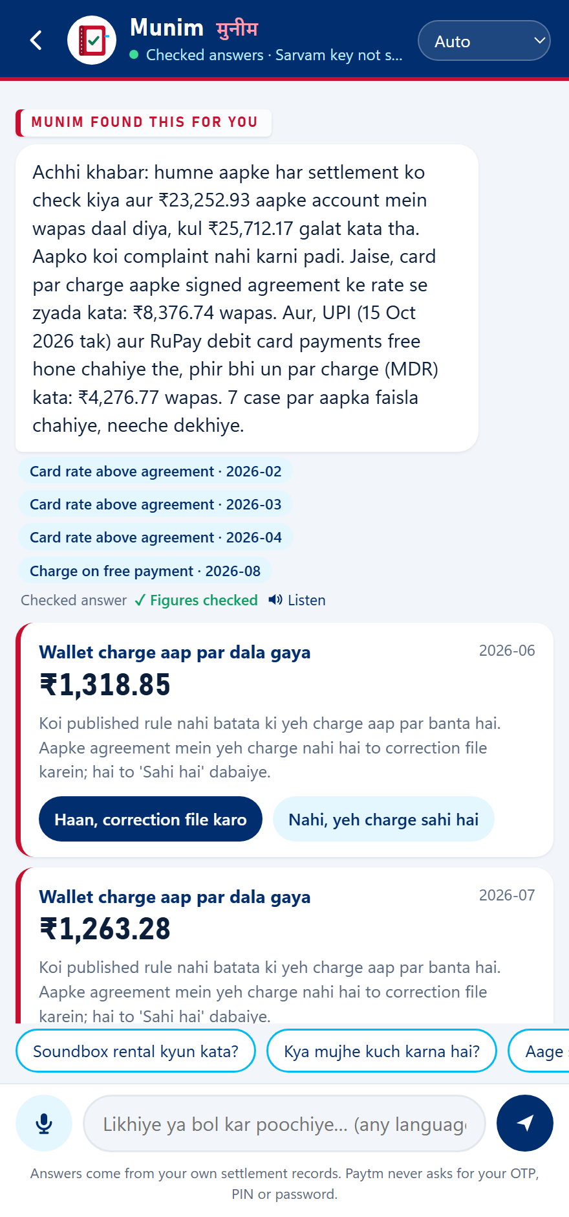
IMPACT AND BENEFITS
The best support ticket is the one nobody had to raise
A merchant who never had to complain keeps taking digital payments. Earning that trust, one settlement at a time, is what Munim is for.
TODAY
Merchant notices
raises a ticket
argues
maybe a refund
WITH MUNIM
Paytm notices
proves it
returns the money
tells the merchant
For merchants
For Paytm
For digital India
₹25,712
₹1.22 L
0 False
found for one supermarket in a year, without being asked
of future leakage stopped at the root
false corrections, so it is safe to run for every merchant
● Money back without a complaint
● Answers in their language, by voice
● Decides edge cases from the chat
● Fewer settlement tickets
● Ops handles only the exceptions
● Spots one fault hitting many merchants, sharing no merchant’s data
● Small merchants keep the nil-charge protection the law gives them
● More shops trust digital payments
The one message the merchant didn’t ask for.
11 Munim Paytm Build for India, Track 3

Slide 12
BUSINESS MODEL
The merchant pays nothing. Paytm earns it back in trust and lower costs.
Munim is a tool Paytm runs for its own merchants. The refund is the merchant’s money, so we never take a cut of it.
WHO PAYS
Paytm runs Munim
in-house, for every merchant
Merchant pays ₹0
no fee, no cut of the refund
Money goes back
in full, straight to the bank
Paytm gains
lower cost, loyal merchants
Where Paytm gets its return
Fewer tickets
Merchants who stay
Fewer repeat mistakes
Cheap to run
Merchants stop calling about settlement charges. Ops only looks at the cases Munim couldn’t prove by itself.
A shopkeeper who gets money back without asking has no reason to switch to another provider or go back to cash.
One root-cause fix protects every merchant on that setting, not just the one who got hit.
The money maths is plain code. AI is only used to explain and chat, through Sarvam, with a local Gemma model as backup if Sarvam is down.
120 / 120
₹25,712
₹1.22 L
0
unclear cases sent to a person
found for one supermarket in a year
of future leakage stopped at the root
external services the core depends on
HOW IT GROWS
Now
Built into Paytm’s settlement ops. Recovery for merchants stays free, always.
Next
Paid add-on for larger merchants: multi-outlet reconciliation and GST-ready reports.
Later
License the proof engine to banks and other payment aggregators as an audit tool.
12 Munim Paytm Build for India, Track 3

Slide 13
RESEARCH AND REFERENCES
Every rate in the engine comes from a source you can check
We read regulator documents directly where we could, and graded every other source so that a weak one can never trigger a claim.
Who may charge what
GST, TCS and TDS
MoF s.10A notification, 14 Sep 2026: UPI up to ₹2,000 and RuPay debit are nil-charge
scconline.com, 15 Sep 2026
RBI/2017-18/105: rationalisation of MDR for debit card transactions
rbi.org.in/commonman/English/scripts/Notification.aspx?Id=2620
NPCI: 0.4% MDR on UPI merchant payments above ₹2,000 from 15 Oct 2026
business-standard.com (15 Sep 2026)
CBIC Circular 194/06/2023-GST: TCS where multiple e-commerce operators are involved
gstcouncil.gov.in/sites/default/files/2024-06/circular-cgst-194.pdf
CBDT guidelines on s.194-O TDS for payment gateways
bdo.in, alerts and updates
RBI (Regulation of Payment Aggregators) Directions, 2025
taxguru.in/rbi/rbi-regulation-payment-aggregators-directions-2025.html
The Paytm data we read
Sponsors and models
How we graded each source
Settlement reports on the Paytm dashboard: the columns our importer reads
paytmpayments.com/docs/settlement-reports-on-dashboard
n8n: workflow automation for the claim lifecycle
docs.n8n.io
Cognee: memory graph for agents
docs.cognee.ai
Sarvam AI: chat, translate, speech-to-text, text-to-speech
docs.sarvam.ai
Gemma 3 on Ollama: on-device backup model
ollama.com/library/gemma3
PRIMARY
regulator or issuer document, read directly
SECONDARY
reputable press reporting a circular
Transaction ID
Order ID
Amount
Commission
GST
Settled Amount
ASSUMED
our inference: can never auto-file a claim
Settled Date
UTR No.
Payment Mode
MID
Full trail: docs/FEE_RULES.md, researched 16 Sep 2026
13 Munim Paytm Build for India, Track 3

