Slide 1
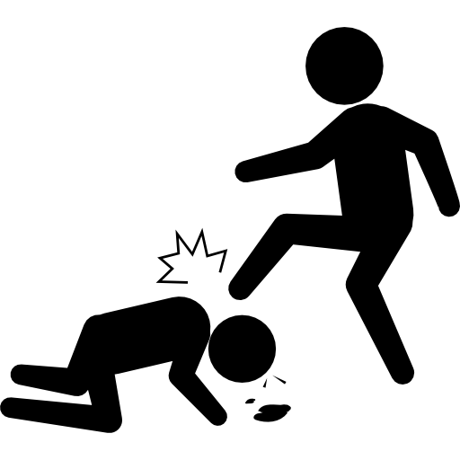
ATTENTION
ATTENTION
ATTENTION
NO FIGHTING in the
War Room
NO FIGHTING in the
War Room
NO FIGHTING in the
War Room
ATTENTION
ATTENTION
ATTENTION
NO FIGHTING in the
War Room
NO FIGHTING in the
War Room
NO FIGHTING in the
War Room
ATTENTION
ATTENTION
ATTENTION
NO FIGHTING in the
War Room
NO FIGHTING in the
War Room
NO FIGHTING in the
War Room

