Slide 1
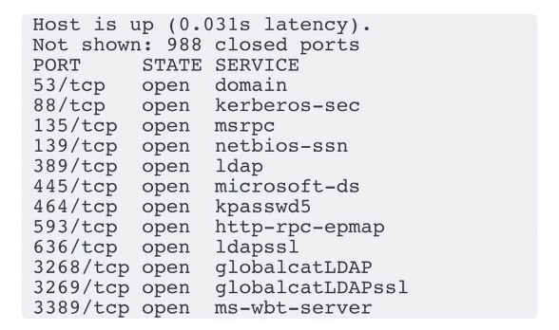
LIVING ON THE EDGE
LIVING ON THE EDGE
LIVING ON THE EDGE
DC IN THE DMZ
DC IN THE DMZ
DC IN THE DMZ
LIVING ON THE EDGE
LIVING ON THE EDGE
LIVING ON THE EDGE
DC IN THE DMZ
DC IN THE DMZ
DC IN THE DMZ
LIVING ON THE EDGE
LIVING ON THE EDGE
LIVING ON THE EDGE
DC IN THE DMZ
DC IN THE DMZ
DC IN THE DMZ
LIVING ON THE EDGE
LIVING ON THE EDGE
LIVING ON THE EDGE
DC IN THE DMZ
DC IN THE DMZ
DC IN THE DMZ

