Slide 1
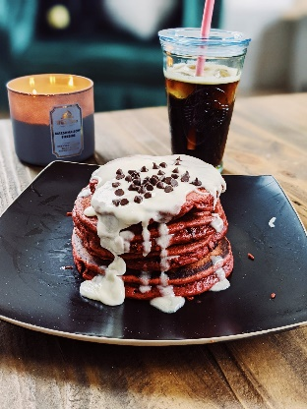
Ignore Ray, that looks heavenly.
Ignore Ray, that looks heavenly.
Ignore Ray, that looks heavenly.
Ignore Ray, that looks heavenly.
Ignore Ray, that looks heavenly.
Ignore Ray, that looks heavenly.
Ignore Ray, that looks heavenly.
Ignore Ray, that looks heavenly.
Ignore Ray, that looks heavenly.
Ignore Ray, that looks heavenly.
Ignore Ray, that looks heavenly.
Ignore Ray, that looks heavenly.
Ignore Ray, that looks heavenly.
Ignore Ray, that looks heavenly.
Ignore Ray, that looks heavenly.

