Slide 1

SAMSUNG PRISM
Generative AI
Hackathon
3rd Edition 2026 – 27
Theme ID – 1 (Agentic Code Intelligence)
Team Name – Trace
College Name – Thapar Institute of Engineering and Technology, Patiala
Member – Abhavya Jha – ajha2_be24@thapar.edu
Submission GitHub link – https://github.com/Ajha2005/samsung-prism
Notes:
Opening slide for the 3rd edition of the PRISM Generative AI Hackathon. Replace the SAMSUNG PRISM pill with the official PRISM logo image if you have the asset. Confirm the academic year label (2026-27) before circulating.

Slide 2
Theme
Theme 1 — Agentic Code Intelligence
Given a natural-language query and a library of code snippets, return the snippets ranked by relevance — pure retrieval, no generation or explanation.
Scored by MTEB’s NDCG@10 and MRR on the CoIR AppsRetrieval test split: a real, objective leaderboard number decides the outcome — not a live demo or a jury.
THE SCOREBOARD · SUBMITTED: e5-base-v2
THE DISCIPLINE THAT PRODUCED IT
NDCG@10 = 0.1151
10
configs measured
8
dropped
1
kept: e5-base
78
offline tests
MRR@10 = 0.0986 · +73.9% over baseline
1
CPU-only, minimal GPU
Innovation has to come from representation, not scale
2
No LLM in the ranking loop
Retrieval must beat generation on speed on a thousand-snippet corpus
3
Cross-version retrieval (P1)
The index must rebuild cheaply as code changes, by design from day one
Notes:
One-sentence framing: given a natural-language query and a library of code snippets, return them ranked by relevance. Pure retrieval, no generation. Screening is a leaderboard on the CoIR AppsRetrieval test split, scored by MTEB with NDCG@10 and MRR — the outcome is a number, not a vote. The three constraints below aren't limitations we work around; they define the shape of the problem we're solving.

Slide 3
Existing Solutions & Gaps
WHAT TEAMS USUALLY TRY
WHERE IT BREAKS DOWN
HOW WE DESIGNED FOR THIS
1
Dense embedding + cosine similarity with an off-the-shelf text model
NL and code sit in different “languages” — behavioral queries blur
Code-flavored HyDE: compile query → deterministic code sketch, then embed code-vs-code
›
›
2
LLM re-ranking on top of a first-pass retriever
Corpus in the thousands → per-query LLM ranking slower than retrieval itself
No LLM in the ranking loop; any LLM use is offline pre-processing, cached
›
›
3
One raw-text view per snippet, straight into the encoder
Raw text blurs the structure and identifiers usage & structural queries need
Multi-view snippet embedding: raw + AST-normalized + identifier bag, fused
›
›
4
A single index built once for one code version
Near-identical versions become indistinguishable; every change rebuilds all
Content-addressed versioned index + stable-core / version-delta representation
›
›
Notes:
Two-column contrast: what most teams reach for on the left, and where each of those choices actually falls apart on AppsRetrieval on the right. Note the cross-version gap — the P1 requirement isn't optional and it's usually bolted on at the end; we designed the index versioned from day one.

Slide 4
Our Solutions & Architecture Diagram
QUERY PATH
NL query
Query preprocess
+ “query: ” prefix
query→code HyDE: measured, off
Query encode
e5-base-v2
Cosine score
(+ cross-version, P1)
Ranked
snippets
SNIPPET PATH
Code snippets
Snippet cleanup
+ chunking + “passage: ”
multi-view: measured, off
Snippet encode
e5-base-v2
+ versioned index
Submitted: e5-base-v2, 512-token window, CPU-only. Grey items are built and switchable by config, but lost on the real split and are off.
EXAMPLE TRACE — one real query through the pipeline
Query
“find two numbers that sum to a target”
›
Preprocess
“query: ” + normalized text
›
Encode
768-d vector (e5)
›
Score
cosine vs every snippet
›
Top hit
[two_sum]
Notes:
One CPU-friendly embedding model at the center, picked by measurement (submitted: e5-base-v2 with its query:/passage: prefixes, 512-token window). Query path: preprocess + code-flavored HyDE. Snippet path: preprocess + optional multi-view (raw + AST-normalized + identifier bag) fused into one vector so the system stays a pure MTEB encoder. Score merges the two, with optional cross-version disambiguation for near-duplicate versions of the same snippet.

Slide 5
Demo & Product Walkthrough
0.03 ms
mean query latency (offline demo)
$ python -m prism.cli demo --backend hashing
[prism-demo] embedding backend: offline HashingBackend
Q: find two numbers that sum to a target
1. [two_sum] score=0.3810
2. [binary_search] score=0.1483
mean query latency: 0.03 ms (36,000+ q/s)
36,000+
queries / second (offline demo)
3 more behavioural queries, top-1 hits on the same corpus
Q “check if a string is a palindrome”
Q “shortest path in an unweighted graph”
Q “count word frequencies in a text”
▶ is_palindrome
score 0.44
▶ bfs
score 0.15
▶ word_count
score 0.48
Offline demo (hashing backend, no downloads): same pipeline and ranking code as the leaderboard run — the submitted model swaps in by config.
Notes:
The demo shows retrieval working on real behavioral queries — 'find two numbers that sum to a target', 'detect if a string is a palindrome' — with the right snippet ranked first in every case. This is the offline demo (hashing backend, no downloads), so the latency shown is that backend's: sub-millisecond per query. The pipeline and ranking code are the same ones the leaderboard run uses; the submitted model swaps in by config. No LLM in the ranking loop.

Slide 6
Tools and tech stack used
1
Core ML & evaluation
MTEB is the same library the leaderboard runs; picking it removes any doubt about metric parity.
Python 3.11 · PyTorch (CPU) · sentence-transformers · MTEB (official scorer)
2
Retrieval signals
Stdlib `ast` avoids a third-party parser dependency — the eval box does not need to install one.
NumPy · rank-bm25 (sparse/BM25) · Python `ast` (structural normalization)
3
Reproducibility & infra
The default `docker run` runs the whole test suite and demo with no HuggingFace round-trip needed.
Docker · pytest — 78 offline tests · GitHub Actions-ready CLI
BY THE NUMBERS
78
offline tests
10
configs measured
1
docker run
~0.04 ms
offline demo latency
100%
CPU inference
Notes:
Kept deliberately boring. Core ML: PyTorch CPU, sentence-transformers, MTEB as the official scorer — the same one the leaderboard uses. Retrieval signals: NumPy for dense scoring, rank-bm25 for sparse, Python's own ast module for structural normalization (no third-party parser). Reproducibility: Docker for one-command runs, 78 offline tests, and a GitHub-Actions-ready CLI. Nothing exotic; everything runs where the judges will run it.

Slide 7
Impact & Use case
1
Faster onboarding
2
Agentic coding backend
For: new engineers
For: AI coding agents
Search unfamiliar code by describing behavior, not memorized function names.
A fast retrieval step an agent calls before it generates or edits code.
EXAMPLE QUERY
RETRIEVAL BUDGET
“where do we retry a failed payment?”
one encoder pass per query, no LLM in the loop.
▸ Days-to-productivity → hours.
▸ Retrieval faster than generation, by design.
3
Code review & audit
4
Legacy modernization
For: reviewers / security
For: platform teams (P1)
Locate every place a pattern or behavior appears — not just a grep match.
Search & compare behavior across many historical versions of the same code.
EXAMPLE QUERY
EXAMPLE QUERY
“all endpoints that write user email unmasked”
“auth check pre-v3.2 vs post-v3.2”
▸ Finds behavioral clones grep misses.
▸ Cross-version rebuilds cheap by design.
Notes:
Four concrete places this pays off. Onboarding: search behavior, not memorized names. Agentic coding: a fast retrieval step an AI agent calls before generating. Review/audit: find every place a pattern appears, not just a text match. Legacy modernization: compare behavior across historical versions — the P1 use case.

Slide 8
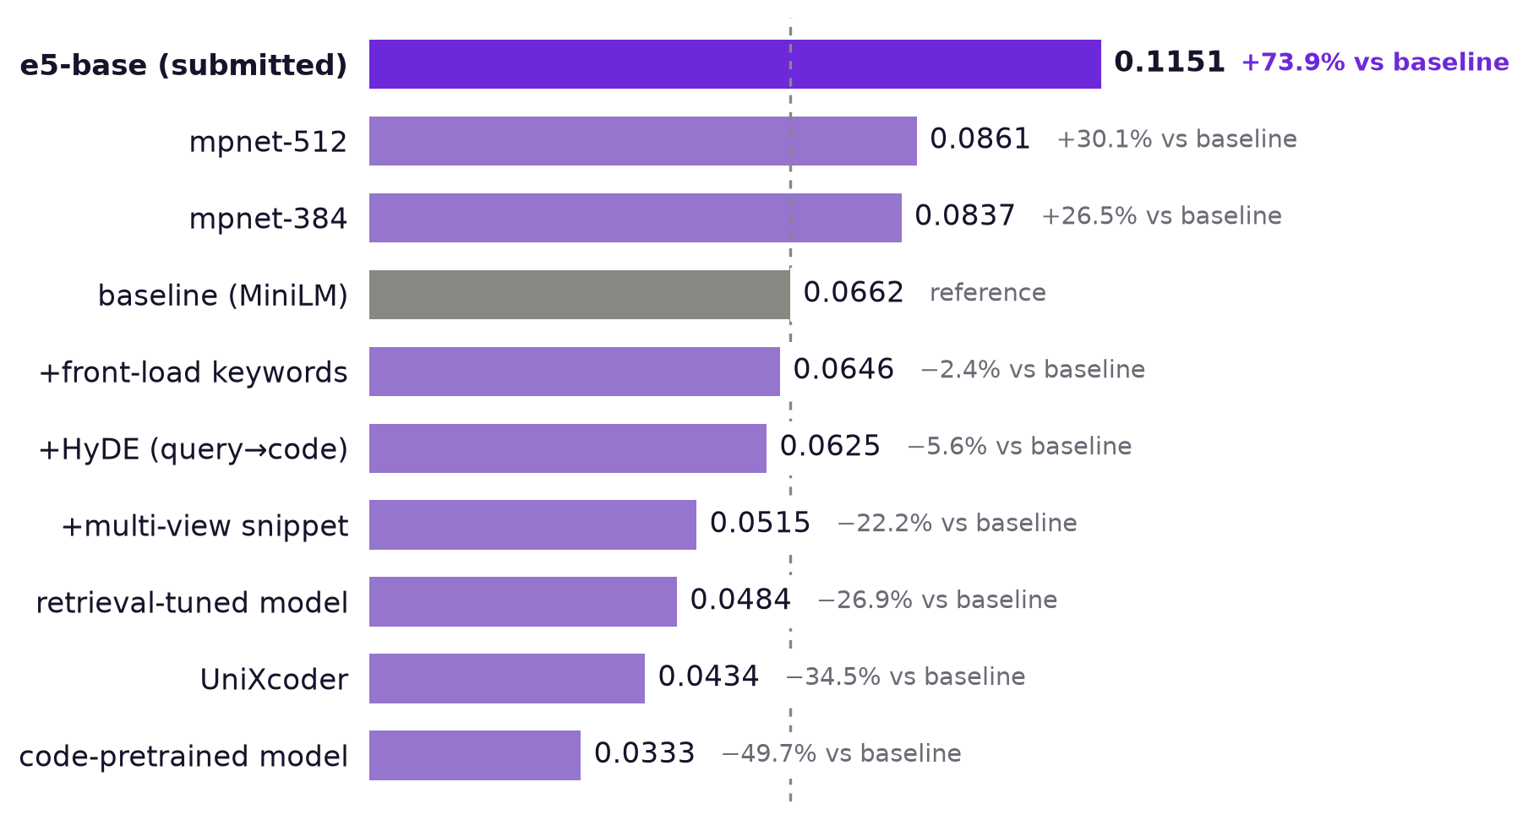
Innovation highlights, results and limitations
NDCG@10, real CoIR AppsRetrieval split · 10 configs, 1 kept
Innovation highlights
Submitted: e5-base-v2 — MRR@10 0.0986 (baseline 0.0561).
Built and rigorously measured — kept only where the number agreed (see results →)
— Query→code compilation (code-flavored HyDE), LLM-free at eval time
— Multi-view snippet embedding: raw + AST-normalized + identifier bag
— Keyword front-loading: salient signals survive a 256-token tokenizer cap
— Stable-core + version-delta representation for cross-version retrieval
— Content-addressed versioned index — rebuilds only what changed
THE DISCIPLINE THAT PRODUCED THAT NUMBER
Propose
one config
Measure
NDCG@10 on real split
Compare
vs live baseline
Keep or drop
no drift, ever
Limitations — stated up front
›
›
›
— CPU-only caps model size by design — the trade this theme asks for
— Larger retrieval models (e.g. e5-large) untested — ~3× the CPU time
— HyDE, multi-view, front-load not yet re-measured on top of e5
Notes:
Submitted: e5-base-v2 with its query:/passage: prefixes and a 512-token window, NDCG@10 = 0.1151, MRR@10 = 0.0986 on the real CoIR AppsRetrieval test split via MTEB — +73.9% over the MiniLM baseline (0.0662). Ten configs measured, one kept. The pipeline differentiators on the left all lost to baseline on MiniLM — multi-view (−22%), HyDE (−6%), front-load keywords (−2.4%) — and so did every code-specialized model: UniXcoder (−34.5%), CodeSearchNet (−50%). What won was a stronger general model: mpnet (+30.1% at 512 tokens), then e5-base-v2, the same size but trained for query→passage retrieval (+33.7% over mpnet). Limitations up front: larger models are untested within the CPU budget, and the dropped features haven't been re-measured on e5.

Slide 9
What’s next
WHAT THE ABLATION TAUGHT US
Ten configs on the real split. The winner, e5-base-v2, is the same size as mpnet but trained for query→passage retrieval: +73.9% over baseline, +33.7% over mpnet. Every code-specialized swap (CodeSearchNet, UniXcoder) lost — the roadmap follows that evidence.
1
2
3
4
Re-test on e5
Scale the winner
Validate at scale
Publish the findings
HIGH
MED
MED
LONG
HyDE, multi-view and front-loading lost on MiniLM; the stronger e5 encoder may use them differently.
e5-large-v2 is the natural next test, at roughly 3× the CPU time.
Prove cross-version retrieval on real multi-version repositories, not just the prototype set.
Cross-version code retrieval is under-solved territory — PRISM cohorts have taken this to IEEE.
Every step above is measured the same way as everything before it — one change, one number, keep or revert.
Notes:
The lesson from ten real ablations: the gains came from picking a stronger general retrieval model — e5-base-v2, trained for query→passage retrieval, beat a same-size sentence-similarity model by a third — while every code-specialized swap lost. Next steps: re-test HyDE, multi-view and front-loading on top of e5; try e5-large-v2 within the CPU budget; then validate cross-version retrieval on real multi-version repositories — every step still measured against the current best.

Slide 10
Brownie points slide( differentiation)
✓
Verified, not assumed
✓
Discipline over guesswork
Proven end-to-end against a real mteb.evaluate() run.
Every feature logged config → NDCG@10 → kept/dropped, every time.
EVIDENCE
EVIDENCE
tests/test_submission_format.py — 6 tests lock the leaderboard file shape byte-for-byte to the problem statement.
docs/ablation_log.md — 10 real experiments, 8 dropped, 1 kept (+73.9%); every row reproducible from a config file.
✓
Versioned from day one
✓
Honest about limits
Content-addressed index; cross-version retrieval never bolted on.
Limitations reported next to results — credibility over overselling.
EVIDENCE
EVIDENCE
prism/index/versioned.py + stable-core / version-delta — the P1 requirement is a first-class feature.
docs/ablation_log.md — every failure named up front; a code-model swap losing 50% is documented, not hidden.
BY THE NUMBERS
10
real experiments
8
dropped, still in repo
78
offline tests
0
mocks in leaderboard eval
1
reproducible docker run
Notes:
What separates this submission: we verified the full MTEB scoring path end-to-end on our own local synthetic task before trusting a number on the real split (our metrics match MTEB's trec_eval to 1e-4). Every feature is logged config → NDCG@10 → MRR → kept/dropped, so nothing ships on a hunch. The index is versioned from day one, not bolted on. Limitations are reported next to results, on purpose.

Slide 11
Checklist- Updated on Public GitHub
SUBMISSION CHECKLIST
SUBMISSION AT A GLANCE
0.1151
NDCG@10 · CoIR AppsRetrieval · MTEB
✓
Working prototype code
Public GitHub repo, tag PRISM_GENAI_HACKATHON_Y2026
github.com/Ajha2005/samsung-prism
✓
README with reproducible setup
Docker one-command run + full CLI
docker build -t prism-code-search . → docker run
VERIFIED
✓
Demo video (≤ 5 min)
Recorded and linked in the submission form
YouTube / Drive link — see form
10
real ablations
+73.9%
over baseline
✓
Presentation file (PPT + PDF)
This deck — 12 slides, speaker notes on every content slide
Thapar_Trace_Submission_ppt.pptx / .pdf
78
offline tests
✓
Leaderboard results JSON
Real CoIR AppsRetrieval, produced by mteb.evaluate()
results/appsretrieval_results.json (attached to release)
100%
CPU inference
✓
Ablation record
10 configs measured, 8 dropped, e5-base kept (+73.9%)
docs/ablation_log.md
Tag · PRISM_GENAI_HACKATHON_Y2026

Slide 12
Team Trace · Thapar Institute of Engineering and Technology
Abhavya Jha
ajha2_be24@thapar.edu
github.com/Ajha2005/samsung-prism
Thank you
Organised by the Language AI Team and the PRISM Team, Samsung R&D Institute India
Notes:
Closing slide. Add the Google Form URL and a contact email before sharing. Edition 2 organising team for reference: Language AI - Sourabh Tiwari, Gaurav, Sanjeeth Pothireddy, Gorang Maniar; PRISM - Binny Lakra, Prakhar Chandrakar, Vishu Kumar; Kick-off and mentors - Giridhar Jakki, Deepraj Prabhakar Patkar (Language AI), Srimanu Prasad Nagaraju, Ashish Kumar (Tech Strategy).

