Slide 1
Yosoku 予測
INDIA DEMAND INDEX · LAUNCH FORECASTS
予
測
Will it land in India?
Forecasting how Japanese anime will perform in India, before the launch decision is made, with a verdict and the evidence behind it.
Team shecodes
1,400
20×
10 of 11
50
anime titles tracked,
2019–2025
more Indian fan voices,
via Hinglish AI
T+7 Launch calls
were real hits
Winter 2027 forecasts
sealed before airing
Thapar Japan Hackathon · GEEK-PS-01
Japanese anime × India
Notes:
Yosoku (予測, 'forecast') answers one question for anyone bringing Japanese anime to India: will this title land here? We are Team shecodes. Four numbers to remember: 1,400 titles tracked; 20x more Indian fan voices found because we read Hinglish; 10 of 11 'Launch' calls at T+7 were real hits on titles the model never saw; and 50 forecasts for next season are sealed so you can check us.

Slide 2



Crore-sized bets, made almost blind
01 — THE PROBLEM
Platforms, licensors, cinema chains and dubbing studios choose which anime to bring to India with little India-specific evidence.
Three questions every India launch must answer
₹66 Cr
¥20 T
What should we license?
Which of ~50 new titles a season will actually travel to India?
Demon Slayer: Infinity Castle, net, in Indian cinemas in about two weeks
Japan's 2033 target for overseas content sales, up from ¥5.8 T in 2023
When should we commit?
Months before the premiere, or after launch-week buzz?
<1 in 2,000
15
Which language do we dub first?
trailer comments use an Indian script. Indian fans type Hinglish.
anime reached Netflix India's weekly Top 10 since July 2021: hits are rare
Hindi, Tamil, Telugu, or subtitles only?
Sources: box office, Outlook India Respawn (net, run still going); target, Japan's Cool Japan Strategy 2024; comment and chart figures, Yosoku's own data.
Notes:
The money is real: Demon Slayer: Infinity Castle took about 66 crore rupees net in Indian cinemas in roughly two weeks, and Japan wants to more than triple overseas content sales to 20 trillion yen by 2033. Yet the people deciding what to license, when to commit and which language to dub have almost no India-specific evidence before launch. Even the obvious signal fails: fewer than 1 in 2,000 trailer comments use an Indian script, because Indian fans type Hinglish in Latin letters. And hits are rare: only 15 anime have reached Netflix India's weekly Top 10 since July 2021.

Slide 3







What makes Yosoku stand out
02 — AT A GLANCE
A verdict with its reasons for every title, built on signals that actually come from India.
20×
Hinglish-aware AI
Three-stage forecast
Launch plan per title
Region & language hubs
AI4Bharat's IndicLID plus our Hindi word rules find 20× more Indian fan comments.
Cold, T−28 and T+7 verdicts: Launch, Test-market or Hold, each with an 80% range.
Commit or test small, when to decide again, which dub first, keep or move the date.
Which Indian language hub a title pulls, and dub demand against a typical title.
Downloadable overview
Check your title
Demand Guide service
Sealed & honest
One-click one-page brief in English, or a Japanese 稟議書 ready for approval.
Describe any title and see how similar anime fared in India, with what-ifs.
Extensible: new markets, signals and content plug into the same engine.
Forecasts sealed with SHA-256 before airing. If a simple rule wins, the rule ships.
Notes:
Eight things a buyer gets from Yosoku that a generic demand dashboard does not. The headline is our Hinglish-aware AI: by reading Hinglish typed in Latin letters, we find 20 times more Indian fan comments than script-based detection. Every title gets a verdict at three moments with an honest range, a launch plan, a language-hub map and dub demand, and prints as a one-page overview in English or as a Japanese ringi-sho. The Demand Guide, including Check your title, is a service layer that extends to new markets, signals and content. And our forecasts are sealed before titles air, so the track record is public and cannot be edited.

Slide 4







From public signals to a launch verdict
03 — HOW IT WORKS
Public data only, collected every day for the titles still in play. The model reruns all 1,400 titles in about 30 seconds.
1
Collect
2
Understand
3
Measure
4
Forecast
5
Deliver
AniList
Hinglish & language AI
India Demand Index
Lookalike
Launch
genre, studio, source, tags
0–100 for every title, from its first 28 days
the 10 closest past titles
Test-market
Word rules
YouTube trailers
Indian scripts, Hinglish words, India mentions
Blend
Hold
comments, day by day
metadata + buzz + prequel
Wikipedia
50% YouTube India comments
The gate
Delivered as
AI4Bharat IndicLID
Launch plan
One-page brief · 稟議書
Demand Guide
Sealed forecasts
Daily alerts
views: en · ja · hi · ta · te
confirms short Hinglish the rules miss
33% Netflix India Top 10
beat simple rules, or step aside
Netflix India
17% Wikipedia views
80% range
weekly Top 10 chart
Out: India-fan flag, language hub, dub ask
Frozen scale: new titles never move old ones.
from past seasons' misses
Train 2019–23, check 2024, test 2025 once: always on unseen titles
No hindsight: a test fails the build if any input post-dates its forecast
Responsible data: official APIs, no usernames, counts instead of text
Notes:
Five steps. Collect: AniList metadata, YouTube trailer comments day by day, Wikipedia views in English, Japanese, Hindi, Tamil and Telugu, and Netflix India's weekly Top 10, all public. Understand: our Hinglish and language AI flags Indian fans, their language hub and dub requests. Measure: the India Demand Index, 0 to 100, from YouTube India comments (50%), Netflix India (33%) and Wikipedia (17%), on a frozen scale. Forecast: a lookalike model and a blend, which must beat simple rules on unseen titles or the simple rule ships instead. Decide and deliver: Launch, Test-market or Hold, with a launch plan, a one-page brief, the Demand Guide, sealed forecasts and daily alerts.

Slide 5
We read Hinglish: 20× more Indian signal
04 — OUR HINGLISH MODEL
Indian fans comment in Hinglish typed in Latin letters, not in Indian scripts, so script-based detection misses almost all of them.
Indian fan comments found, per 10,000 trailer comments
How each comment is read
1
Word rules
20×
≈ 100
Indian scripts, Hinglish words (two strong, or one strong plus two common) and India, city or language names
2
AI4Bharat IndicLID, run on our own machine
more Indian fan voices found
A romanized fastText model confirms short Hinglish the rules miss
(p ≥ 0.5, 3+ words, 2+ Hindi words); no text leaves the machine
3
Signals out
< 5
India-fan flag → Demand Index · language hub → region map · dub and where-to-watch asks → Demand Guide
✓ “Kab release hogi ye movie”
caught by IndicLID, not by word rules
✕ Spanish, Indonesian, emoji
IndicLID false alarms we filter out
561 → 858
41 → 107
167,323
0.66 → 0.32
Hinglish comments found once IndicLID was added (+53%)
of 200 titles now carry an India signal (2.6×)
Latin-letter comments labelled; new ones every day
T+7 accuracy without trailer comments: our most valuable input
Notes:
This is the model that fixed our Hinglish problem. Fewer than 1 in 2,000 trailer comments use an Indian script, so a script-based detector sees almost no Indian fans. Our word rules catch Hinglish typed in Latin letters and mentions of India, its cities and languages, and AI4Bharat's IndicLID language model confirms the short Hinglish the rules miss, like 'Kab release hogi ye movie'. The correction runs both ways: on its own IndicLID calls Spanish, Indonesian and emoji Indian, so a comment also needs two Hindi words. Result: about 1 in 100 comments, 20 times more Indian voices; 41 to 107 of 200 titles now carry an India signal; adding IndicLID alone took Hinglish finds from 561 to 858. It runs locally and keeps only counts. Trailer comments are our most valuable input: without them, T+7 accuracy halves, from 0.66 to 0.32.

Slide 6
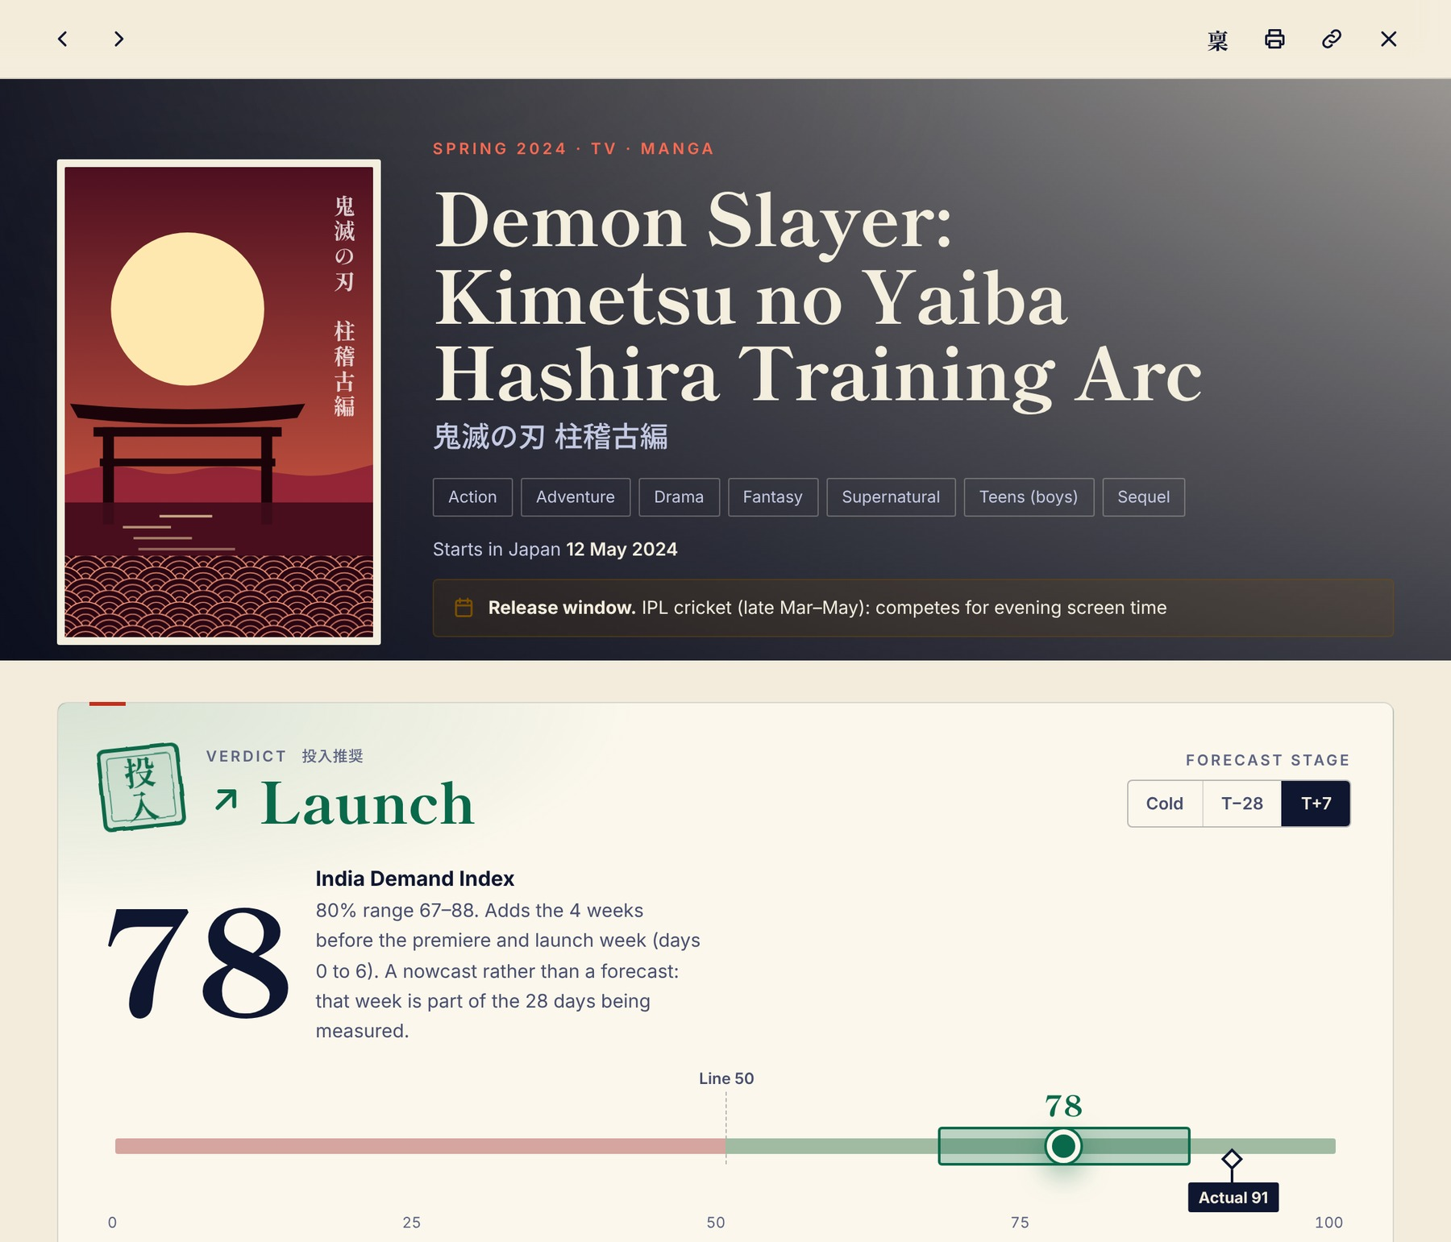

Every title, one verdict, three moments
05 — THE FORECAST
Each title gets a verdict at three points of its release cycle, with an honest range and the evidence behind it.
1
1
Downloadable one-page overview
English brief: verdict, range, drivers and launch plan, one click to PDF
稟
稟議書 (ringi-sho): the Japanese approval paper, with conclusion, grounds, precedents, risks, next dates and seal boxes
2
Three forecast moments
Cold
T−28
T+7
2
any time: genre, studio and the closest past titles
4 weeks before the premiere, adding early buzz
1 week after, adding launch week (a nowcast)
3
An honest 80% range sets the verdict
3
Launch
whole range above the line
Test-market
range straddles: test small
Hold
whole range below the line
Notes:
A real forecast sheet from our prototype: Demon Slayer, Hashira Training Arc, 2024, a title the model never trained on. At T+7 it says Launch, India Demand Index 78, 80% range 67 to 88; the real result was 91. Marker 1: the 稟 and print buttons turn any sheet into a downloadable one-page overview, in English or as a Japanese ringi-sho with seal boxes, the format a Japanese licensor uses for approval. Marker 2: the same title at three moments, Cold, T-28 and T+7. Marker 3: the verdict comes from the range, not the point: Launch only if the whole range clears the line, Hold only if it is all below, otherwise Test-market.

Slide 7
Proven on titles the model never saw
06 — RESULTS
Trained on 2019–2023, then checked on 52 titles from 2024 it had never seen. Every number below comes from that held-out season.
10 of 11
4 of 4
0.66
8.4 pts
T+7 Launch calls in India's real top third, against 1 in 3 by chance
T−28 Launch calls, 4 weeks before the premiere, were real hits
T+7 rank accuracy, against 0.52 for the best simple rule
average T+7 miss on the 0–100 index; best simple rule: 9.5
Who ranks India demand best? (T+7, 2024 titles)
When will we know? A forecast made on each day
Rank accuracy: 1 = perfect order, 0 = chance. The Blend is our model; the rest are simple rules anyone could apply.
Days from the Japanese premiere. Waiting before it buys little (0.29 → 0.38); day 0 → +3 is the jump (0.41 → 0.53). So: license small early, decide the dub on day 3–7.
Notes:
Every result here is on 2024 titles the model never saw. At T+7, 10 of the 11 titles we called Launch ended in the real top third of India demand; random picking lands there one time in three. At T-28, four weeks before the premiere, all 4 Launch calls were real hits. Our blend ranks India demand at 0.66, against 0.52 for the best simple rule, and misses by 8.4 points on a 0-100 scale. The lines were tuned on these titles, so treat the hit rates as optimistic; the sealed forecasts are the honest check. The decision clock on the right shows when a forecast becomes trustworthy: barely better from seven weeks to one week out, then a jump between the premiere and day 3. That is advice a buyer can act on: license small and early, decide the dub on day 3 to 7. At Cold our model did not beat the genre average, so the rule makes those forecasts and the site says so.

Slide 8
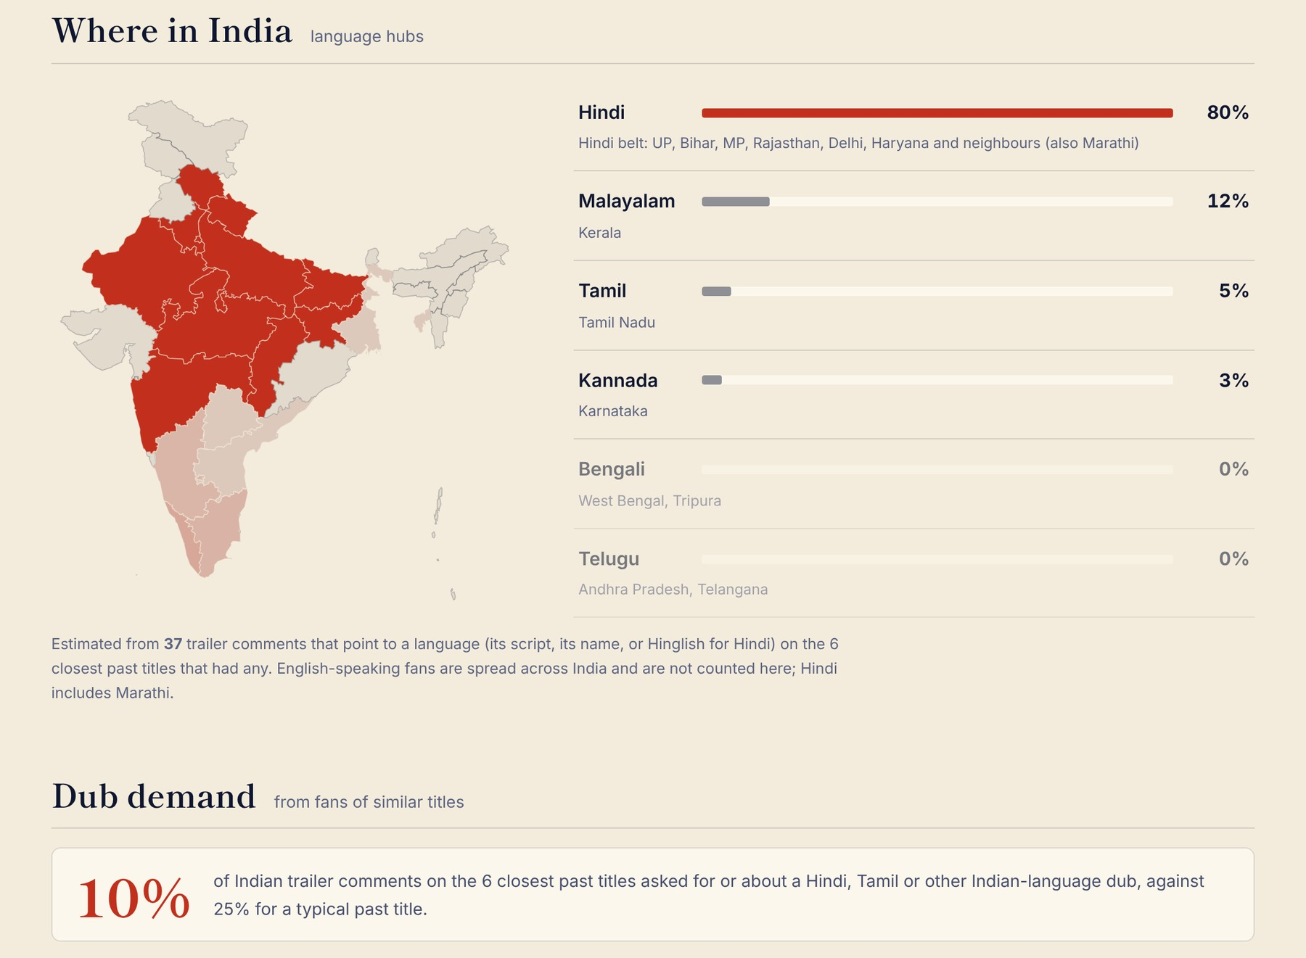

Where in India, and which dub first
07 — REGION & LANGUAGE
Every title gets a language-hub map and a dub-demand score, read from Indian fans of its closest past titles.
1,090
91%
Indian comments asking for a dub, on 68 titles
of language-tagged Indian comments are Hindi or Hinglish
Dub requests by language
Launch plan: subtitles first, a Hindi dub if early viewing shows demand
A ‘thin evidence’ flag when a map rests on under 30 comments
Release-window what-if: festive season, board exams, IPL
Notes:
Region and language are first-class outputs. For each title we map which Indian language hub its fans come from, read from the script, the language named or Hinglish in trailer comments on its closest past titles, and we measure dub demand against a typical title. Across our data, 1,090 Indian comments on 68 titles ask for a dub, 1,016 of them for Hindi, and 91% of language-tagged Indian comments are Hindi or Hinglish. The launch plan turns this into an action, such as subtitles first and then Hindi, then Malayalam, and the sheet flags thin evidence honestly when a map rests on fewer than 30 comments.

Slide 9
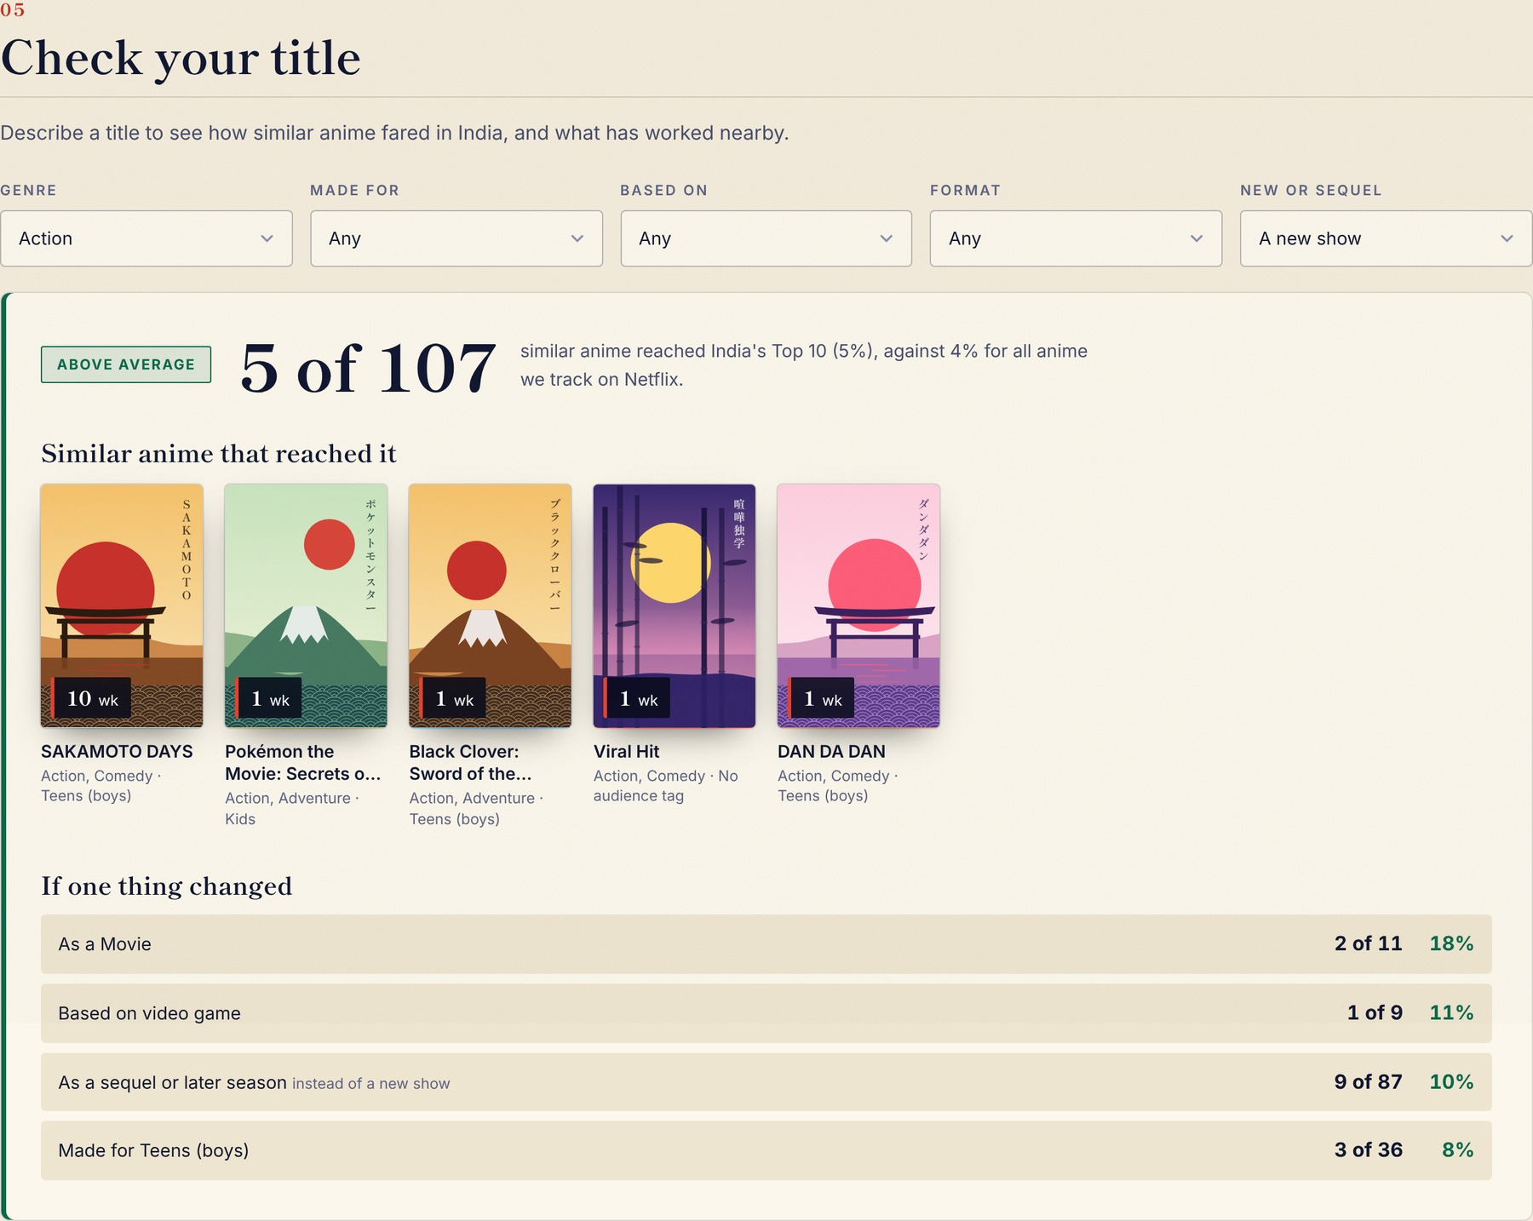

Demand Guide: an extensible service
08 — DEMAND GUIDE
Built only from what India has watched and said, so it helps even sellers whose own title is unlikely to work.
Four views, one guide
1
What India actually watched
15 anime reached Netflix India's Top 10 in 277 weeks
2
What kind of title gets there
split by genre, audience, source, format, new or sequel
3
What India is asking for
1,197 asks on 68 titles: Solo Leveling S2 (173), Infinity Castle (146), Suzume (103)
4
Check your title ◂ shown left
describe a title: similar anime that charted, plus ‘if one thing changed’
Extensible by design: plug in
+ New market
+ New signal
one line of config: Indonesia, Thailand, Brazil, Mexico ready
streaming availability → titles India asks for and cannot get
+ New content
+ New delivery
K-dramas, Japanese films, Indian films abroad
API, Excel slate, alerts in Slack, Teams or LINE WORKS
Notes:
The Demand Guide is a separate service from the forecasts. It uses only two counted signals, Netflix India's weekly Top 10 and India-flagged trailer comments, so it is useful even to a seller whose own title is unlikely to work. Four views: what India actually watched; what kind of title gets there; what India is asking for, with 1,197 comments on 68 titles asking for a dub or for where to watch; and Check your title, shown here: describe a title and see how similar anime fared in India and what would change if one thing were different. It is built to extend: a new market is one line of configuration, a new signal such as streaming availability turns the asks into a sales list, and new content types and delivery channels plug into the same engine.

Slide 10






Business model and where we go next
09 — BUSINESS
One wrong rights deal or dub costs more than years of a subscription, and serving one more title costs close to nothing.
Who pays
How we earn
Future expansion
Indian streaming & TV
Season subscription
NOW
what to license, when, and whether to dub
every new title at all three stages, refreshed daily
Japanese anime → India: 1,400 titles, Winter 2027 forecasts sealed
Japanese studios & licensors
Per-title briefs
which titles to offer India, at what price
one-page overview, in English or as a 稟議書
NEXT · 3 MONTHS
Cinema chains
Partner tier
Grade the sealed season; pilots with a Japanese rights holder and an Indian distributor; Indonesia, Thailand, Brazil, Mexico
which anime films, in which languages
adds a platform's own pre-launch signals
LATER · 12 MONTHS
Dubbing studios
Accuracy guarantee
K-dramas and Japanese films in India, Indian films abroad; revenue forecasts with partner data; Japanese UI and API
which titles and languages to pitch
a season free if under 70% land in range, once proven
Moat: a sealed, dated track record no rival can backfill
Tailwind: Japan targets ¥20 T in overseas content sales by 2033
Reach: Netflix publishes Top 10 charts for about 90 countries
Notes:
Who pays: whoever makes an India launch decision with money on it. Indian streaming platforms and TV decide what to license, when and whether to dub; Japanese studios and licensors decide which titles to offer India and at what price; cinema chains pick films and languages; dubbing studios pick titles and languages to pitch. How we earn: a season subscription covering every new title at all three stages; per-title one-page briefs in English or Japanese; a partner tier that adds a platform's own pre-launch signals; and, once sealed seasons prove the ranges, an accuracy guarantee. We have not tested prices with a buyer yet. Future expansion: now Japanese anime in India; next, grade the sealed season, run pilots with one Japanese rights holder and one Indian distributor, and open Indonesia, Thailand, Brazil and Mexico, which are already set up; later, K-dramas, Japanese films, Indian films abroad and revenue forecasts with partner data. Global firms such as Parrot Analytics already sell demand data to studios, so buyers pay for this answer; Yosoku is narrower, cheaper and India-specific, with a decision attached. The code can be copied; a sealed, dated track record cannot. Thank you from Team shecodes.

