Slide 1
NAME- AJHAY.V
ROLL NUMBER – 1931004
MSC SS 2YEAR
PROJECT – A RESPONSIVE MUSIC INSTITUATION WEBSITE
WEBSITE NAME – Guitartfacbe

Slide 2
Guitartfacbe
PROJECT ABSTRACT–
The core objective of this project is to give my music institution a good responsive website for teaching through online effectively in these tough times.
I ve used React js platform to build the front-end design and I ve used firebase database for the back-end to store the videos , images and other important stuffs like who have logged in , for video chat , to show who belong to which batch etc…
Vs code is used for coding and an internal connection is given for the front-end to connect with the back-end database.

Slide 3
PACKAGES USED –
To build this website effectively I ve used JAVASCRIPT,HTML,CSS,BOOTSTRAP
NPM,NPX,AND YARN PACKAGES in the front end and building process is still underway.
A RESPONSIVE WEBSITE ?-
The idea about building a responsive website is that , the website is viewed in different gadgets , so its resoultions vary .Thus building a responsive website helps people who use it to see the content s with no disturbance

Slide 4
HOW TO START –
To start with all the neccassary packages are installed and we are good to go .
Code has been put in the way that whenever any user tries to use it
He/she must first login with the G-mail id he/she has
And the person who has logged in will be saved in the database.

Slide 5
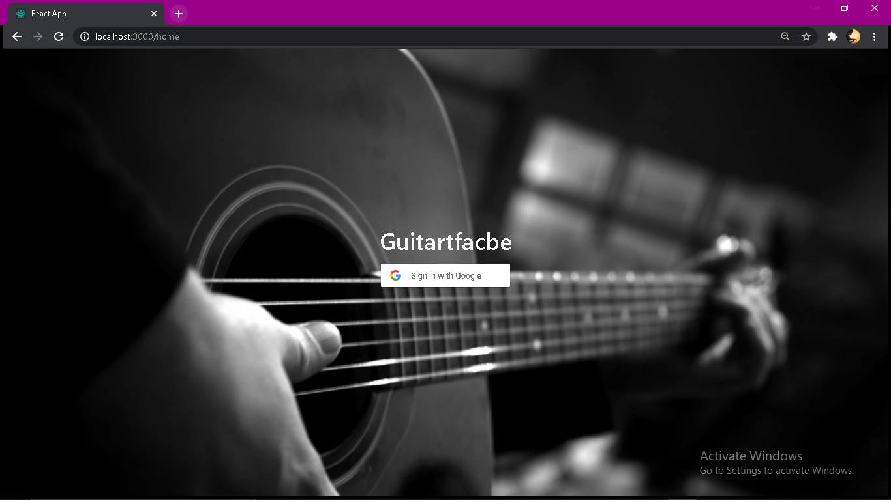
LOGIN PAGE

Slide 6
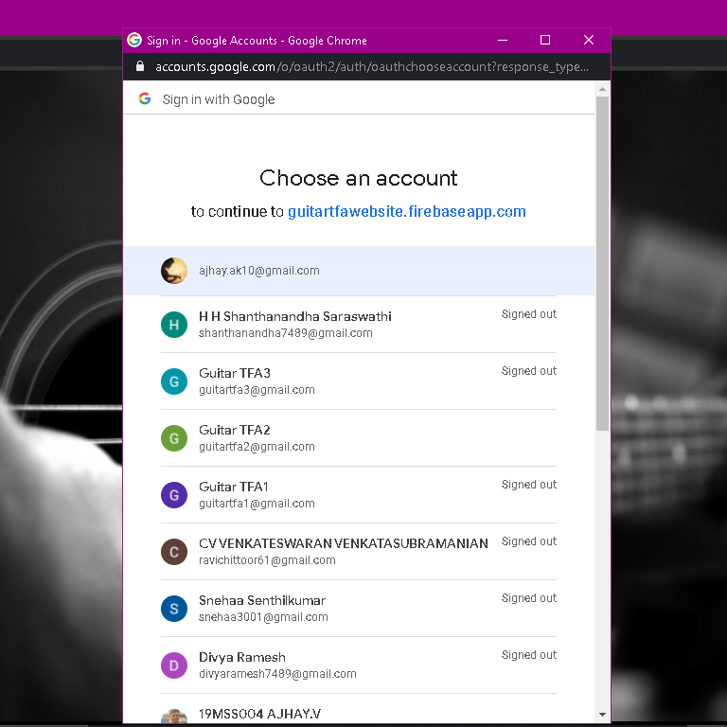
CHOOSE AN ACCOUNT TO SIGN-IN

Slide 7
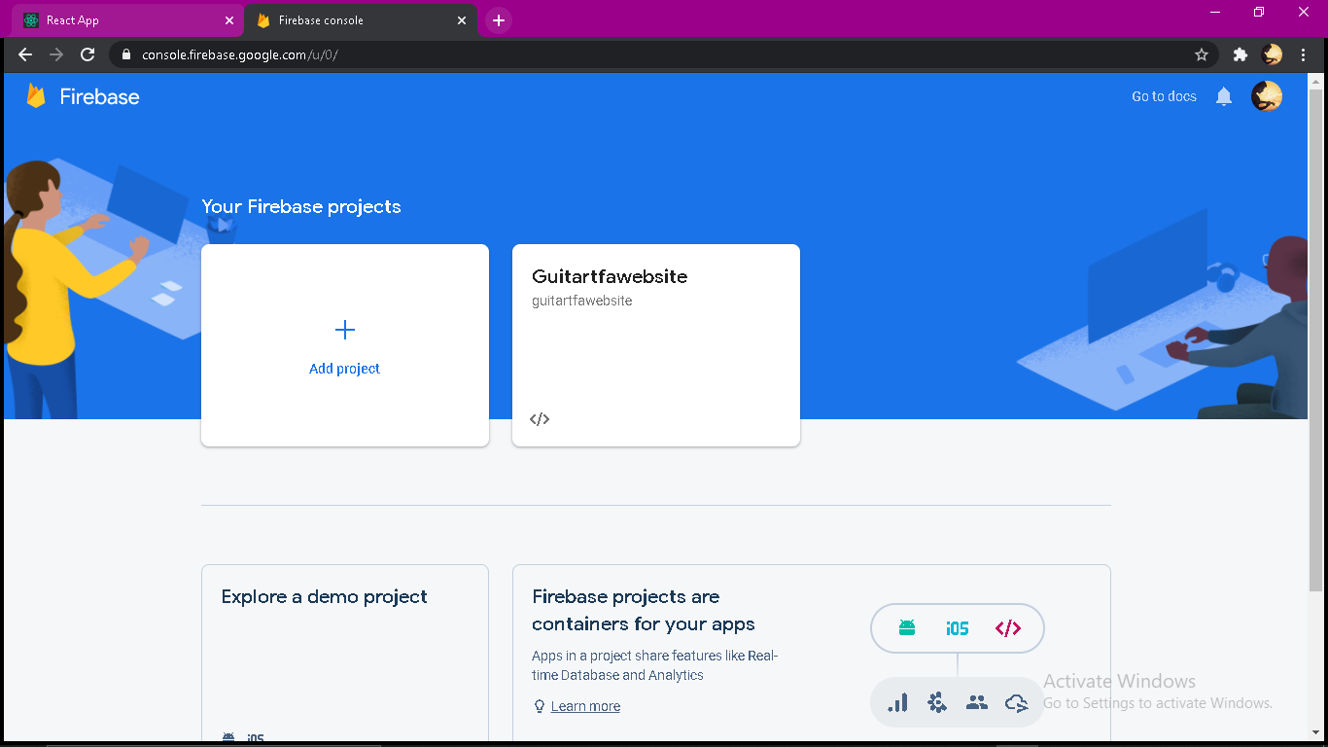
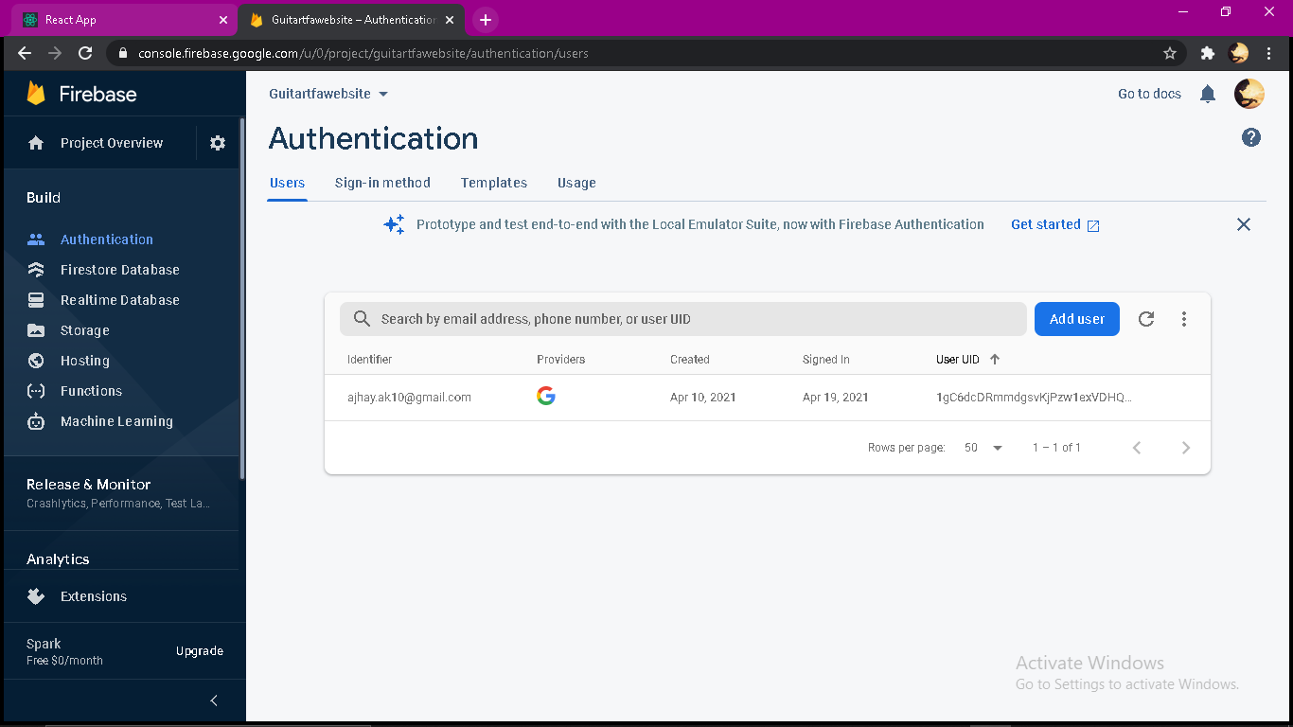
In the database our mail id is seen logged -in

Slide 8
AFTER LOGGING IN – The user can see the interface having ,
Home page – Tells about the Institution.
Batchlist -which batch he/she belongs to.
Video lessons – For Video lessons
Notes – To Use Notes
Audios – To hear lesson Audios
Meet a batch – Meet a batch option can only be accessed by the Administrator.
i.e,The staff . This is to have video calls like Gmeet to set classes via online or for anyother interaction.
As a part of extension Message option will also be Available.

Slide 9
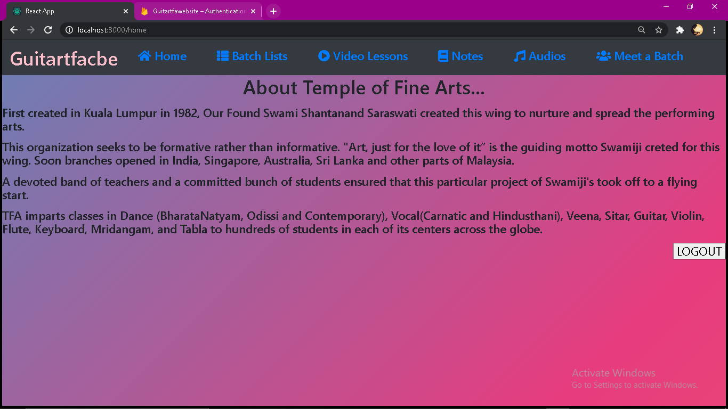
THIS IS THE FIRST PAGE WE WOULD SEE WHEN WE LOGIN and using the LOGOUT BUTTON one can go back the login page

Slide 10
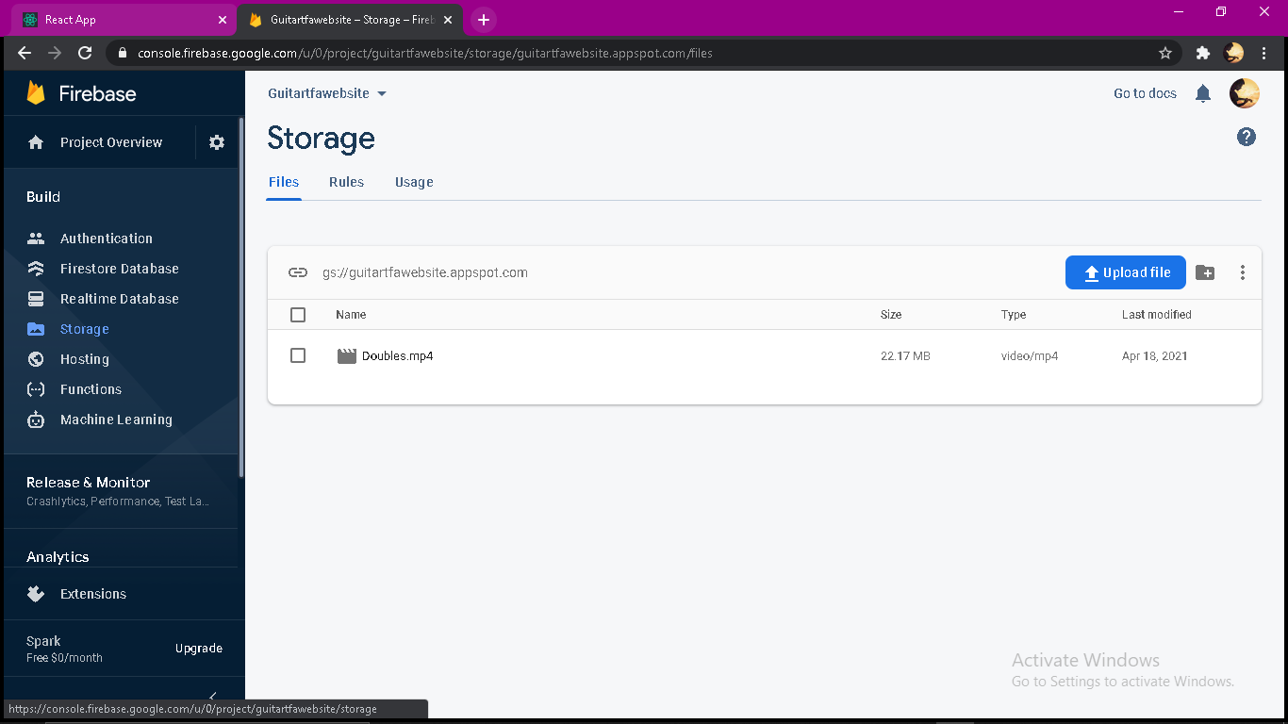
WHATS NEXT?...
ALL THE NECCASSAY VIDEOS AND IMAGES ARE ADDED TO THE FIREBASE DATABASE,
THE ONLY OBJECTIVE IS TO MAKE THEM VIEW IN OUR WEBSITE.

Slide 11
WILL BE DONE SOON ! THANK YOU …
-Guitartfacbe!

