Slide 1

Emanon
Monica Acosta
Andrew Henk
Samuel Ramirez

Slide 2
Overview
Electronic Record System for Medical Files
HIPAA Compliancy
Input Validation
Java
JavaFX
MongoDB
Client Info
Greg Anerino
Southwest Florida Prosthetic Center

Slide 3
Progress
Andrew Henk - Backend
Monica Acosta - Frontend
Sam Ramirez – Frontend
Meetings Twice a Week @5:00-8:00
Communication via GroupMe & FaceToFace();

Slide 4
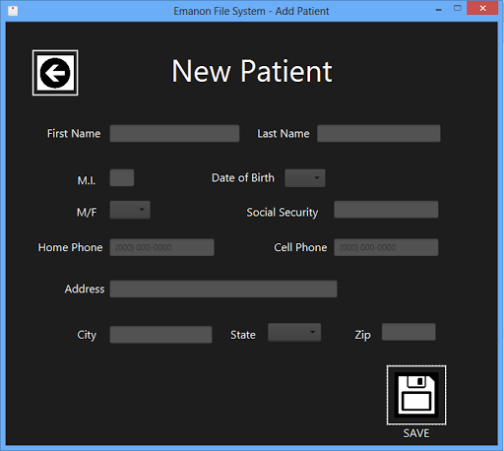
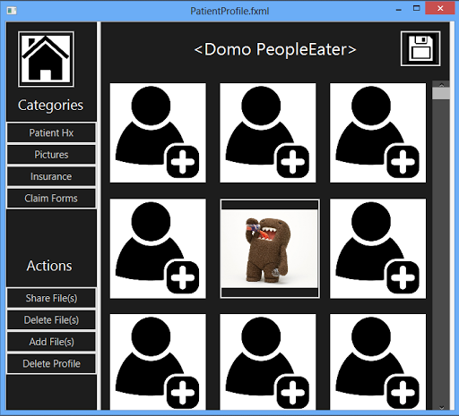
Final Product
New Patient Creation
Input Validation
Export to Database

Slide 5
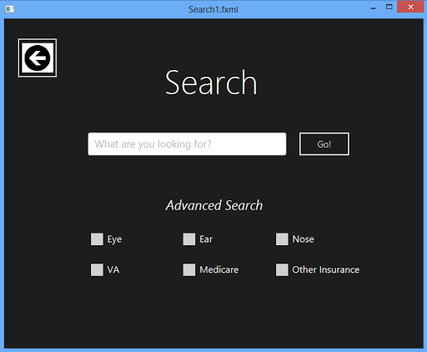
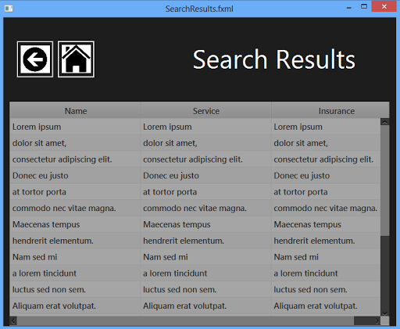
Final Product
Patient Searching
User Profiles

Slide 6
Video Preview
<Insert URL Here>

Slide 7
Test Results
Test Case ID: 3.4.1
Objective: Unsuccessfully create a patient profile
Description: User clicks “Add Patient” in home screen. A form appears with fields to enter patient billing information. User enters “Gingerbread” “Man” “Drury Lane” “Narnia” “Seven Isles” “00000” “1” “1” “01/01/0001” “Medicare AARP” into respective fields. User clicks “Save”.
Test Conditions: 3.2
Expected Results: Error window appears and states that phone number and SSN fields have invalid inputs and prompts user to correct the entries.
Successfully prevents the creation of the Gingerbread man
Successfully add a picture to the patient profile
---------------------
Test Case ID: 3.7.0
Objective: Add picture to patient profile
Description: In the patient profile, the user selects the “Add picture” button. File selector appears and user selects picture file and selects “OK”
Test Conditions: 3.6

Slide 8
Test Results
Test Case ID: 3.2
Objective: Proper login
Description: Attempt login with: “Admin1” username and “password1” password.
Test Conditions: 3.1
Expected Results: Home screen successfully loads.
Properly logs into the program
Properly logs into the program
---------------------
Test Case ID: 3.2.1
Objective: Improper login.
Description: Attempt login with: “penguins@#” username and “password**” password.
Test Conditions: 3.1
Expected Results: Invalid login message appears.

Slide 9
Test Results
Test Case ID: 3.3
Objective: Change password
Description: Select the “Forgot Password.” Authenticate user by inputting “Admin1” username and “potato” for the “Favorite food?” security question in their appropriate locations. Input “x2o09ijk” password in the new password box. Select “Ok.”
Test Conditions: 3.1
Expected Results: Password Changed popup appears, user redirected to login screen.
Fails to change password
Fails to search correctly
Just loads all patients
---------------------
Test Case ID: 3.5.1
Objective: No matching search criteria
Description: User starts at the home screen and clicks on “Search Patient” button. A search window appears and the user will enter “Gingerbread Man” and will click the “Search” button.
Test Conditions: 3.4
Expected Results: A search results window appears with “No search results found” text.

Slide 10
Legacy
Encrypt Everything
Fix all the database problems
Don’t change platforms or languages
Defensive programming should be maintained
Understand Git

Slide 11
Thank you! && Questions?

