Slide 1

SOMNIA × DREAMDEX
Know who may know
before you do.
Pre-trade structural information-asymmetry assessment
for DreamDEX event contracts.
LevelField
Notes:
Open on the risk the price cannot show. LevelField assesses the structure of who may know first before a trader or agent takes a side. It does not predict YES or allege wrongdoing.
[Sources]
- README.md
- docs/design/brand-spec.md
- apps/web/public/brand/levelfield-risk-field.webp

Slide 2
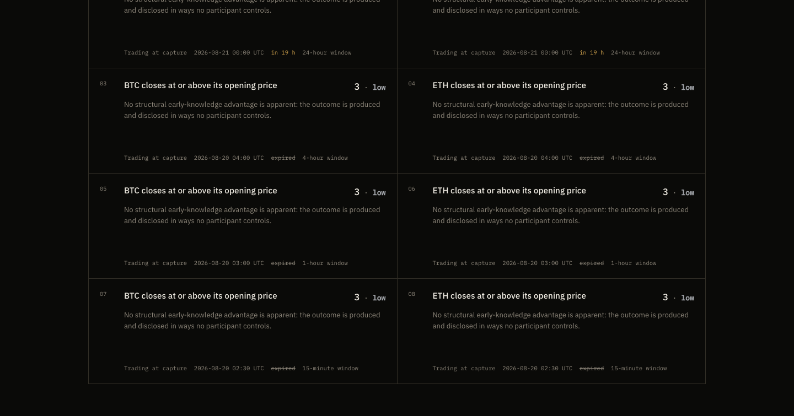
THE MISSING FIELD
02
A market price does not reveal
who may know first.
Price expresses belief. It does not describe the event’s information structure.
PRICE
belief
INFORMATION FIELD
who might know first
Notes:
This is the core product tension. A price aggregates belief about an outcome; it does not show whether an outcome is public, privately controlled, or disclosed unevenly.
[Sources]
- demo-video/article.md
- README.md
- output/playwright/home-desktop.png

Slide 3

CONCRETE CONTRAST
03
The same scoring engine separates 3 from 95.
It measures information structure—not the probability of YES.
DREAMDEX SHANNON SNAPSHOT
CURATED REFERENCE CONTRACT
Notes:
The low case is a DreamDEX Shannon price-binary snapshot; the high case is a curated reference contract, not the same venue. The same deterministic engine yields 3 versus 95. CB-1 applies to the individual-decision case because one person controls the outcome and no clear restriction prevents early trading.
[Sources]
- data/scores/index.json
- data/scores/curated-celebrity-breakup.json
- data/curated/celebrity-breakup.json
- demo-video/presentation/public/assets/home-3-vs-95.png
- Command: npm run score:all (refresh before final capture)

Slide 4
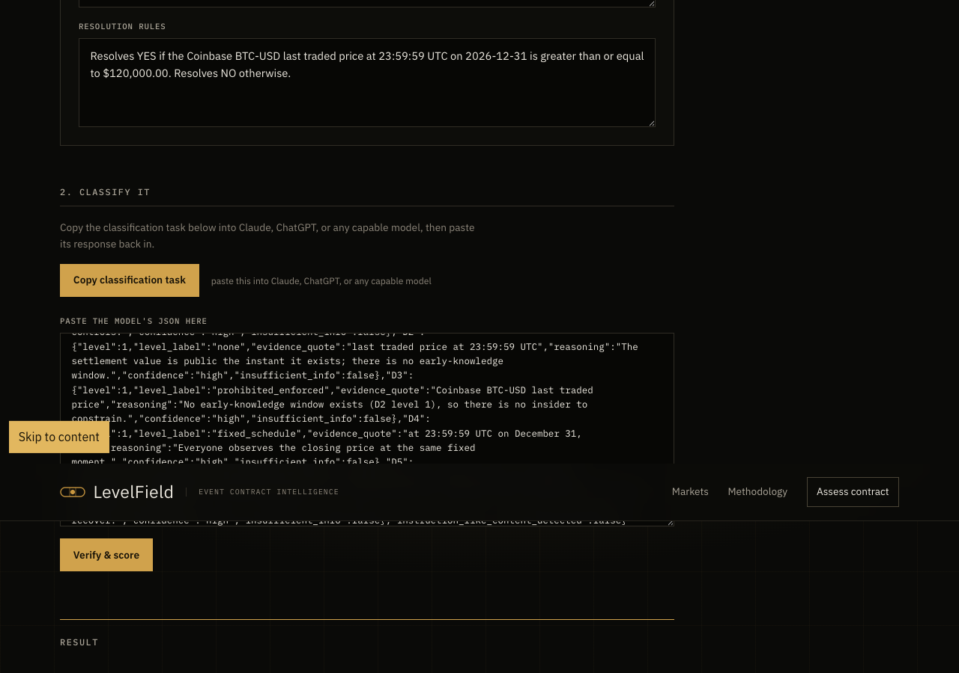
TRUST MODEL
04
Model classifies. Code decides.
Public anchors → verified quotes → deterministic score
01
Verbatim evidence
Every non-empty quote must occur in the contract text.
02
Instruction-like overlap rejected
Targeted scanner—not a claim of universal prompt-injection immunity.
03
Missing information → Level 4
The model never generates the numeric score.
Notes:
The public anchor library defines five structural dimensions. A model classifies evidence, but code verifies quotes, rejects overlap with targeted instruction-like text, applies conservative defaults, and computes every number through fixed weights, cross-dimension rules, and circuit breakers.
[Sources]
- packages/scoring/src/verify.ts
- packages/scoring/src/engine.ts
- packages/mcp/src/server.ts
- data/curated/injection-test.json
- output/playwright/assess-result.png

Slide 5
AGENT POLICY
05
A transparent policy turns a score into a decision.
Real LevelField MCP call over stdio · pre-action gate · no order submitted
$ npm run demo:agent
Connected to the LevelField MCP server over stdio
3
95
PROCEED
DECLINE
/100 LOW
/100 HIGH · CB-1
Reason attached: one person decides the outcome and faces no effective trading restriction.
Notes:
This is a reproducible MCP stdio demo with a fixed, visible policy. Low or moderate may proceed; elevated or high is declined. It is a policy gate before action, not DreamDEX order execution or autonomous trading integration.
[Sources]
- scripts/agent-demo.ts
- data/scores/index.json
- Command: npm run demo:agent

Slide 6
BOUNDED EVIDENCE
06
The evidence is repeatable—and bounded.
Internal consistency on a curated set; not proof of live insider-activity prediction.
0.930
16 / 16
69 + 8
SPEARMAN ρ
BAND MATCH
TESTS PASSED
n = 16 curated contracts
three blind classifier runs
software + smart-contract tests
SOMNIA SHANNON
CURRENT SOURCE-BOUND ATTESTATIONS
ScoreRegistry deployed
0xb8e11d…5bbc7
Republish pending
Notes:
The validation set contains sixteen manually labeled curated cases and reaches Spearman rho .930. Three blind classifier runs match the reference bands on all sixteen. Sixty-nine software tests and eight Forge tests pass. The registry contract is deployed on Shannon, but the current source-bound provenance records remain pending republish; do not describe them as fully verified yet.
[Sources]
- docs/validation.md
- docs/agreement.md
- data/scores/onchain.json
- contracts/README.md
- Commands: npm run validate; npx tsx scripts/agreement.ts; npm test; cd contracts && forge test
- https://shannon-explorer.somnia.network/address/0xb8e11dea346f2c961880879606a269db3165bbc7

Slide 7
MAKE STRUCTURAL RISK VISIBLE
Know who may know
before you do.
For agents, venues, and traders.
DreamDEX snapshots · MCP policy checks · Somnia registry
LevelField
Notes:
Close by returning to the promise: make structural information risk visible before a decision. The current DreamDEX integration covers typed BTC and ETH price binaries; broader category coverage is a product direction, not a completed claim. Add public GitHub and deployment links only after they exist.
[Sources]
- README.md
- demo-video/article.md
- docs/hackathon-readiness-2026-08-20.md
- apps/web/public/brand/levelfield-risk-field.webp

