Slide 1
In Amsterdam: does an increase of population lead to an increase in bikes?
Svetlana Gruzdeva - Alexandra Victoria
Gruzdeva-Victoria Group BV
October 2020

Slide 2
AVAILABLE DATA
CONCERNING ‘BIKES’ in AMSTERDAM per/Year :
TOTAL AMOUNT of BIKES in AMSTERDAM
PURCHASED BIKES
CONFISCATED BIKES
STOLEN BIKES
FETCHED BIKES from CANALS (Average)
INCREASE
CONCERNING ‘POPULATION’ in AMSTERDAM per/Year:
TOTAL AMOUNT OF ‘AMSTERDAMERS’
NET INCREASE in POPULATION
Notes:
This is an ex of a note

Slide 3
DATA LIMITATIONS - COMPARISONS
DATA LIMITATIONS:
CONFISCATED BIKES : Redefinition of the proportion taken
STOLEN BIKES: Not defined, Not taken
PURCHASED BIKES : Data extrapolated
FETCHED BIKES: Redefinition of the data per year
COMPARISONS
PURCHASED BIKES vs. CONFISCATED BIKES
PURCHASED BIKES vs. FETCHED BIKES
NET INCREASE BIKES vs. NET INCREASE POPULATION

Slide 4
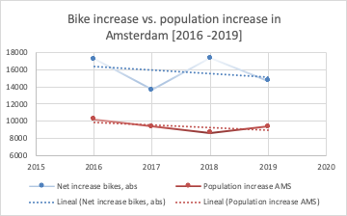
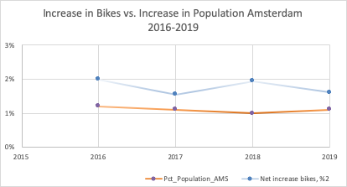
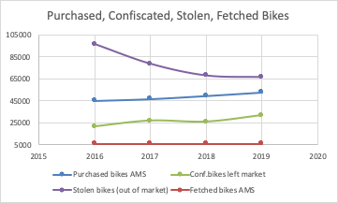
RESULTS

Slide 5
POST-ANALISIS DIAGNOSIS
OTHER FACTORS INFLUENCING ‘BIKES’
AMSTERDAM CITIZENS != AMSTERDAM POPULATION
SPECIFIC SPORTS (requiring a different bike)
OTHER FACTORS INFLUENCING ‘POPULATION:
AGE GAPS within the period chosen
OTHER NATIONALITIES (not counted in increase of NL Population)

