Slide 1
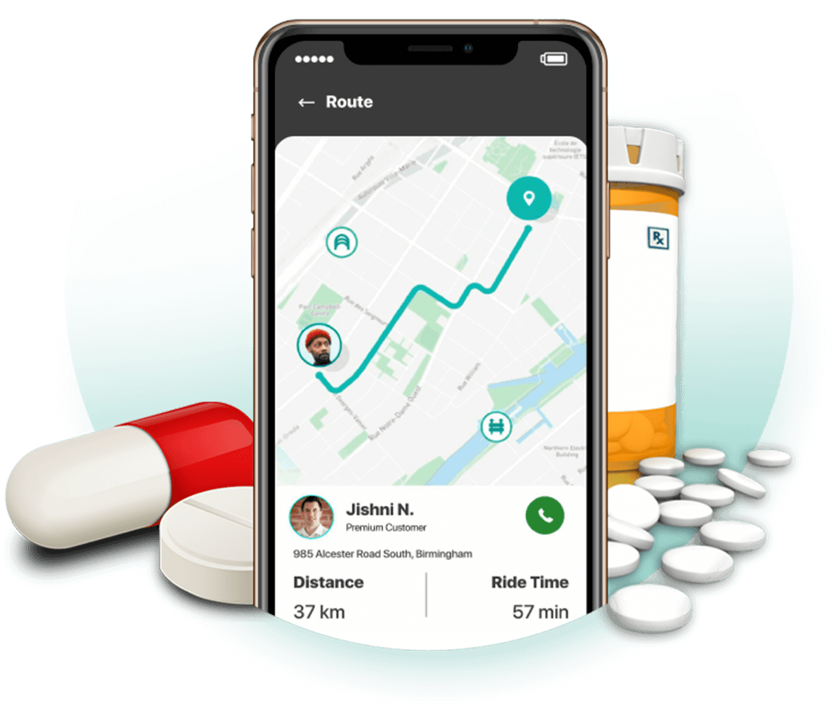
EduConnect : A Web-Base Platform for Academic Collaboration and Resources Sharing
Presented by,
Mohammad Ajij
ID: MUH2011023M
Session: 2019-20
Department of ICE,
NSTU.
Supervised by,
Md. Mahbubul Alam
Assistant Professor
Department of ICE,
NSTU.
23-07-2025

Slide 2
Outlines
INTRODUCTION
PROBLEM STATEMENT
OBJECTIVES
RELATED WORK
METHODOLOGY
RESULT
LIMITATIONS & FUTURE SCOPE
CONCLUSION
2

Slide 3
.
Introduction
Serve students and teachers with a structured academic platform.
Offers discussions, virtual study rooms and group collaboration.
Provide easy access to share notes and class materials.
Send real-time alerts for exams and schedules.
Use AI for quick study help and smart task tracking.
Reduce social distractions and boost focus, productivity, and teamwork.
3

Slide 4
.
Problem statement
Existing academic communication relies on social media, causing distractions.
Lack of effective academic collaboration tools.
No central place for group study, AI help, or resource sharing.
Lack of timely class and exam schedule notifications.
Poor organization of class notes and academic materials.
4

Slide 5
.
Objectives
To build a focused, distraction-free academic platform.
To promote collaboration through group chats and study rooms.
To deliver real-time class and exam schedules.
To provide AI-based study help and task tracking.
To improve academic communication and resource access.
To reduce dependency on social media for learning.
5

Slide 6
Related Work
Academic Platforms Reduce Distractions – Studies suggest dedicated a cademic platforms enhance learning by minimizing distractions.
Integration of CMC with Education – Combining communication tools with structured academic resources improves student engagement.
Social Media Disrupts Learning – Research shows platforms like Facebook hinder academic performance due to non-educational distractions.
Need for Structured Collaboration – Scholars propose designing structured academic platforms that support organized discussions and resource sharing.
Project Addresses These Gaps – This project develops a web-based academic platform focused on collaboration, workflow management, and distraction-free learning.
6

Slide 7
Methodology
Project Module
Student & Teacher Module
Admin Module
Participate in academic discussions
Share and access class materials and notes
Join study groups and collaborate with peers
Manage tasks using a smart to-do list
Securely upload and organize personal notes
View Class and Exam Schedule
Get instant study help using the built-in AI assistant
User Management
Schedule Management
Generate Report
Manage Different Academic Info
Manage real-time user updates
7

Slide 8
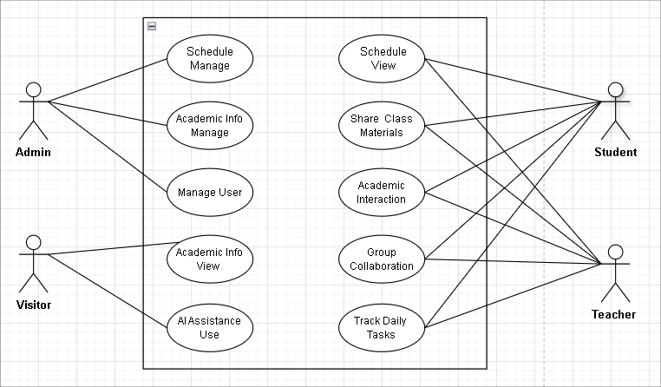
Use Case Diagram
Figure : Use case diagram.
8

Slide 9
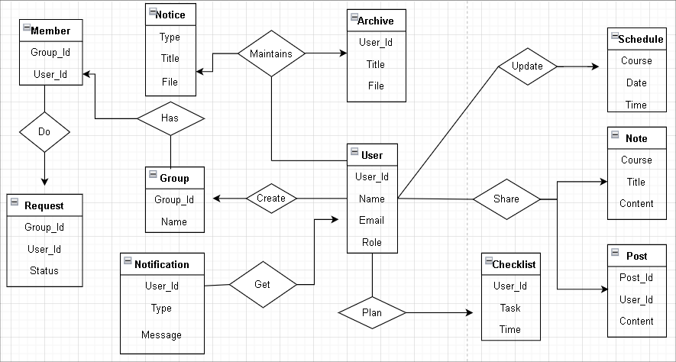
E-R Diagram
Figure : E-R diagram.
9

Slide 10
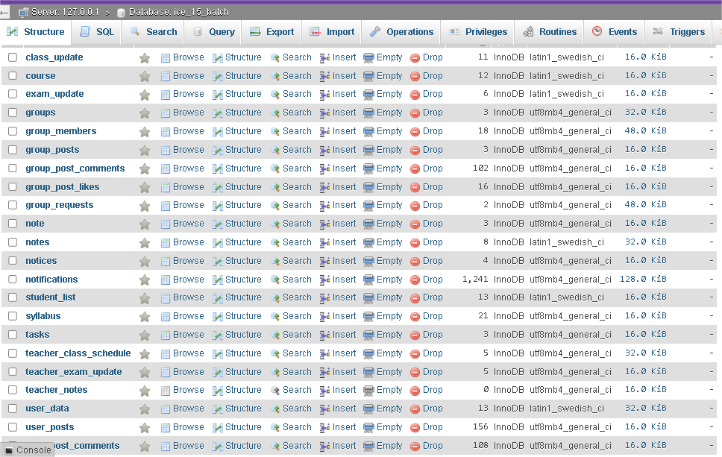
Database Design
Figure : E-R diagram.
9

Slide 11
Technologies and Tools
Front-end Development
HTML
Back-end Development
PHP
Database Related Tools
MySQL
CSS
Bootstrap
JavaScript
11

Slide 12
Result and Discussion
The system was structured into 4 integrated module :
Student module
Teacher module
Admin module
Visitor module
12

Slide 13
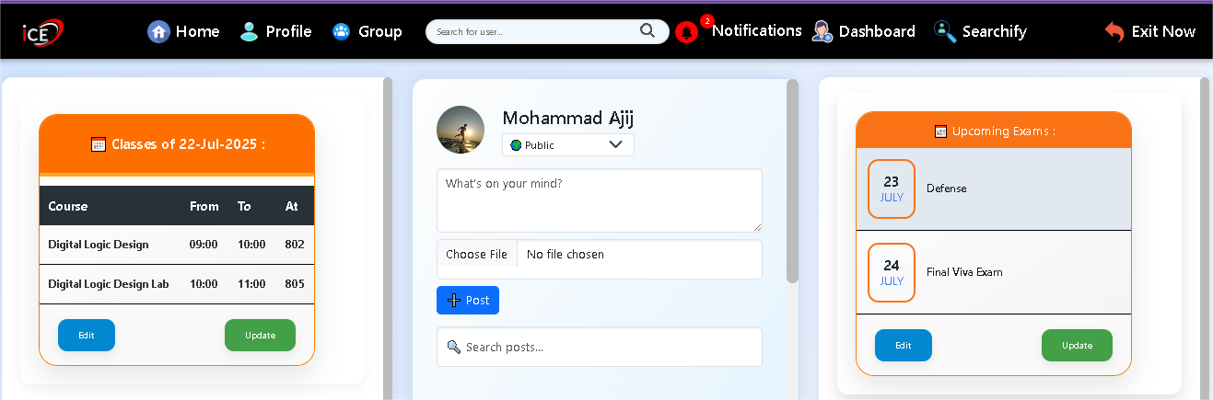
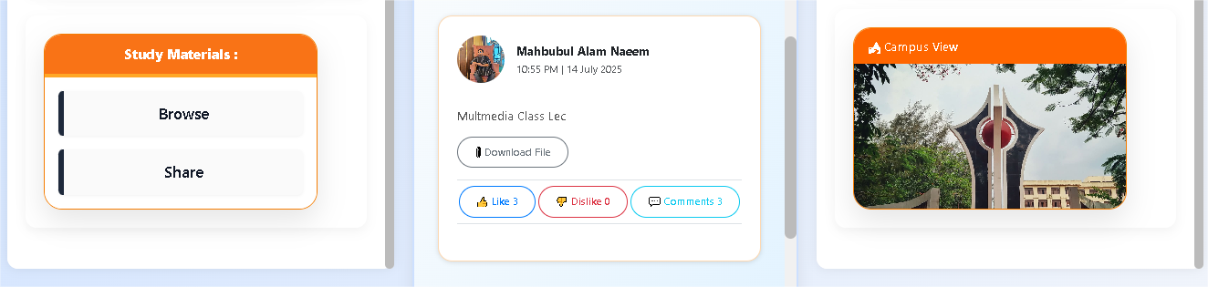
Student Dashboard
Figure : Student Dashboard of the system
13

Slide 14
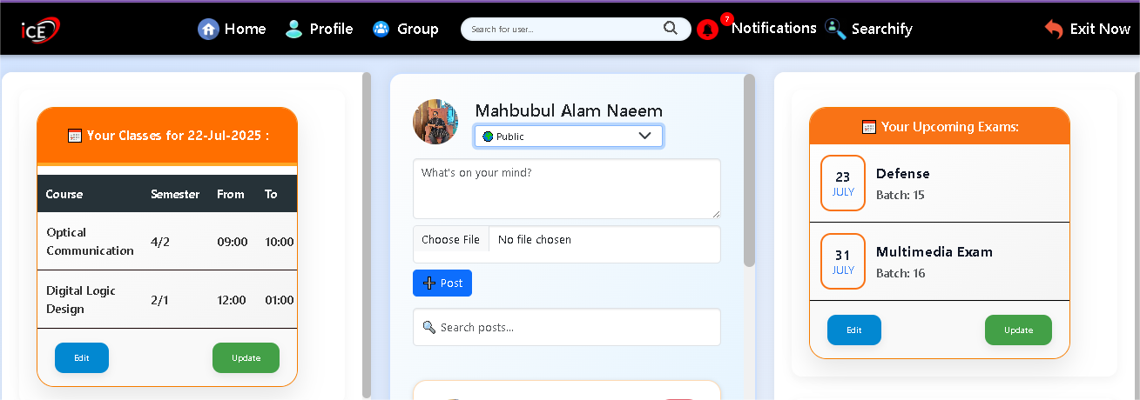
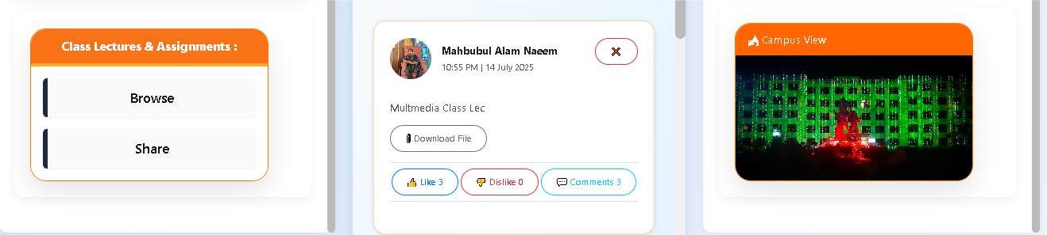
Teacher Dashboard
Figure : Teacher Dashboard of the system
14

Slide 15
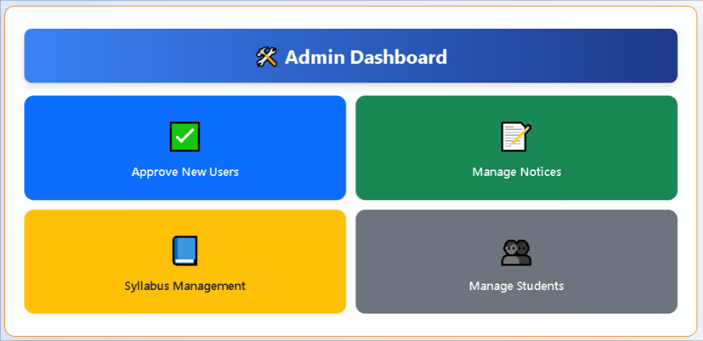
Admin Dashboard
Figure : Admin Dashboard of the system
15

Slide 16
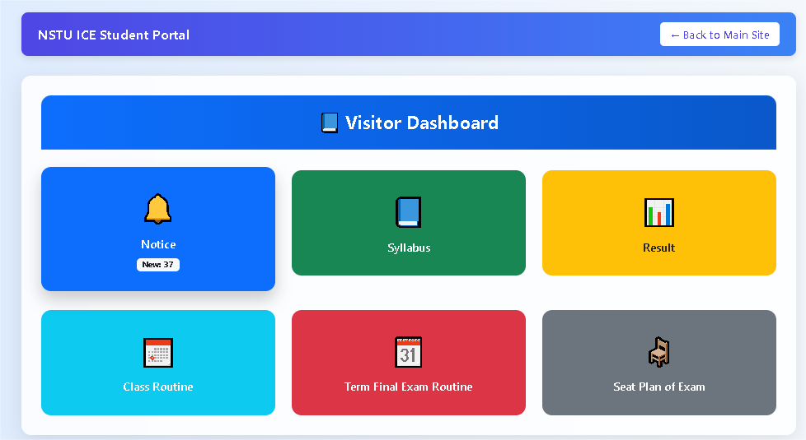
Visitor Dashboard
Figure : Visitor Dashboard of the system
16

Slide 17
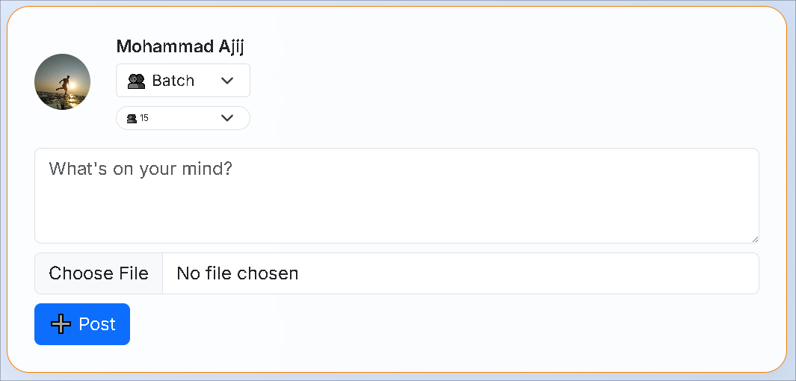
Academic Collaboration
Figure : Post Creation Box Page
17

Slide 18
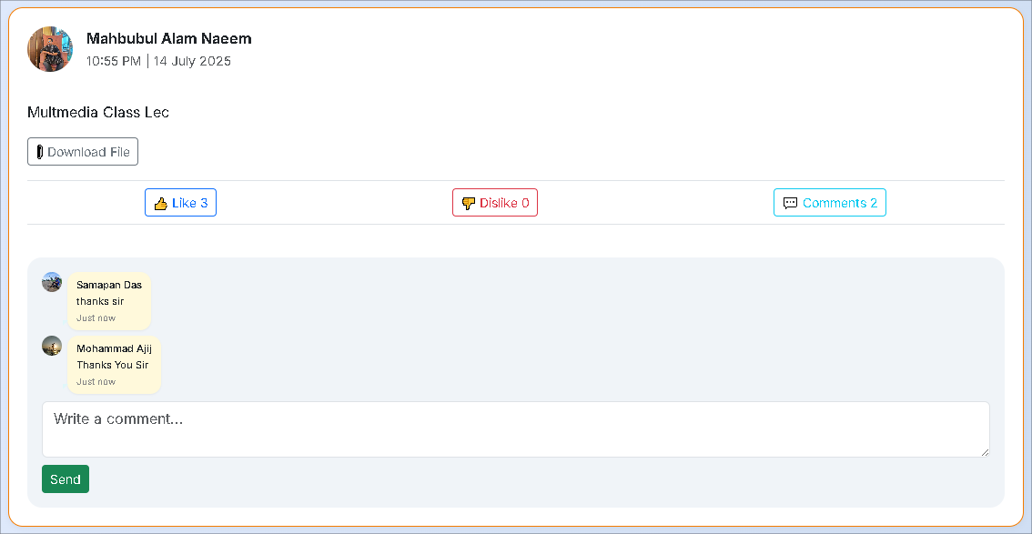
Figure : Shared Post with Comment Feature
18

Slide 19
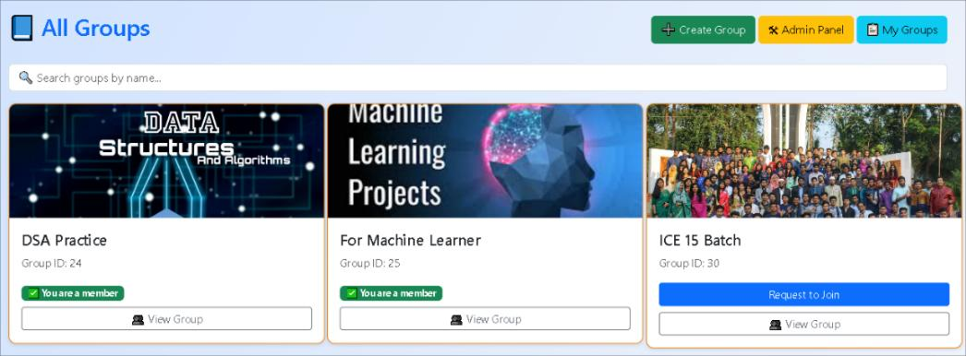
Collaborative Group Forum
Figure : Group Directory Page
19

Slide 20
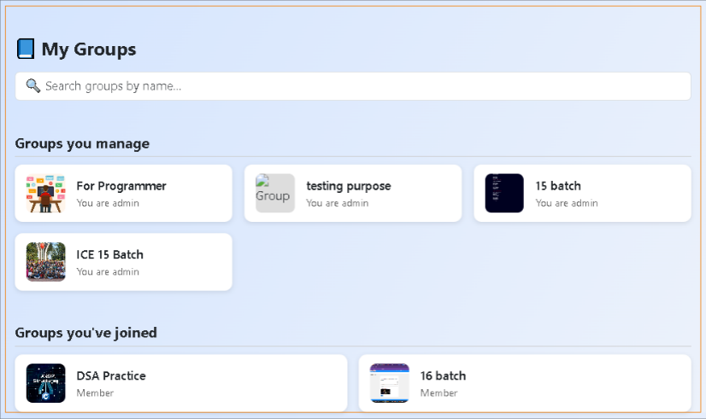
Figure : My Groups Page
20

Slide 21
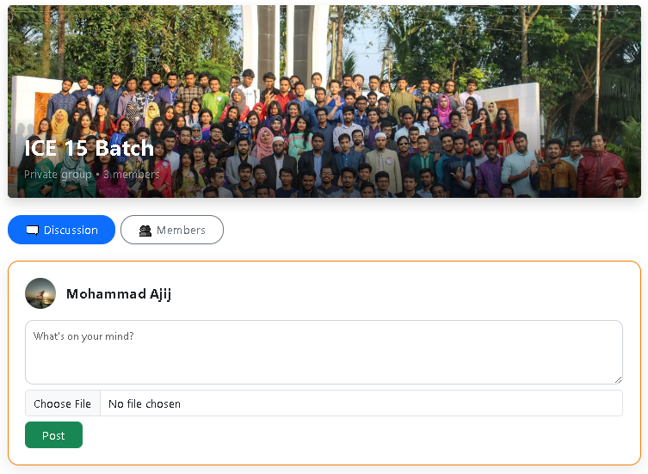
Figure : My Groups Page
Figure : Collaborative Group Forum
21

Slide 22
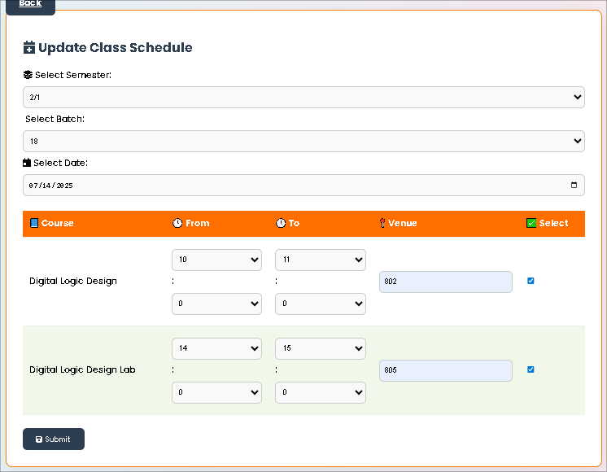
Update Class Schedule
Figure : Update Class Schedule
22

Slide 23
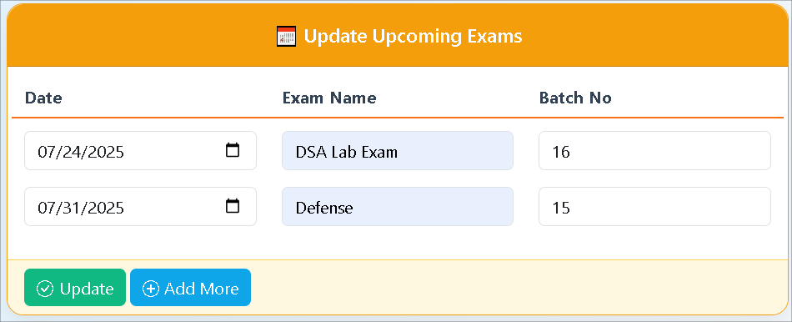
Update Exam Schedule
Figure : Update Exam Schedule
23

Slide 24
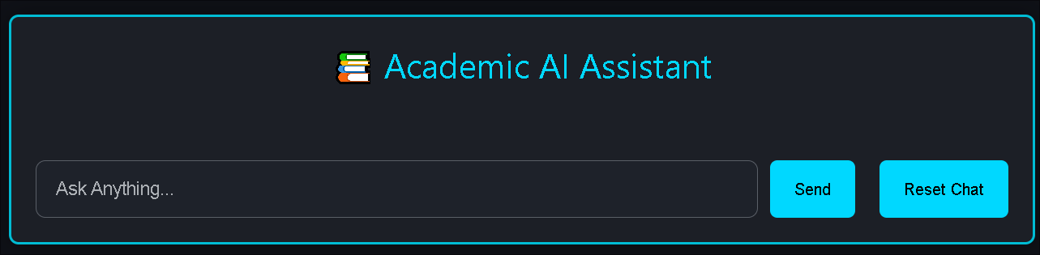
Academic AI Assistant Chat Module
Figure : AI Query Panel
24

Slide 25
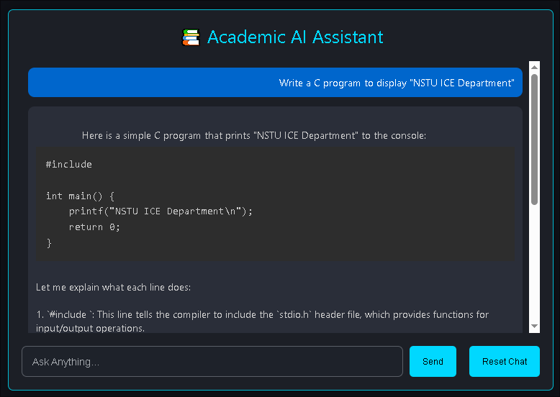
Figure : AI Response Viewer
25

Slide 26
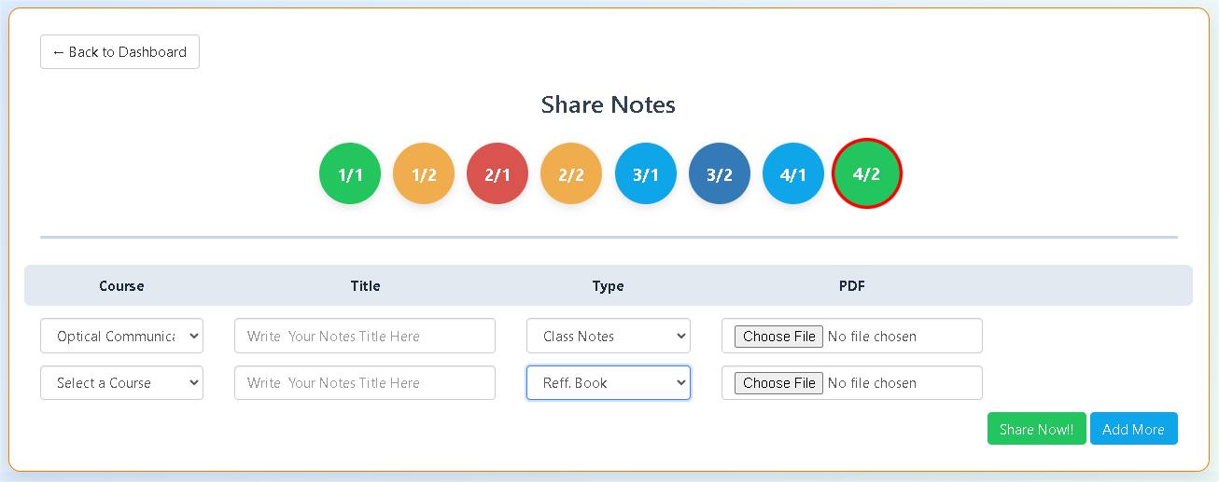
Note Sharing Page
Figure : Note Upload Page
26

Slide 27
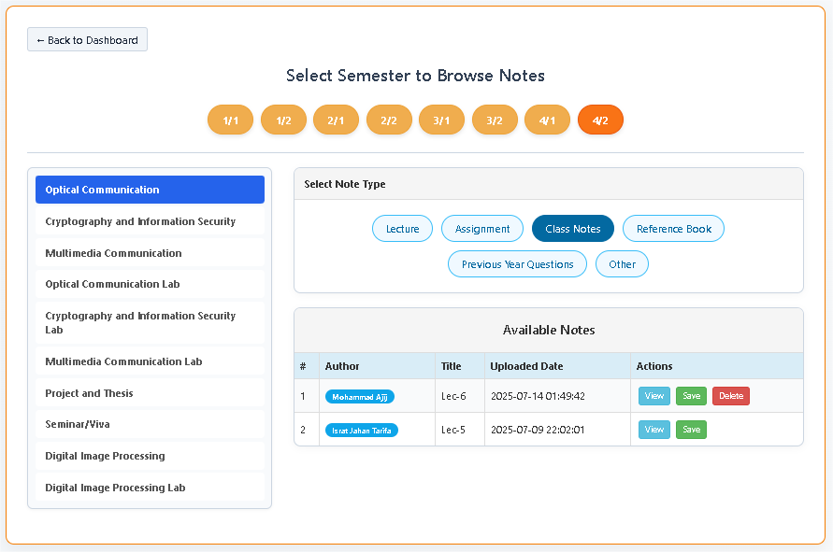
Study Materials Explorer
Figure : Available Notes Viewer Page
27

Slide 28
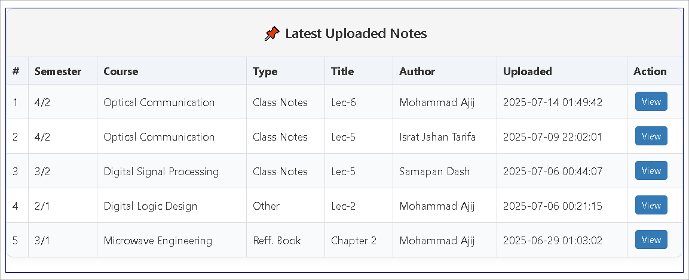
Latest Uploaded Notes
Figure : Latest Uploaded Notes
28

Slide 29
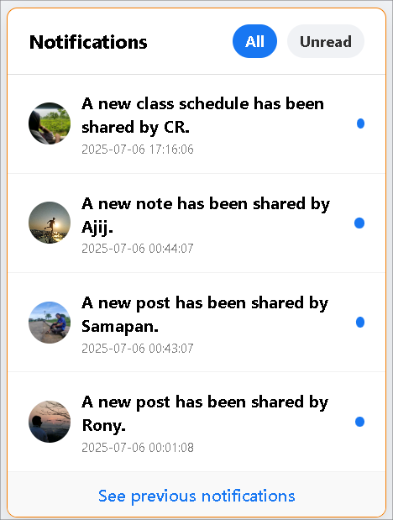
Notification Panel
Figure : Notification Panel
29

Slide 30
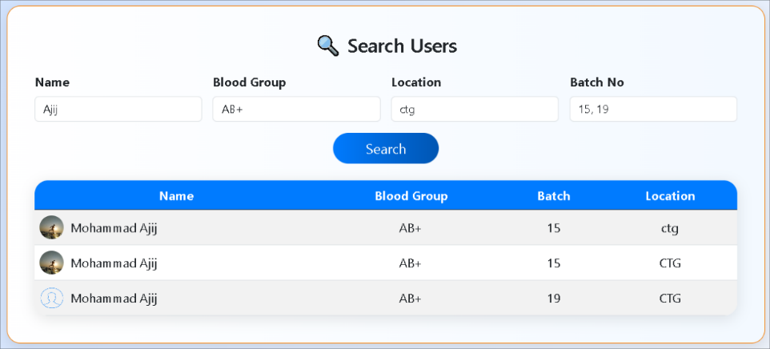
Smart User Finder Module
Figure : Smart User Finder Module
30

Slide 31
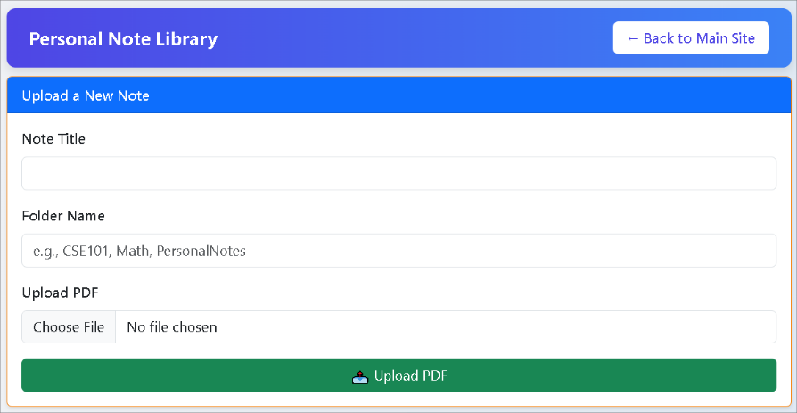
Private Notes Archive
Figure : Note Upload Interface
31

Slide 32
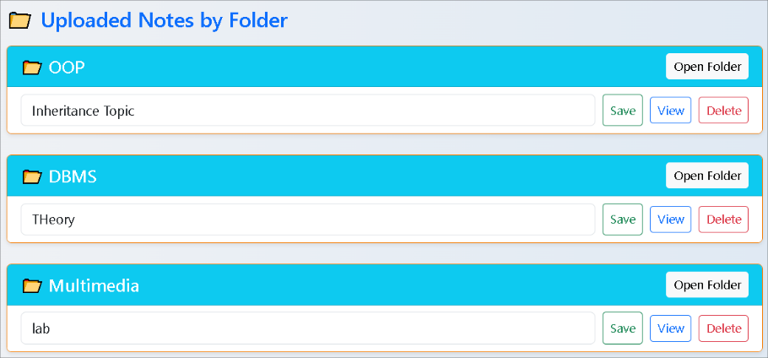
Organized Note Management
Figure : Organized Note Management Panel
32

Slide 33
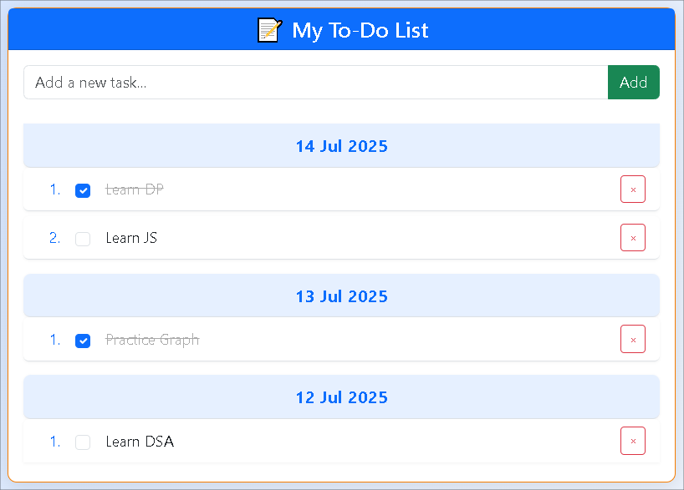
Smart Task Tracker
Figure : Smart Task Tracker
33

Slide 34
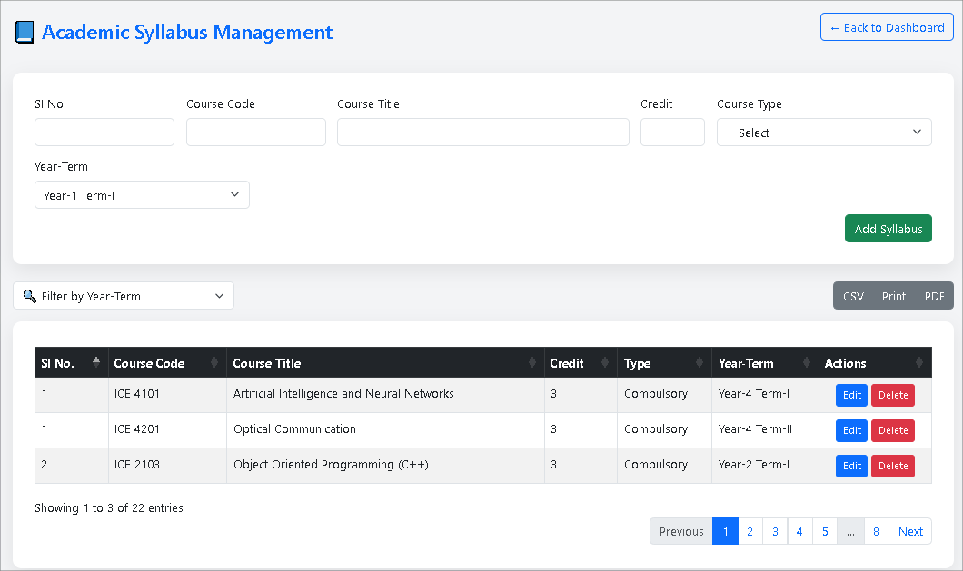
Academic Syllabus Management
Figure : Academic Syllabus Management
34

Slide 35
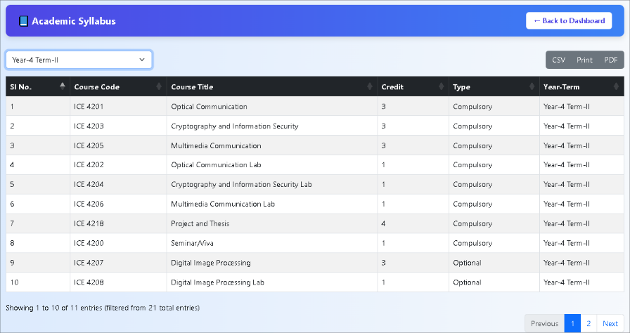
View Academic Syllabus
Figure : View Academic Syllabus
35

Slide 36
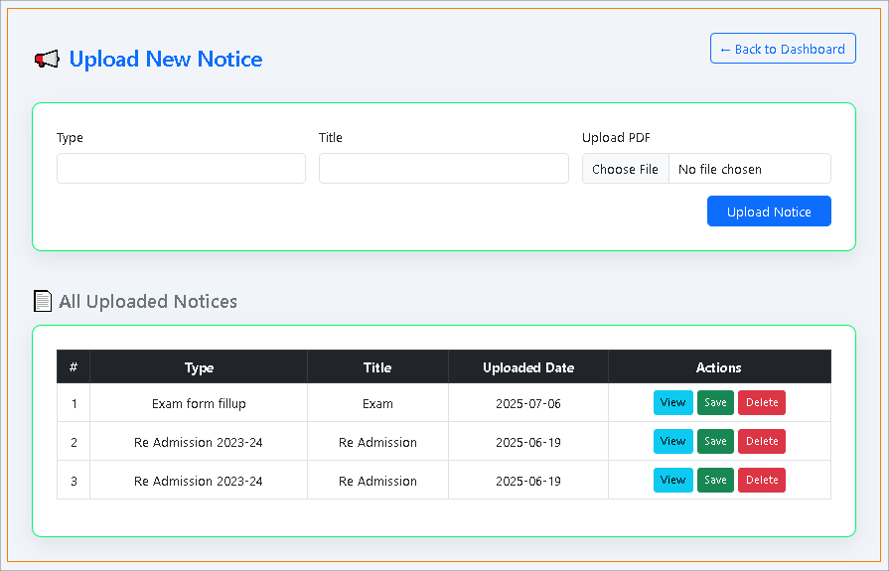
Notice Management Panel
Figure : Notice Management Panel
36

Slide 37
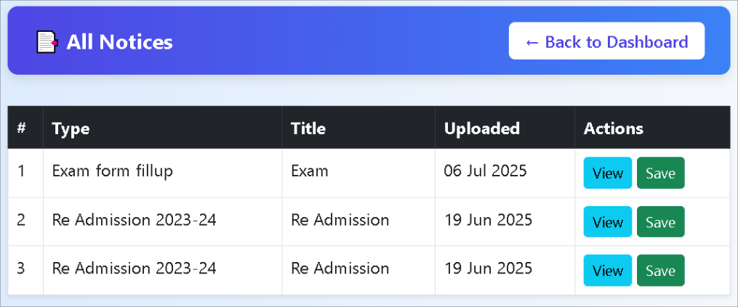
Notice Board Overview
Figure : Notice Board Overview
37

Slide 38
Limitations
Dependency on Internet Connectivity
Scalability issues for larger user bases
Need for regular maintenance and updates
No offline mode for accessing resources
No live video in group study
Cost of hosting and development
38

Slide 39
Future Scope
Mobile App Development
Mentorship Features
Integration of Video Tutorials
Expanded Virtual Study Rooms
Enable offline access
39

Slide 40
Conclusion
Provides a focused platform for academic collaboration
Enhances collaboration with discussions, study rooms, and AI help.
Reduces distractions and streamlines academic management.
Improves communication and boosts learning efficiency.
40

Slide 41
Thank you

