Slide 1
SAINTGITS COLLEGE OF ENGINEERING
Department of Electronics & Communications Engineering
BJT THERMAL RUNAWAY
Fixed Bias vs Voltage Divider Bias
EDC Project | Academic Year 2025–26
Project Guide: Dr Vinodkumar Jacob
Ajil Reji — 06 • Geojin Mathew — 31 • Jeril Liju Philip — 38
Joshua Joseph Varghese — 41 • Meeval Varghese — 47
Simulation-based investigation using LTspice

Slide 2
Introduction & Objectives
Why biasing stability matters in transistor circuits
BJT basics
Thermal sensitivity
Why compare biasing?
A bipolar junction transistor controls collector current through base drive. Its operating point depends on bias and temperature.
Temperature affects parameters such as base–emitter voltage and leakage current, shifting collector current.
A stable operating point helps electronic circuits remain predictable as temperature changes.
Project objectives
• Compare fixed-bias and voltage-divider-bias circuits using a nominal 12 V supply.
• Observe collector-current variation across a simulated temperature sweep.
• Quantify the current change between 25°C and 80°C.
• Discuss which bias arrangement provides better temperature stability in this simulation.
Scope: LTspice simulation only; no physical prototype has been tested.
2

Slide 3
Thermal Runaway — Feedback Mechanism
Temperature sensitivity can contribute to instability under some conditions
1
Temperature rises
2
Collector current may rise
3
Power dissipation increases
4
Further heating may occur
Relevant relation
Important distinction
Approximate transistor power dissipation: P ≈ VCE × IC. Higher current can increase heating depending on operating conditions.
A current rise over a temperature sweep shows temperature sensitivity; it does not by itself prove thermal runaway occurred.
This project compares how two bias networks respond to temperature.
3

Slide 4
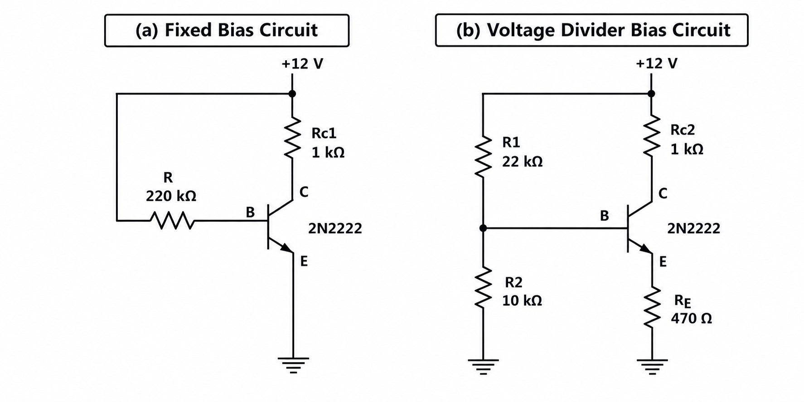
Circuit Comparison
Component values taken from the supplied LTspice schematic
Key difference: the voltage-divider sets the base voltage; RE = 470 Ω provides negative feedback that tends to oppose current increases.
4

Slide 5
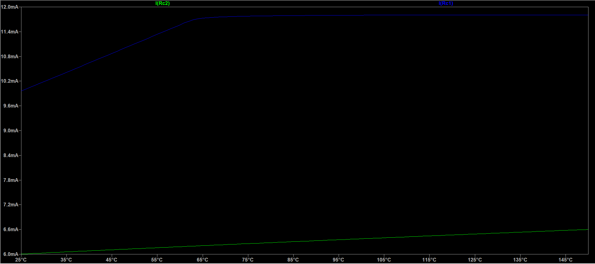
LTspice Simulation Method
Both circuits were simulated in one file and swept over temperature
Software & model
LTspice • schematic label: 2N2222
Supply voltage
12 V for each circuit
Temperature sweep
.dc temp 25 150 1
25°C to 150°C in 1°C steps
Traces:
I(Rc1) = fixed bias
I(Rc2) = voltage-divider bias
5

Slide 6
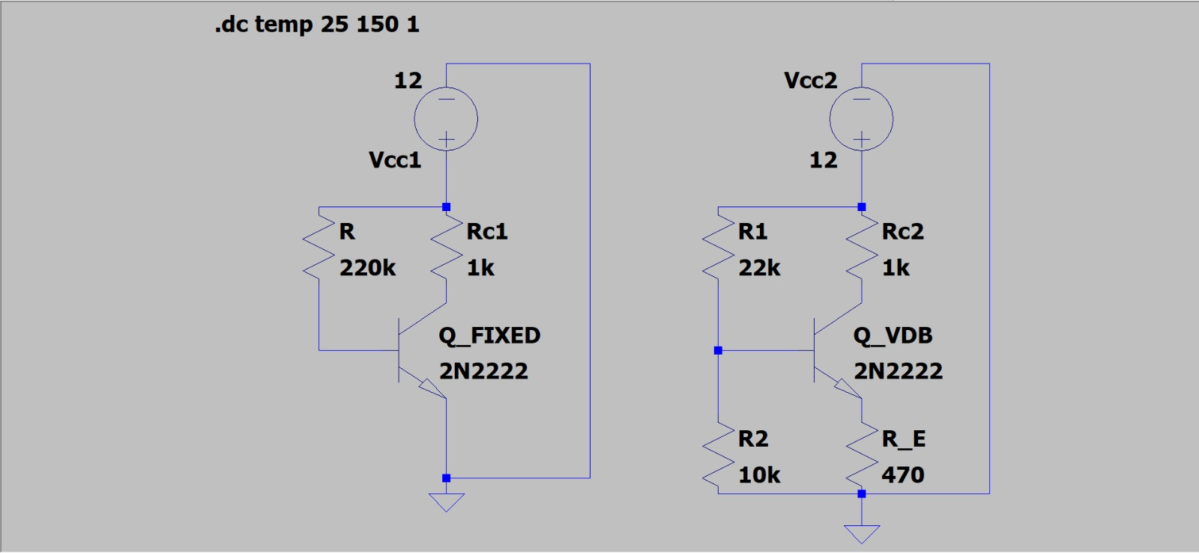
Simulation Results
Collector current at 25°C and 80°C
Parameter | Fixed bias | Voltage-divider
IC at 25°C | 9.957 mA | 6.0033 mA
IC at 80°C | 11.785 mA | 6.2812 mA
Absolute increase | 1.828 mA | 0.2779 mA
Percentage increase | 18.36% | 4.63%
Fixed bias
Voltage-divider bias
Current increase: 1.828 mA (18.36%)
Current increase: 0.2779 mA (4.63%)
Percent increase = (IC at 80°C − IC at 25°C) / IC at 25°C × 100
6

Slide 7
Comparison & Discussion
Voltage-divider bias showed lower current variation in this simulation
Fixed bias
18.36% increase from 25°C to 80°C
Voltage-divider bias
4.63% increase over the same interval
Fixed-bias percentage increase ≈ 3.96× the voltage-divider result.
The emitter resistor provides negative feedback. This supports a relative-stability conclusion, not proof of runaway.
7

Slide 8
Sustainable Development Goals
Indirect relevance to reliable and responsible electronics design
SDG 9 — Industry, Innovation and Infrastructure
SDG 12 — Responsible Consumption and Production
The project applies simulation to compare circuit design choices and understand stability in electronic systems. Better-informed design can support reliable engineering.
Understanding thermal stress and stability can inform component protection and potentially reduce premature failure and electronic waste.
These are potential, indirect contributions; the project does not directly measure sustainability outcomes.
8

Slide 9
Conclusion & Future Scope
What the simulation supports — and what remains to be tested
Conclusion
Project limitation
• Fixed bias: 18.36% collector-current increase
• Voltage-divider bias: 4.63% increase
• Voltage-divider bias showed lower current variation over 25–80°C.
Simulation only. No physical circuit was assembled, and thermal runaway was not experimentally demonstrated.
Future scope
• Assemble both circuits and measure collector current and transistor temperature.
• Test additional temperatures and operating conditions.
• Investigate thermal protection, heatsinking and component limits.
Main takeaway: emitter-resistor feedback improved temperature stability in this simulated comparison.
9

Slide 10
REFERENCES
1. onsemi, 2N2222A / PN2222A NPN transistor datasheet. Verify the exact model variant used in LTspice.
2. Analog Devices, LTspice simulator resources: https://www.analog.com/en/resources/design-tools-and-calculators/ltspice-simulator.html
3. Sedra, A. S. and Smith, K. C., Microelectronic Circuits, Oxford University Press. BJT biasing and thermal stability theory.
4. United Nations, Sustainable Development Goals: https://sdgs.un.org/goals
5. Project data: LTspice schematic, temperature sweep graph and cursor readings supplied by the project team.
THANK YOU
Questions?
EDC Project • Saintgits College of Engineering

