Slide 1

Introduction to OpenCV and its installation
on Code::Blocks IDE

Slide 2

INTRODUCTION
OpenCV (Open Source Computer Vision) is a library of programming functions for real time computer vision.
It was started at Intel in 1999 by Gary Bradski, and is currently maintained by Willow Garage.
It is an open source library written in C and C++ and runs under Windows, Linux and Mac OS X. There is also a full Python interface.

Slide 3
INTRODUCTION(contd)
OpenCV can be downloaded from
http://opencv.willowgarage.com/wiki/
http://sourceforge.net/projects/opencvlibrary/
There is a documentation by the makers, and is of much use: Learning OpenCV: Computer Vision with the OpenCV Library by Gary Bradski and Adrian Kaehler
http://proquest.safaribooksonline.com/9780596516130

Slide 4
Why OpenCV????
We could have used Matlab. But Matlab, although having huge resources and proper documentation is not fit for real time processing. It is very slow, and is not preferable for real time scenarios
OpenCV already has a successful history in robotics, including its use on Stanley, the winning 2005 DARPA Grand Challenge vehicle.
It is now being widely used by researchers and developers to develop HCI( human computer interaction ) interfaces.
Moreover the number of inbuilt functions for image processing, make it inevitable in its use.

Slide 5
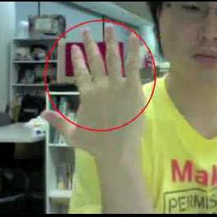



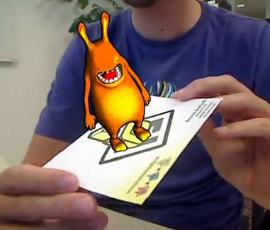
OpenCV Applications
The images show the applications of OpenCV. It is being used to develop HCI like Gesture recognition, augmented reality, real time image processing for autonomous driving, image processing interfaces, etc.

Slide 6
Steps to integrating OpenCV to Code::Blocks IDE
There are several versions of OpenCV starting from OpenCV 1 .0 to OpenCV 2.2. We would be using a standard OpenCV 2.0 and integrate it with Code::Blocks. Similarly other versions can also be integrated. The following steps must be followed to integrate OpenCV:
STEP1: Linker settings
From the main menu of Code::Bocks select: Settings -> Compiler and debugger.
Set the Selected Compiler to GNU GCC Compiler
In the window select, Global compiler settings and go to the tab, Linker Settings Click Add and add all the following directories one by one:
C:\OpenCV2.0\lib\libcv200.dll.a C:\OpenCV2.0\lib\libcvaux200.dll.a C:\OpenCV2.0\lib\libcxcore200.dll.a C:\OpenCV2.0\lib\libcxts200.dll.a C:\OpenCV2.0\lib\libhighgui200.dll.a C:\OpenCV2.0\lib\libml200.dll.a

Slide 7
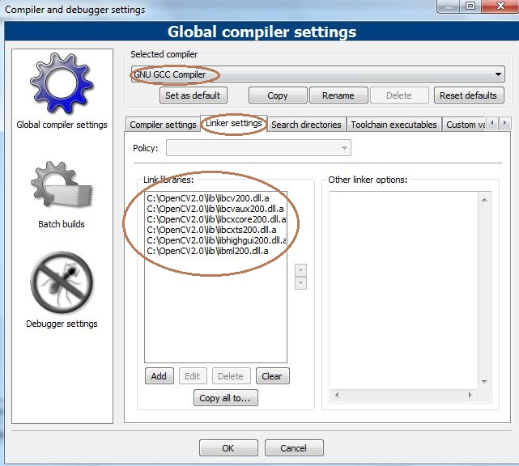
INTEGRATION(contd)
The rounded part shows the included files for linker settings

Slide 8
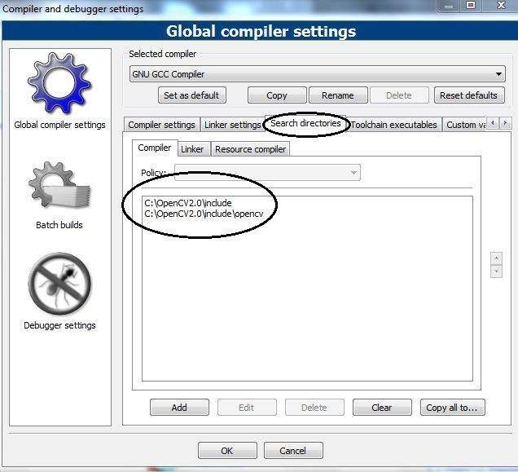
INTEGRATION(contd)
STEP2: Directory setting
In the window select, Global compiler settings and go to the tab, Search directories -> Compiler Click Add and add all the following directories one by one C:\OpenCV2.0\include C:\OpenCV2.0\include\opencv

Slide 9
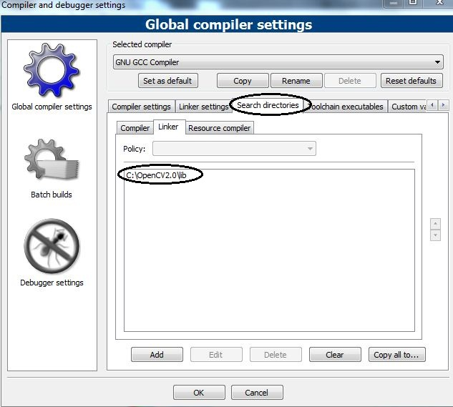
INTEGRATION(contd)
In the window select, Global compiler settings and go to the tab, Search directories -> Linker Click Add and add all the following directories one by one
C:\OpenCV2.0\lib

Slide 10
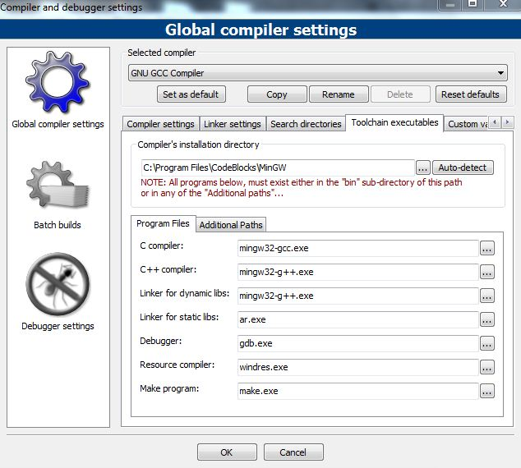
INTEGRATION(contd)
STEP3: Setting Toolchain executables
In the window select, Global compiler settings and go to the tab, Toolchain executables, and set the compilers as
C compiler- mingw32-gcc.exe
C++ compiler- mingw32-g++.exe

Slide 11
INTEGRATION(contd)
STEP4:Editing the header file “cxoperations.hpp”
In the header file cxoperations.hpp ,edit it by adding __MINGW32__ to the end of line number 68 or replace the line by the line given below. #if __GNUC__ >= 4 || __MINGW32__
Now the integration has been successfully completed.

Slide 12
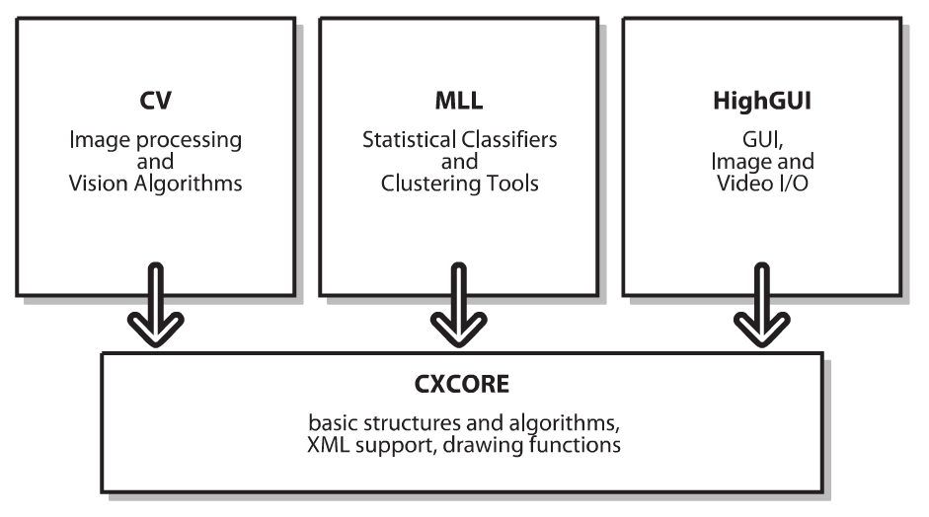
OpenCV – Architecture & Modules
CvAux
Required for Defunc areas and experimental algorithms.
IPP
Required for high performance low-level routines.

Slide 13
OpenCV - Architecture & Modules(contd)
HighGUI
“Smart” windows – Required for creating windows, to display images
Image I/O, rendering – Required for image input and output
Processing keyboard and other events, timeouts
Track bars – They can be used to set parameters by use of trackbars
Mouse callbacks – It can be used to monitor mouse events like click, or mouse cursor
Video I/O – Required for working on videos

Slide 14
THANK YOU
Amit Arup Nayak Gigyanshu Ranjan Pradhan
nayakamitarup@gmail.com gigyanshupradhan@gmail.com

