Slide 1
Name : ajil denogine a. s.

Slide 2
Generate fake human faces using DCGANs foR data augmentation.
DCGANs are used to create synthetic human faces resembling real ones. By training a generator and discriminator network, realistic fake faces are generated from random noise. These faces are added to the original dataset to enhance diversity for tasks like facial recognition. This augmentation improves model performance, but careful monitoring and evaluation are necessary.

Slide 3
agenda
Introduction to DCGANs
Dataset collection and preparation
DCGAN architecture setup
Training process
Generating synthetic human faces
Data augmentation with synthetic faces
Benefits and considerations
Conclusion and next steps

Slide 4
Problem statement
"Addressing the challenge of limited dataset diversity in facial analysis applications through the utilization of DCGANs to generate lifelike synthetic human faces, thereby augmenting existing datasets and improving the accuracy and resilience of facial analysis models."

Slide 5
Project overview
This project utilizes DCGANs to generate synthetic human faces, augmenting datasets for facial analysis tasks. By integrating synthetic faces with real data, the aim is to enhance model accuracy and robustness in applications like facial recognition and emotion detection. Key focuses include DCGAN training optimization, face quality monitoring, and evaluating augmented dataset efficacy.

Slide 6
Who are the end users
End users of this project encompass developers, researchers, and organizations engaged in facial analysis applications such as facial recognition, emotion detection, security, medical diagnostics, and industries utilizing facial analysis for customer insights and entertainment.

Slide 7
Solutions and its proposition
Our solution uses DCGANs to generate realistic synthetic faces, improving dataset diversity for facial analysis tasks. This enhances model accuracy and applicability, offering developers and organizations better-performing facial analysis systems.

Slide 8
The wow in our solution
Our solution wows by using DCGANs to craft synthetic human faces that blend seamlessly with real data, elevating facial analysis accuracy and reliability to unprecedented levels.

Slide 9
modeling
By employing advanced Deep Convolutional Generative Adversarial Networks (DCGANs), our solution pioneers a groundbreaking modeling approach, meticulously crafting synthetic human faces that rival the authenticity of real images. This innovative technique revolutionizes data augmentation, infusing datasets with unparalleled diversity and empowering facial analysis models with heightened accuracy and robustness.

Slide 10
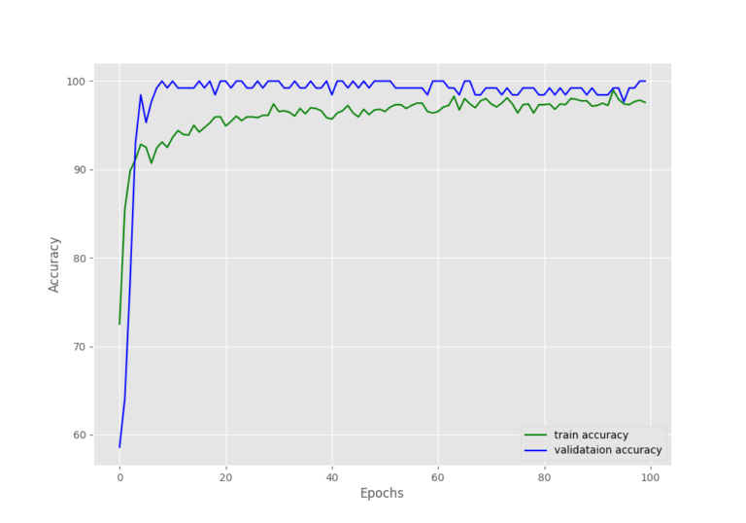
result

