Slide 1

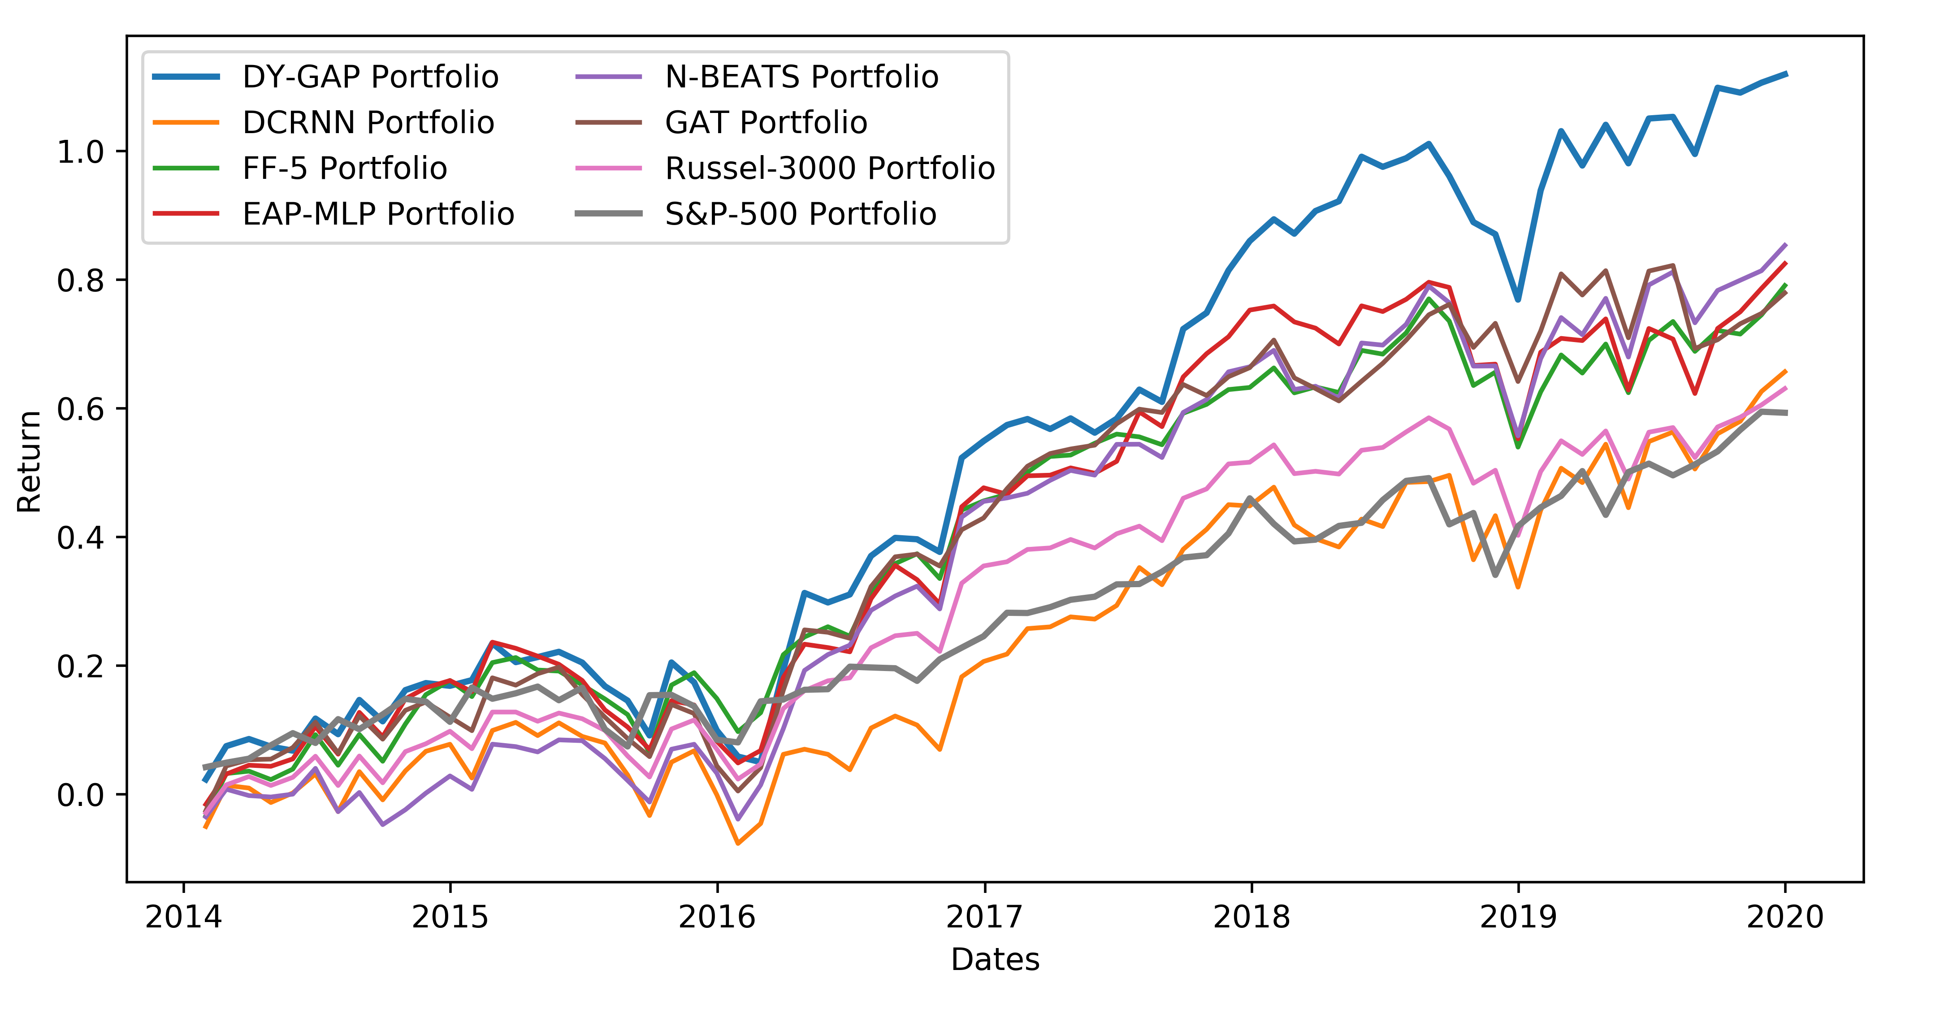
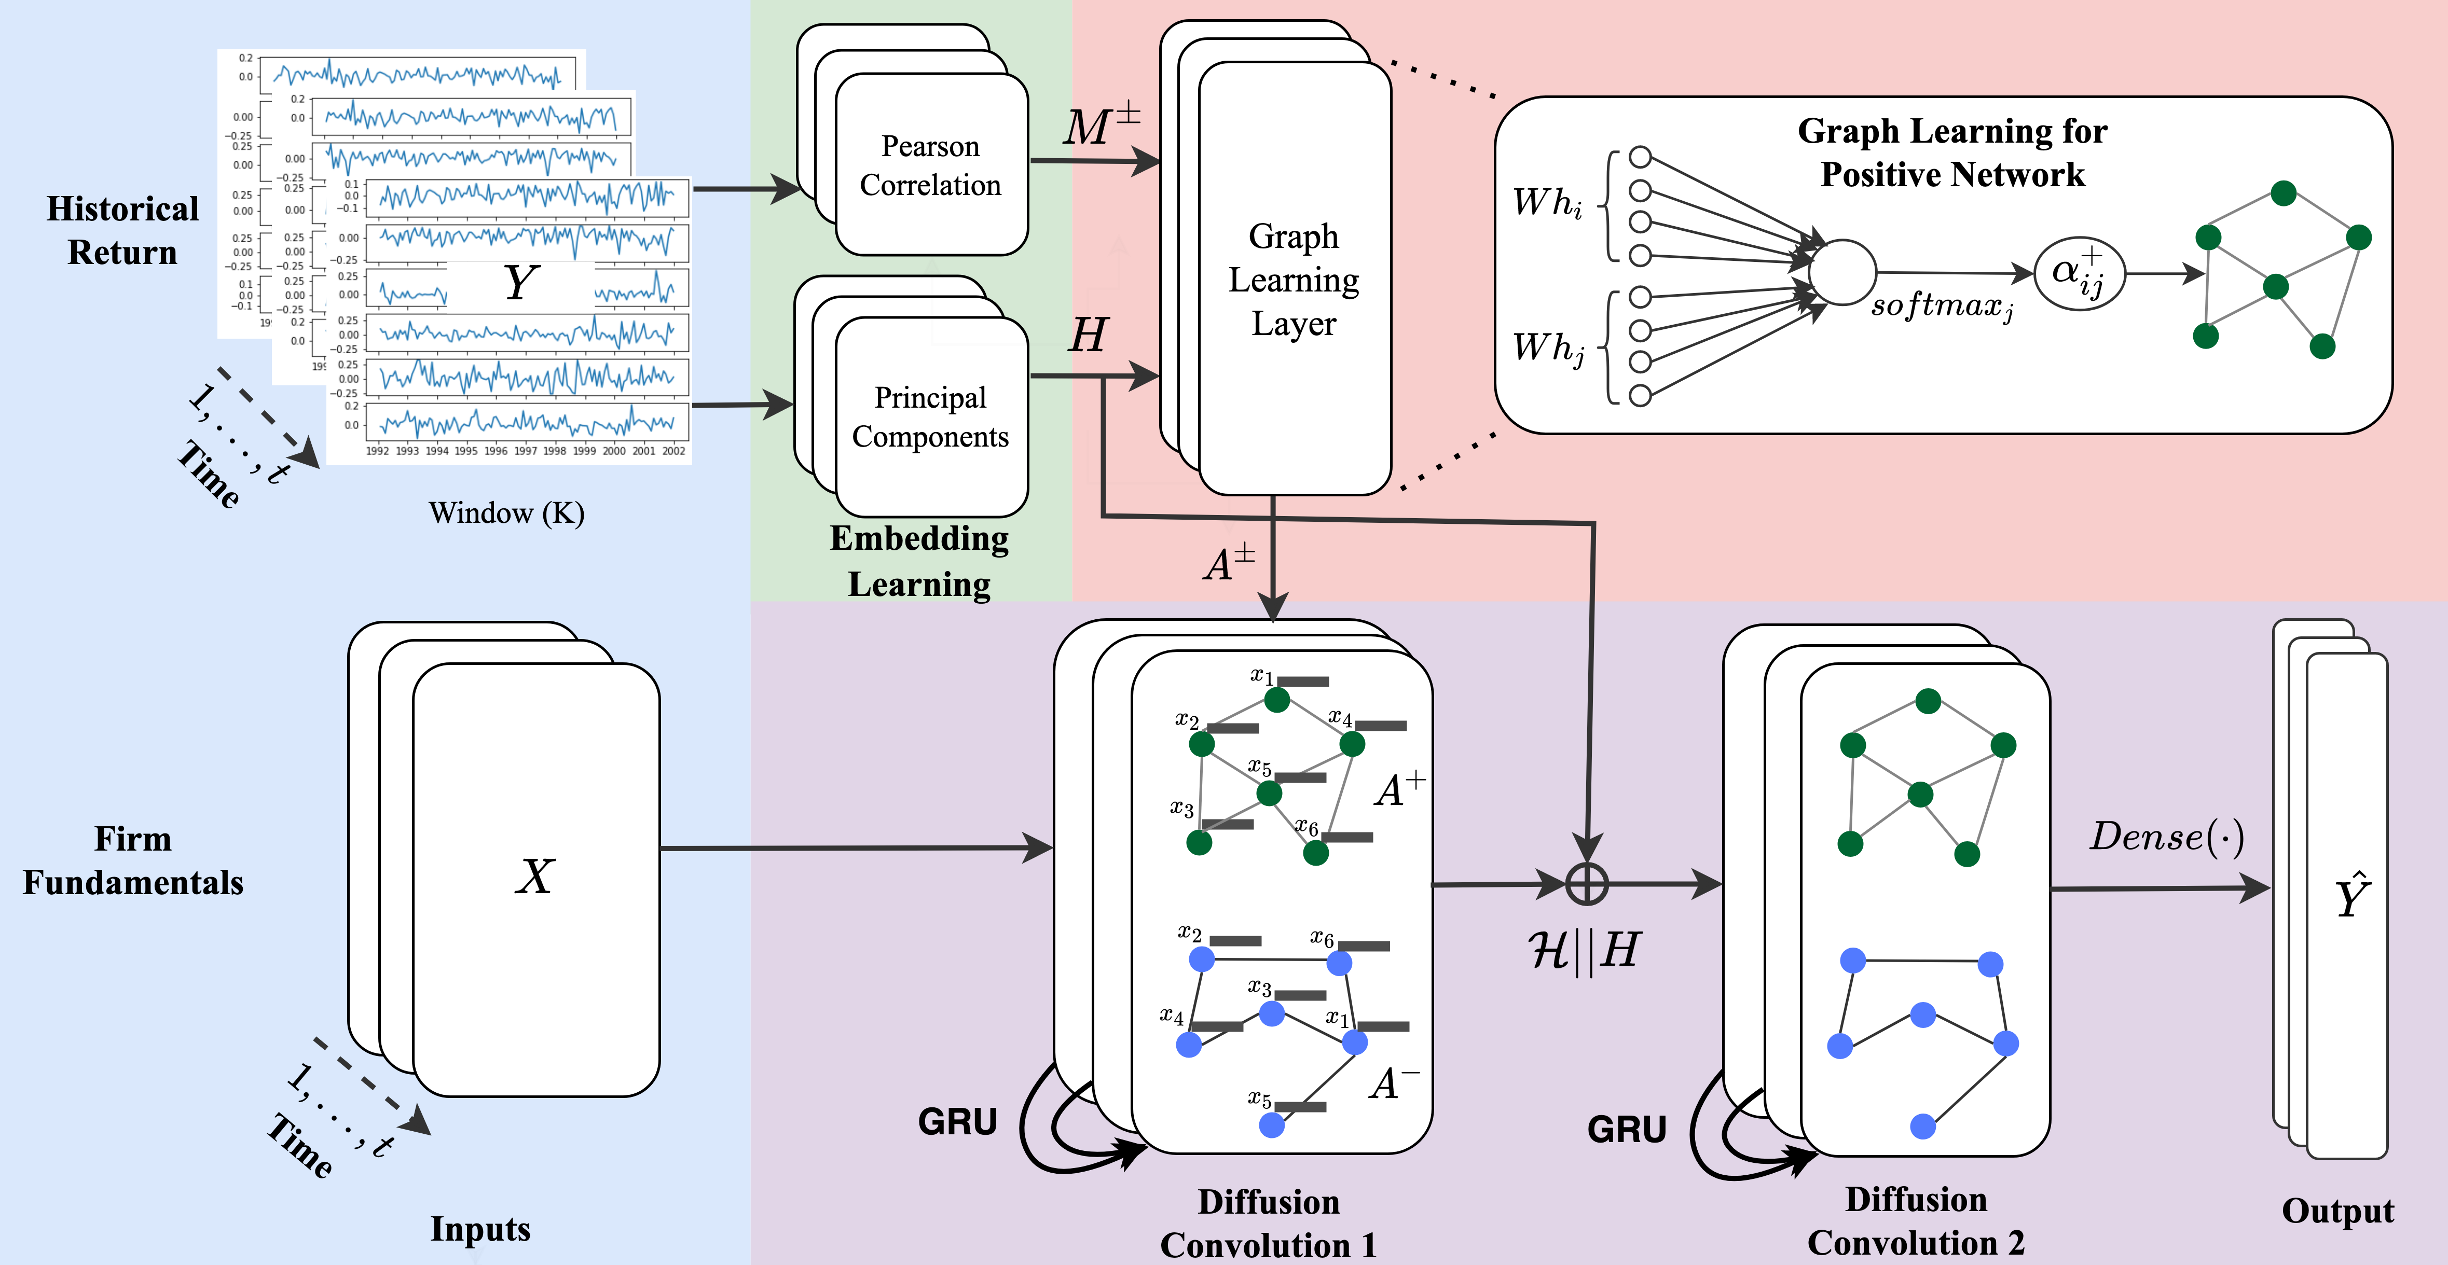
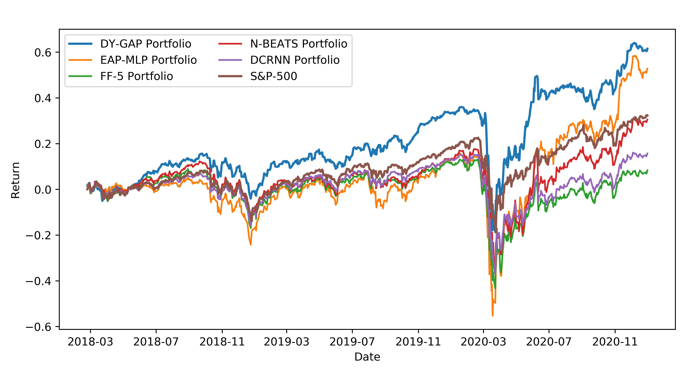
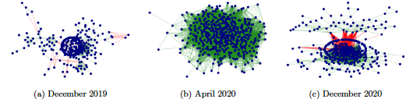
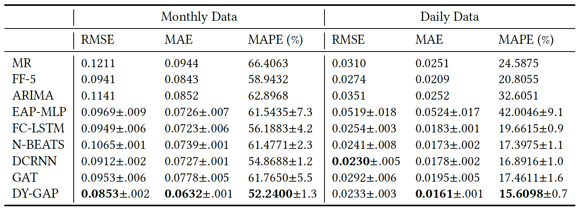
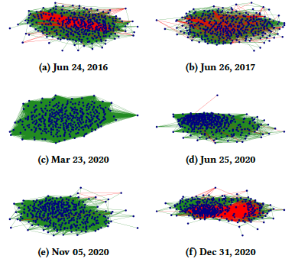
Attention Based Dynamic Graph Learning Framework for Asset Pricing
Ajim Uddin, Xinyuan Tao, and Dantong Yu
New Jersey Institute of Technology
MOTIVATION
OUR MODEL
PORTFOLIO PERFORMANCE
The network among firms play an important role in firms’ returns
The equity market network is dynamic, complex, and unknown
Many factor influence the network
The Pearson correlation:
  has both positive and negative coefficients
Cannot directly apply methods developed in CS or IS
Negative edges are important too
An Ideal Model
Capture the time-varying networks of the equity market
Model non-linear connectivity and dependency
Model time-series pattern
Appropriate for finance application
  deal with dynamic relations
  deal with positive and negative relations
Use an attention mechanism to learn the dynamic network structure of the U.S. equity market
Use masked attention to incorporate both positive and negative relations among firms
Use a recurrent diffusion convolution network to model the spatial and temporal dependency among firms
DY-GAP earns a high return rate (1.5% monthly) with relatively low risk (3%)
Over time DY-GAP cumulative return doubles both from the S&P-500 and Russel-3000 index.
Our model is not immune to market downside but has faster recovery
Monthly
DY-GAP MODEL FRAMEWORK
Daily
DATA
RETURN PREDICTION
GRAPH LEARNING
CONTRIBUTIONS
Monthly Data
  1098 stocks from Russell 3000 Index
Daily Data
  441 firms from S&P500 Index
Firm Fundamental Characteristics
  21 monthly and 24 daily features
Offers a novel solution to two critical problems in asset pricing
  the interaction among firms
  the evolution of the interaction
Develop a flexible attention mechanism to learn new networks from scratch or improve upon initial networks
Outperforms many traditional asset pricing and advanced machine learning models

