Slide 1

Software Testing
Manual Testing – Day 1
Skill Development Engineer

Slide 2
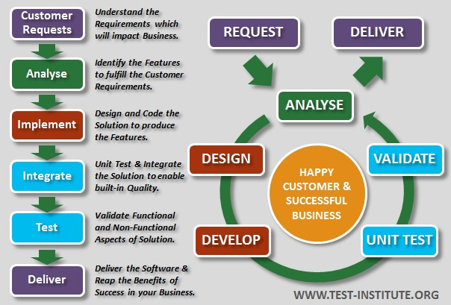
Software Testing Methodology

Slide 3

What is Software Testing?
Software Testing is a method to check whether the actual software product matches expected requirements and to ensure that software product is Defect free.
It involves execution of software/system components using manual or automated tools to evaluate one or more properties of interest.
The purpose of software testing is to identify errors, gaps or missing requirements in contrast to actual requirements.

Slide 4

Why Software Testing ?
Software Testing is Important because if there are any bugs or errors in the software, it can be identified early and can be solved before delivery of the software product.
Properly tested software product ensures reliability, security and high performance which further results in time saving, cost effectiveness and customer satisfaction.

Slide 5
Error, Defect ,Bug, Failure
Error : An error is a mistake made by a human during the development process. It could be a coding mistake, a logic error, or a misunderstanding of requirements(Syntax error, Run time Error)
Defect : The defect/fault is the incorrect implementation of the requirement.
Bug : if QA detect the requirement mismatch during testing and notify developer about the issue, developer will check it and give conformance about the issue, then the issue will be considered as a bug and QA will report it.
Failure : A failure occurs when the software does not meet the end user's requirements and fails to perform as expected. In this case, if any defect is overlooked by QA engineers but is noticed by end users, it is considered a failure.

Slide 6
Benefits of software Testing
Cost-Effective: It is one of the important advantages of software testing. Testing any IT project on time helps you to save your money for the long term. In case if the bugs caught in the earlier stage of software testing, it costs less to fix.
Security: It is the most vulnerable and sensitive benefit of software testing. People are looking for trusted products. It helps in removing risks and problems earlier.
Product quality: It is an essential requirement of any software product. Testing ensures a quality product is delivered to customers.
Customer Satisfaction: The main aim of any product is to give satisfaction to their customers. UI/UX Testing ensures the best user experience.

Slide 7
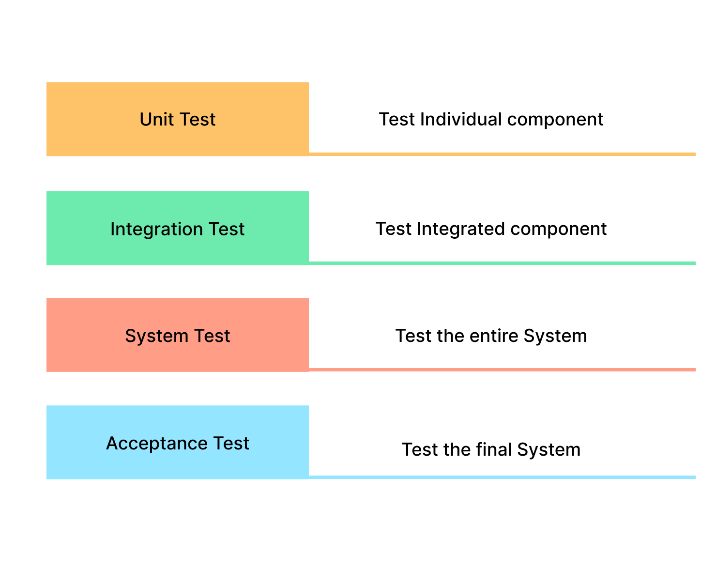
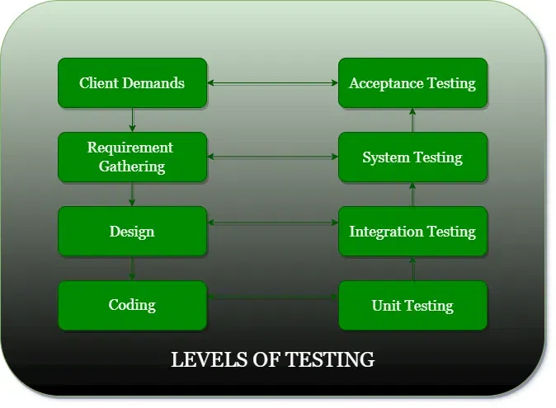
Levels of software Testing

Slide 8
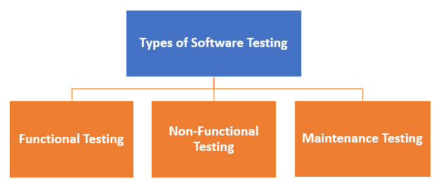
Software Test Types

Slide 9
Functional Testing
Unit Testing
Integration Testing
Smoke
UAT ( User Acceptance Testing)
Localization
Globalization
Interoperability
So on

Slide 10
Non Functional Testing
Performance
Endurance
Load
Volume
Scalability
Usability
So on

Slide 11
Maintenance
Regression
Maintenance

Slide 12

Unit Testing
This software testing basic approach is followed by the programmer to test the unit of the program. It helps developers to know whether the individual unit of the code is working properly or not.

Slide 13

In this simple example, you could use unit testing to verify that the calculator program adds two numbers correctly.
First, outline and document the expectations of the program, such as:
The program should accept two numerical values
It should return the sum of these two values
It should also handle negative numbers correctly
You can then write unit tests that feed these values into the program and verify the correct output. For example, you could have a test that checks the program returns 2 when 1 and 1 are entered. You could have another test that checks the program returns -3 when 1 and -4 are entered. Once all the tests have been written and executed, you can confidently say that the calculator program has been successfully tested and works as expected.

Slide 14
Integration Testing
It focuses on the construction and design of the software. You need to see that the integrated units are working without errors or not.
Unit tests focus on individual components, such as methods and functions, while integration tests check if these components work together properly

Slide 15
How to Do Integration Testing?
Integration tests are critical in software development, ensuring all application components perform correctly. To make things easier:
Create an integration test plan for testing the integration of components – Follow a strategy to test according to the testing types mentioned above.
The test plan should include test cases with priority and expectations.
Assign the test cases for execution.
Execute the test cases
Record the results of test cases.
Report the failures.
Once the failures are fixed, verify the fixes.

Slide 16
Example
Test Case ID | Test Description | Input | Expected Result
TS-1 | Test integration between the payment gateway and the booking system | User books a service and makes a payment | Payment is processed correctly and the booking is confirmed
TS-2 | Test the integration between the messaging system and the notification system | User sends a message and receives a notification | The message is delivered correctly and the user receives the expected notification
TS-3 | Test the integration between the billing system and the accounting system | System generates a bill and sends it to the accounting system | The bill is correctly processed and recorded in the accounting system
TS-4 | Test the integration between the search engine and the recommendation engine | User performs a search and receives recommendations | The search results and recommendations are accurate and relevant to the users search query

Slide 17
System Testing
In this method, your software is compiled as a whole and then tested as a whole. This testing strategy checks the functionality, security, portability, amongst others.

Slide 18
System Testing
20
System Testing involves testing the system as a whole. System Testing commences after completion of unit, functional, and
integration testing. The emphasis is on verifying end-to-end workflows and scenarios. All the software components, all the hardware components, should be tested.
The whole system is checked not only for validity but also for met objectives. The system test is intended to verify program performance in accordance with the system specification and those requirement specifications referenced from the RS document.
System Testing requires system test environment that comprises of deployment like environment from hardware and software requirements. In addition, it may require test automation tools and analysis tools. In addition, we may need test data. As days are progressing, part of system testing is happening in the live environment as well which may include performance testing and external interface testing including interoperability testing.
www.iamneo.ai

Slide 19
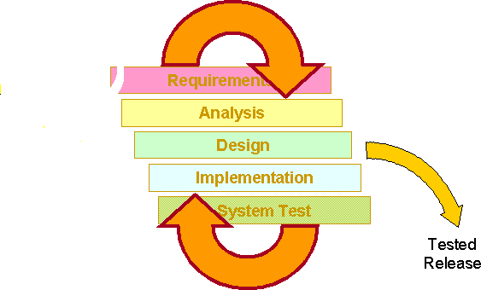

Systems Testing
23
When the System testing fit in to the Project ?
Once all the modules are integrated , several errors may arise or successfully completed then system testing done at
this stage.
Types under System Testing : some examples
Security testing
Report /document testing
Sanity /Smoke testing
Exploratory testing
Ad-Hoc testing
Performance testing.
Etc……………….
www.iamneo.ai

Slide 20
Types of System Testing
Usability Testing – mainly focuses on the user’s ease to use the application, flexibility in handling controls and ability of the system to meet its objectives
Load Testing – is necessary to know that a software solution will perform under real-life loads.
Regression Testing – involves testing done to make sure none of the changes made over the course of the development process have caused new bugs. It also makes sure no old bugs appear from the addition of new software modules over time.
Recovery Testing – is done to demonstrate a software solution is reliable, trustworthy and can successfully recoup from possible crashes.
Migration Testing – is done to ensure that the software can be moved from older system infrastructures to current system infrastructures without any issues.

Slide 21
Acceptance Testing
Acceptance testing is related to the business requirement analysis part. It includes testing the software product in user atmosphere.
Acceptance tests reveal the compatibility problems with the different systems, which is available within the user atmosphere.
It conjointly discovers the non-functional problems like load and performance defects within the real user atmosphere.

Slide 22
Program Testing
Program Testing in software testing is a method of executing an actual software program with the aim of testing program behavior and finding errors.
The software program is executed with test case data to analyse the program behavior or response to the test data.
A good program testing is one which has high chances of finding bugs.

Slide 23
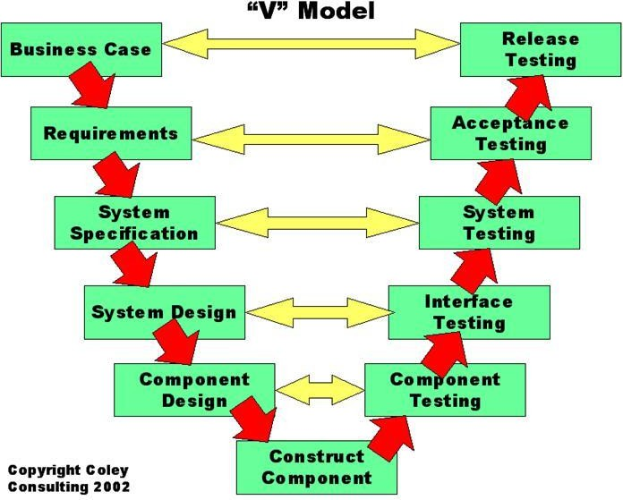
The V-Model
4
Followings are the Levels used in the project across the organization,
↔ Component testing (or) Module testing (or) Unit testing
↔ Integration Testing
↔ System Testing
↔ User Acceptance Testing
www.iamneo.ai

Slide 24
Change Related Testing
Change related testing is used for majorly two purpose:-
Confirmation testing:- Ensuring that all the detected bugs have been successfully fixed.
Regression testing:- Ensuring that new defects have not appeared after the changes made.

Slide 25
Summary - Levels of Testing
31
Levels of Testing | Description
Unit Testing | A unit is the smallest testable part of an application. it may be an individual program, function, procedure, etc.
Integration Testing | Black-box type testing that is based on overall requirements specifications; covers all combined parts of a system
System Integration Testing | Testing of combined parts of an application to determine if they function together correctly. The 'parts' can be code modules, individual applications.
E2E/System Testing | Black-box type testing is a testing process that exercises a software system's coexistence with others
UAT | Determining if software is satisfactory to an end-user or customer.
www.iamneo.ai

Slide 26


