Slide 2
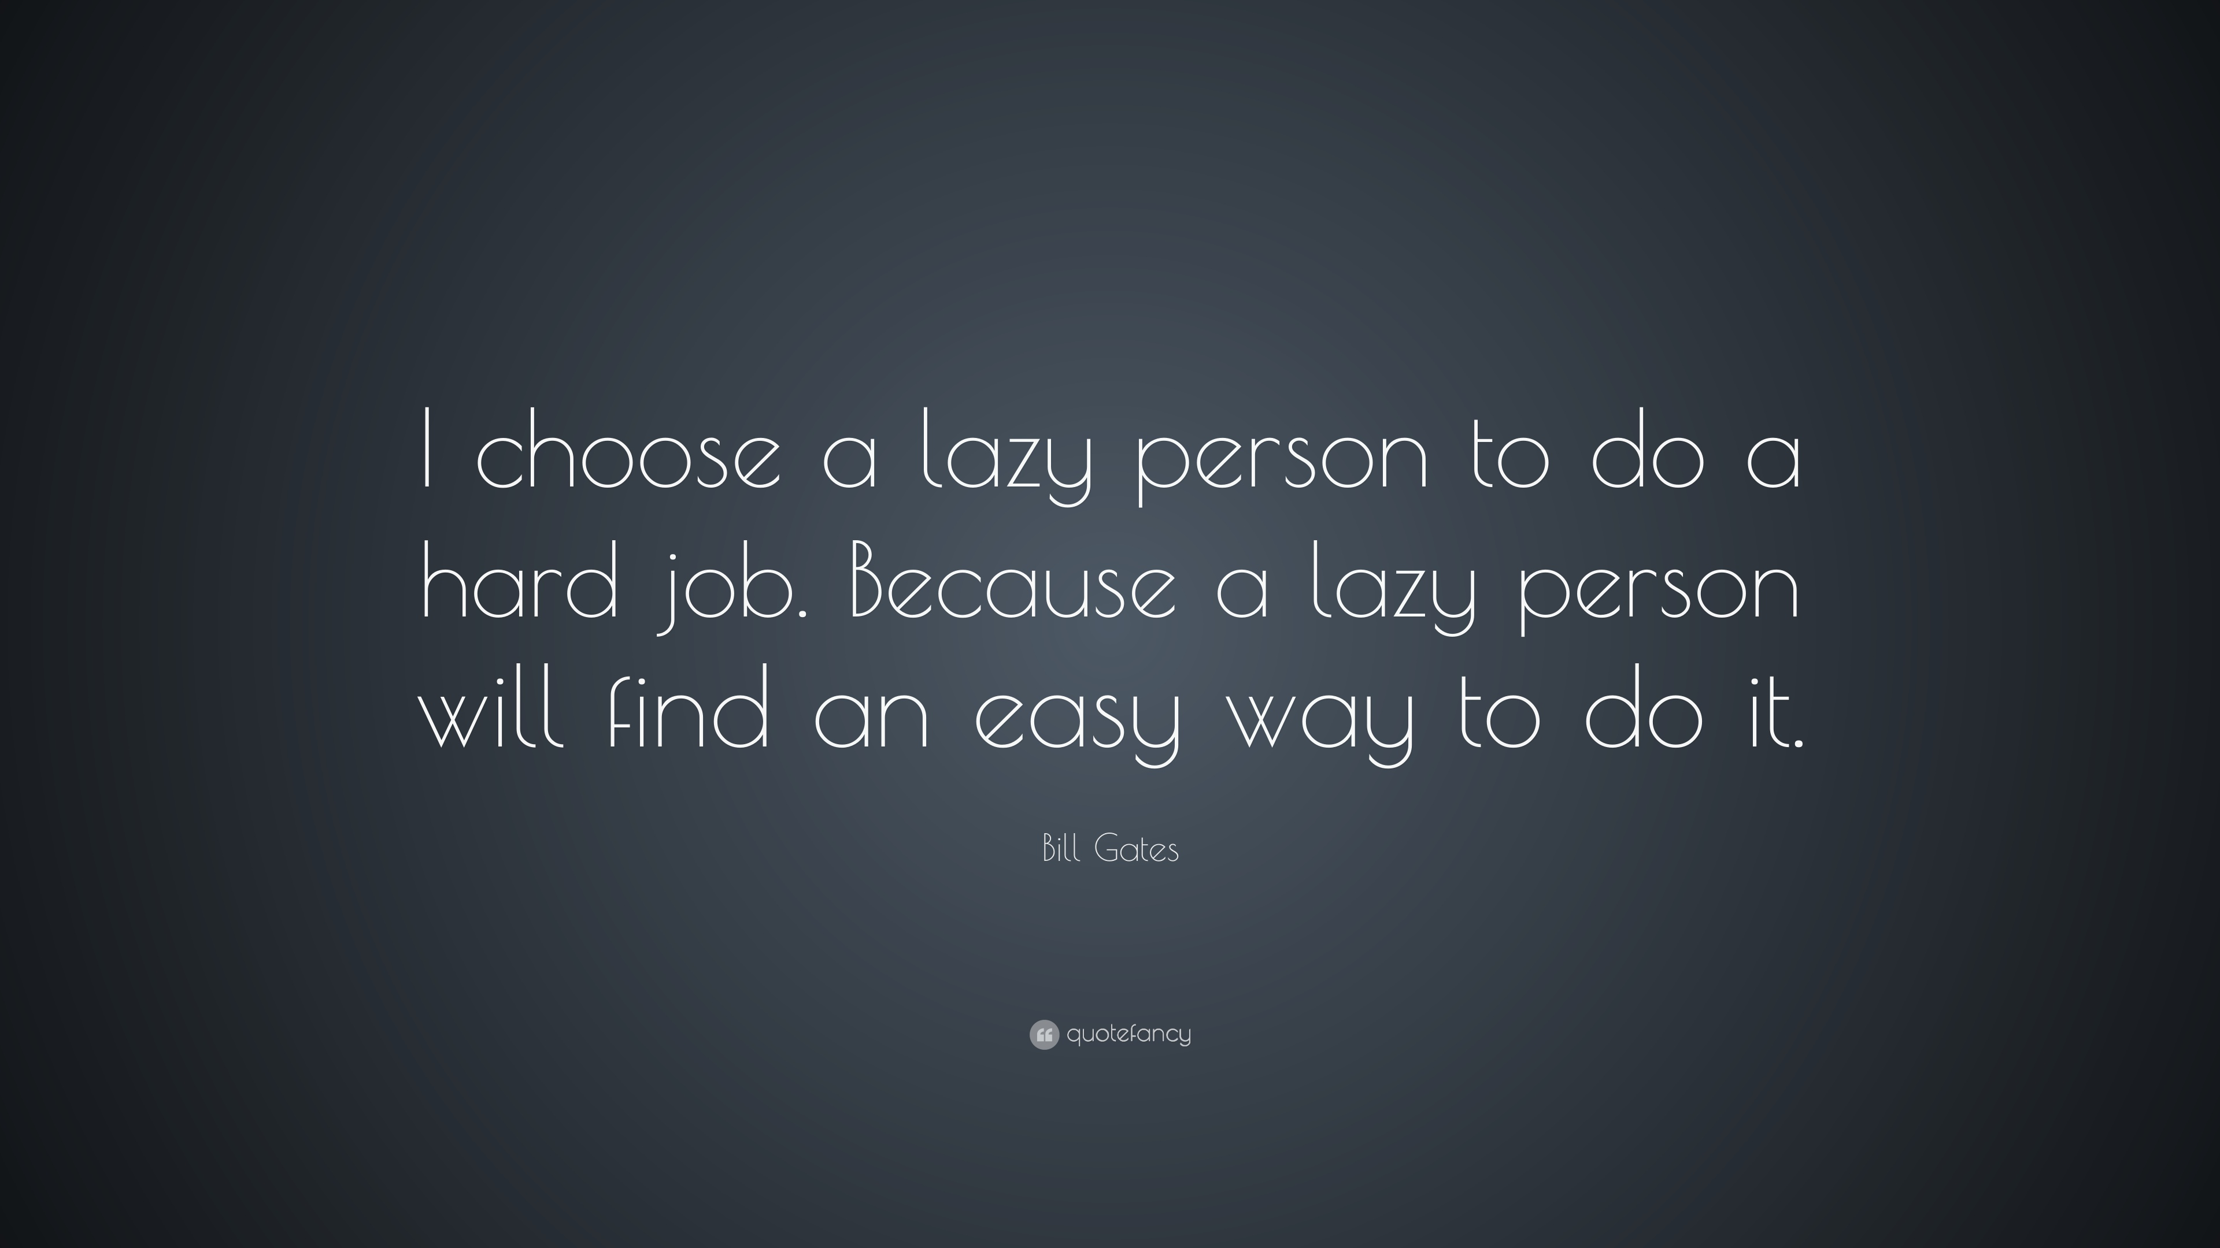

Slide 3
Computer Vision using Azure Services
Subtitle or speaker name
AJIN K J
Microsoft Student Ambassador

Slide 4
Agenda:
Computer Vision
Azure Cognitive Service
Azure Computer Vision
Hands On

Slide 5
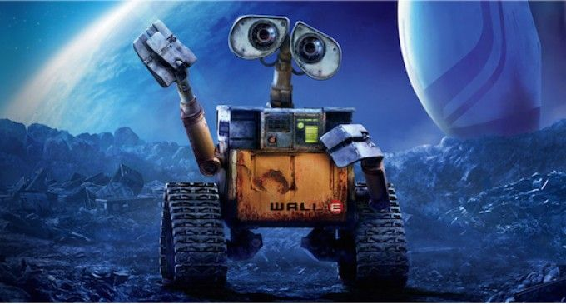
Computer vision
Computer vision is one of the core areas of artificial intelligence (AI), and focuses on creating solutions that enable AI applications to "see" the world and make sense of it.

Slide 6
Some potential uses for computer vision include:
Content Organization: Identify people or objects in photos and organize them based on that identification. Photo recognition applications like this are commonly used in photo storage and social media applications.
Text Extraction: Analyze images and PDF documents that contain text and extract the text into a structured format.
Spatial Analysis: Identify people or objects, such as cars, in a space and map their movement within that space.

Slide 7
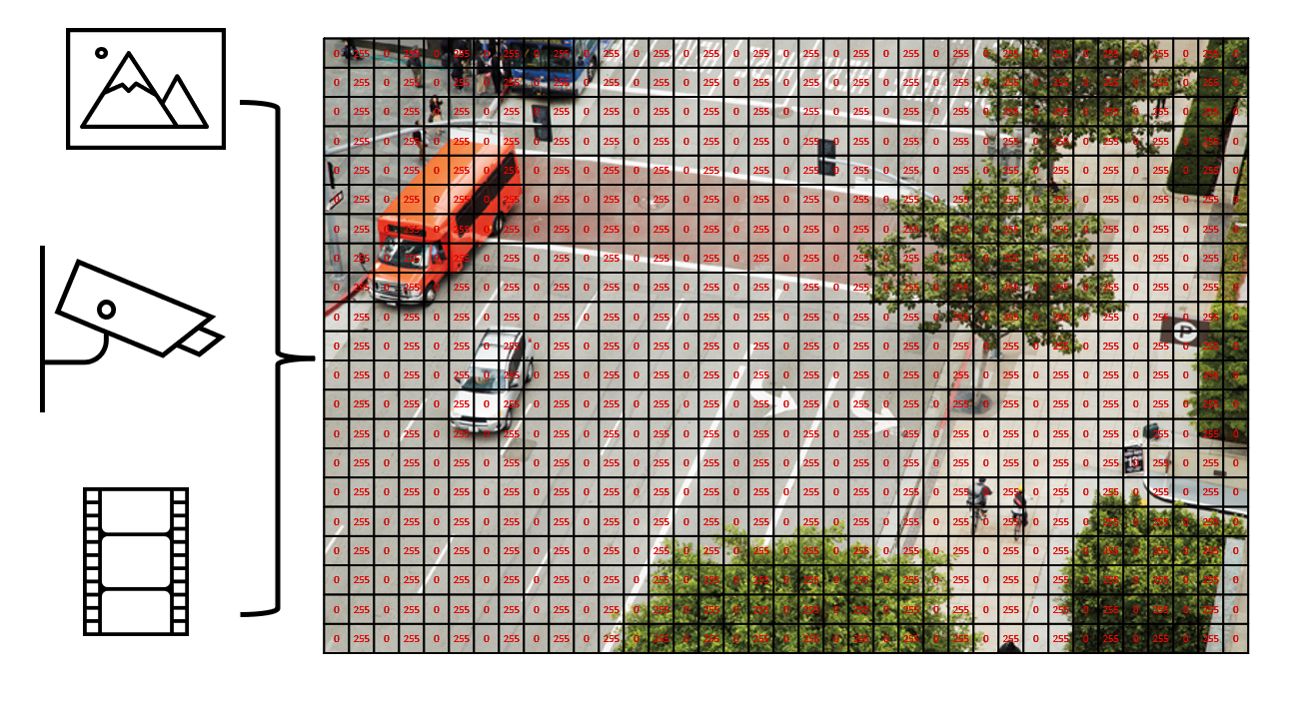
To an AI application, an image is just an array of pixel values. These numeric values can be used as features to train machine learning models that make predictions about the image and its contents.

Slide 8

Azure Cognitive Service
Azure Cognitive Services are APIs, SDKs, and services available to help developers build intelligent applications without having direct AI or Data Science skills or knowledge.

Slide 9
Computer Vision
The Computer Vision service is a cognitive service in Microsoft Azure that provides pre-built computer vision capabilities. The service can analyze images, and return detailed information about an image and the objects it depicts.
Capabilities

Slide 10

Hands On

Slide 11
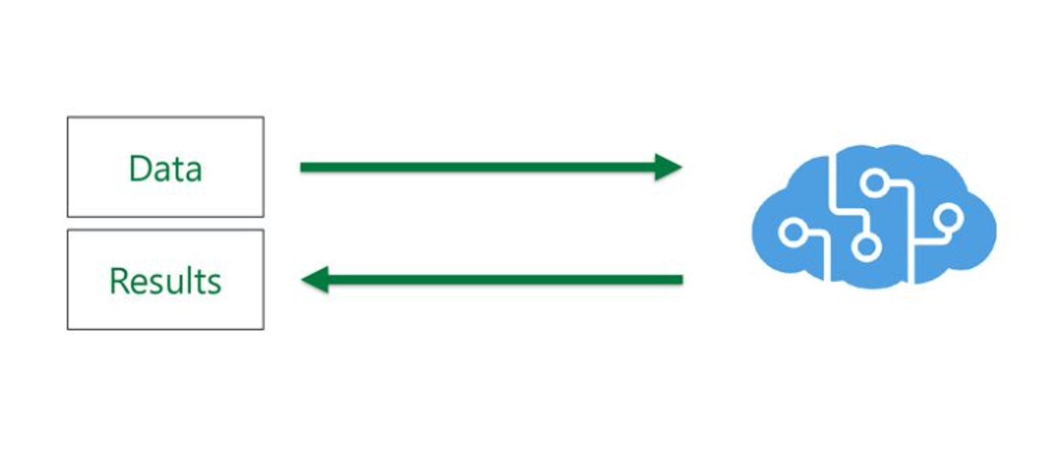
Azure Cognitive Service
Computer Vision
Examples

Slide 12


https://github.com/Ajinkj/
https://www.linkedin.com/in/ajin-k-j/

Slide 13
Q & A
Subtitle or speaker name

