Slide 1
Job Scheduling in Networked Manufacturing using Game Theory

Slide 2
Introduction
Globalization – a new trend for enterprise.
Agile and Rapid response
Need of manufacturing models characterized by
- Globalization
- Digitalization

Slide 3
Networked Manufacturing
Traditional Job Scheduling Approach
Networked Manufacturing Job Scheduling Approach
- Customer centric job scheduling
- Geographically distributive
machines

Slide 4
Problem Statement
Statement :
“To schedule a series of jobs submitted by different customers which are competing with each other to occupy the corresponding machines according to their own respective objectives, e.g., minimal makespan”

Slide 5
Assumptions
No job preemption
No two jobs are scheduled on the same machine at the same time
The transportation time exists
Job availability at time zero

Slide 6
Motivation
Job scheduling problem
- NP-complete problem
- NP Optimization problem
- Time Complexity = (n!)^m
Decentralization
Automation needed

Slide 7
Objective
The goal of the project is
- To apply the sophisticated mathematical model
- To find the optimal schedule of jobs

Slide 8
Methodology
To apply N-person non co-operative strategy to solve the game
To find the NE point of game
To design a genetic algorithm to reach the NE point of game

Slide 9
Nash’s Equilibrium
Characteristic :
“An NE point is an N-tuple of strategies, one for each player, such that anyone who deviates from it unilaterally cannot possibly improve its expected payoff.”

Slide 10


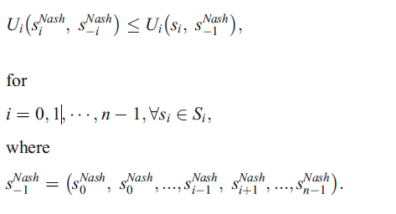
Mathematical Model
The solution profile
is characterised by -
Notes:
<number>
VIT

Slide 11
prathamesh
Delete this slide and your slides from here onwards

Slide 12
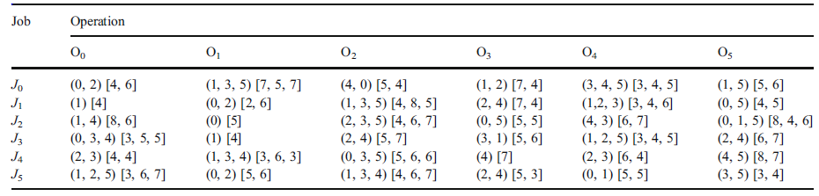
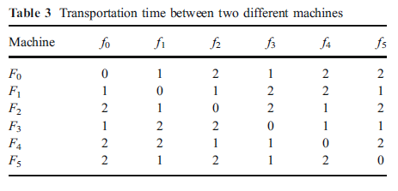
Problem Formulation (contd…)

Slide 13
Experimental Result

Slide 14
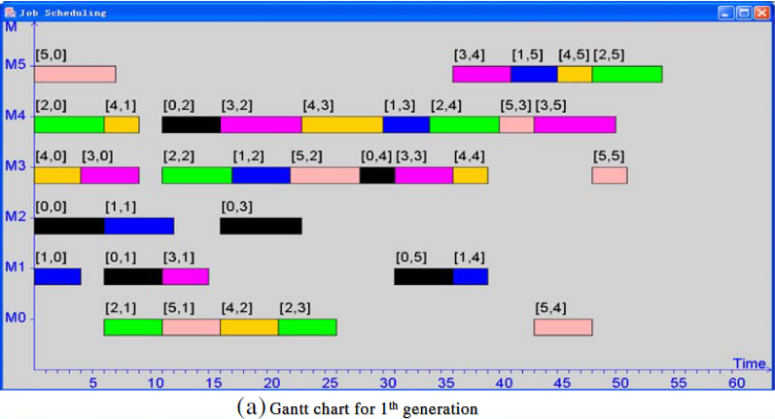
1st Generation

Slide 15
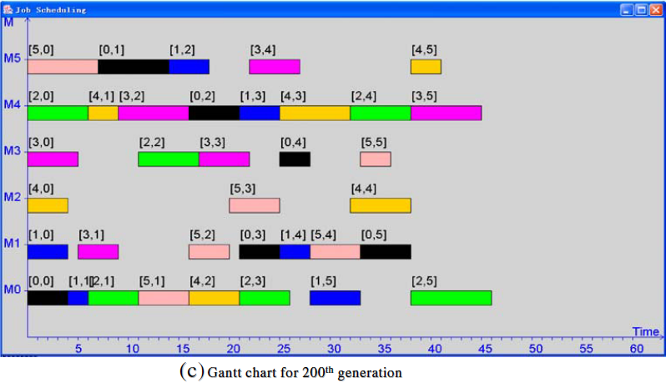
200th Generation

Slide 16
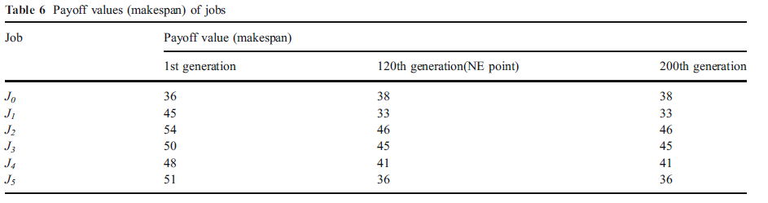
Comparision

Slide 17
Alternatives
A hierarchic approach for
production planning and scheduling
A holonics manufacturing
scheduling architecture
The branch-and-bound algorithm to deal with the scheduling problem in a flow shop
An ant colony algorithm to model and deal with the permutation flowshop scheduling problems

Slide 18
Limitations
You tell me what are they

Slide 19
Conclusion
Defined of conceptual model for job
scheduling
Formulated a job scheduling model for optimally scheduling the jobs adopting game theory
Proposed and developed the GA-based solution algorithm to solve our optimization problem

