Slide 1

CS 40107 : Object Oriented Modeling and Design
Lecture 4
Views and Details

Slide 2
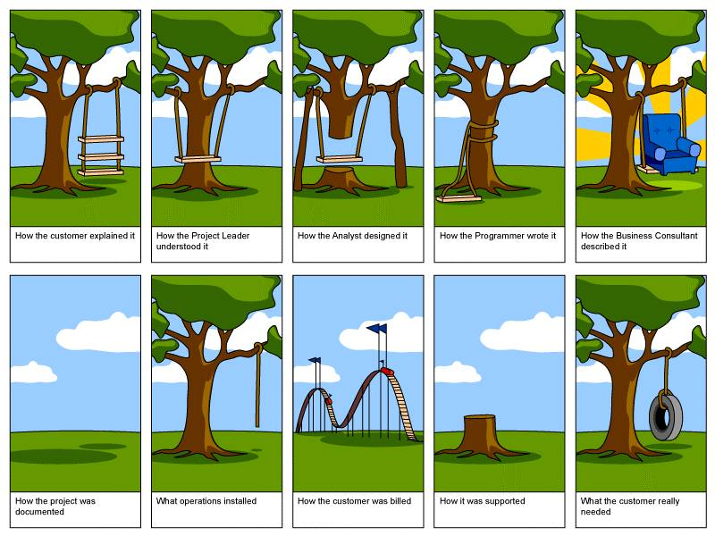
System Development

Slide 3
Design Method Evolution
1997
OOAD with UML
1990
OOAD
1986
CASE
1986
OOP
1980
4GL
1980
Data Modeling
1980
Structured Analysis
1975
Structured Design
1970
Structured Programming

Slide 4
Models
Models are the language of designer, in many disciplines
Models are representations of the system to-be-built or as-built
Models are vehicle for communications with various stakeholders
Visual models, blueprints
Scale
Models allow reasoning about some characteristic of the real system
Multiple Views
Architecture is many things to many different interested parties
  end-user
  customer
  project manager
  system engineer
  developer
  architect
  maintainer
  other developers
Multidimensional reality
Multiple stakeholders: multiple views, multiple blueprints

Slide 5
UML
An Object-Oriented Perspective : UML (Unified Modelling Language)
Models
  enhance the understanding of complex things
  models are a simplification of reality
  can come in a variety of forms
scale models (e.g. cars, buildings)
    simulations (e.g. weather, aerodynamics of aircraft, consumer behaviour)
    'story boards'
    diagrams
Language
a set of allowed symbols, words etc.
a syntax (the rules i.e. allowed ways of combining the words and symbols)
UML mostly consists of diagrams
thus languages such as UML are sometimes referred to as visual languages

Slide 6
UML
Unified
1989 → a variety of object-oriented approaches to analysis and design appear
1994-1997 → an attempt is made to standardise these
Nov 1997 → UML becomes the standard object-oriented modelling language.
1997 → subsequent versions appear
Three principle designers: Booch, Jacobson, and Rumbaugh, each of which were major players in various aspects of Object Oriented Analysis and Design
Adopted as a standard by the Object Management Group (OMG) (OMG is also responsible for other standards: "The MDA - Model Driven Architecture - is a new way of writing specifications and developing applications, based on a platform-independent model (PIM)" [OMG] This uses UML)
Overview of UML
UML was designed to cover the whole range of the development process, i.e.
requirements → analysis → design → implementation
UML is not tied to a process model (methodology).
It doesn't state how to, it provides a language to document a system.
(e.g. it doesn't state how to do interviews, it provides a technique to document them (scenarios, use cases, use case diagrams))

Slide 7
What is UML?
Year Version
2003: UML 2.0
2001: UML 1.4
1999: UML 1.3
1997: UML 1.0, 1.1
1996: UML 0.9 & 0.91
1995: Unified Method 0.8
Booch ‘93
OMT - 2
Other methods
Booch ‘91
OMT - 1
began in late 1994(unifying the Booch and OMT (Object Modeling Technique) methods )

Slide 8
UML goal
1) Provide users with a ready-to-use, expressive visual modeling language
2) Provide extensibility and specialization mechanisms to extend the core concepts.
3) Be independent of particular programming languages and development processes.
4) Provide a formal basis for understanding the modeling language.
5) Encourage the growth of the OO tools market.
6) Support higher-level development concepts such as collaborations, frameworks, patterns and components.
7) Integrate best practices.

Slide 9
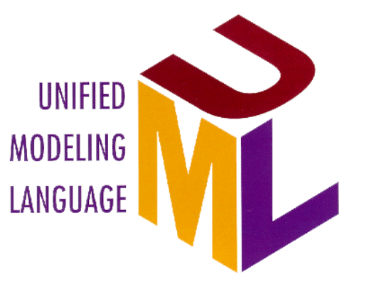
UML Supports
Relationships
Objects
Business Objects
large scale system
ORDBMS
Oracle
Classes
application partitioning
Components
Microsoft
Scenarios
CORBA
OMG
Use Cases
ActiveX/COM
Microsoft
Business Process
Notes:
11
Transition: So! Who should use UML? Everybody who is doing software development.
Core Message: UML supports object and component-based technology.
Key Point 1: UML is an expressive language that can be used to describe pretty much everything about software application.
- object technology: objet, class, relationships, scenario, Use Case
- component-based development: component, ActiveX/COM, CORBA
- large scale system, application partitioning

Slide 10
Models
The models of your system may present various levels of detail as your system development progresses and matures over time.
The conceptual model captures the system in terms of the domain entities that exist (or will exist) and their association with other such entities of your system. The conceptual level of modeling is performed using the terminology of your business domain and should not be technology- oriented .
The logical view of a system takes the concepts created in the conceptual model and establishes the existence and meaning of the key abstractions and mechanisms that will determine the system’s architecture and overall design.
The physical model of a system describes the concrete software and hardware composition of the system’s implementation. Obviously, the physical model is technology-specific.

Slide 11
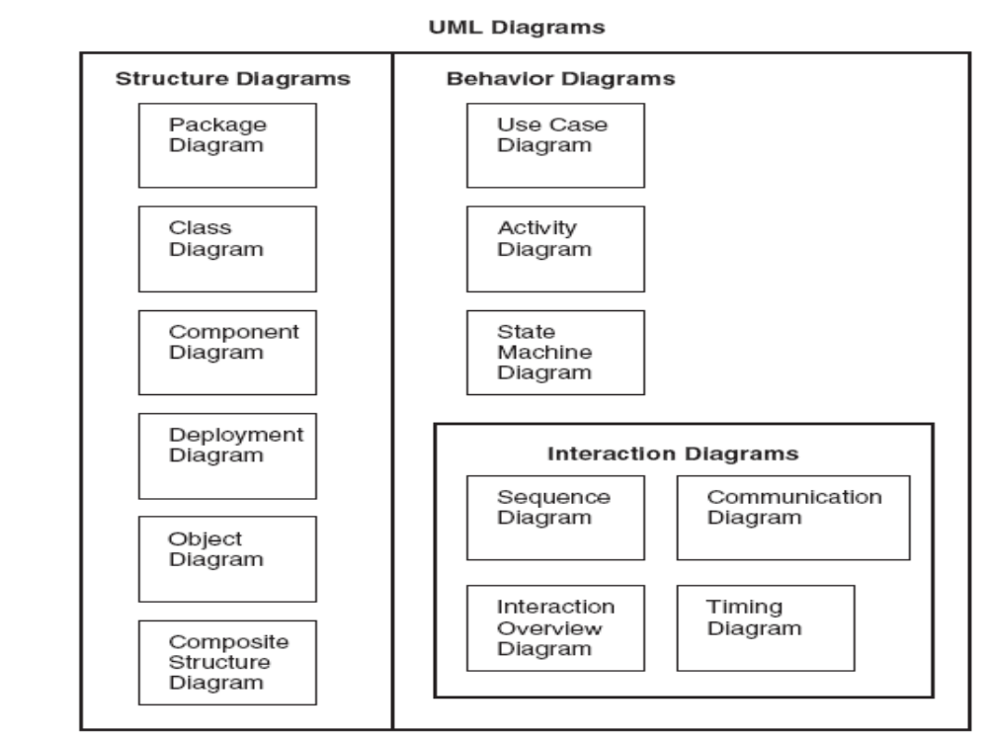
Diagram Taxonomy

Slide 12
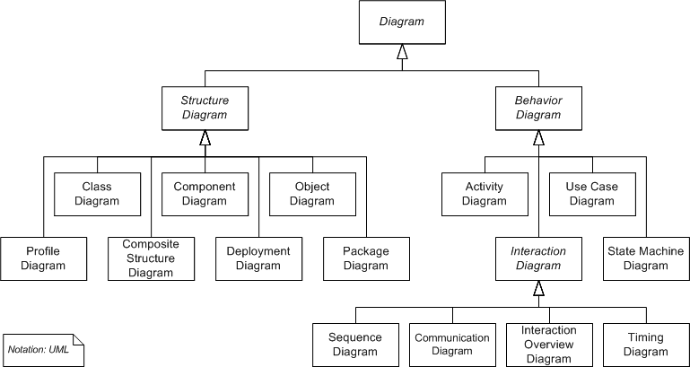
Diagram Taxonomy

Slide 13
Meaning of Unified
Across historical methods and notations. The UML combines the commonly accepted concepts from many object-oriented methods, selecting a clear definition for each concept, as well as a notation and terminology. The UML can represent most existing models as well as or better than the original methods can.
Across the development lifecycle. The UML is seamless from requirements to deployment. The same set of concepts and notation can be used in different stages of development and even mixed within a single model. It is unnecessary to translate from one stage to another. This seamlessness is critical for iterative, incremental development.
Across application domains. The UML is intended to model most application domains, including those involving systems that are large, complex, real-time, distributed, data or computation intensive, among other properties.
Across implementation languages and platforms. The UML is intended to be usable for systems implemented in various implementation languages and platforms, including programming languages, databases, 4GLs, organization docu­ments, firmware, and so on.
Across development processes. The UML is a modeling language, not a description of a detailed development process. It is intended to be usable as the modeling language underlying most existing or new development processes, just as a general-purpose programming language can be used in many styles of programming. It is particularly intended to support the iterative, incremental style of development that is often recommended.
Across internal concepts. In constructing the UML metamodel, a deliberate effort to discover and represent underlying relationships among various concepts was made trying to capture modeling concepts in a broad way applicable to many known and unknown situations. This process led to a better understanding of the concepts and a more general applicability of them. This was not the original purpose of the unification work, but it was one of the most important results.

Slide 14
Goals of UML
UML is a general-purpose modeling language that all modelers can use. It is nonproprietary and based on common agreement by much of the computing community. It is meant to include the concepts of the leading methods so that it can be used as their modeling language.
It is meant to support good practices for design, such as encapsulation, separation of concerns, and capture of the intent of a model construct. It is intended to address current software development issues, such as large scale, distribution, concurrency, patterns, and team development.
UML is not intended to be a complete development method. It does not include a step-by-step development process. It is important to realize that UML and a process for using UML are two separate things.
A final goal of UML was to be as simple as possible while still being capable of modeling the full range of practical systems that need to be built. UML needs to be expressive enough to handle all the concepts that arise in a modern system, such as concurrency and distribution, as well as software engineering mechanisms, such as encapsulation and components.

Slide 15
Static Structure
Static structure. Any precise model must ﬁrst deﬁne the universe of discourse, that is, the key concepts from the application, their internal properties, and their relationships to each other. This set of constructs is the static view.
  The application concepts are modeled as classes, each of which describes a set of discrete objects that hold information and communicate to implement behavior. The information they hold is modeled as attributes; the behavior they perform is modeled as operations.
  The static view can be used to generate most data structure decla­rations in a program. There are several other kinds of elements in UML diagrams, such as interfaces, data types, use cases, and signals. Collectively, these are called classiﬁers, and they behave much like classes with certain restrictions on each kind of classiﬁer.

Slide 16
Dynamic Behavior
There are two ways to model behavior.
  One is the life history of one object as it interacts with the rest of the world; the other is the communication patterns of a set of connected objects as they interact to implement behavior.
  The view of an object in isolation is a state machine—a view of an object as it responds to events based on its current state, performs actions as part of its response, and transitions to a new state. State machines are displayed in statechart diagrams.
The view of a system of interacting objects is a collaboration, a context-dependent view of objects and their links to each other, together with the ﬂow of messages between objects across data links.
  This viewpoint uniﬁes data structure, control ﬂow, and data ﬂow in a single view. Collaborations and interactions are shown in sequence diagrams and collaboration diagrams.
  Guiding all the behavior views is a set of use cases, each a description of a slice of system functionality as visible to an actor, an external user of the system.

Slide 17
Implementation Constructs
UML models are meant for both logical analysis and physical implementation. Certain constructs represent implementation items.
A component is a physical, replaceable part of a system that conforms to and provides the realization of a set of interfaces. It is intended to be easily substitutable for other components that meet the same specification.
A node is a run-time computing resource that defines a location. It can hold components and objects. The deployment view describes the configuration of nodes in a running system and the arrangement of components and objects on them, including possible migration of contents among nodes.

Slide 18
Model Organization
Computers can deal with large flat models, but humans can­not. In a large system, the modeling information must be divided into coherent pieces so that teams can work on different parts concurrently. Even on a smaller system, human understanding requires the organization of model content into packages of modest size.
Packages are general-purpose hierarchical organizational units of UML models. They can be used for storage, access control, configuration management, and constructing libraries that contain reusable model fragments.
A dependency between packages summarizes the dependencies among the package contents. A dependency among packages can be imposed by the overall system architecture. Then the contents of the packages must conform to the package dependencies and to the imposed system architecture.

Slide 19
Extensibility Mechanisms
No matter how complete the facilities in a language, people will want to make extensions.
A stereotype is a new kind of model element with the same structure as an existing element, but with additional constraints, a different interpretation and icon, and different treatment by code generators and other back-end tools.
A tagged value is an arbitrary tag-value pair of strings that can be attached to any kind of model element to hold arbitrary information, such as project management information, code generator guidance, and required values for stereotypes. The tag and the value are represented as strings.
A constraint is a well-formedness condition expressed as a text string in some constraint language, such as a programming language, special constraint language, or natural language.
UML includes a constraint language called OCL. As with any extensibility mechanism, these mechanisms must be used with care because of the risk of producing a private dialect unintelligible to others. But they can avoid the need for more radical changes.

Slide 20
Architectural View
An architectural view is a simplified description (an abstraction) of a system from a particular perspective or vantage point, covering particular concerns, and omitting entities that are not relevant to this perspective
Architecture Elements
Desirable Characteristics
Not all design is architecture
Main “business” classes
Important mechanisms
Processors and processes
Layers and subsystems
Architectural views = slices through models
Resilient
Simple
Approachable
Clear separation of concerns
Balanced distribution of responsibilities
Balances economic and technology constraints

Slide 21
Representing System Architecture
Logical View
Implementation View
End-user
Programmers
Software management
Functionality
Use Case View
Process View
Deployment View
System integrators
System engineering
Performance
Scalability
Throughput
System topology
Delivery, installation
Communication
Conceptual
Physical

Slide 22
Use Case View
focuses on scenarios generated by system users (and external systems) i.e. external behaviour
a specification of what the system will do (not how it will do it) i.e. the requirements (so it constrains all other views, this is why it has a central role)
integrates the content of the four other views; of most interest to end users, analysts and testers

Slide 23
Design View
the logical structures which support the requirements expressed in the case view
describes classes (and objects) and their behaviour (including interactions between them)
the design view is of particular interest to programmers because the functionality of the system is described through this view
most of the UML notation is design related
the design view describes the logical components of the system

Slide 24
Implementation/Process/Deployment Views
Implementation view
describes the physical components out of which the system is to be constructed (e.g. source code, executables, physical databases, documentation, code libraries)
this view is relevant to activities such as configuration management and system integration
Process view
deals with issues of concurrency
time and flow of control
performance and scalability
Deployment view
geographical distribution i.e. how the physical components are distributed across the physical environment (e.g. network of computers)

Slide 25
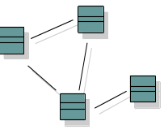

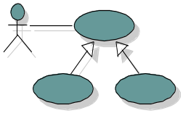
Architecture and the UML
Design View
Implementation View
Classes, interfaces,
collaborations
Use cases
Components
Use Case View
Process View
Deployment View
Active classes
Nodes
Organization
Package, subsystem
Dynamics
Interaction
State machine

Slide 26
Relation Between Views
Logical view
Component view
α
Process view
β
Deployment view

Slide 27
How many views?
Simplified models to fit the context
Not all systems require all views:
  Single processor: drop deployment view
  Single process: drop process view
  Very Small program: drop implementation view
Adding views:
  Data view, security view
Is an open standard
Supports the entire software development lifecycle
Supports diverse applications areas
Is based on experience and needs of the user community
Supported by many tools
Value
Of UML

Slide 28

Contributions to the UML 1.4
Harel
Meyer
Gamma, et al
Statecharts
Before and after
conditions
Frameworks and patterns,
HP Fusion
Booch
Operation descriptions and
message numbering
Booch method
Rumbaugh
Embley
OMT
Singleton classes and
high-level view
Jacobson
Wirfs-Brock
OOSE
Responsibilities
Shlaer - Mellor
Odell
Object lifecycles
Classification

Slide 29
Why Models are used?
To capture and precisely state requirements and domain knowledge so that all stakeholders may understand and agree on them.
To think about the design of a system.
To capture design decisions in a mutable form separate from the requirements.
To generate usable work products.
To organize, ﬁnd, ﬁlter, retrieve, examine, and edit information about large systems.
To explore multiple solutions economically
To master complex systems.

Slide 30
Levels of Model
Guides to the thought process.
  High-level models built early in a project serve to focus the thought process of the stakeholders and highlight options. They capture requirements and represent a starting point toward a system design.
  The early models help the originators explore possible options before converging on a system concept. As design progresses, the early models are replaced by more accurate models.
Abstract speciﬁcations of the essential structure of a system.
  Models in the analysis or preliminary design stages focus on the key concepts and mechanisms of the eventual system. They correspond in certain ways with the ﬁnal system.
  But details are missing from the model, which must be added explicitly during the design process. The purpose of the abstract models is to get the high-level pervasive issues correct before tackling the more localized details.
Full speciﬁcations of a ﬁnal system.
  An implementation model includes enough information to build the system. It must include not only the logical semantics of the system and the algorithms, data structures, and mechanisms that ensure proper performance, but also organizational decisions about the system artifacts that are necessary for cooperative work by humans and processing by tools.

Slide 31
Levels of Model cond…
Exemplars of typical or possible systems.
  Well-chosen examples can give insight to humans and can validate system specifications and implementations.
  Even a large collection of examples, however, necessarily falls short of a definitive description. Ultimately, we need models that specify the general case; that is what a program is, after all.
Complete or partial descriptions of systems.
  A model can be a complete description of a single system with no outside references. More often, it is organized as a set of distinct, discrete units, each of which may be stored and manipulated separately as a part of the entire description.
  Such models have “loose ends” that must be bound to other models in a complete system. Because the pieces have coherence and meaning, they can be combined with other pieces in various ways to produce many different systems. Achieving reuse is an important goal of good modeling.
Models evolve over time. Models with greater degrees of detail are derived from more abstract models, and more concrete models are derived from more logical models.

Slide 32
Semantics and presentation
Models have two major aspects: semantic information (semantics) and visual presentation (notation).
The semantic aspect captures the meaning of an application as a network of log­ical constructs, such as classes, associations, states, use cases, and messages.
  Semantic model elements carry the meaning of the model—that is, they convey the semantics. The semantic modeling elements are used for code generation, validity checking, complexity metrics, and so on.
  The visual appearance is irrelevant to most tools that process models. The semantic information is often called the model. A semantic model has a syntactic structure, well-formedness rules, and execution dynamics.
The visual presentation shows semantic information in a form that can be seen, browsed, and edited by humans.
  Presentation elements carry the visual presentation of the model—that is, they show it in a form directly apprehensible by hu­mans.
  They do not add meaning, but they do organize the presentation to emphasize the arrangement of the model in a usable way.

Slide 33
Context
Models are not built and used in isolation.
Context. Models are themselves artifacts in a computer system, and they are used within a larger context that gives them their full meaning. This context includes
  the internal organization of the model, annotations about the use of each model in the overall development process,
  a set of defaults and assumptions for element creation and manipulation, and
  a relationship to the environment in which they are used.
Models require an internal organization that permits simultaneous use by mul­tiple work groups without undue interference. This decomposition is not needed for semantic reasons—a large monolithic model would be as precise as a set of models organized into coherent packages, maybe even more precise because the organizational boundaries complicate the job of deﬁning precise semantics.
Models capture semantic information about an application system, but they also need to record many kinds of information about the development process it­self, such as the author of a class, the debug status of a procedure, and the human access permission of a diagram.
The commands used to create and modify a model are not part of the semantics of the modeling language any more than the commands of a text editor or browser are part of the semantics of a programming language. Model element properties do not have default values; in a particular model, they simply have values.

Slide 34
What does a model mean?
Abstraction versus detail.
  A model captures the essential aspects of a system and ignores others. Which ones are essential is a matter of judgment that depends on the purpose of the model.
  A modeling language is not a programming language.
  A modeling language may be less precise on purpose because additional detail is irrelevant for the purpose at hand.
  Models at different levels of precision can be used across the life of a project.
Specification versus implementation.
  A model can tell what something does (specification), as well as how the function is accomplished (implementation).
  These aspects should be separated in modeling. It is important to get the what cor­rect before investing much time in the how.
  Abstracting away from implementation is an important facet of modeling. There may be a chain of several specification-implementation relationships, in which each implementation defines the specifications for the next layer.

Slide 35
What does a model mean?
Description versus instance. Models are mostly description.
  The things they de­scribe are instances, which usually appear in models only as examples. Most instances exist only as part of the run-time execution.
  Sometimes, however, run­time instances are themselves descriptions of other things. We call these hybrid objects metadata.
  Something is an instance or a description not in isolation but only in relation to something else, and most things can be ap­proached from multiple viewpoints.
Variations in interpretation. There are many possible interpretations of models in a modeling language.
  One can deﬁne certain semantic variation points—places at which different interpretations are possible—and assign each interpretation a name as a semantic variation so that one can state which variation is being used.
  Semantic variation points permit different execution models to be supported.

Slide 36
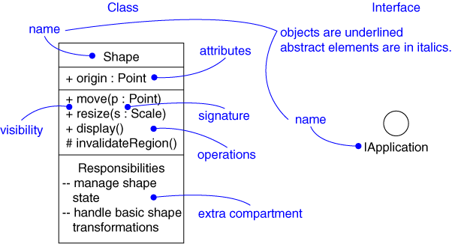
Modeling Elements
Structural elements
  class, interface, collaboration, use case, active class, component, node
Behavioral elements
  interaction, state machine
Grouping elements
  package, subsystem
Other elements
  note

Slide 37
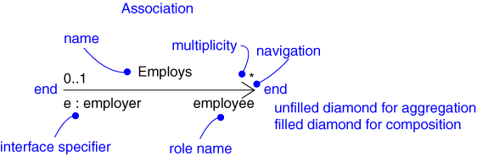
Relationships
Dependency
Association
Generalization
Realization

Slide 38
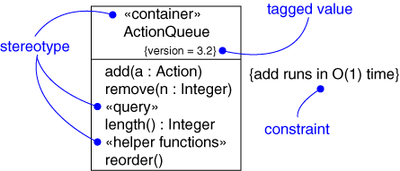
Extensibility Mechanisms
Stereotype
Tagged value
Constraint

Slide 39
Models, Views, and Diagrams
A model is a complete description of a system from a particular perspective
State
Diagrams
State
Diagrams
Class
Diagrams
Use Case
Diagrams
Use Case
Diagrams
State
Diagrams
Use Case
Diagrams
Use Case
Diagrams
State
Diagrams
Use Case
Diagrams
Object
Diagrams
Sequence
Diagrams
Scenario
Diagrams
State
Diagrams
Scenario
Diagrams
State
Diagrams
Collaboration
Diagrams
Component
Diagrams
Models
Scenario
Diagrams
Component
Diagrams
Scenario
Diagrams
Component
Diagrams
Statechart
Diagrams
Deployment
Diagrams
Activity
Diagrams

Slide 40
Diagrams
A diagram is a view into a model
  Presented from the aspect of a particular stakeholder
  Provides a partial representation of the system
  Is semantically consistent with other views
In the UML, there are nine standard diagrams
  Static views: use case, class, object, component, deployment
  Dynamic views: sequence, collaboration, statechart, activity

Slide 41
Diagrams and Views
Diagram Type | UML view | Classification | Comments
Activity | Design view | Behaviour | Shows the workflows among activities associated with a given object(s)/entities
Class | Design view | Structure | Shows (a) the classes in the system and their relationship to one another and/or (b) the fields and methods of a class
Collaboration/ Communication | Use case and design views | Interaction | Show flow of control and message flow between collaborating objects. Collaboration diagrams in UML 1 are renamed Communication diagrams in UML 2.
Component | Implementation view | Structure | Shows the dependencies amongst software components
Deployment | Deployment view | Structure | Show runtime configuration of hardware, software and middleware in a system
Object | Use case and design views | Structure | Show an instance of a class or classes, possibly including field (attribute) values
Sequence | Use case and design views | Interaction | Show message flow (method) calls) between objects.
State Machine | Design view | Behaviour | Show how an entity responds to events and its resultant changes in state. Also called Statechart diagrams
Use Case | Use case view | Behaviour | Show the relationship between the actors and use cases in a system
UML 2 has 13 diagram types. In addition to the above it has:
Composite Structure diagrams, Interaction Overview diagrams, Package diagrams and Timing diagrams.

Slide 42
Why an extension mechanism?
Although UML is very well-defined, there are situations in which it needs to be customized to specific problem domains
UML extension mechanisms are used to extend UML by:
  adding new model elements,
  creating new properties,
  and specifying new semantics
There are three extension mechanisms:
  stereotypes, tagged values, constraints and notes

Slide 43
Stereotypes
Stereotypes are used to extend UML to create new model elements that can be used in specific domains
E.g. when modeling an elevator control system, we may need to represent some classes, states etc. as
  «hardware»
  «software»
Stereotypes should always be applied in a consistent way

Slide 44
Stereotypes (cont.)
Ways of representing a stereotype:
  Place the name of the stereotype above the name of an existing UML element (if any)
    The name of the stereotype needs to be between «» (e.g. «node»)
    Don’t use double ‘<‘ or ‘>’ symbols, there are special characters called open and close guillemets
  Create new icons
Stereotype
Stereotype
in form of icon
«button»
CancelButton
❑
state
CancelButton

Slide 45
Tagged Values
Tagged values
  Define additional properties for any kind of model elements
  Can be defined for existing model elements and for stereotypes
  Are shown as a tag-value pair where the tag represent the property and the value represent the value of the property
Tagged values can be useful for adding properties about
  code generation
  version control
  configuration management
  authorship
  etc.

Slide 46
Tagged Values (cont.)
A tagged value is shown as a string that is enclosed by brackets {} and which consists of:
  the tag, a separator (the symbol =), and a value
Two tagged values
{author = “Ram”,
Version = 2.5}
Employee
name
address

Slide 47
Constraints
Constraints are used to extend the semantics of UML by adding new rules, or modifying existing ones.
Constraints can also be used to specify conditions that must be held true at all times for the elements of a model.
Constraints can be represented using the natural language or OCL (Object Constraint Language)

Slide 48

θ
n
κ
a
Υ
υ
o

