Slide 1
OO Methodologies
A Concise Survey…

Slide 2
Methodology
A framework for applying software engineering practices with the specific aim of providing the necessary means for developing software-intensive systems
Aimed at viewing, modelling and implementing the system as a collection of interacting objects
Consists of:
    Modeling language
    Process
Categorized into
  Seminal methodologies-(1st & 2nd generation )
  Integrated methodologies-(3rd generation)
  Agile methodologies

Slide 3
Object Oriented Methodologies..
Seminal methodologies:-
Shlaer-Mellor (1988-1992)
Coad-Yourdon (1989,1991)
Wirfs-Brock (1990)
Booch (1991,1994)
Rumbaugh (1991)
Embley & Kurtz (1992)
Jacobson (1992)
BON (1992,1995)
Hodge-Mock (1992)
Syntropy (1994)
Fusion (1994)
Integrated methodologies:-
Dori (1995,2002)
Catalysis (1995,1998)
OPEN (1996)
RUP (1995,2000,2003)
EUP (2000,2005)
FOOM (2001)
UML (1997)
Agile methodologies:-
DSDM (1995, 2003)
Scrum (1995, 2001)
XP (1996, 2004)
ASD (1997, 2000)
dX (1998)
Crystal (1998, 2004)
FDD (1999, 2002)

Slide 4
Seminal Methodologies
Shlaer-Mellor’s methodology (1988-1992)
partition the system into domains according to the four domain types defined in the methodology; the partitions practically divide the structure, functionality, and behavior of the software system into four tiers: problem domain, application-independent services, physical architecture, and physical implementation;
analyze the application (problem) domain;
confirm the analysis through static and dynamic verification;
extract the requirements for the application-independent service domains that sup­port the application domain;
analyze the service domains;
specify the components of the architectural domain (physical configuration of the software);
build the architectural components;
translate (implement) the analysis models of relevant domains into the architec­tural components.

Slide 5
Shlaer and Mellor
For the Information models row
  Research
  Develop and Refine the Model
  Integrate with Other Models
  Review
For the State models row
  Construct the State Model
  Verify the Interactions between state models and the object communications model
  Build, or update, the subsystem communication model
  Review for correctness and consistency
For the Process models
  Construct Active Data Flow Diagrams
  Integrate and Merge with State Process Tables, then produce the object access model for the subsystem and update the subsystem access model
  Review

Slide 6
Berard
Object-Oriented Analysis
  Identify the sources of requirements information
  Characterize the sources of requirements information
  Identify candidate objects
  Build object-oriented models of both the problem, and the potential solution, as necessary
  Re-localize the information around the appropriate candidate objects
  Select, create, and verify candidate objects
  Assign the candidate objects to the appropriate section of the object-oriented requirements specification (OORS)
  Develop and refine the precise and concise system description

Slide 7
Berard
Object-Oriented Design
  Identify Candidate Objects
    Develop an object-oriented model of the solution
    Identify objects of interest from the model
    Associate attributes with the operations of interest
  Identify operations suffered by, and required of, candidate objects
    Identify operations of interest / Associate attributes with the operations of interest
    Handle composite operations
      Decompose into primitive operations
      Decouple objects
  Select, create, and verify objects for design
    Bind objects and operations
    Examine objects for completeness
  Decide on programming language implementation of objects
    Objects identified during analysis
    Objects identified during design
  Create object-oriented graphical models
  Establish the interface for each object-oriented item
  Implement each object-oriented item
    Refine the interface objects / Refine the other objects
    Recursively apply the object-oriented development process

Slide 8
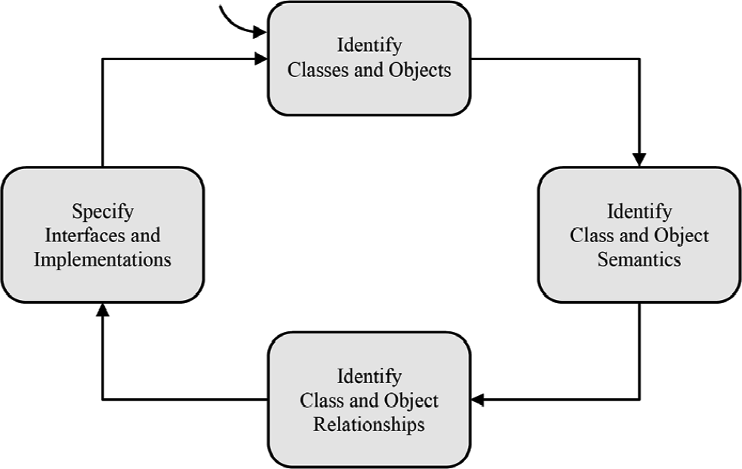
Grady Booch’s methodology (1991,1994)
First to suggest using the object-oriented approach in system design
Repeating process (The Micro Process) within a lifecycle-level repeating process(The Macro Process)
Macro as a controlling framework for micro process
Micro process

Slide 9
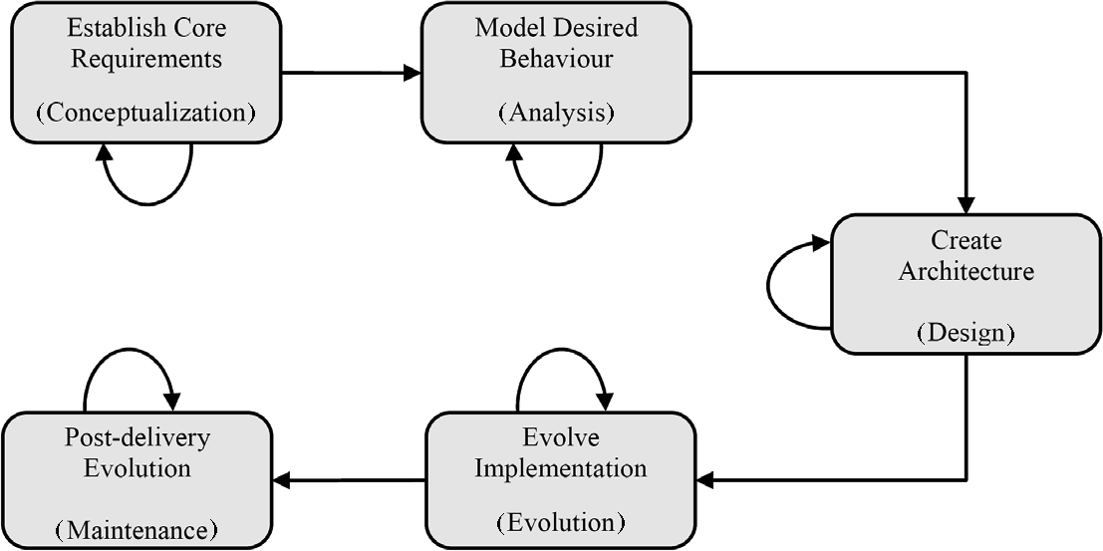
Macro process

Slide 10
Booch
Object-Oriented Design
  Identify Classes and Objects
  Identify the Semantics of Classes and Objects
  Identify the Relationships Among Classes and Objects
  Implement Classes and Objects

Slide 11
Coad-Yourdon’s methodology (1989-1991)
Comparatively simplest
Introductory object oriented methodology
Only span the generic analysis and design phases, it does offer guidelines for implementation
This class diagrams has:-
Subject layer
Class & Object layer
Structure layer
Attribute layer
Service layer
Designed in 4 components:-
Problem domain
Human interaction
Task management
Data management

Slide 12
Coad and Yourdon
Object-Oriented Analysis
  Identify Objects
  Identify Structures
    Gen-Spec Structures
    Whole-Part Structures
    Multiple Structures
  Identify Subjects
  Define Attributes
    Identify the Attributes
    Position the Attributes
    Identify Instance Connections
    Check special cases
    Specify the Attributes
  Define Services
    Identify Object States
    Identify the Required Services
    Identify Message Connections
    Specify the Services
    Put the OOA documentation set together

Slide 13
Coad and Yourdon
Object-Oriented Design
  Design the Problem Domain Component
    Reuse design and programming classes
    Group problem-domain-specific Classes together
    Establish a protocol by adding a generalization Class
    Accommodate the supported level of inheritance
    Improve performance
    Support the Data Management Component
    Add lower level components
    Review and challenge the additions to OOA results
  Design the Human Interaction Component
    Classify the humans
    Describe the humans and their task scenarios
    Design the command hierarchy
    Design the detailed interaction
    Continue to prototype
    Design the Human Interaction Components Classes
    Design, accounting for GUI (when applicable)

Slide 14
Coad and Yourdon
Object-Oriented Design
  Design the Task Management Component
    When needed tasks
    Identify event-driven tasks
    Identify clock-driven tasks
    Identify priority tasks and critical tasks
    Identify a coordinator
    Challenge each task
    Define each task
  Design the Data Management Component
    Select Data management approach
    Assess data management tools
    Design the Data Management Component

Slide 15
Colbert
Object-Oriented Requirements Analysis
  Perform Object-Oriented Requirements Analysis
  Create an Object-Interaction Specification
  Create Object-Class Specifications
  Create Behavior Specifications
  Create Attribute Specifications
Object-Oriented Design
  Represent each object in the Object-Interaction Diagram
  Represent each class in the Object-Class Diagram
  Represent each interaction in the Object-Interaction Diagram
  Review the State-Transition for details of behavior that affect the Ada Structure
  Add Ada-specific components needed to complete the representation

Slide 16
Embley & Kurtz Object Oriented System Analysis
Only concerned with object-oriented analysis
A model driven technique
Consists 3 parts:-
Object relationship model
Object behavior model
Object interaction model

Slide 17
Embley and Kurtz
Object-Oriented Systems Analysis
  Construct Object-Relationship Models
  Construct Object-Behavior Models
  Construct Object Interaction Models
  Integrate Models

Slide 18
IBM
Object-Oriented Design
  Design the View
    Define Business Transactions
    Capture the User's Model
      Model the User's Objects
      Model the User's Behavior
      Enhance the User's Model
      Provide Natural Interaction Techniques
      Extract the Objects
      Document the User's Model
      Validate and Iterate
    Specify the Objects
      Find and Document the Objects
      Find and Document the Methods
      Find the Detailed Methods for the Model Objects

Slide 19
IBM
Object-Oriented Design
    Build the View
      Design Direct Manipulation Actions
      Decompose the Model Objects
      Define Instance Variables
      Design the Windows
    Code and Test the View
      Code and Open the View Object
      Initialize and Update Pointers and Primitives
      Change Pointer Object
      Get More Details
      Implement Direct Manipulation
      Test the View

Slide 20
IBM
Design the Business Model
    Find the Technical Model Objects
      Process New Model Interface Objects
      Determine Required Knowledge and Decompose into Elementary Objects
      Re-Evaluate the Objects and Document Their Relationships
    Implement the Model Objects
      Define Methods to Access Knowledge
      Create Message Interaction Diagrams
      Document the Model Interface Objects
    Code and Test the Classes
      Compare Objects to Database
      Code the Classes
      Simulate Dynamic Behavior of Objects
    Build the Objects
      Refine the Class Hierarchy
      Group Objects
      Abstract Classes
      Decompose or Compose
      Iterate

Slide 21
Martin and Odell
Object-Oriented Behavior Analysis
  Define Analysis Goals
  Clarify Event Type
  Generalize Event Type
  Define Operation Conditions
  Identify Operation Causes
  Refine Cycle Results

Slide 22
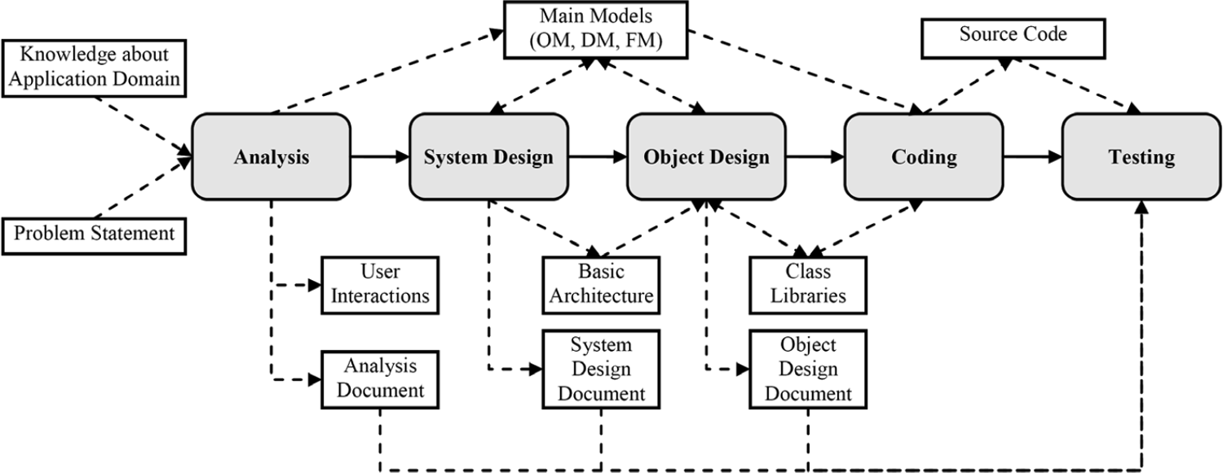
Rumbaugh OMT methodology (1991)
OMT defines system using:-
Object model
Dynamic model
Functional model
Process

Slide 23
Rumbaugh
Analysis
  Write or obtain an initial description of the problem (Problem Statement)
  Build an Object Model
    Identify object classes.
    Begin a data dictionary containing descriptions of classes, attributes, and associations
    Add associations between classes
    Add attributes for objects and links.
    Organize and simplify object classes using inheritance.
    Test access paths using scenarios and iterate the above steps as necessary
    Group classes into modules, based on close coupling and related function.
  Develop a Dynamic Model
    Prepare scenarios of typical interaction sequences.
    Identify events between objects and prepare an event trace for each scenario.
    Prepare an event flow diagram for the system.
    Develop a state diagram for each class that has important dynamic behavior
    Check for consistency and completeness of events shared among the state diagrams.

Slide 24
Rumbaugh
Analysis
  Construct a Functional Model
    Identify input and output values.
    Use data flow diagrams as needed to show functional dependencies.
    Describe what each function does.
    Identify constraints.
    Specify optimization criteria.
  Verify, iterate, and refine the three models.
    Add key operations from Functional to Object model
    Verify consistency and completeness of classes, attributes, associations, and operations
    Develop more detailed models to further explore and verify the three models
    Iterate the above steps as needed to complete the analysis

Slide 25
Rumbaugh
System Design
  Organize the system into subsystems
  Identify concurrency inherent in the problem.
  Allocate subsystems to processors and tasks.
  Choose the basic strategy for implementing data stores in terms data structures, files, and databases.
  Identify global resources and determine mechanisms for controlling access to them.
  Choose an approach to implementing software control
    Use the location within the program to hold state, or
    Directly implement a state machine, or
    Use concurrent tasks
  Consider boundary conditions.
  Establish trade-off priorities.

Slide 26
Rumbaugh
Object Design
  Obtain operations for the object model from the other models:
    Find an operation for each process in the functional model
    Define an operation for each event in the dynamic model, depending on the implementation of control
  Design algorithms to implement operations:
    Choose algorithms that minimize the cost of implementing the operation
    Select data structures appropriate to the algorithms.
    Define new internal classes and operations.
    Assign responsibility for operations that are not clearly associated with a single class.
  Optimize access paths to data:
    Add redundant associations to minimize access cost and maximize convenience.
    Rearrange the computation for greater efficiency.
    Save derived values to avoid recomputation of complicated expressions.
  Implement software control by fleshing out the approach chosen during system design.

Slide 27
Rumbaugh
Object Design
  Adjust class structure to increase inheritance:
    Rearrange and adjust classes and operations to increase inheritance.
    Abstract common behavior out of groups of classes.
    Use delegation to share behavior where inheritance is semantically invalid.
  Design implementation of associations:
    Analyze the traversal of associations
    Implement each association as a distinct object or by adding object-valued attributes to one or both classes in the association.
  Determine the exact representation of object attributes.
  Package classes and associations into modules.

Slide 28
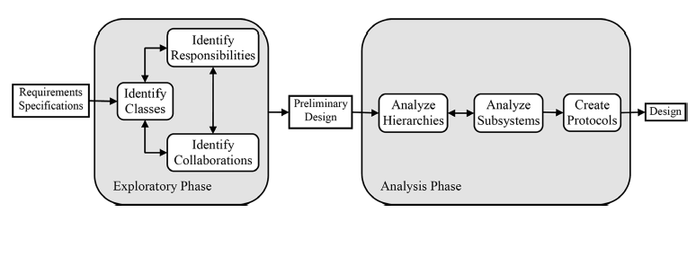
Wirfs-Brock’s Responsibility Driven Design (1990)
Great impact on object-oriented s/w engineering
Useful notion responsibility includes:-
Knowledge an object maintains
Actions an object can perform
Phases

Slide 29
Wirfs-Brock
Read and Understand the Specification
As you follow the steps below, walk through various scenarios to explore possibilities. Record the results on design cards.
Extract noun phrases from the specification and build a list.
Look for nouns that may be hidden (for example, by the use of the passive voice), and add them to the list.
Identify candidate classes from the noun phrases by applying the following guidelines:
  Model physical objects
  Model conceptual entities
  Use a single term for each concept
  Be wary of the use of adjectives
  Model categories of objects
  Model external interfaces
  Model the values of an object's attributes
Identify candidates for abstract superclasses by grouping classes that share common attributes.
Use categories to look for classes that may be missing.
Write a short statement for the purpose of the class.

Slide 30
Wirfs-Brock
Find responsibilities using the following guidelines:
  Recall the purpose for each class, as implied by its name and specified in the statement of purpose
  Extract responsibilities from the specification by looking for actions and information.
  Identify responsibilities implied by the relationships between classes.
Assign responsibilities to classes using the following guidelines:
  Evenly distribute system intelligence
  State responsibilities as generally as possible
  Keep behavior with related information
  Keep information about one thing in one place.
  Share responsibilities among related classes.
Find additional responsibilities by looking for relationships between classes.
  Use "is-kind-of" relationships to find inheritance relationships.
  Use "is-analogous-to" relationships to find missing superclasses.
  Use "is-part-of" relationships to find other missing classes.
Find and list collaborations by examining the responsibilities associated with classes.
Identify additional collaborations.

Slide 31
Wirfs-Brock
Discard classes if no classes collaborate with them, and they collaborate with no other classes.
Build hierarchy graphs that illustrate the inheritance relationships between classes.
Identify which classes are abstract and which are concrete.
Draw Venn diagrams representing the responsibilities shared between classes.
Construct class hierarchies.
Construct the contracts defined by each class.
Draw a complete collaborations graph of your system.
Identify possible subsystems within your design.
Simplify the collaborations between and within subsystems
Construct the protocols for each class. Refine responsibilities into sets of signatures that maximize the usefulness of classes.
Write a design specification for each class.
Write a design specification for each subsystem.
Write a design specification for each contract.

Slide 32
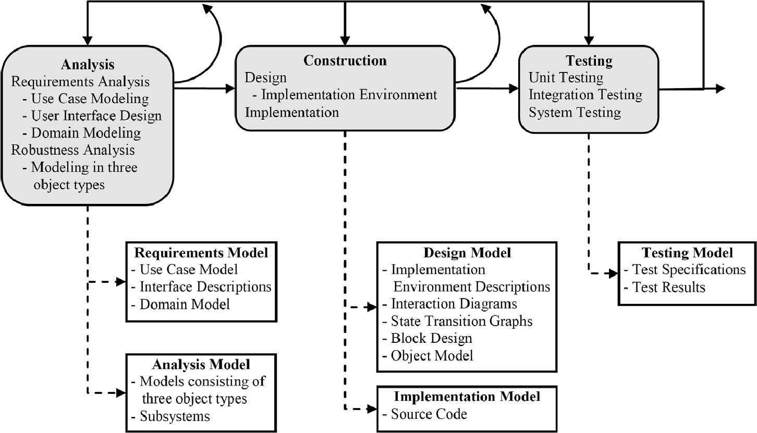
Jacobson (OOSE) methodology
Although each model is built in a specific phase of the process, models are usually revisited and refined during later phases

Slide 33
OOSE
1) analysis: focuses on understanding the system and creating a conceptual model of it. This phase consists of two non-sequential, iterative subphases:
  (1.1) requirements analysis, aims at eliciting and modeling the requirements of the system. A requirements model is produced as a result of this activity.
  (1.2) robustness analysis, aims at modeling the structure of the system in terms of interface, data, and control objects, and also by specifying the subsystems making up the overall system. An analysis model is produced as the result of this activity.
(2) construction: focuses on creating a blueprint of the software and producing the code. This phase consists of two subphases:
  (2.1) design, aims at modeling the run-time structure of the system, and also the inter-object as well as intra-object behavior necessary to realize the requirements. A design model is produced as the result of this activity.
  (2.2) implementation, aims at building the software. An implementation model (in­cluding the code) is produced as the result of this activity.
  (3) testing focuses on verifying and validating the implemented system. A test model is produced during this phase.

Slide 34
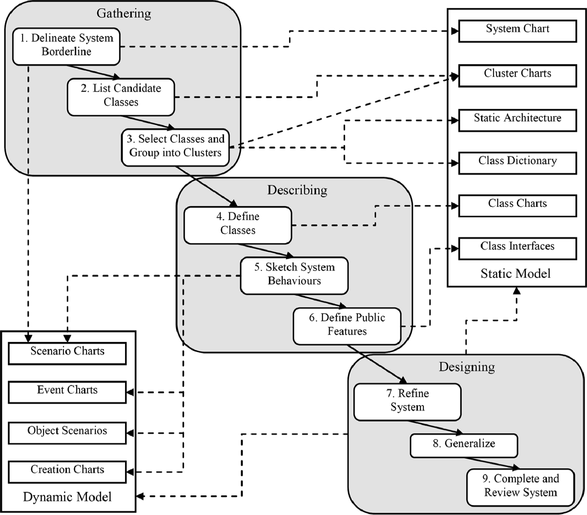
Business Objection Notation (BON) methodology
Language independent
Each task has a set of input sources controlled by acceptance criteria, & produces a set of deliverables

Slide 35
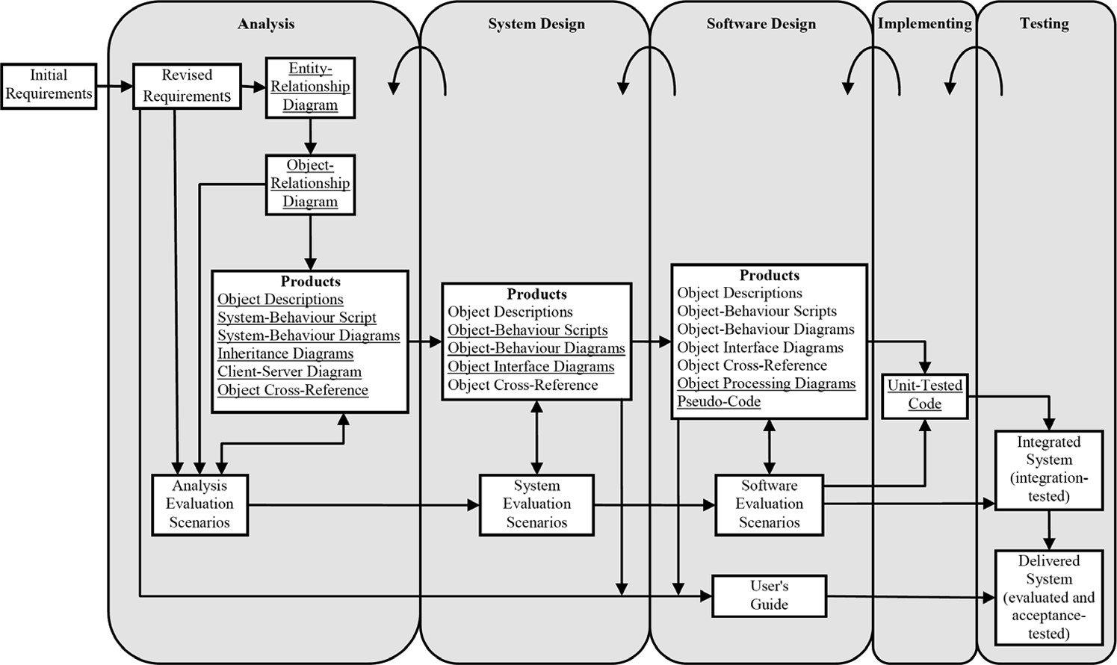
Hodge-Mock methodology (1992)
For use in simulation & prototyping lab- Automation into Air Traffic Control systems

Slide 36
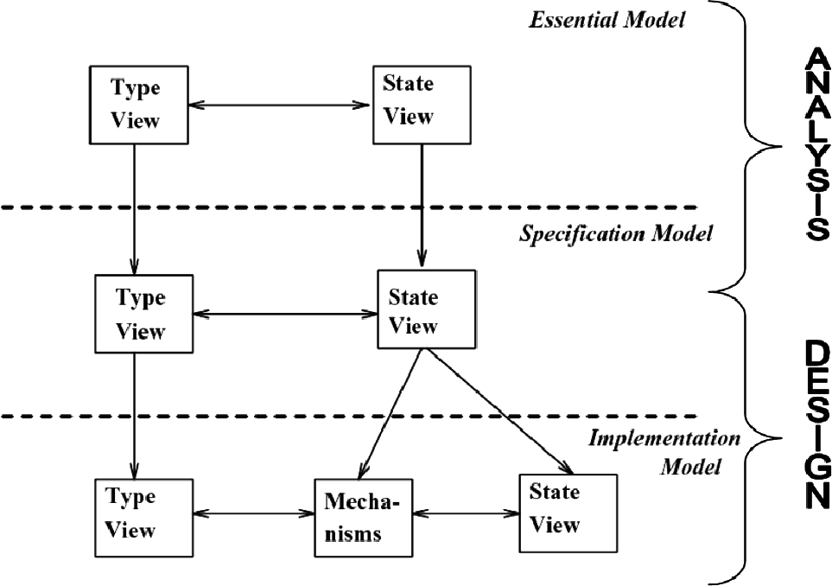
Cook-Daniel Syntropy methodology (1994)
Suggest a definite process through the levels of modelling it prescribes
Model levels:-
Essential model
Specification model
Implementation model
Views

Slide 37
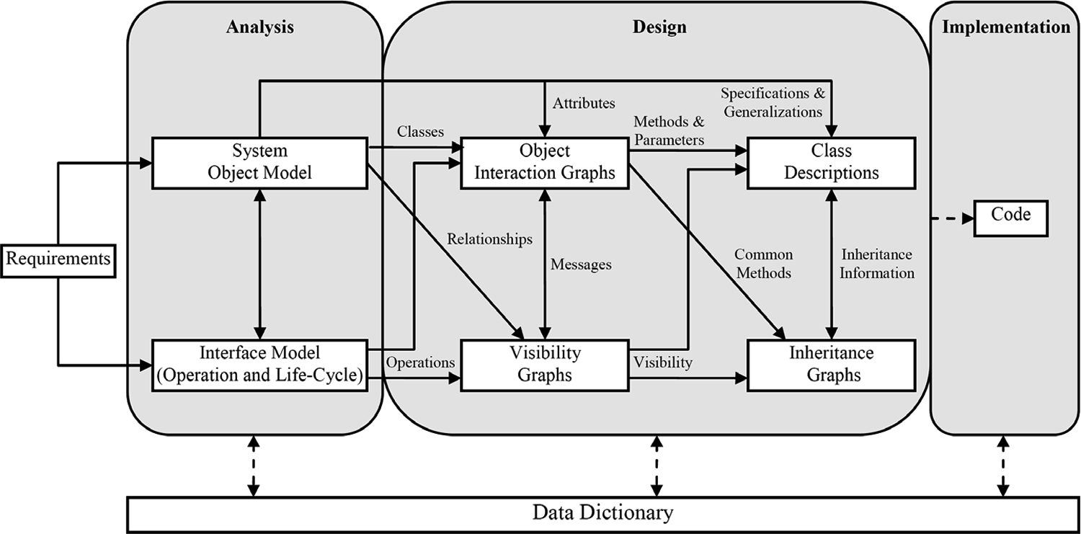
Fusion methodology (1994)
Integration, unification and extension of a no. of older methodologies
Provides consistency and completeness checks between phases

Slide 38
Integrated Methodologies..
Dori’s Object Process Methodology (OPM)
Combining the classic process-oriented modelling approach with object-oriented modelling techniques
Only one type of diagram is used for modelling the structure, function, and behaviour of the system
Avoids the problems of model multiplicity
Diagram: Object, Process, State
OPM process is little more than an abstract framework
Sub processes:-
Initiating
Developing
Deploying

Slide 39
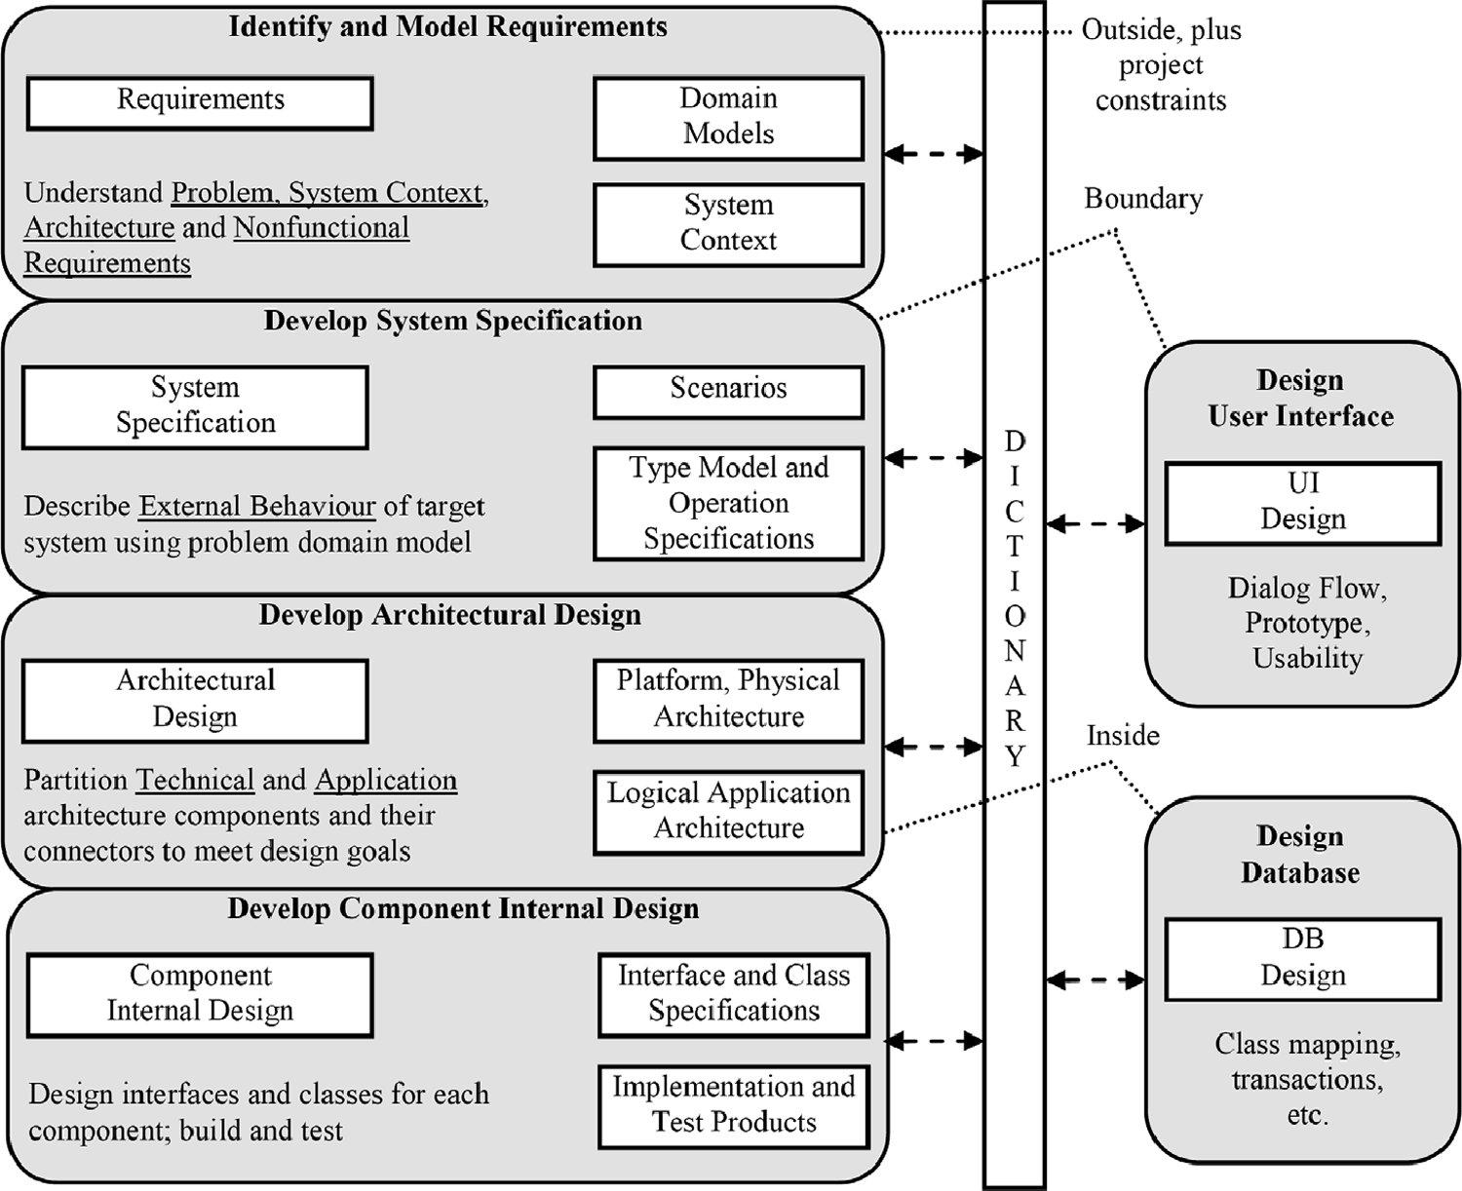
D’Souza & Wills Catalysis methodology (1995-98)
Greatly influenced and inspired object-oriented component-based development processes
Specific process for business system

Slide 40
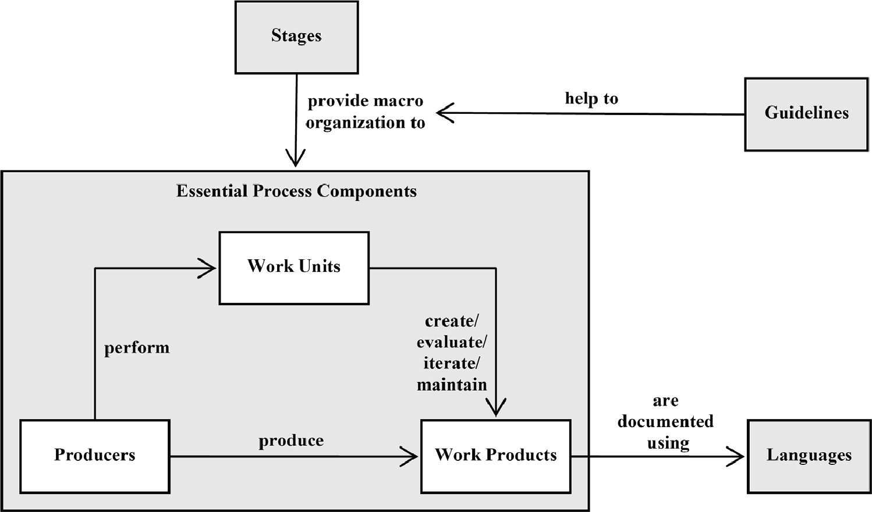
Object-Oriented Process, Environment, and Notation (OPEN)
Language: OML (OPEN Modeling Language)
Framework: OPF (OPEN Process Framework)
OPF :Process metamodel defining 5 classes of components & guidelines for constructing customized OPEN processes

Slide 41
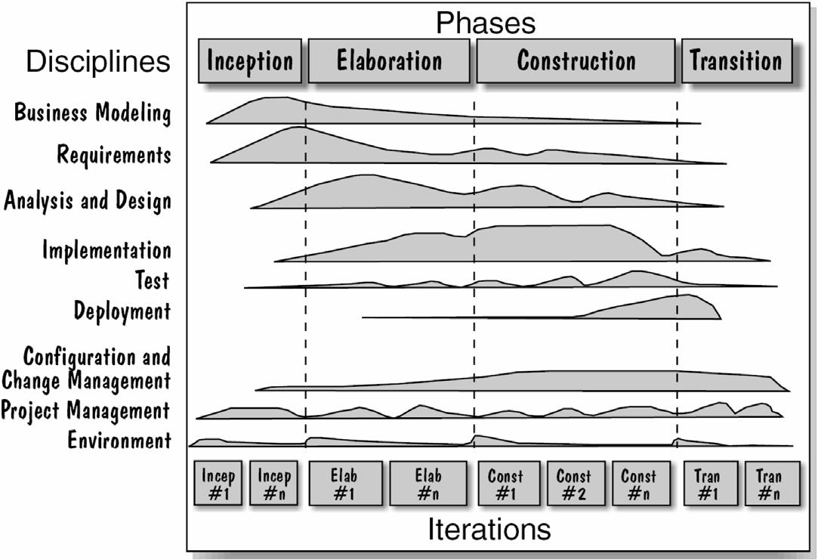
Rational Unified Process(RUP)
Use case driven
Iterative and incremental with the overall process
UML is used as the modelling language in RUP-mistakenly called the UML Methodology

Slide 42
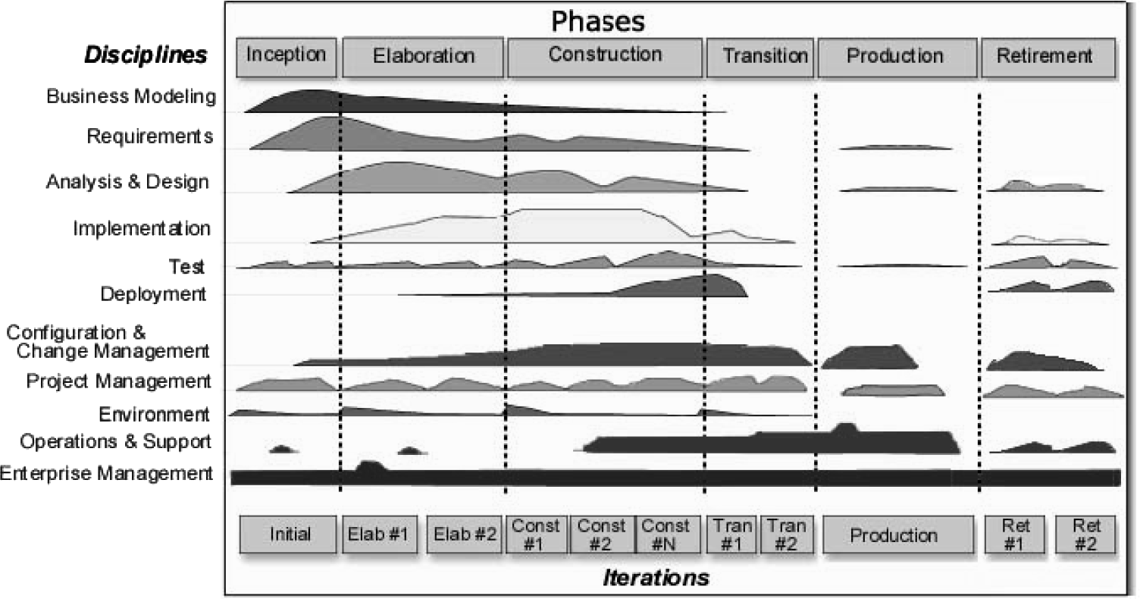
Enterprise Unified Process (EUP) methodology
Extended variant of RUP
EUP overcomes the drawbacks of RUP which are-
System support & eventual retirement
Supports org-wide infrastructure development
Iterative nature of the lifecycle isn’t hard to grasp
RUP was tool-driven
Phase

Slide 43
Functional and Object-Oriented Methodology (FOOM)
Strives to combine the classical process-oriented approach with the object-oriented paradigm as OMT
Phases:-
Analysis
Design
Implementation
Targeted at data-intensive information systems
Lack of provision for behavioural modelling during systems analysis

Slide 44
UML (Unified Modeling Language)
UML is result of the war among seminal methodologies
Unified the visual modelling languages of Booch, Rumbaugh & Jacobson’s methodologies
Process independent methodology
De-facto standard for object oriented modeling
UML consists mainly of a bunch of diagram styles used to depicts different aspects of systems
UML is purely notation ie no modeling method associated it
Has a standardized metamodel
UML combines best techniques from data modelling (entity relationship diagrams), business modelling (work flows), object modelling, and component modelling
Can be used with all processes, throughout the software development life cycle, and across different implementation technologies

Slide 45
UML 2.0 has corrected deficiency of its 1.x versions by deleting the dynamic collaboration diagram generated from a sequence diagram and authorizing a real hybrid object diagram
UML 2.0 also works in real-time system
There are four parts to the UML 2.x specification:
Superstructure (notation and semantics for diagrams and their model elements)
Infrastructure (core metamodel on which the Superstructure is based)
Object Constraint Language (OCL) for defining rules for model elements
UML Diagram Interchange (defines how UML 2 diagram layouts are exchanged)

Slide 46
Dynamic Systems Development Method
DSDM is a management and control framework for Rapid Application Development
RAD aims to build a working system rapidly
Prototyping aims to build elements of a system (a partial system) quickly
Similar development environments can be used for both
A prototype may incrementally become a working system

Slide 47
DSDM – A historic necessity
1980s – Waterfall Lifecycle dominates
– slow, expensive, not delivering what was needed
1990s – Problems with Waterfall give rise to
Rapid Application Development
– quick but often dirty, high lifetime costs
Key problems:
Late, Buggy, Costly, Not fit for purpose

Slide 48
DSDM – More than a method
Balance
  Cost, Time, Scope, Quality
Best Practice
  From the outset
  Constantly updated
Consortium
  Accredited Training,
  Experience based qualifications
  Community

Slide 49
DSDM – The Framework
Principles
  Common sense underpinning everything
Lifecycle
  Iterative, incremental, flexible, formal
Techniques
  Many and varied, tried and tested
People
  People + Process = Success
  Responsibilities clearly defined

Slide 50
DSDM Principles
1. Active user involvement is imperative
2. The team must be empowered to make decisions
3. The focus is on frequent delivery of products
4. Fitness for business purpose is the essential
criterion for acceptance of deliverables
5. Iterative and incremental delivery is necessary
to converge on accurate business solution
6. All changes during development are reversible
7. Requirements are baselined at a high level
8. Testing is integrated throughout the lifecycle
9. Collaboration and co-operation between all stakeholders is essential
all to be applied wherever possible

Slide 51
DSDM full-project Lifecycle
Pre-project
Post-project
Feasibility
Study
Business Study
Agree Plan
Implement
Create
Identify
Functional
Functional
Model
Functional
Review
Implementation
Train
Prototype
Iteration (x3)
Prototype
Business
Users
Review Prototype
User Approval
& Guidelines
Identify Design
Prototypes
Review
Agree
Design & Build
Design
Plan
Iteration (x3)
Prototype
Create Design
Prototype

Slide 52
DSDM Techniques
Best of breed
At the heart of DSDM are:-
  Facilitated Workshops
  MoSCoW Prioritisation
  Timeboxing
  Prototyping
As well as others, for example
  Risk Management
  Configuration Management
  Modelling

Slide 53
MoSCoW Prioritisation
Estimated
Effort
60%
Must
Should
Could
Won’t
Minimum Useable SubseT
I guarantee this
Significant benefits. Work-
arounds possible but costly
All out to achieve this
40%
Significant benefits. Work-
arounds easy or cheap
Best endeavours
We’ll re-prioritise
next time
Out of Scope this time
1
2
3
4
5
6
7
8
9
MoSCoW only meaningful within a timeframe
(e.g. Project/Incremet/Timebox)
Hierarchical breakdown
M
S
C
W
M
S
C
W
M
S
S
C
Notes:
TRAINERS NOTES
Objective – to understand how the MoSCoW rules work.
Explain MoSCoW rules and stress difference from normal HML prioritisation (e.g. M&S may have traditionally been called High or Mandatory)
Timeframe – “Must” by when? MoSCoW depends upon timeframe. A MUST by the end of the project might be a SHOULD for the first increment.
Hierarchy – e.g. a high level MUST may break down into 2 MUSTS, a SHOULD and 2 COULDS. Equally a high level COULD may break down and may include a MUST (IF you do provide the COULD then in order to work it MUST)

Slide 54
People
Project Level Roles
  Executive Sponsor
  Visionary
  DSDM Project Manager
  Technical Co-ordinator
Core Team Roles
  DSDM Team Leader
  Developer
  Ambassador User
  Tester
  Scribe
Other Roles
  Advisor User, Facilitator, Specialists
One person many roles
One role many people
Substitute responsibilities
  But cover them all
e.g. Ambassador User
Input to business requirements
Provide detail business scenarios
Communicate with other users
Provide input to prototyping sessions
Review documentation
Review and accept delivered software
User training / user documentation
Organise and control user testing
Notes:
TRAINERS NOTES
Objective – to understand concept of DSDM roles and how they should be used to help plan project teams.
Roles don’t necessarily relate to individuals on a one-to-one basis. One person may cover two or more roles, and a role could be split between two or more people. Give examples and discuss possible risks.
Real world constraints may get in the way of having the ideal team structure – important thing is that all responsibilities are effectively covered. Consider
Having named substitutes or understudies for key roles.
Having written terms of reference for each role - STRESS THAT THIS IS NOT IN DSDM MANUAL
Gaining commitment to responsibilities through workshops - STRESS THAT THIS IS NOT IN DSDM MANUAL
Running scenarios in workshops to test that everyone understands - STRESS THAT THIS IS NOT IN DSDM MANUAL
Introduce roles and explain difference between project level roles and core team roles.

Slide 55
DSDM – A Real World Solution
DSDM is focussed on:-
Building the right solution through constant
  Communication
  Validation
Building the solution right via an approach which is:-
  Disciplined
  Flexible and adaptable
  Holistic

Slide 56
θ
n
κ
a
Υ
υ
o

