Slide 1
SMART INDIA HACKATHON 2025
TITLE PAGE
• Problem Statement ID : Enter your assigned PS ID (e.g. SIH2025-MED01)
• Problem Statement Title : AI-Driven Culturally Grounded Digital Therapeutics & Cognitive Care for Dementia
• Project Name : Smriti-NER (স্মৃতি) — Cognitive Health Platform for North East India
• Theme : MedTech / BioTech / Healthcare & Rural Health
• PS Category : Software
• Team ID : Enter your Team ID
• Team Name : Enter your Registered Team Name

Slide 2
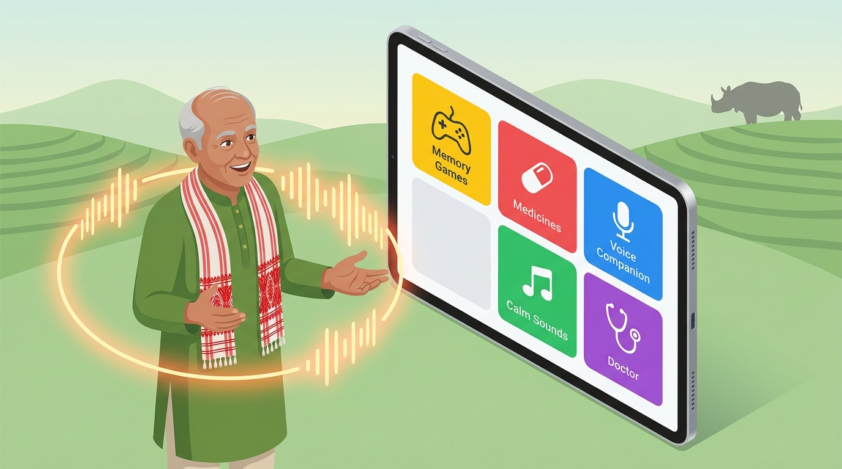
Your Team Name
IDEA TITLE: SMRITI-NER (স্মৃতি)
SMART INDIA
HACKATHON 2025
Proposed Solution (3 Core Pillars):
• Zero-Confusion Elderly UI: 5 giant high-affordance tactile tiles with password-free 1-tap fast-pass login for dementia patients.
• 8-Game Cultural Therapeutic Suite: Clinically designed cognitive exercises using familiar North Eastern motifs (Kaziranga rhino, tea sorting, Bihu rhythms) stimulating memory and combating visual agnosia.
• Multilingual Neural AI Voice Companion: Empathetic voice assistant providing hands-free guidance and daily medication, water, and appointment reminders in Assamese and English.
How It Addresses The Problem:
• Bridges Rural Diagnostic Gap: Solves the 85%+ undiagnosed dementia gap in rural NER with zero-cost smartphone deployment and empowers local ASHA health workers.
Innovation & Uniqueness:
• Passive Micro-Latency Tracking: Records millisecond reaction speeds and accuracy curves to generate MMSE-correlated clinical radar reports for neurologists.
@SIH Idea submission- Template 2

Slide 3
Your Team Name
TECHNICAL APPROACH
SMART INDIA
HACKATHON 2025
Technologies & Architecture:
• Frontend / UX: React 19, Vite, TailwindCSS (WCAG 2.1 AAA High-Contrast Palette for Elderly).
• Voice AI Engine: Multilingual Neural Speech Synthesis, Web Speech API, Web Audio API.
• Backend & Database: Supabase Cloud (PostgreSQL), Granular Row-Level Security (RLS).
• Clinical Analytics: Recharts (5-axis Cognitive Domain Radar Charts, Longitudinal Latency Curves).
• Deployment: Vercel Edge Network, Progressive Web App (PWA) with Offline IndexedDB Cache.
Implementation Workflow & Process:
• 1. 1-Tap Access: Dementia patient logs in with single-tap remembered avatar, zero password friction.
• 2. Multilingual Engagement: Listens to natural Assamese/English audio orientation and selects from 8 therapeutic games.
• 3. Passive Metric Extraction: Engine logs interaction latencies (ms), decision errors, and motor accuracy in real-time.
• 4. Smart Reminders: Proactive automated voice reminders for daily medications, hydration, and doctor visits.
• 5. Clinical Tele-Triaging: Syncs encrypted longitudinal records to ASHA workers and GMCH neurologists for early intervention.
@SIH Idea submission- Template 3

Slide 4
Your Team Name
FEASIBILITY AND VIABILITY
SMART INDIA
HACKATHON 2025
1. Feasibility Analysis of the Idea:
• Working Live Prototype: Already fully developed and deployed on Vercel with real-time cloud data sync.
• Zero Hardware Cost: Runs seamlessly on any standard smartphone, tablet, or PHC desktop without expensive external sensors.
• Low-Bandwidth Optimization: Designed to operate reliably on rural 2G/3G networks across remote hilly regions.
2. Potential Challenges & Mitigation Strategies:
• Risk 1: Intermittent Internet in Remote Hilly Districts (e.g., Majuli, Dima Hasao) ➔ Mitigation: Offline-First PWA architecture with local IndexedDB storage that automatically syncs when online.
• Risk 2: Digital Hesitancy & Tech Anxiety among 70+ Dementia Seniors ➔ Mitigation: High-affordance 5-tile UI, giant touch targets, voice guidance, and zero password typing.
• Risk 3: Health Data Privacy & Security (DPDP Act / Healthcare Compliance) ➔ Mitigation: Granular Row-Level Security (RLS), encrypted patient IDs, and anonymized clinical session logs.
@SIH Idea submission- Template 4

Slide 5
Your Team Name
IMPACT AND BENEFITS
SMART INDIA
HACKATHON 2025
Target Audience Impact
• Slowing Cognitive Decline: Regular cognitive stimulation preserves neural plasticity in MCI patients.
• Emotional Calming & Sundowning Relief: Traditional folk music and bird calls reduce anxiety and agitation.
• Independence & Dignity: Seniors independently track water, medicines, and daily orientation.
Social & Healthcare Benefits
• Empowering ASHA Workers: Provides objective digital screening tools during routine rural home visits.
• Bridging Healthcare Divide: Direct digital linkage from village PHCs to tertiary centers (GMCH/NEIGRIHMS).
• Culturally Inclusive Care: First healthcare tool embracing indigenous North Eastern heritage and languages.
Economic Viability
• Massive Cost Savings: Reduces avoidable hospitalizations and specialized dementia caregiver costs.
• National Scalability: Seamlessly aligns with National Programme for Health Care of the Elderly (NPHCE).
• Zero Cost to Seniors: High public health ROI with zero proprietary hardware requirements.
@SIH Idea submission- Template 5

Slide 6
Your Team Name
RESEARCH AND REFERENCES
SMART INDIA
HACKATHON 2025
Clinical Research & Scientific Grounding:
• World Health Organization (WHO): Global Action Plan on the Public Health Response to Dementia (2017–2025).
• Dementia India Report (ARDSI): Assessment of high prevalence and clinical diagnostic gaps in rural and North Eastern populations.
• The Lancet Commission (2024): Dementia prevention, intervention, and care — emphasizing early cognitive and sensory stimulation.
• Folstein et al. (MMSE & MoCA): Mini-Mental State Examination protocols and adaptation for multilingual Indian demographics.
Standards & Frameworks:
• W3C Web Content Accessibility Guidelines (WCAG 2.1 AAA): Elderly touch targets, color contrast, and audio guidance standards.
• Ayushman Bharat Digital Mission (ABDM): Healthcare registry interoperability and tele-monitoring frameworks.
Live Prototype & Verification Link:
• Live Application URL: https://smriti-ner-three.vercel.app (Verified Working Production Prototype)
@SIH Idea submission- Template 6

