Slide 1
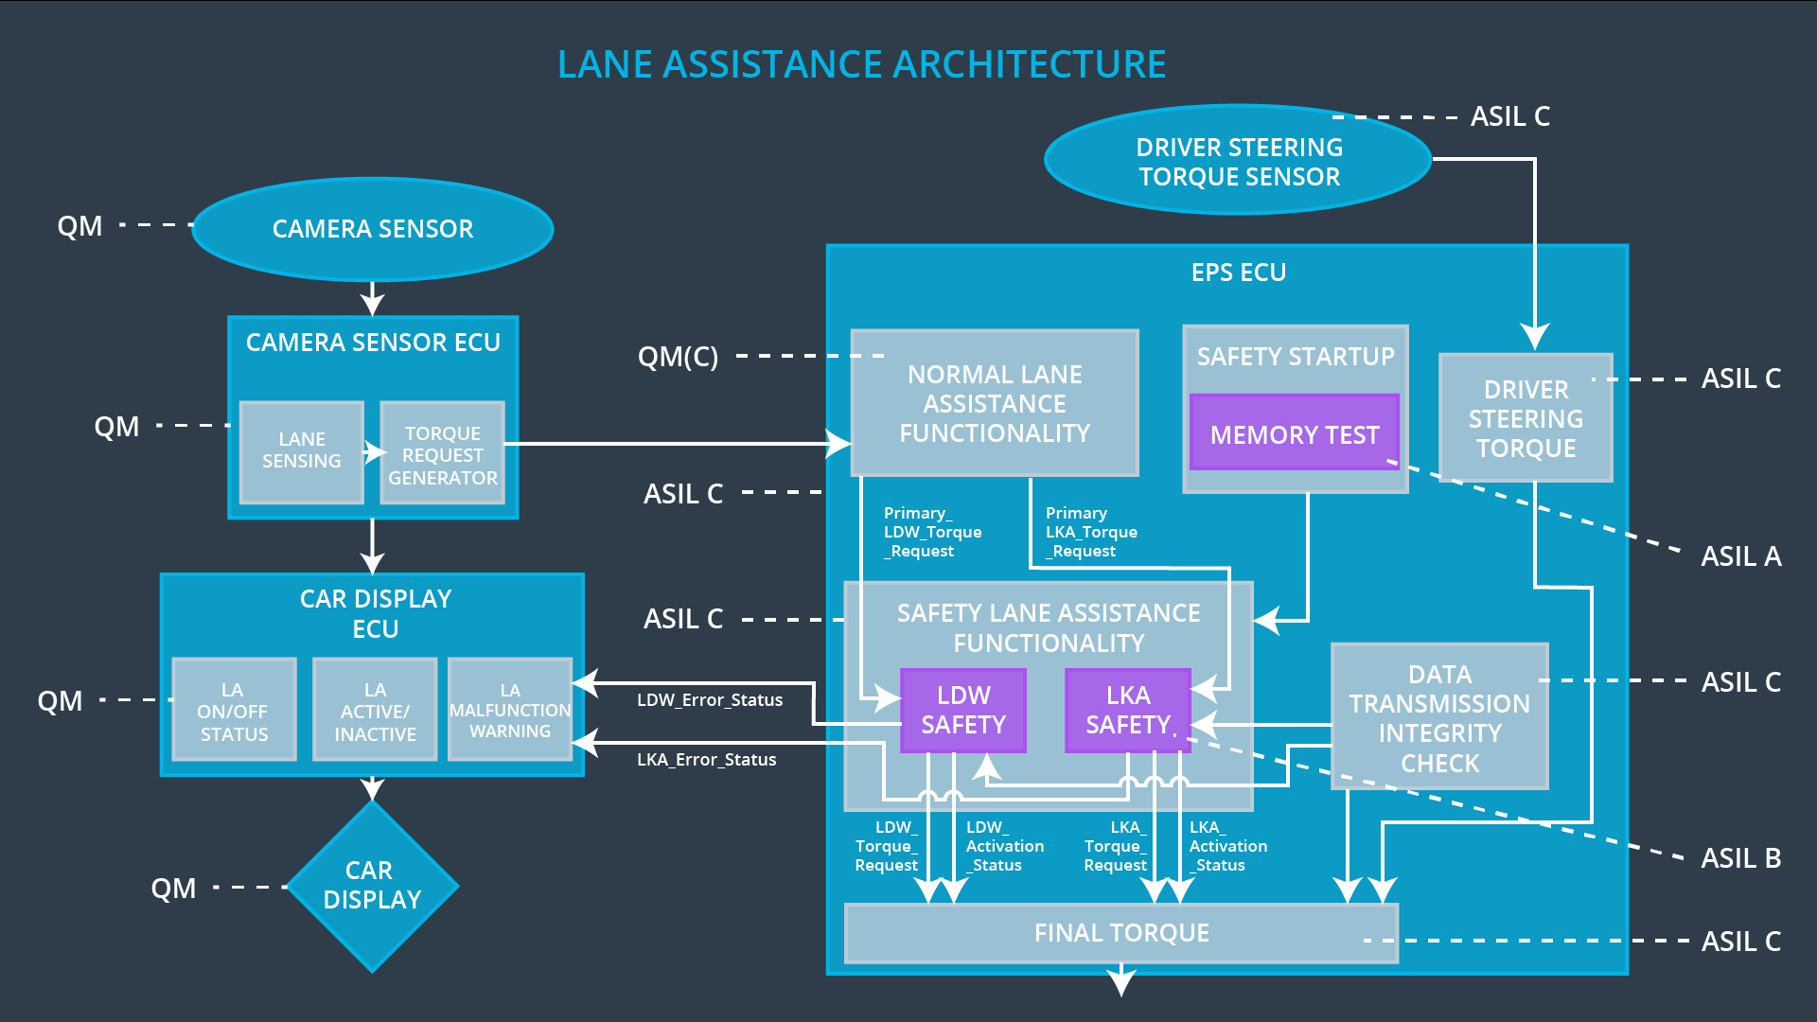
Camera_Torque_Request

