Slide 1
Payment Trends Viz
File created on: 8/16/20 10:30:46 PM PDT
Created by Ajinkya P Bhavik

Slide 2
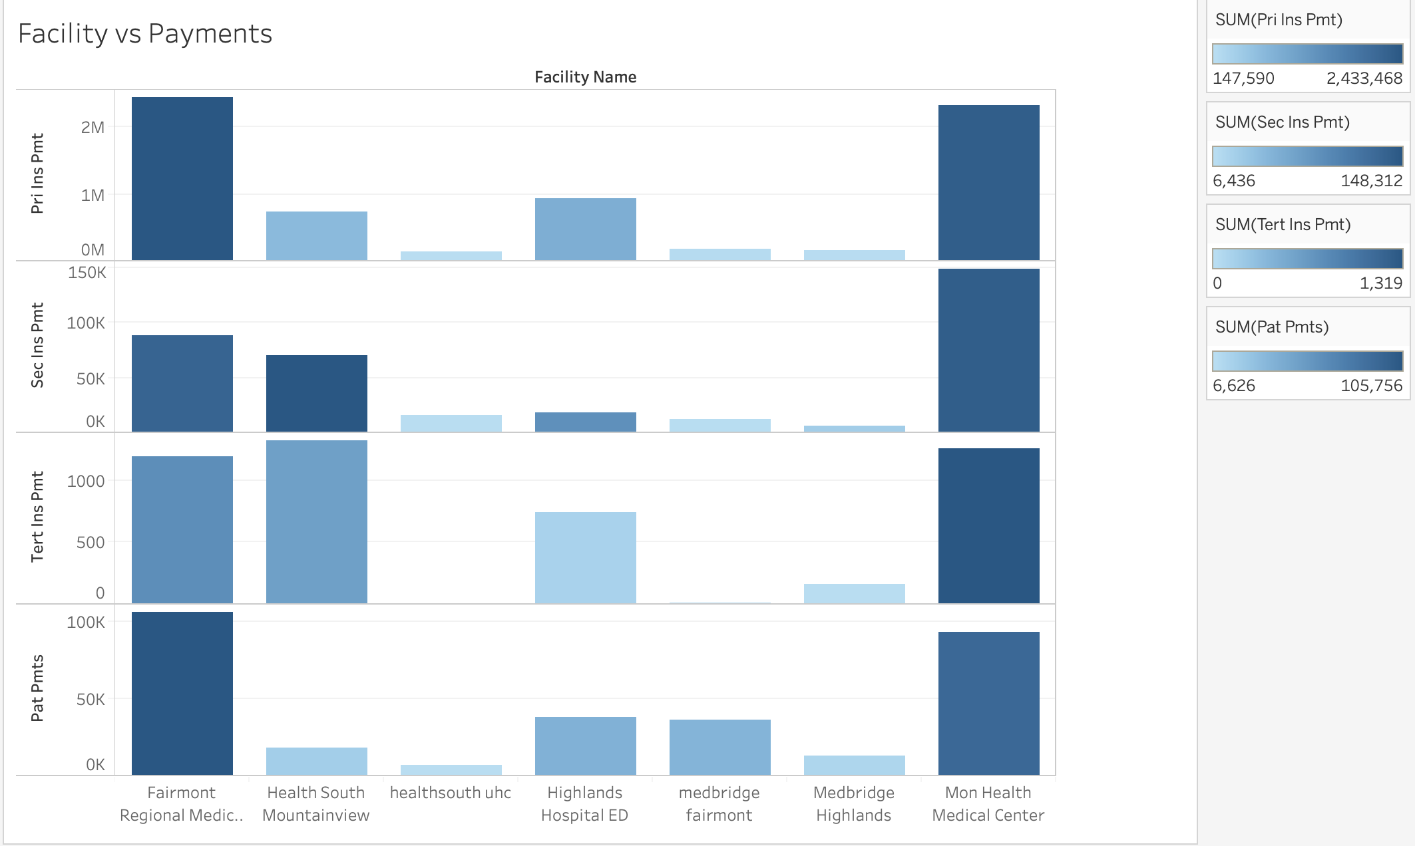
Visualization :
In this visualization we cross analyze all the types of payments with that of the facility to understand what type of payments are done on a larger scale as compared to others.
We also color code them and mention the exact value to understand how much payments are made for each section.
Insights Gained :
Fairmont regional and Mon health regional appears to have the highest primary insurance payments.
HealthSouth uhc has quite lower or negligible tertiary insurance payments when we look at the broad spectrum
Med bridge Fairmont has the higher amount of patient payments as compared to the other facilities.
Mon health Medical Center overall has a higher value for all the payments made in all different categories.
Next Steps :
The thing to analyze further would be what influences these payment trends and visualizing the reasons behind it.

Slide 3
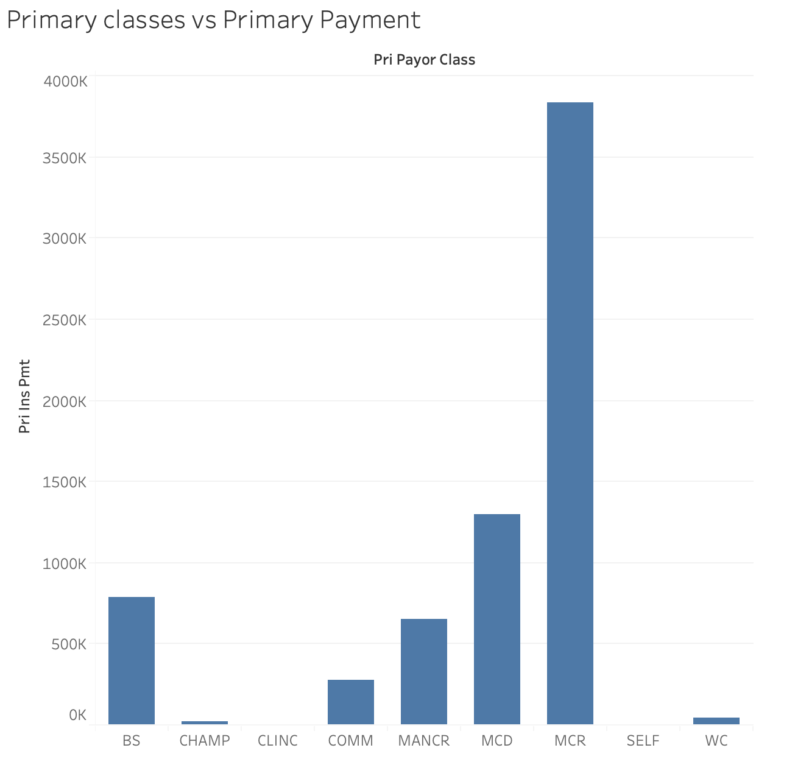
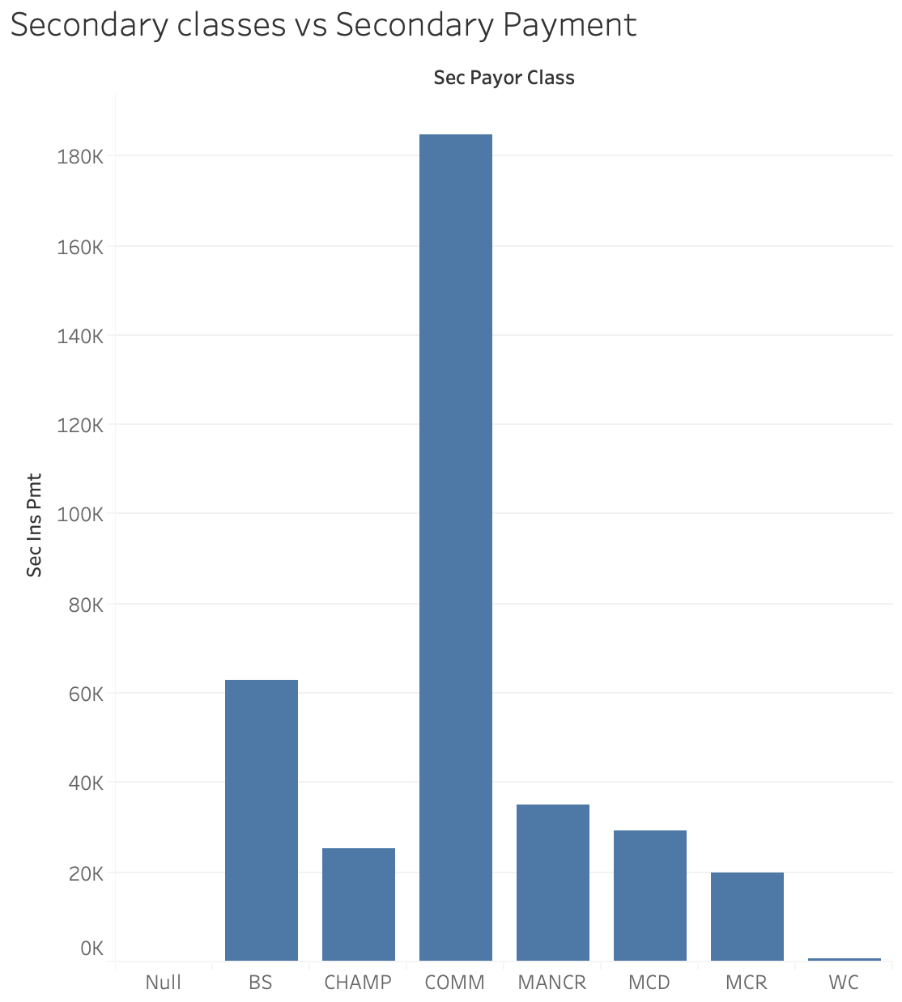
Visualization :
In this visualization we cross analyze secondary type of insurance payments with that of the class that it originates from.
We do this to understand the highest paying and influencing classes in all of the facilities combined.
Insights Gained :
The Class COMM appears to have the highest payment in the secondary payer classes while WC appears to have the lowest payment in the same secondary section.
The MANCR appears to have the highest payment in the primary payer classes while CHAMP appears to have the lowest payment in the same secondary section.
The primary payer class have higher scale i.e. around 100 - 400K thus telling us that primary insurance payments have been higher in the dataset as compared to the secondary classes whose scale ranges lower than 200K.
Next Steps :
Figuring out if there are classes missing in the dataset for the tertiary payments.

Slide 4
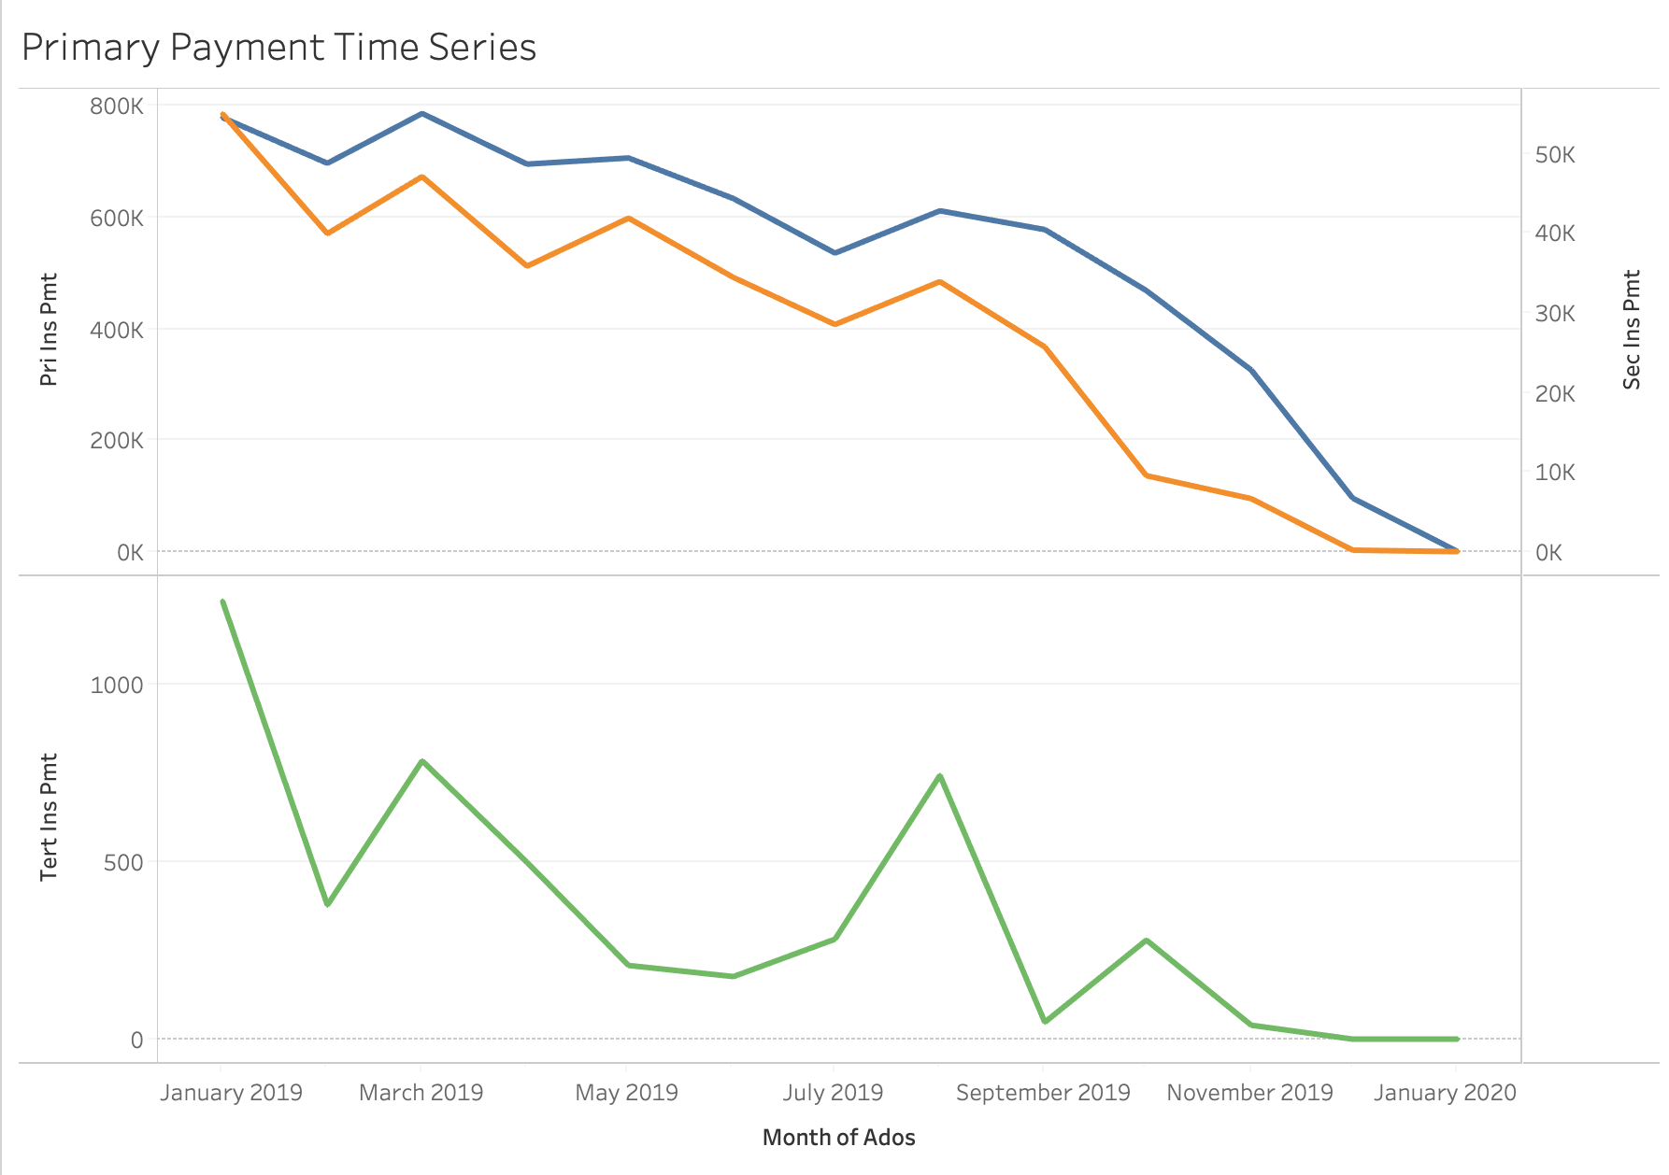
Visualization :
In this visualization we cross analyze all type of insurance payments with that over a time series.
We do this to understand how the payment varies over a period of time from January 2019 to January 2020.
Insights Gained :
We see the highest payments in January 2019 while there has been a consistent decline over a period of time till January 2020.
For the tertiary payment time series we see the there a cyclic increase and decrease in the payments made over a period of time. We see the payment dip in the months of February, April may June September in the year 2019 and January 2020 while increase in the months of January, march, July, august, October in the year 2019.
We see a higher dip in the primary and secondary payments from the months of August 2019 till January 2020 over all facilities.
Next Steps :
Figuring out the segregation of payment times on weekly to daily time basis to understand how day to day charges affect the payments over time.
Also need to understand what CPT’s and descriptions have affected the payment or charges over a period of time.

Slide 5
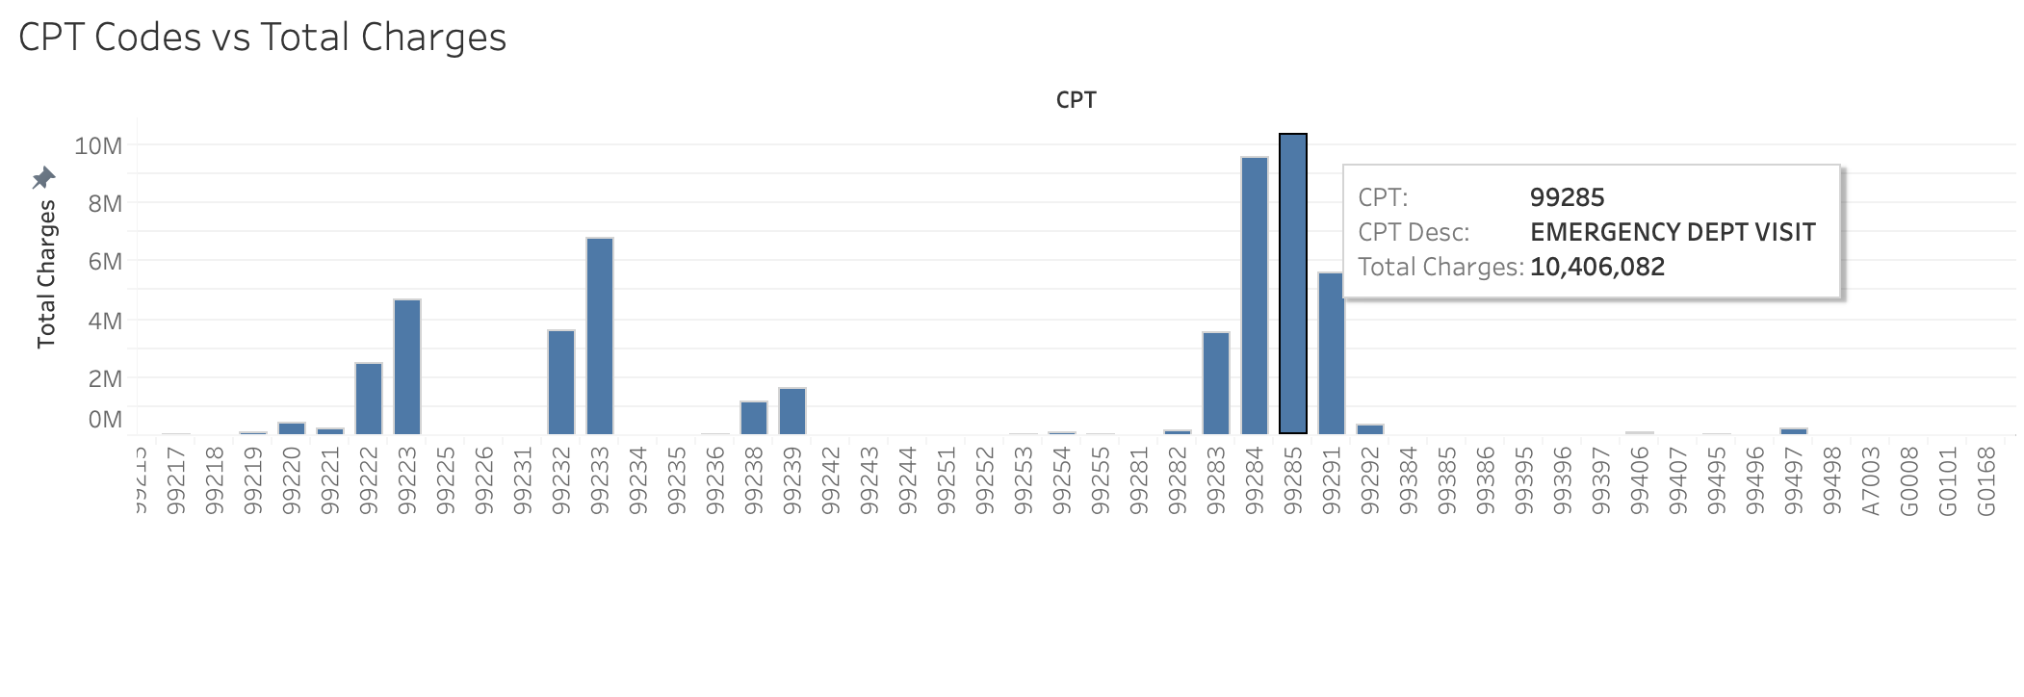
Visualization :
In this visualization we cross visualize the combination of the different types of charges, balances as Total Charges compared to the CPT codes.
We do this to understand the CPT code and the CPT description which is giving us showing us those combined highest charges.
Insights Gained :
The CPT code 99285 i.e. EMERGENCY DEPARTMENT VISIT appears to have the highest total charges of around 10,406,082 within all facilities
The other CPT code i.e. 99284 appears to trail very close to the highest since it also has emergency dept visits as being around the highest.
The 99291 also appears very close with charges of 5608803. It being critical care first hour makes more sense to be charges so high.
Next Steps :
Understanding and visualizing how different CPT codes affect charges in different segments

