Slide 1
Android - Fragments
Fragments in Android represent a behavior or a portion of the user interface.
Fragments are like modular pieces of an Activity.
Fragments have their own lifecycles and receive their own input events.
Fragments MUST be attached to an Activity.
A Fragment’s lifecycle is affected by its Activity.
For instance, when an Activity is destroyed, so are all of its Fragments.
You can have multiple fragments in a single activity.
This will or can give you a multi-pane UI layout.

Slide 2
The Application has Two Activates
MainActivity
Entry point of application, sets main content view to R.layout.main
DetailActiviy
Used in portrait mode to display the DetailFragment.
Uses R.layout.activity_detail as its main content view.
The Application has Two Fragments
FruitListFragment
ListFragment which contains a list of fruits.
DetailFragment
Shows details for each list item

Slide 3
Android – Fragment - Tutorial App
In Portrait mode
When a fruit in the list is clicked, DetailActivity is started with an explicit Intent.
The layout of DetailFragment is inflated in onCreate().
Details for the fruit is set with the setDetails() method
In Landscape mode
When a fruit in the list is clicked, The application will look for DetailFragment in the layout.
Since App is in landscape mode, DetailFragment is found and it will be displayed as part of the UI on the side of the FruitListFragment.
Fruit detail will be set via setDetails()

Slide 4
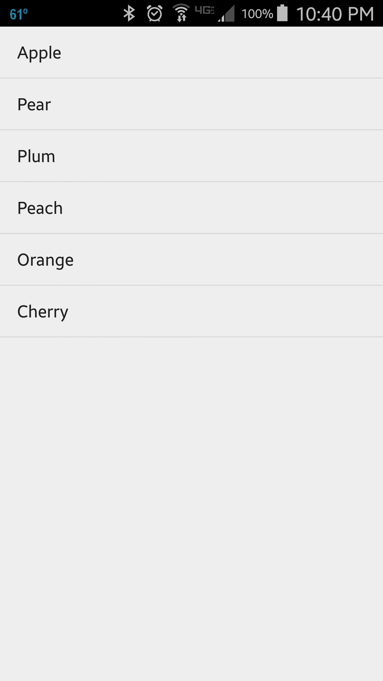
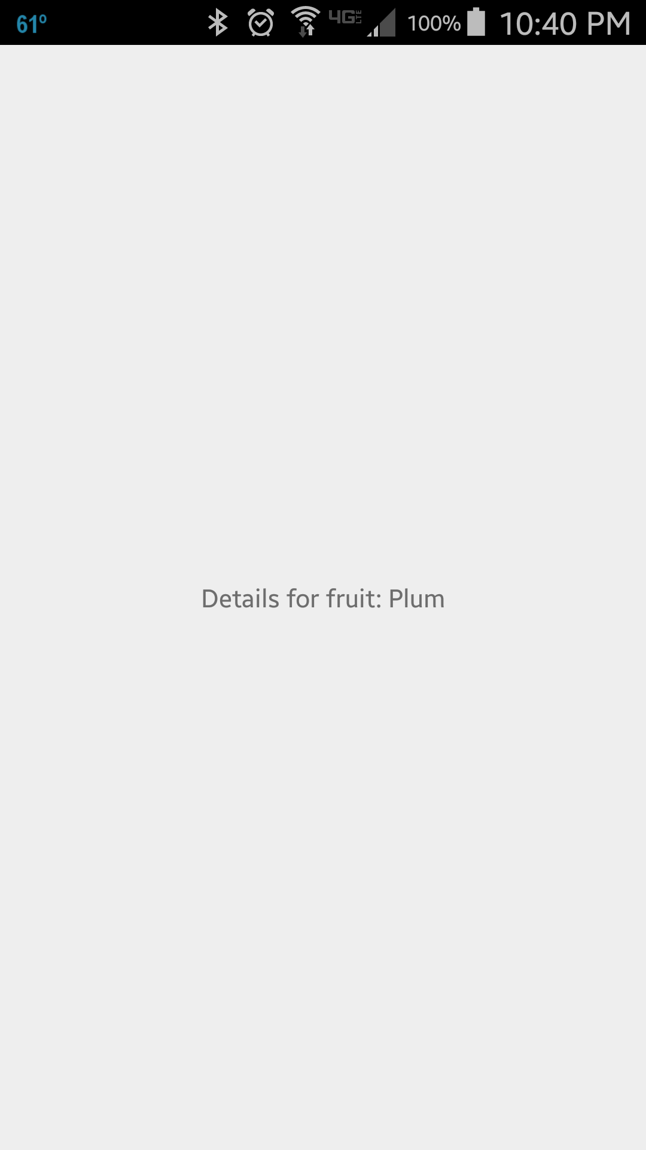
When Plum is clicked, the DetailFragment covers the FruitListFragment. This happens because the DetailActivity is called via an intent and the DetailFragment is attached to DetailActivity. Only happens in Portrait mode for this application.

Slide 5
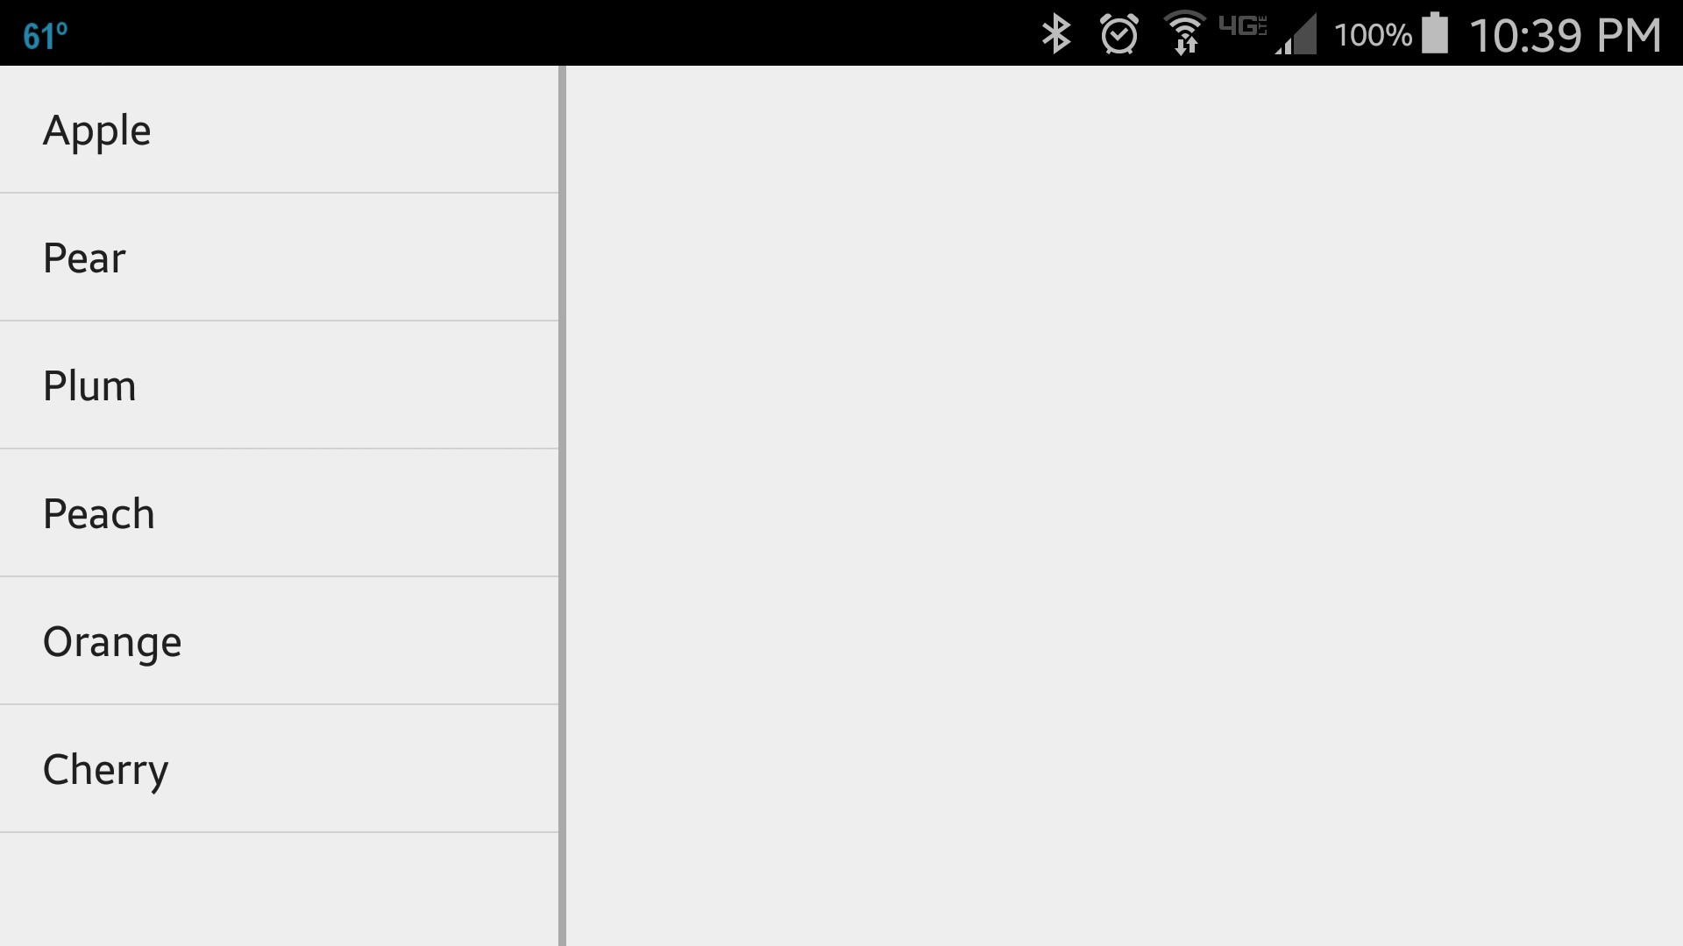
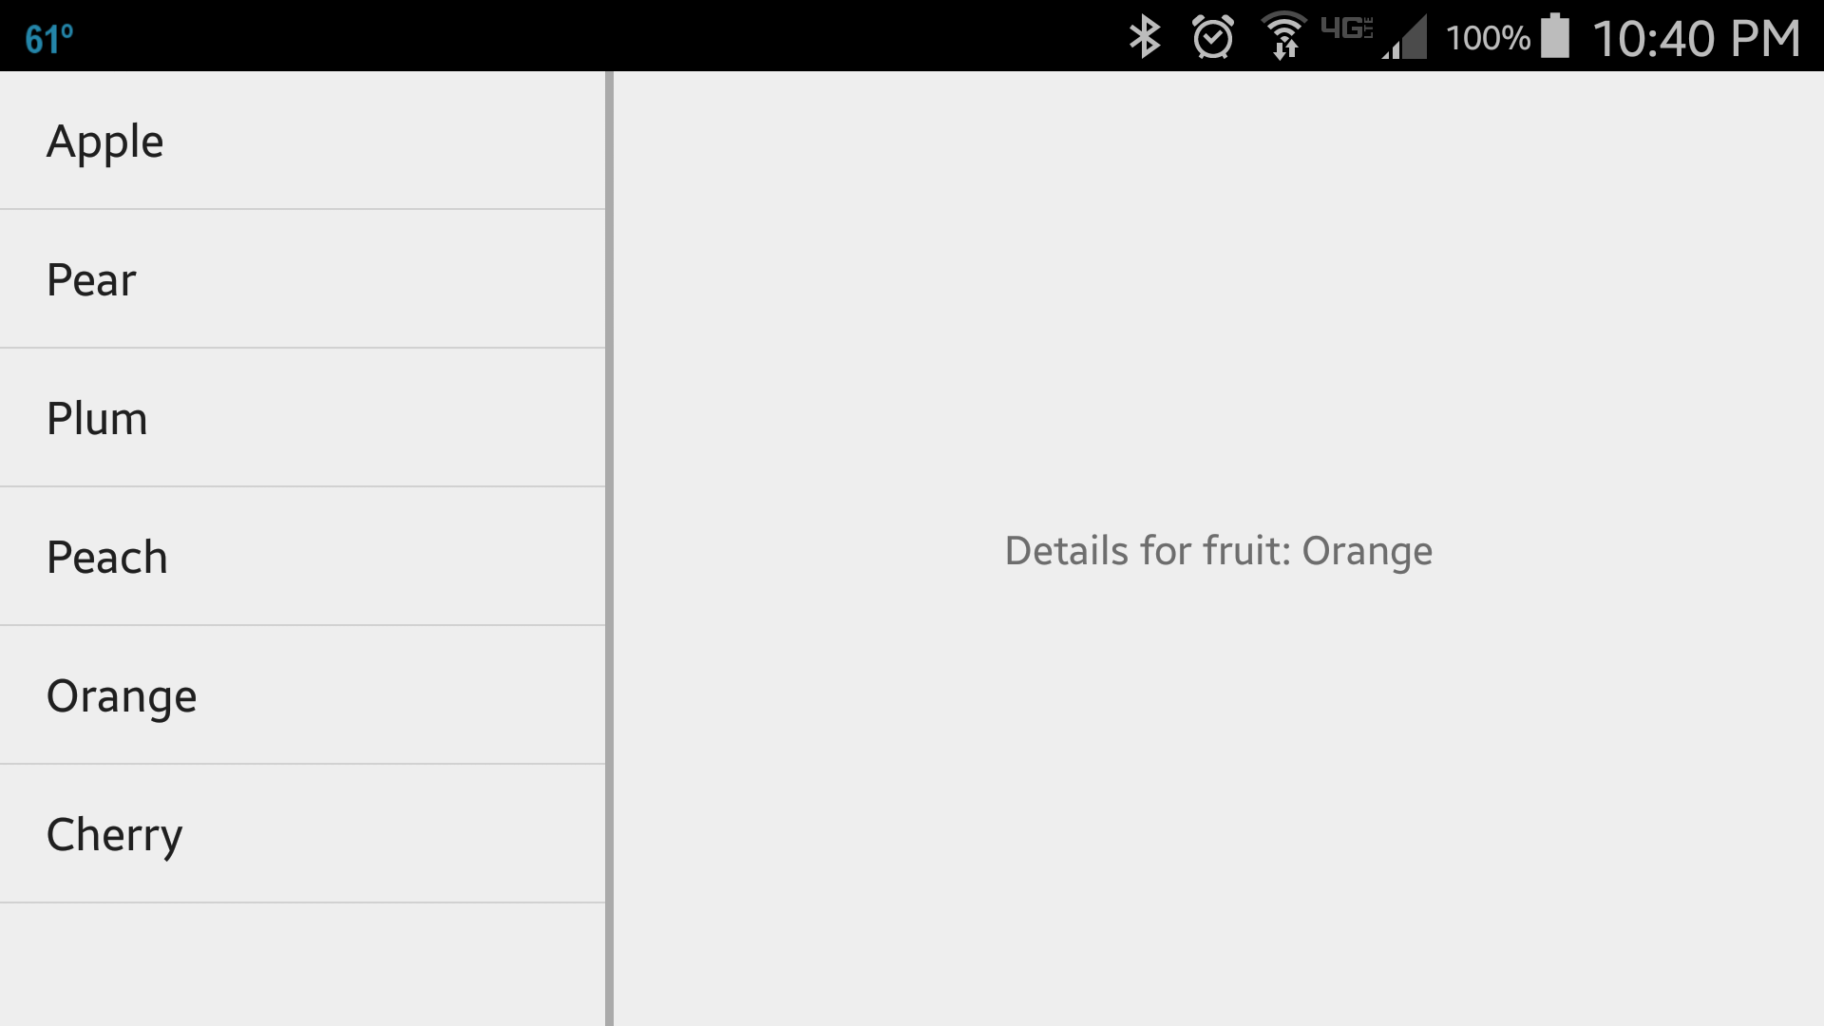
In landscape mode, the application will lay Fragments side-by-side(other configurations are possible) . When Orange is clicked AND the Application detects it’s in Landscape mode, the application will show FragmentDetail on the right side of FruitListFragment.

Slide 6
References
Fragment Guide
Class Fragment
Class ListFragment

Slide 7
Exercise
Change the implementation of FruitListFragment in such a way that it uses a custom layout and no longer derives from ListFragment. The custom layout should have two buttons labelled “Apple” and “Orange” whose click-listener does the same as for the ListView.

