Slide 1
Android - Handler
Long running operations may not be performed on the UI thread, otherwise a ANR (Application Not Responding) Error will be issued.
Standard Java class java.lang.Thread can be used under Android to perform long running operations.
To simplify synchronization, class android.os.Handler can be used.
Class Handler is used to deliver queued message one after another via the callback handleMessage().
A Handler is associated with a thread. If created in the context of the UI thread, the Handler can be used to safely update the UI.
The actual dispatching happens by an instance of class Looper. Android will create a Looper instance for the UI thread automatically.
A different thread can also have its own Looper instance. Class android.os.HandlerThread is a helper class that automatically creates a Looper for a new thread.

Slide 2
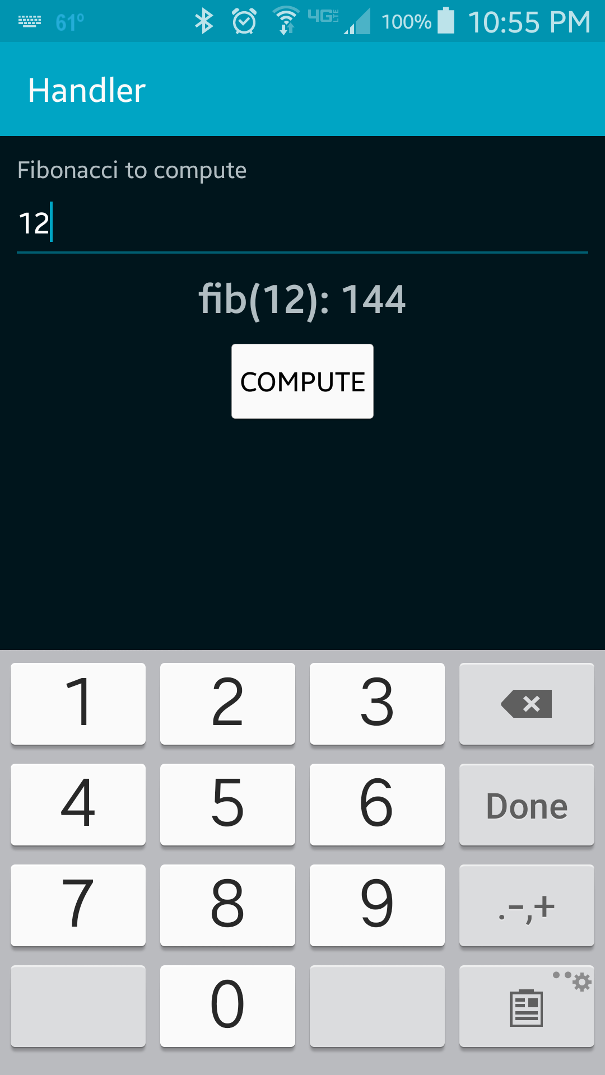
Entering "12" and then pushing the button "Compute" will show the result (144) after a 5 second delay.

Slide 3
References
java.lang.Thread
android.os.Handler
android.os.Looper
android.os.HandlerThread

Slide 4
Exercise
Class android.view.View has a method post() that can also be used to post messages to the UI thread. Rewrite the application such that View.post() is used instead of class UIHandler

