Slide 1
Android – HelloWorld (decl)
Simple “Hello World” which uses declarative layout
Layout described in layout file
XML syntax – res/layout/main.xml
XML-tags correspond to Java classes of the same name from Android Library
XML-attributes correspond to methods of the respective class
android:text => TextView.setText()
The nesting of the XML elements represents the view hierarchy
Android SDK uses the basename of the file to generate JAVA identifier with unique ID in R-class
Can be referenced via R.layout.main
setContentView(R.layout.main)
Overloaded version takes ID as parameters; ID is referenced via R-class

Slide 2
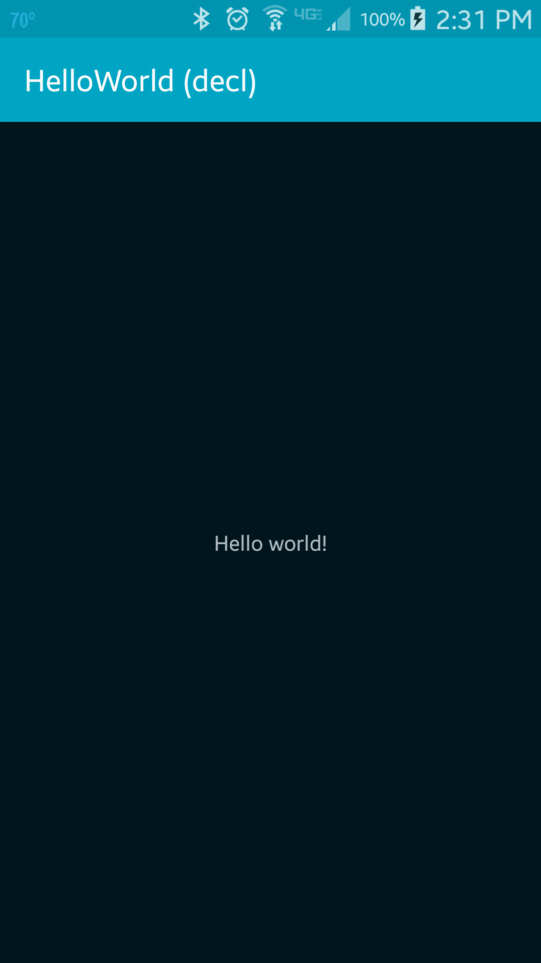
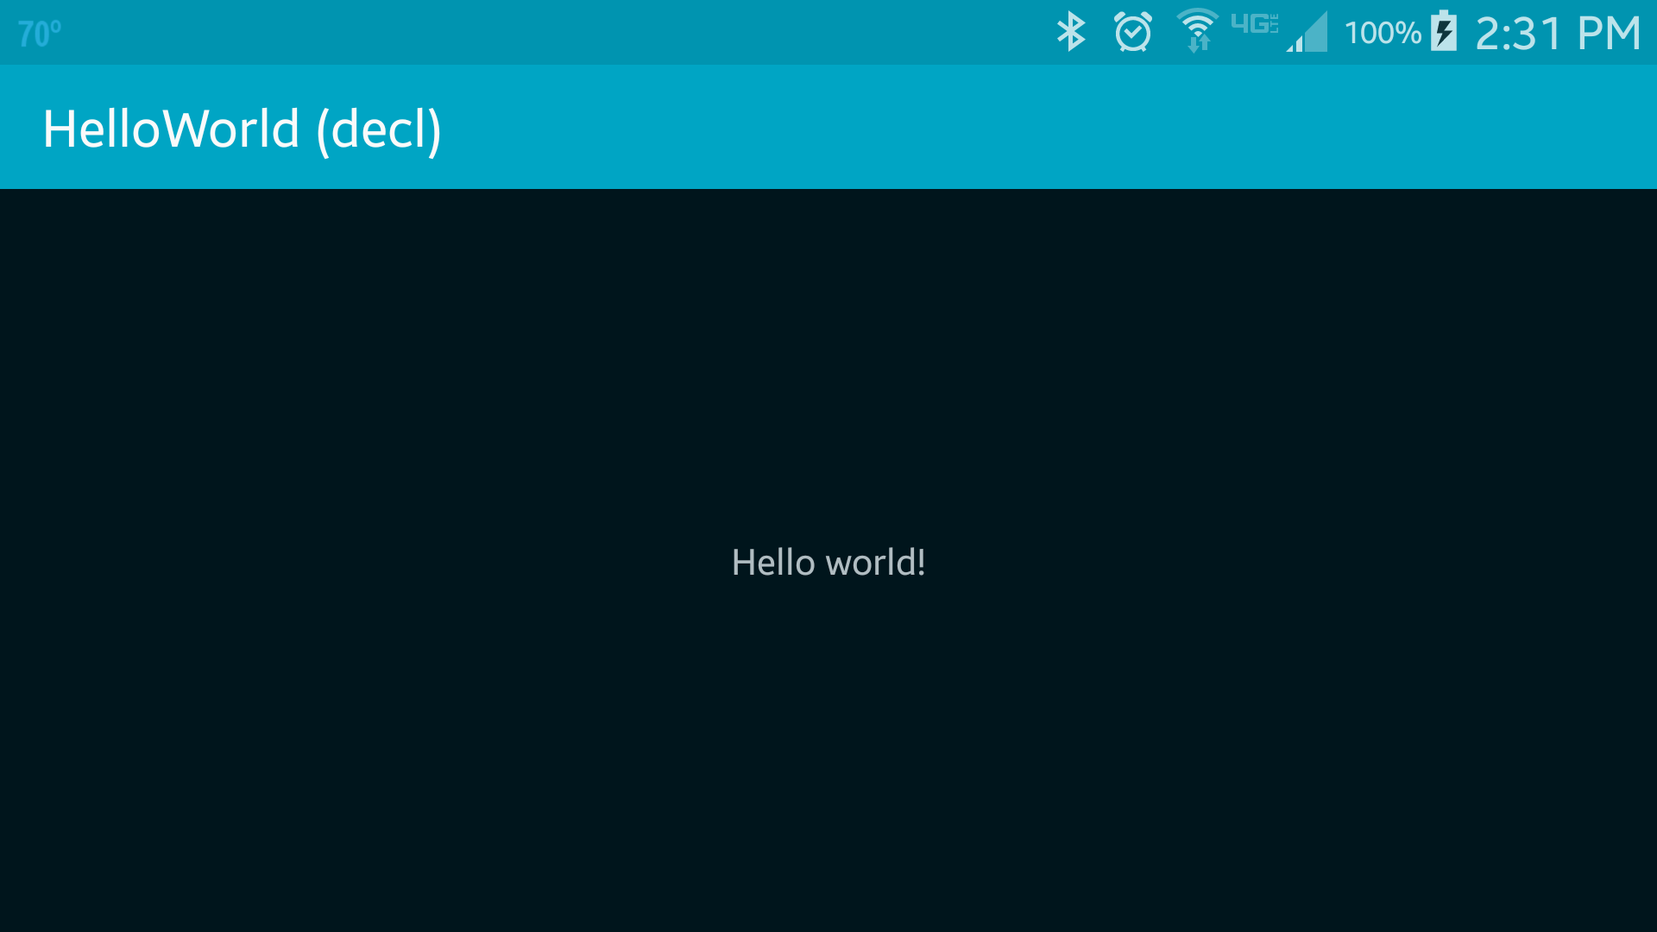
The “Hello World” is displayed at the center of the screen
android:layout_centerInParent=“true”
Relative layout is used
This application works partially when compiled using XMLVM. Rotation does not work.

Slide 3
References
Layout
Declaring Layout
R-Class

Slide 4
Exercise
Change the message that will be displayed to “Hi there!”

