Slide 1
Android – SayHello (prog)
Application that allows user to enter a name
On press of button, a greeting message with the name is displayed
Three widgets are arranged using LinearLayout:
EditText
For entering name
TextView
For displaying greeting
Button
Once clicked, will add message to TextView
Does not use layout resource, but programmatically build the interface
LinearLayout.setOrientation()
Used to create vertically aligned LinearLayout container for the widgets

Slide 2
Android – SayHello(prog)
Layout parameters specific to LinearLayout can be used for EditText and TextView to set parameters
EditText, TextView and Button are added as children to LinearLayout
onClickListener is set for the button but instantiating an anonymous class
Anonymous class implements the interface onClickListener
When user presses button onClick() callback is called
EditText and TextView are referenced in this anonymous class and hence has to be declared final.

Slide 3
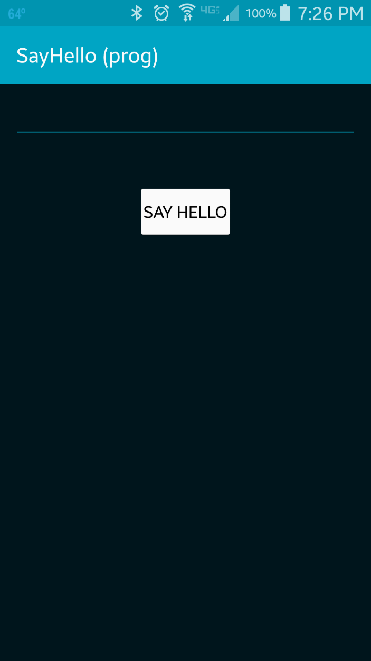
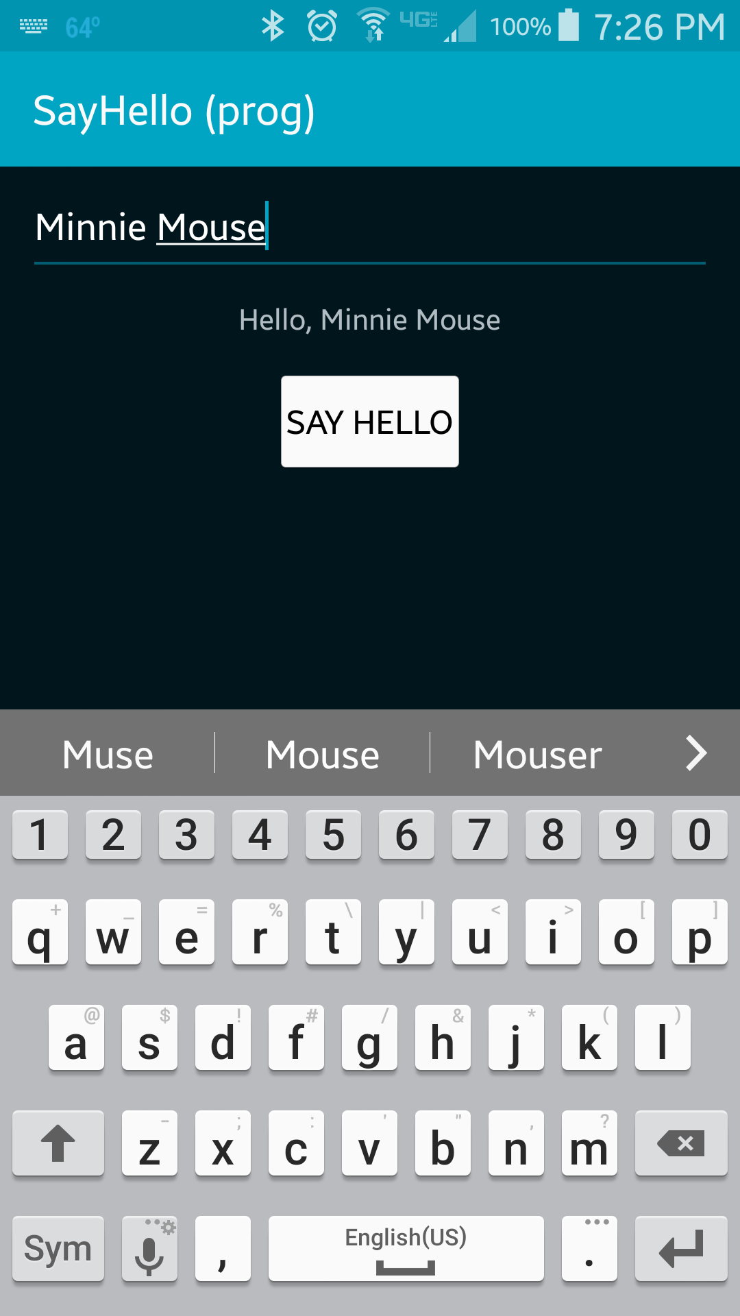
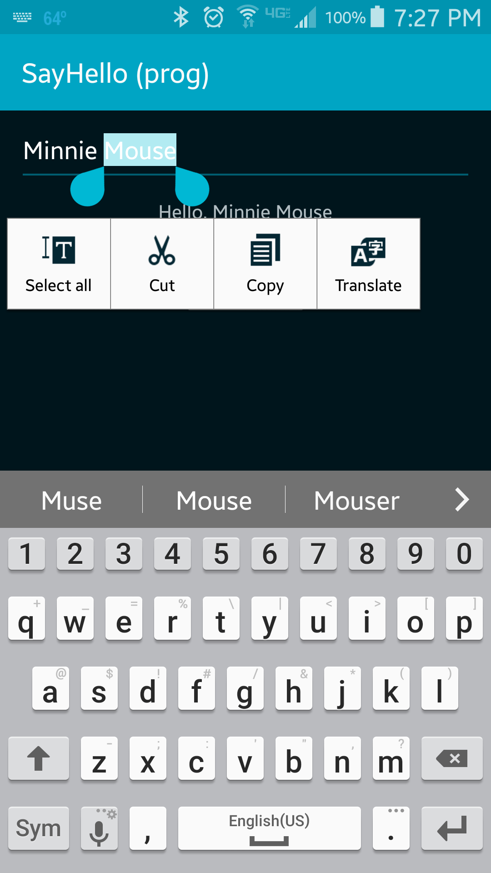
User enters the name in the EditText and pressed button
Greeting message with the name is displayed in the TextView

Slide 4
References
EditText
TextView
Button
LinearLayout
OnCLickListener

Slide 5
Exercise
Add a second button below the “Say Hello” button. The label for the second button should read “Ask” and when clicked, should echo “How are you, XXX?” to the label (overwriting any previous message), where XXX is the name the user entered.

