Slide 1
Android - Sound
The application demonstrates the use of MediaPlayer
A button allows the user to start and stop the media playback
A switch allows the user to enable/disable the looping of playback
The switch is implemented using the ToggleButton widget provided by Android
When ToggleButton is:
on - enable looping
off - disable looping
MediaPlayer can support several sources.
Here, local resource is used as source for playback
Placed in res/raw directory
Referenced using resourceID

Slide 2
The MediaPlayer has various states:
When the MediaPlayer is created using new() the object is in 'idle' state
The MediaPlayer has to be in 'prepared' state before it is 'started'
using prepare()
When the MediaPlayer is created using create() the object is already 'prepared'
Do not call prepare() explicitly
MediaPlayer enters 'Stopped' state by calling stop()
MediaPlayer enters 'PlaybackCompleted' state when OnCompletion() is invoked and looping is not enabled
When playback reaches end of the stream,
If looping is enabled, the MediaPlayer is still in 'started' state
If looping is not enabled, then callback method onCompletion() is invoked
Registered using setOnCompletionListener()

Slide 3
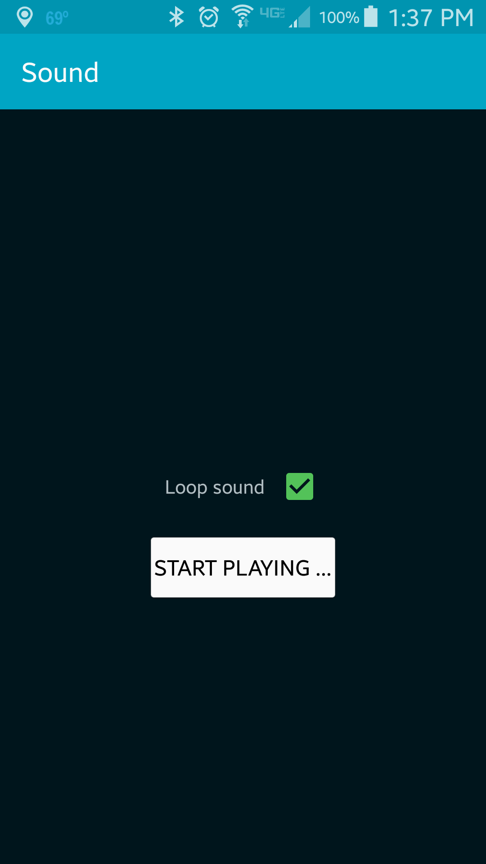
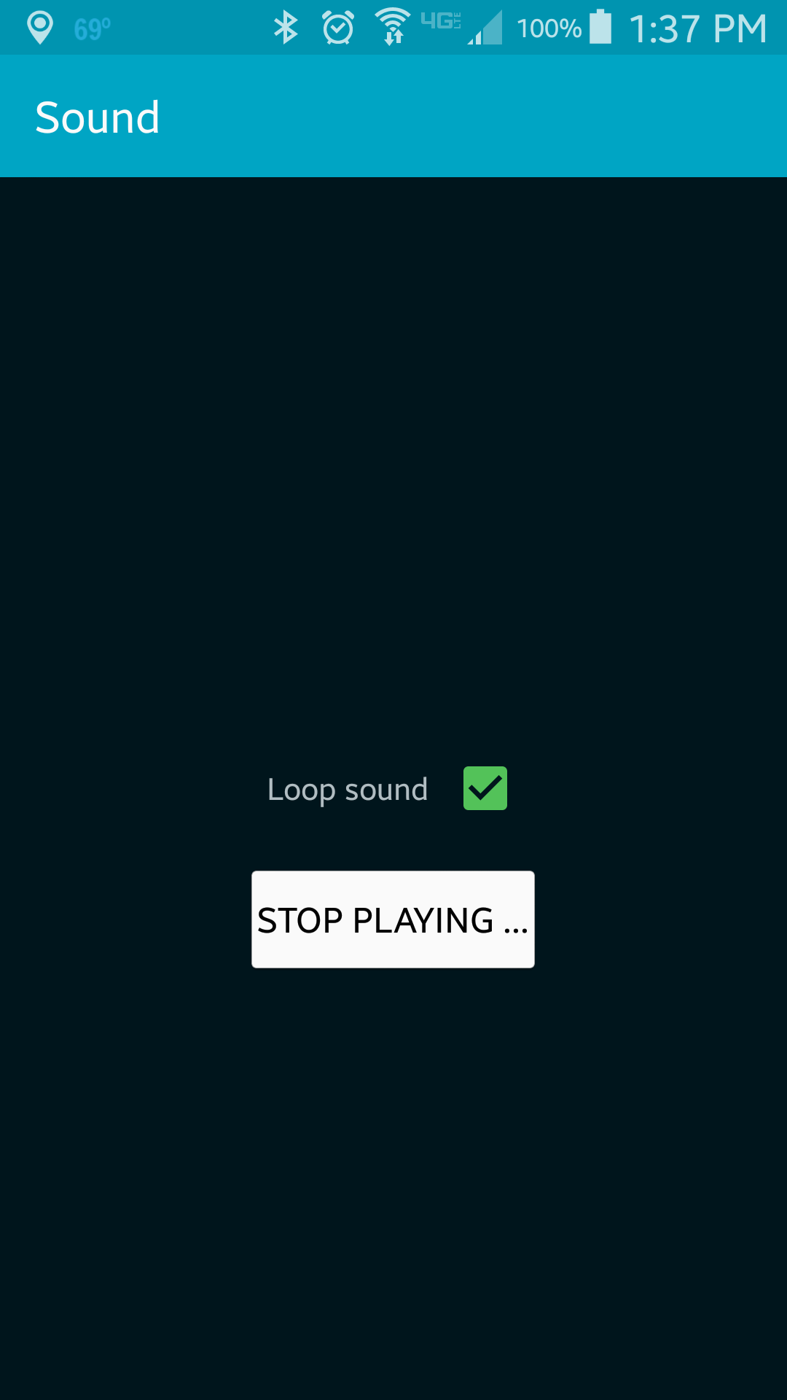
The button provided helps user to start and stop the playback
The switch provided helps used to enable/disable the looping

Slide 4
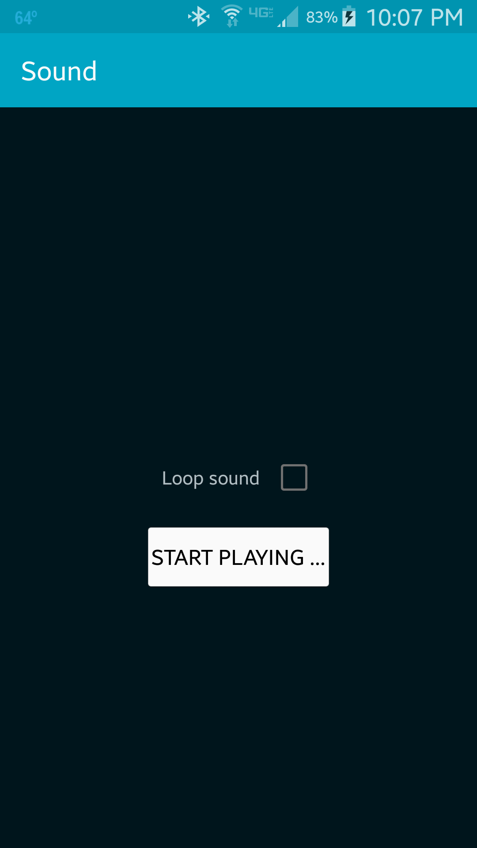
When the playback has reached end of stream, if the looping is not enabled, the state of button changes accordingly.
The MediaPlayer and the resources the object is holding has to be released once we are done using it
Proper handling of resources (releasing the resources) onPause() has to be done (not implemented in this example)

Slide 5
References
MediaPlayer
ToggleButton

Slide 6
Exercise
Add an (arbitrary) MP3 file as a resource to the project (i.e., your favorite song).
Add another button to the UI “Play MP3” that will play the MP3 file when pressed.

