Slide 1
Android - Internationalization
Hello World" application localized for different languages
Currently English and German
Main view defined by layout resource via R.layout.main
TextView in layout resource references a string that can be internationalized
The name of the directory contains the two letter country code by which different locales can be distinguished
English version of string => res/values/strings.xml (default)
German version of string => res/values-de/strings.xml
Depending on device settings one of the string resource is used
Resources which do not need localization - declare in default resource file instead of declaring in all localized resource files

Slide 2
In main.xml, XML-attribute 'text' of tag <TextView> does
not contain a string literal It references to string defined in strings.xml main.xml android:text="@string/greeting"
strings.xml
<string name="greeting">Hello World!</string> The application partially works when cross-compiled using XMLVM. Rotation does not work.
designates a string resource to be looked up in strings.xml
designates a symbolic label used to identify the particular string

Slide 3
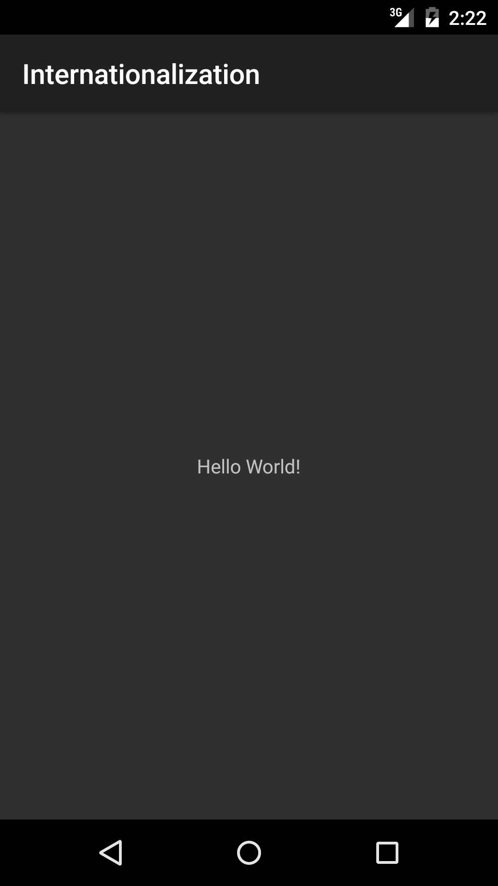
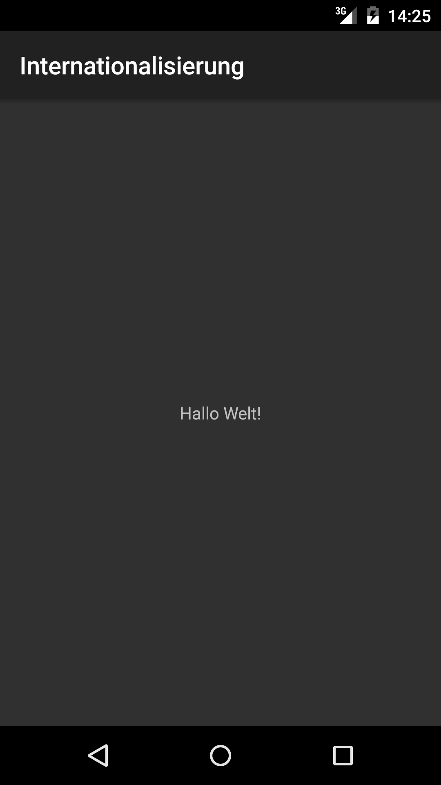
The emulator locale can be changed using the adb shell
German :
res/values-de/strings.xml
Pick the language code to which you want to change the locale to
Once the emulator is launched, run adb shell:
adb shell
In adb shell prompt, run:
setprop persist.sys.language de;stop;sleep 5;start
The emulator will restart
English :
res/values/strings.xml

Slide 4
References
Localization
Application Resource
TextView

Slide 5
Exercise
Add a localization for French (fr). The message to be displayed should be “Salut!”

