Slide 1
Android - Alerts
App shows two different kinds of alerts: AlertDialog and Toast.
AlertDialog:
Modal dialog that can have one or more buttons.
Users have to explicitly acknowledge by pressing one of the buttons.
Toast:
Short text message that is displayed for a few seconds.
Toasts are automatically removed

Slide 2
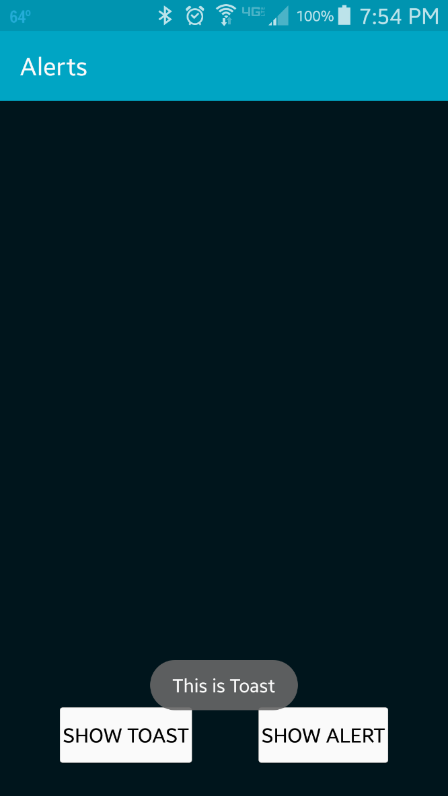
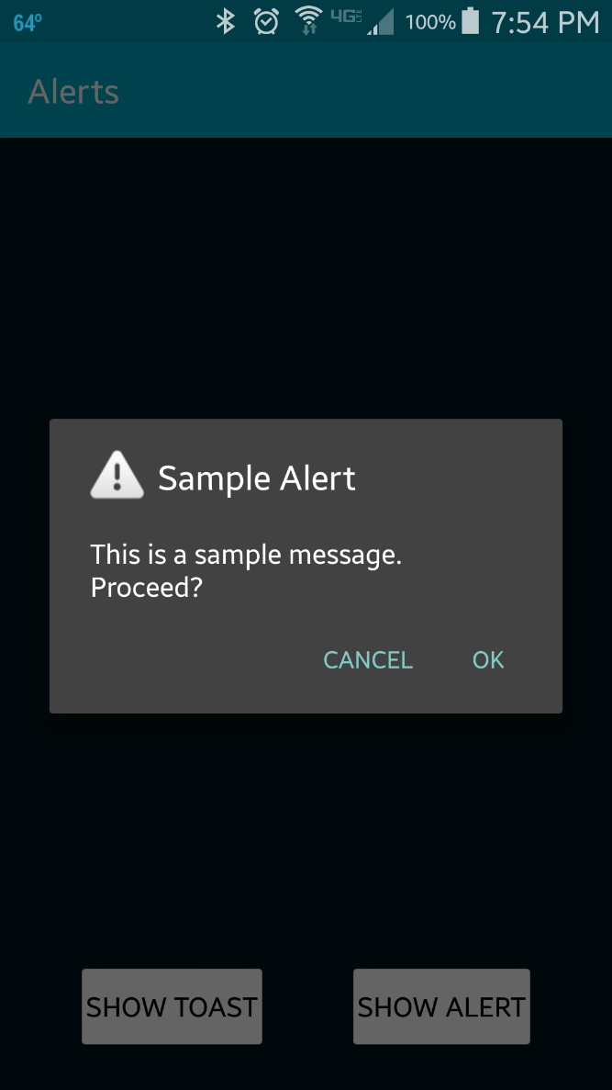
Toast
AlertDialog

Slide 3
References
Toasts
Dialogs

Slide 4
Exercise
Add a third button with the title “Reject” to the AlertDialog

