Slide 1
Android - Widgets
Application to demonstrate the available widgets in Android which enhance the UI experience
The application demonstrates only the visual representation and not the associated callbacks.
Android widgets are available in the package android.widget.*
In this example, the widgets are implemented using layout XML - res/layout/main.xml (it can be implemented programmatically)

Slide 2
ScrollView
Enables user to scroll, where the view is larger than the physical display
Should contain a child which contains the contents that need to be scrolled
TextView
Used to display any text to the user
Button
Implements a simple button which can be pressed or clicked upon
The image of the button can be customized based on the various states of the button using state list drawable
EditText
Subclass of TextView with editing capabilities

Slide 3
CheckBox
Based on the 2 states - checked/unchecked, necessary actions can be taken
RadioGroup
Used to create a scope for set of radio buttons
When one of the radio button within this scope is checked, the rest are unchecked
The RadioGroup can be cleared to remove the checked state of the radio button.
RadioButton
Has two states - checked/unchecked
The radio button cannot be unchecked. This can be achieved by clearing the RadioGroup instead
ToggleButton
Is used to render the on/off states like a switch

Slide 4
RatingBar
Used to indicate the rating using the stars.
The rating bar can be set to read only if required.
A listener can be set to handle the change in the ratings.
AnalogClock
Displays the time in form of analogic clock
DigitalClock
Displays time digitally with seconds
TimePicker
Is used to enable user to select the time from 24 hour or AM/PM mode.

Slide 5
DatePicker
Is used to select a date.
The user can select the year, month and day.
It can be customized such that the user is constrained to select between a range of dates.
The DatePicker can be initialized with an initial by passing the year, month, date and a listener when the date value is changed to init()
ProgressBar
Is used to indicate the progress of any on-going operation. The progress displayed on the bar can be controlled by the application.
The indeterminate indicator can be used to indicate the progress when the time taken for the operation is not known.

Slide 6
SeekBar
Is similar to progress bar but it has a draggable element which the user can use to drag.
Toast
Is used to notify user.
It remains visible only for specified period of time and disappears automatically.
ImageButton
Renders a button with an image.
The image is defined using android:src (if using xml) or setImageResource() (programmatically)

Slide 7
Spinner
Is like a drop down list which enables user to select from a list of items.
The list of strings that should be displayed in the selection dialog is defined in res/values/strings.xml
Each item in the string array(defined in strings.xml) is bound with initial appearance and an ArrayAdapter is created using createFromResource() which is required to set the data.

Slide 8
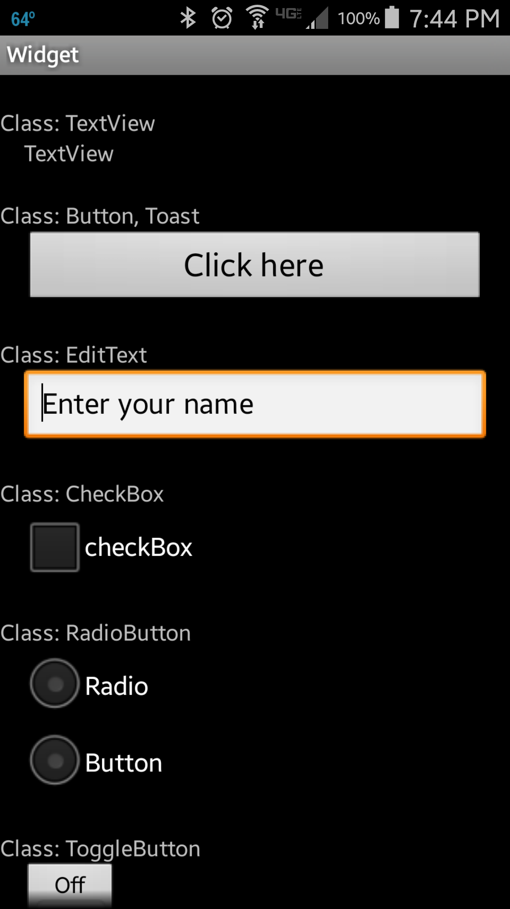
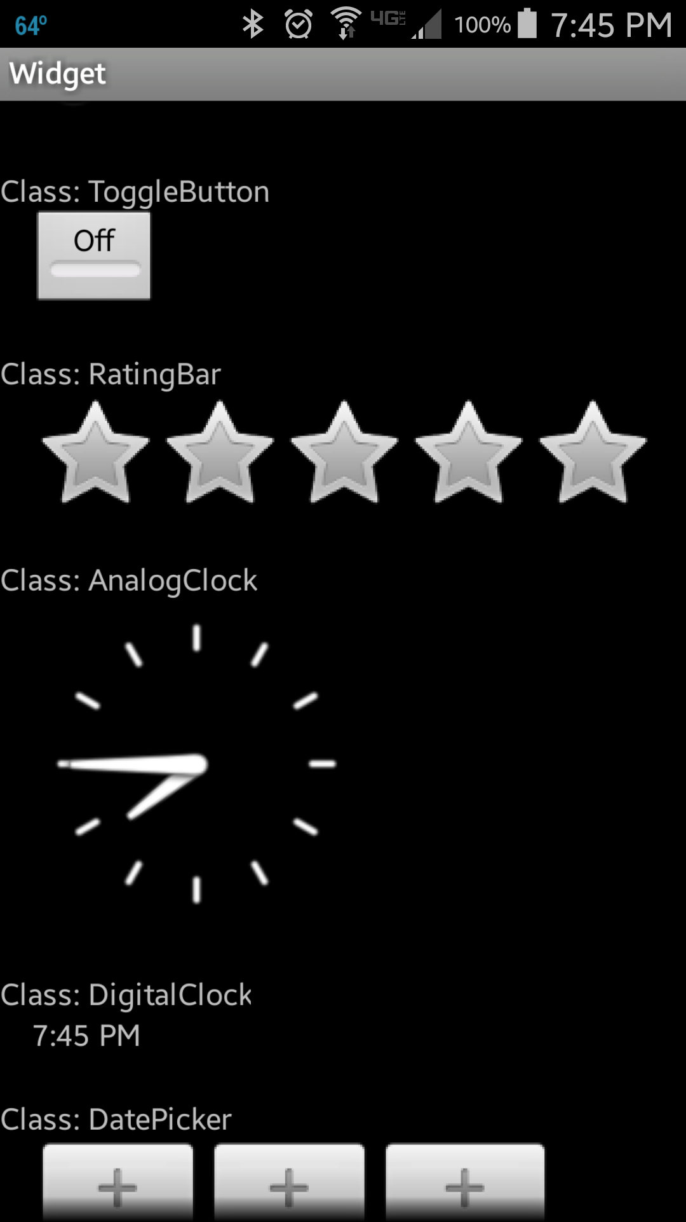

Slide 9
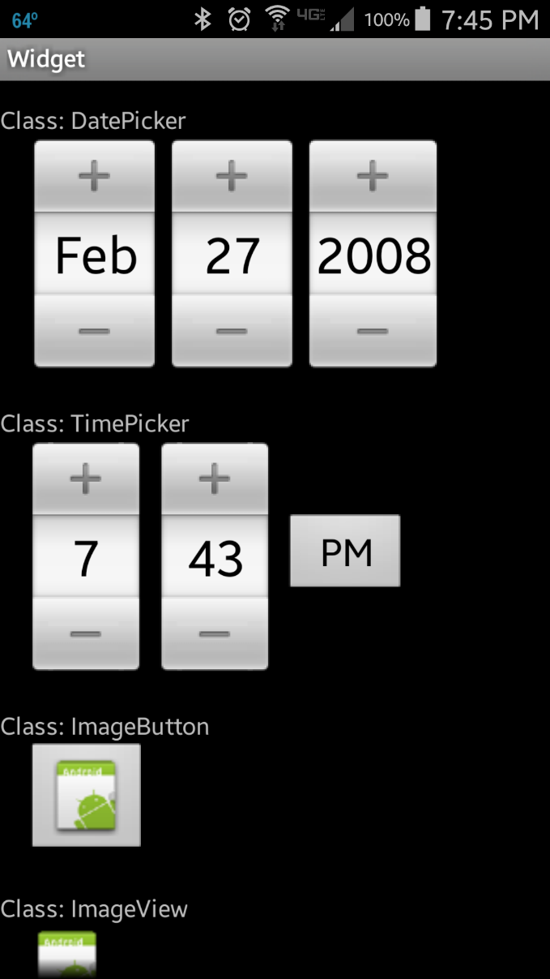
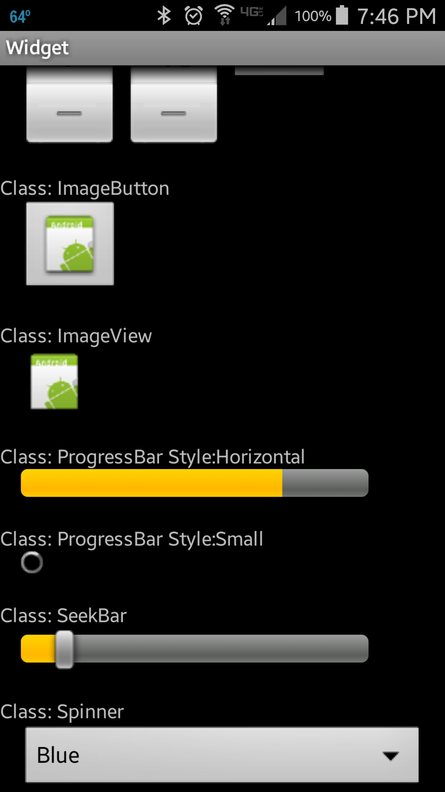

Slide 10
References
Android Widgets
ScrollView
TextView
Button
EditText
CheckBox
RadioGroup
RadioButton
ToggleButton
RatingBar
AnalogClock
DigitalClock
DatePicker
TimePicker
ImageButton
SeekBar
ProgressBar
Spinner
Toast

Slide 11
Exercise
Nothing to do!

