Slide 1
Android – HelloWorld(prog)
Simple version of “Hello World”
Does not make use of layout files
“Activity”
Main Android abstraction for user interaction
Each application needs at least one activity
Implementation class is derived from “Activity” class
Main Activity is referenced in AndroidManifest.xml under <activity> tag
The main entry point of an activity is onCreate()
Called whenever the activity is first created
One of the callbacks called as part of activity’s lifecycle
Each method that is part of activity lifecycle has to call base class implementation
setContentView() sets main view of of the activity
Displayed when activity becomes visible

Slide 2
Android – HelloWorld(prog)
Bundle parameter
In this example, it is used to load application state that was made persistent during previous invocation of the same activity.
Layout manager
Acts as a container for widgets that arrange its children according to specific policy
Has it owns layout parameters that allow to express rules for how a widget should be positioned
In this example Relative Layout is used
Aligns widgets relative to one another and the enclosing container
TextView used to represent “Hello World” label
The application partially works when cross-compiled using XMLVM. Rotation does not work.

Slide 3
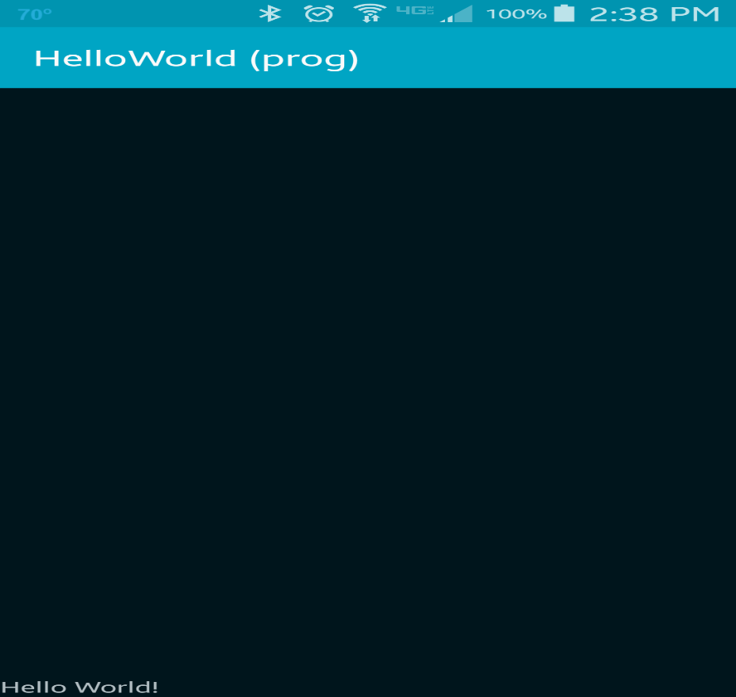
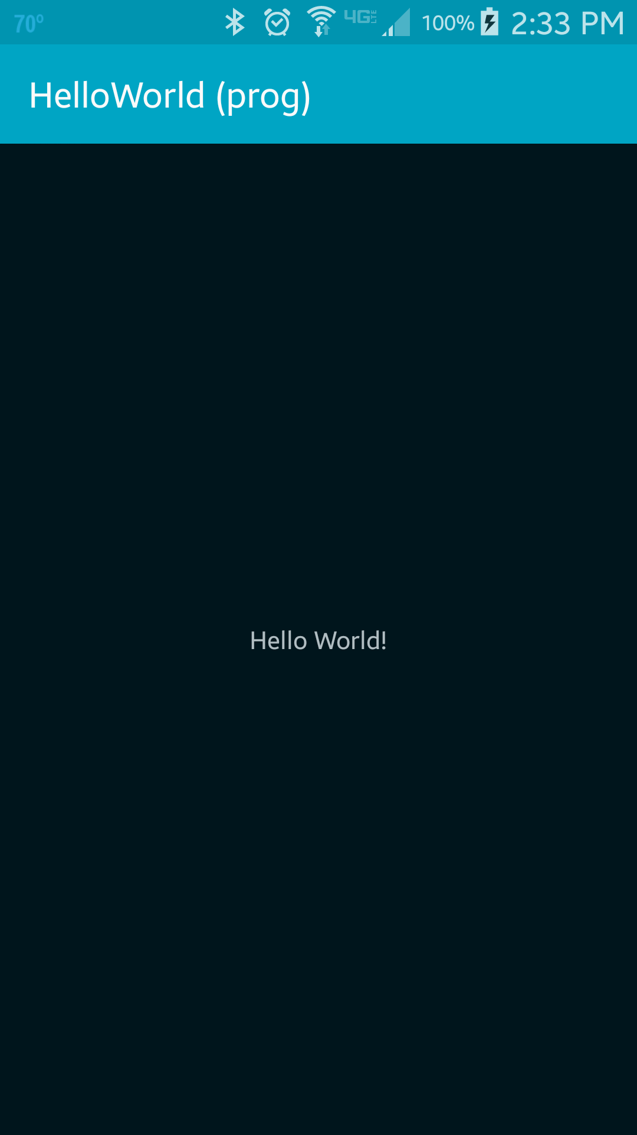
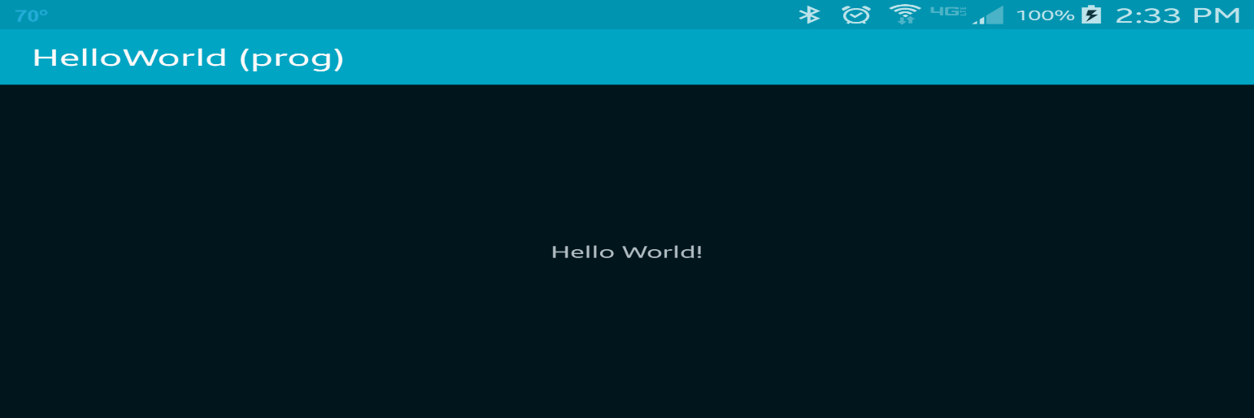
“Hello World” is displayed at the center of the screen which can be changed using layout parameters
Use fn + control + f11 to change orientation
RelativeLayout.ALIGN_PARENT_BOTTOM
RelativeLayout.CENTER_IN_PARENT

Slide 4
References
Activity
Bundle
LayoutParams
View
TextView

Slide 5
Exercise
Change the message that will be displayed to “Hi There!”

