Slide 1
Android - Settings
Settings allow the user to change certain aspects of the applications behavior.
Settings are handled by an activity that should be derived from class PreferenceActivity.
As of API 11, you should use a PreferenceFragment to display your settings.
Handled by a FragmentManager
A PreferenceFragment can be attached to any activity, evern a PreferenceActivity.
The settings are defined declaratively via an XML file that needs to be stored in res/xml.
Android defines the schema of this file.
Various standard settings are offered by Android.
Class PreferenceManager can be used to retrieve the current settings.

Slide 2
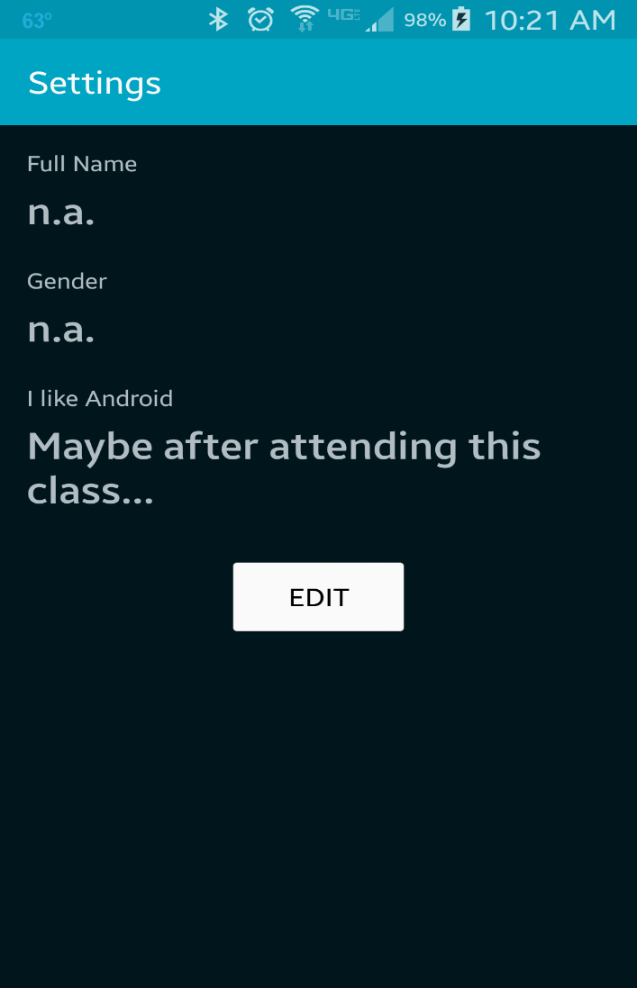
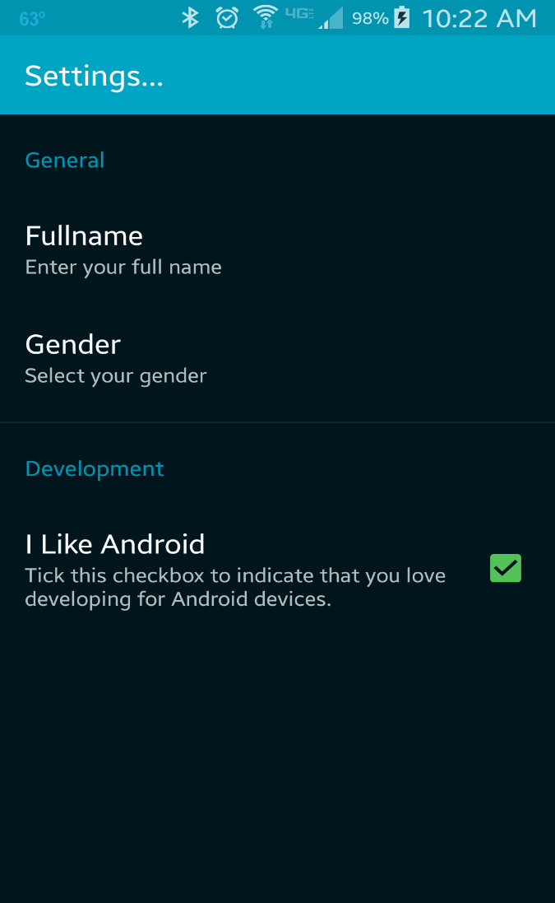
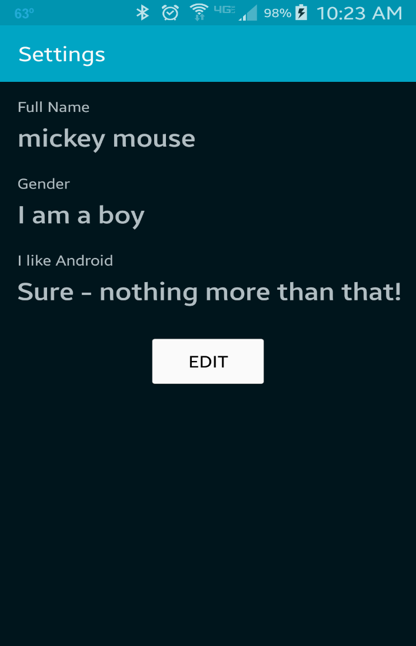
Launching the app for the first time, showing the default settings. Clicking on "Edit" launches settings
Defining some settings. Then press 'back' button to return to MainActivity
MainActivity shows the changed settings

Slide 3
References
Overview of Android settings
Class PreferenceActivity
Class PreferenceFragment
Class FragmentManager
Class PreferenceManager

Slide 4
Exercise
Add a <SwitchPreference> to res/xml/settings.xml and display its value in MainActivity.

