Slide 1
Android – Immersive Mode
Immersive mode was added in API level 19.
Allows application to take over the complete screen-real-estate.
Useful for games and e-book applications.

Slide 2
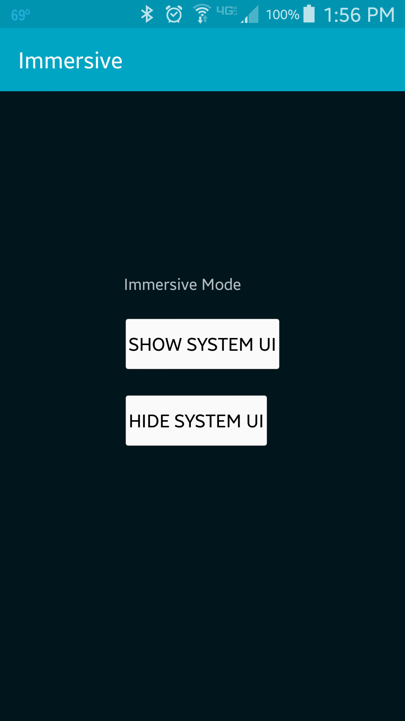
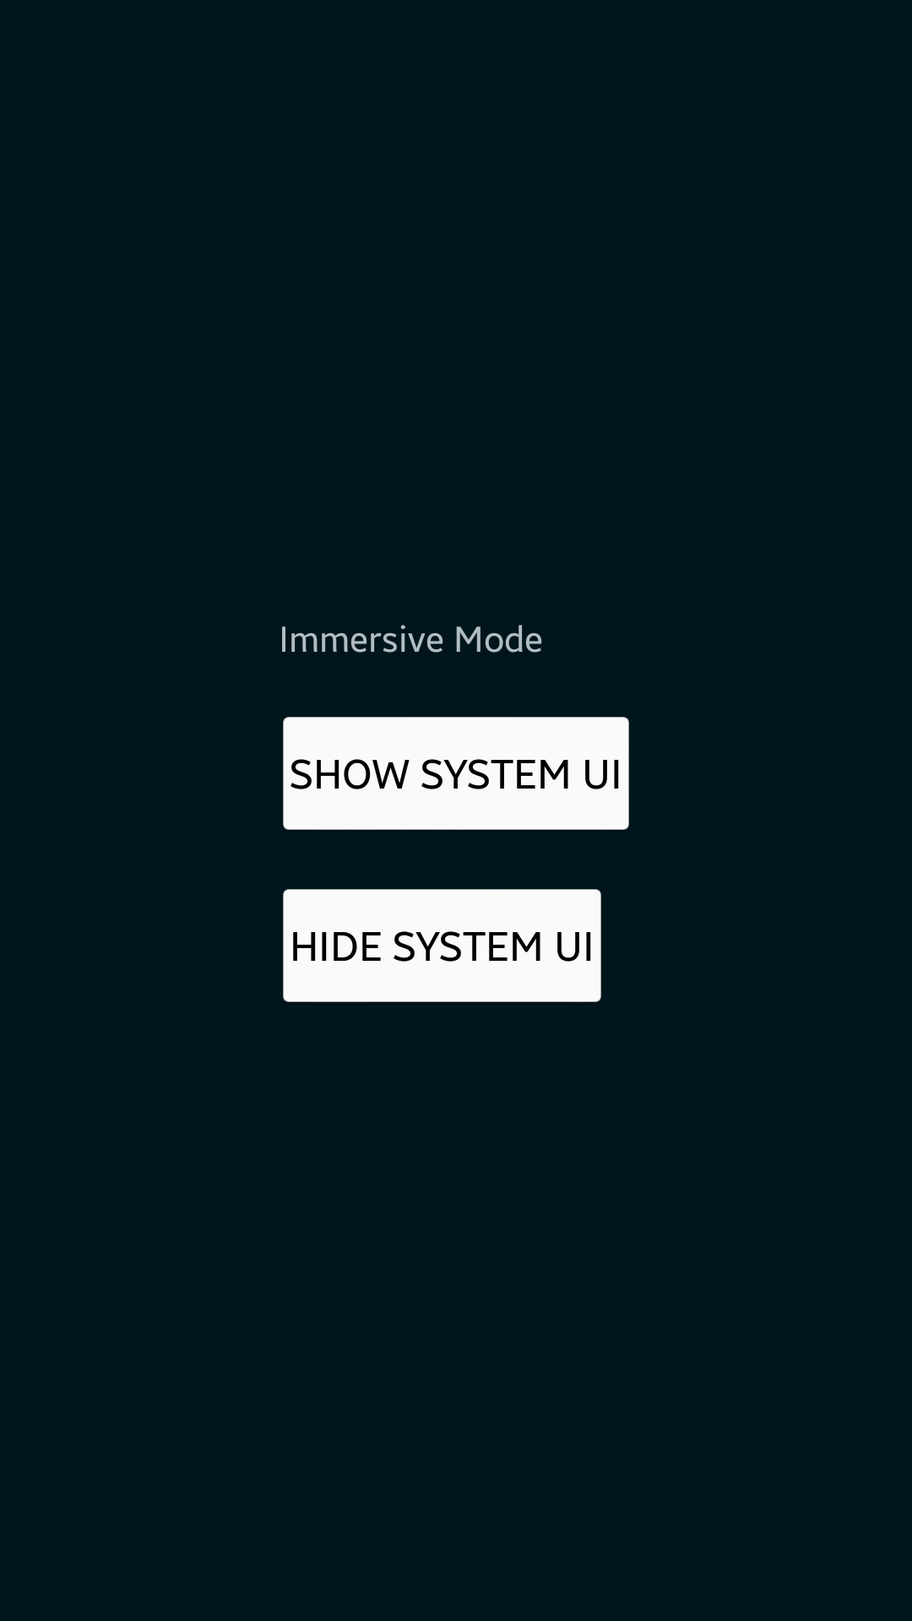
With System UI
Without System UI

Slide 3
References
Using immersive full-screen mode

Slide 4
Exercise
Nothing to do!

