Slide 1
Android – Layout (linear)
Shows use of LinearLayout for portrait and landscape mode
Displays six buttons arranged according to orientation
Layout resource is referenced via indentifier R.layout.main
Layout resource is picked based on screen orientation:
res/layout/main.xml – portrait mode
res/layout-land/main.xml – landscape mode
Layout resource uses:
LinearLayout on top-level of view hierarchy
Nested Linearlayouts to achieve portrait/landscape orientation
<LinearLayout>
<Button .. .... />
</LinearLayout>
Layout parameters in <Button> must match capabilities defined in LinearLayout

Slide 2
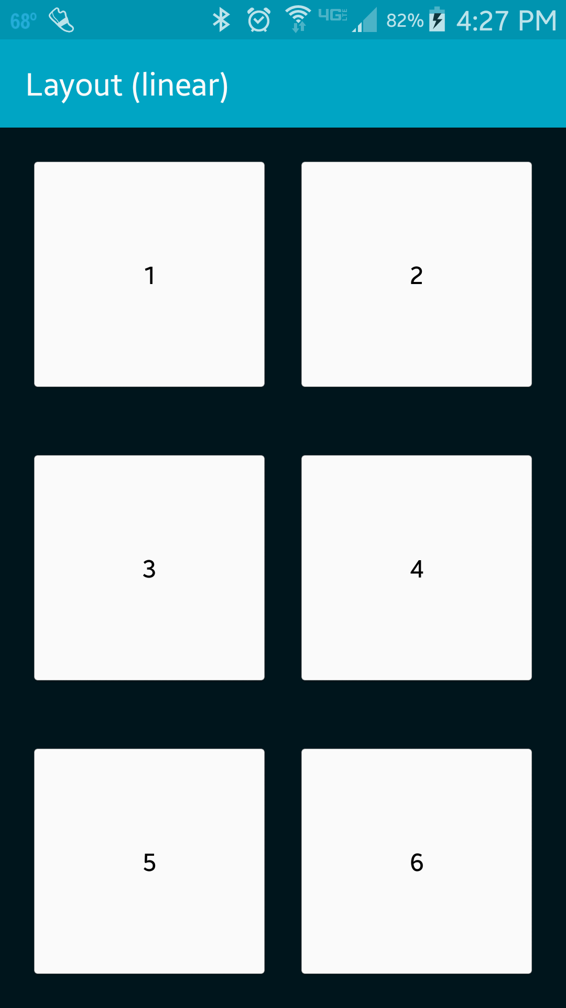
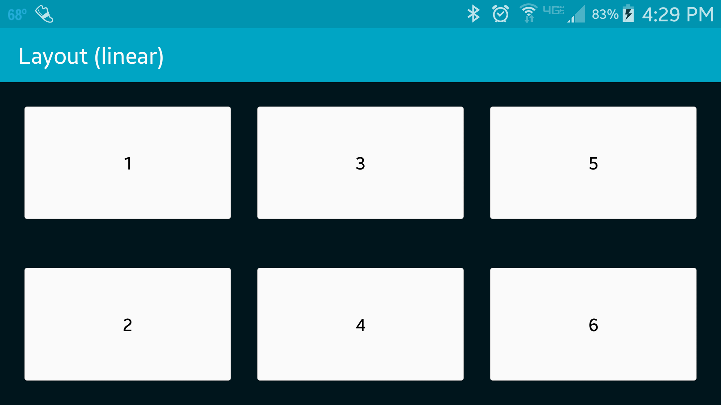
Layout resources uses:
3 nested LinearLayout to achieve portrait orientation of six button
2 nested LinearLayout to achieve landscape orientation

Slide 3
References
Layout objects
LinearLayout
LinearLayout.LayoutParams
Button

Slide 4
Exercise
Change the application such that the positions of the buttons 1 and 6 are swapped in landscaped mode (i.e., button “6” should be in the upper left corner). The position of the buttons in portrait mode should remain unchanged.

