Slide 1
Android – Immersive Mode
tutorial/android/immersive
Immersive mode was added in API level 19.
Allows application to take over the complete screen-real-estate.
Useful for games and e-book applications.

Slide 2
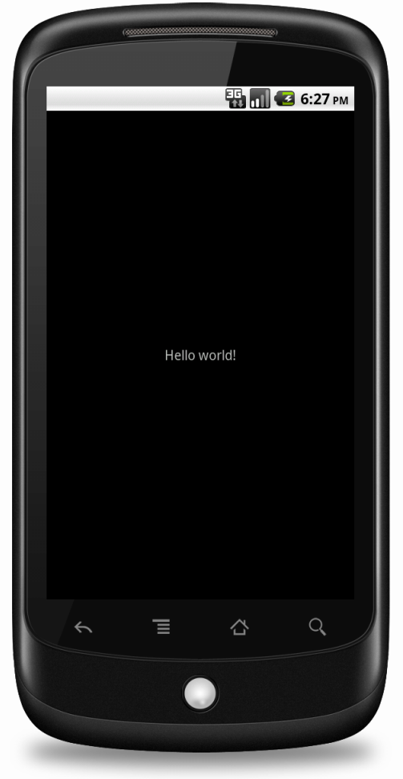
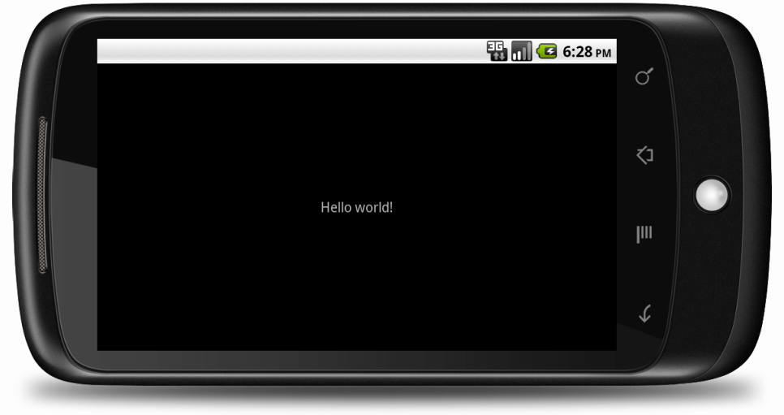
Anthony: please take two portrait-screenshots with and without system UI
"Hello World" is displayed at the center of the screen; but the title bar is hidden in this full screen version of Hello World
The application partially works when cross-compiled with XMLVM. The title bar is not hidden.

Slide 3
References
Using immersive full-screen mode

Slide 4
Exercise
Nothing to do!

